Slide 1
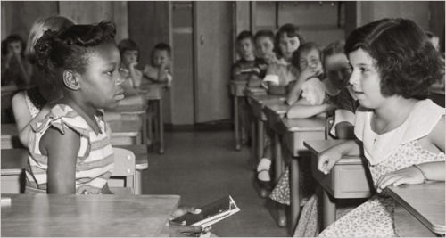
JIM CROW
SEPARATE
& UNEQUAL

Slide 2
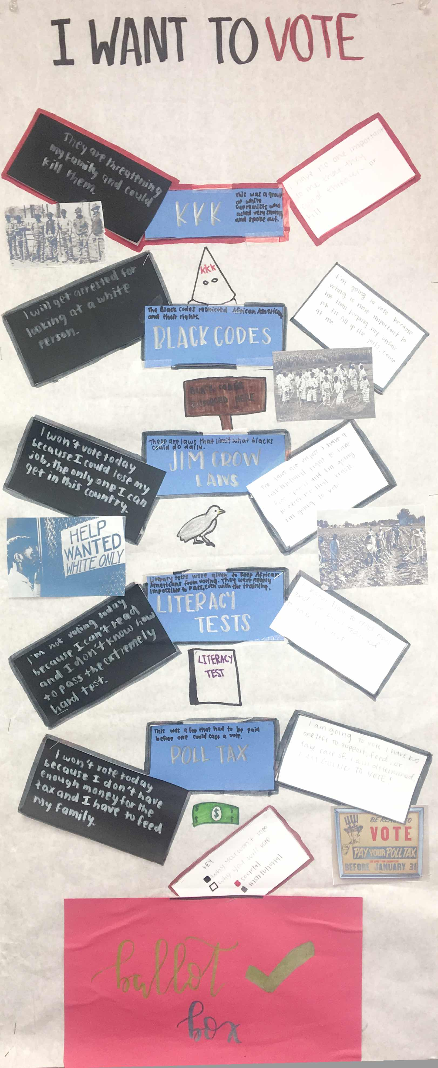
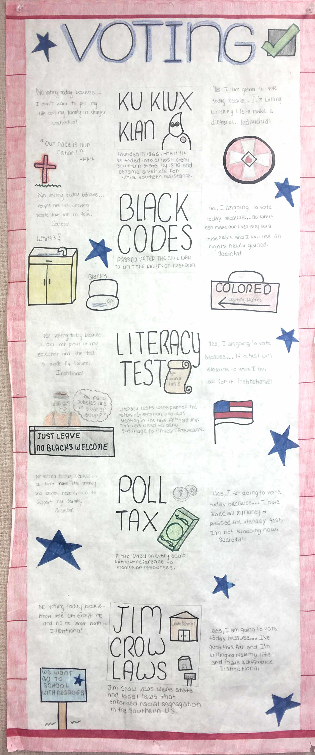
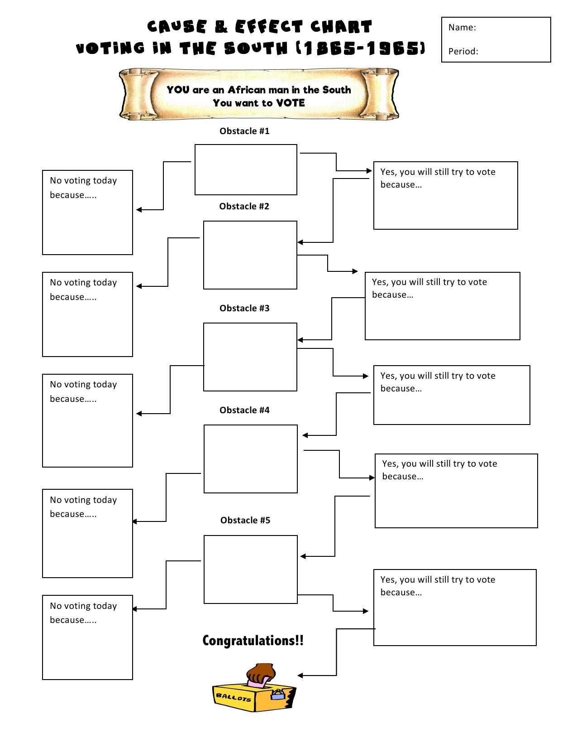
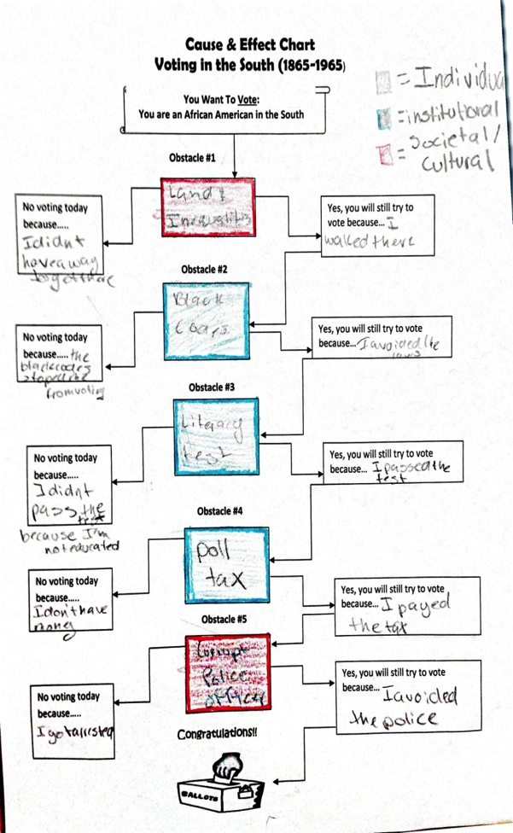
Conclusion of this lesson- You will create a ‘Cause And Effect Chart’
Directions:
Fill out the ‘Cause and Effect Chart’. Write in chronological order the obstacles that served to discourage or prevent African Americans from exercising their right to vote.
Choose FIVE obstacles from the word bank when filling out the chart.
Briefly explain in point form what each obstacle was, and how it may have been a barrier in the voting process. (Refer to your power-point notes, upcoming movie, and textbook if needed)
Identify at which of the three levels of ‘oppression’ the obstacle fits by shading/coloring each obstacle’s square. (Example: blue= Institutional, red=Cultural, yellow= Individual)
Institutional
Societal/Cultural
Individual
Final Draft:
On a larger piece of paper, recreate the chart and include illustrations.
Draw a picture/illustration beside each of the obstacles.
Note: *Leave additional space to add any forms of ‘resistance’ that you see in the film, ‘Freedom Song’.
Notes:
This lesson will begin with the teacher briefly going over the final unit project, and then re-visting the instructions for the project at the end of the power-point.

Slide 3
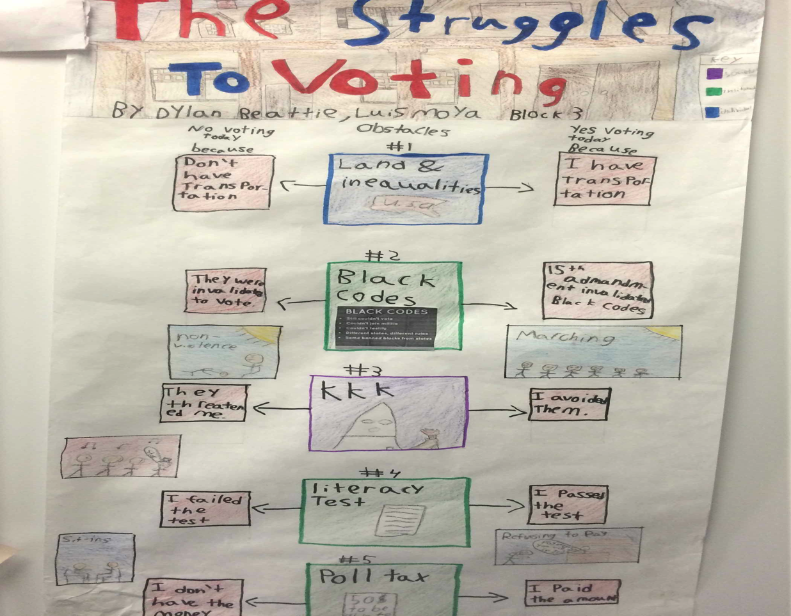
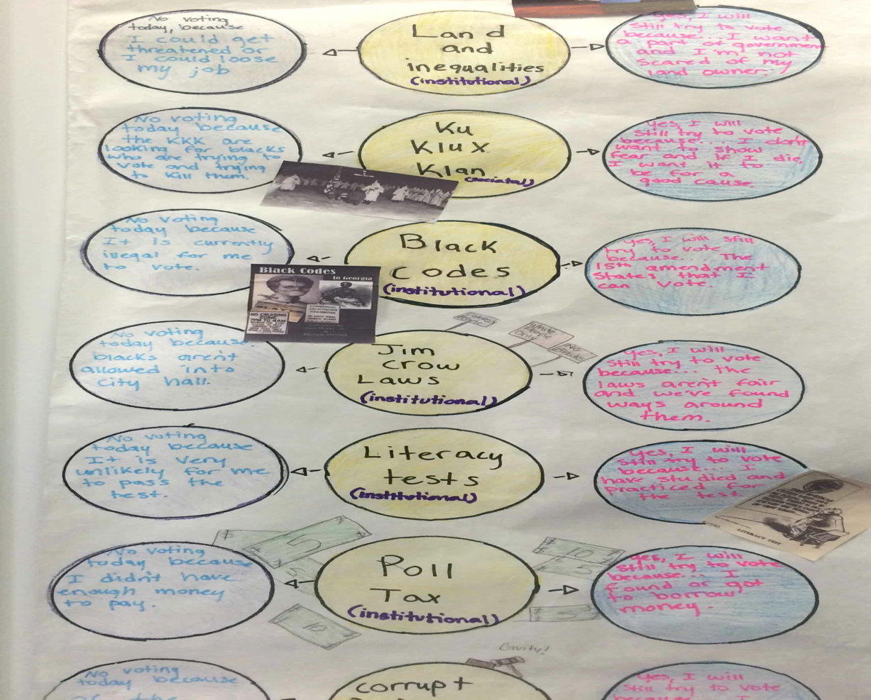
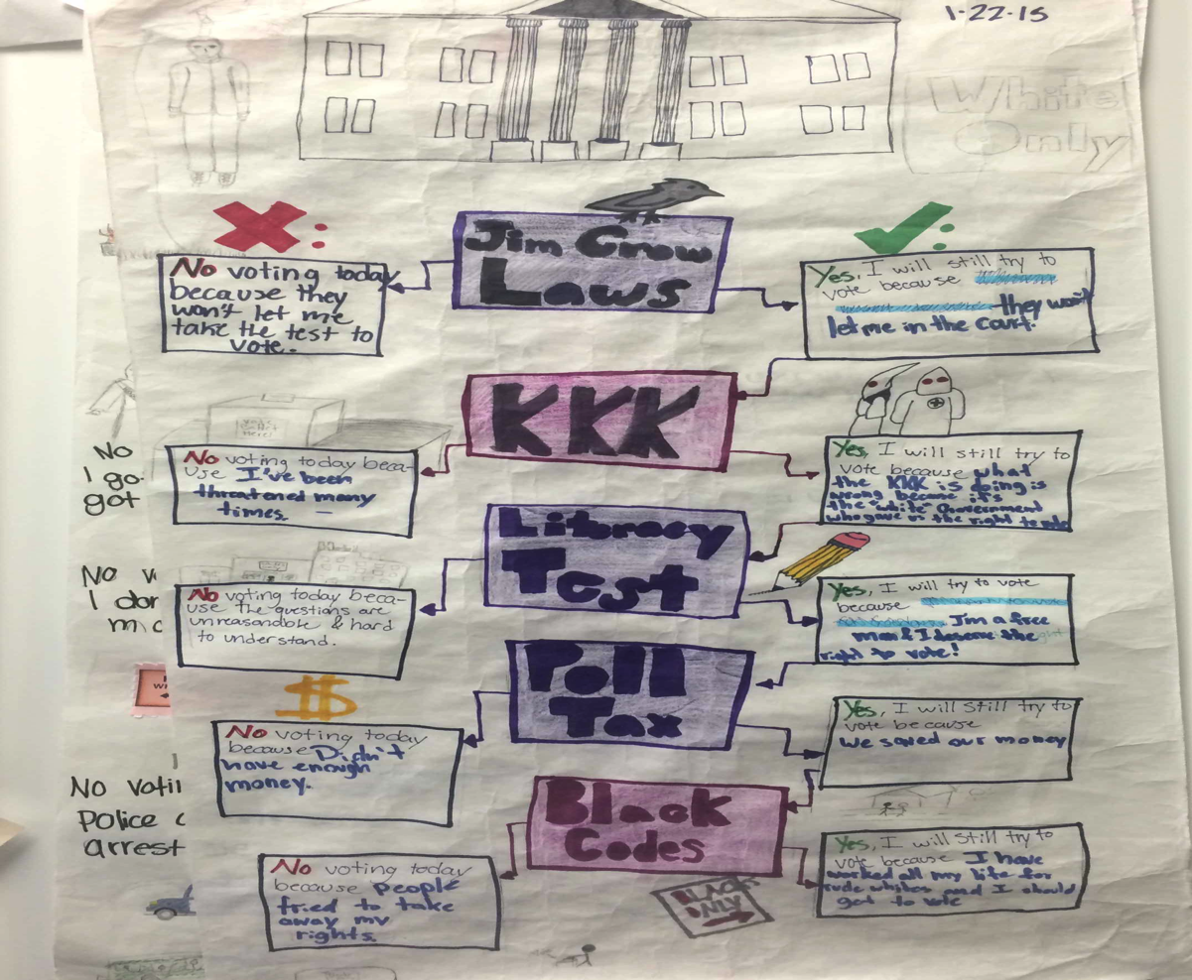
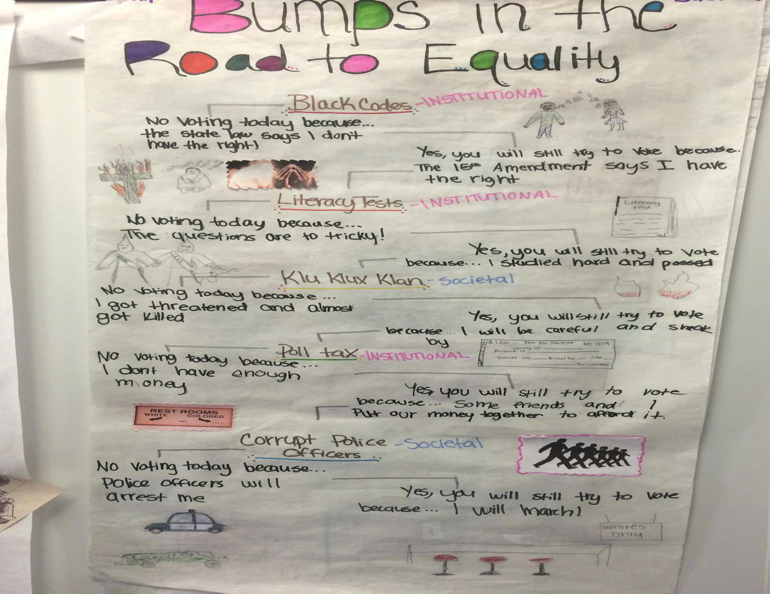
Final Draft: Student Examples

Slide 4
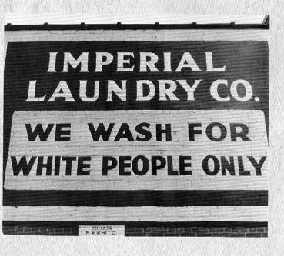
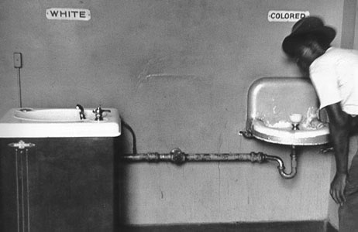
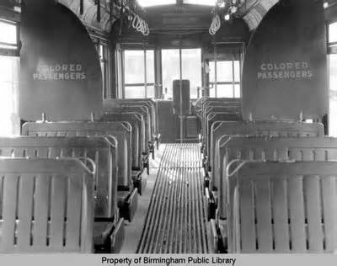
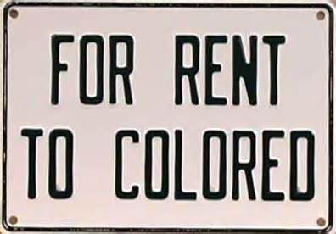
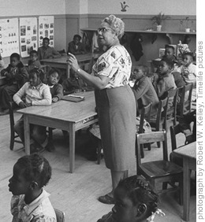
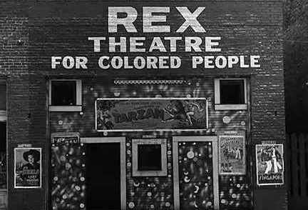
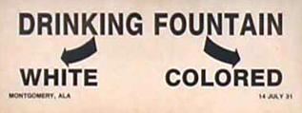
THINK & DISCUSS:
Based upon these primary sources, what were the
'Jim Crow Laws'?
Notes:
Students can share their answers in pairs, or discuss as a class.

Slide 5
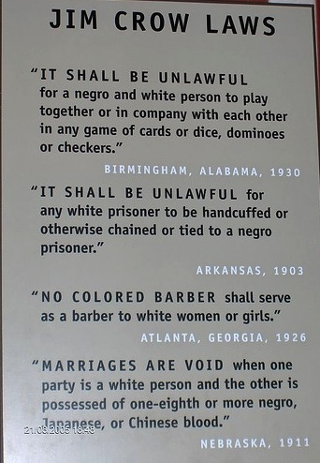
Jim Crow laws
The Jim Crow laws were state and local laws in the United States enacted between 1876 and 1965.
They mandated segregation in all public facilities, with a "separate but equal" status for black Americans and members of other non-white racial groups.
Read each Jim Crow law as a class, and answer the two following questions & support your answers:
Which law in your opinion appears to be the most limiting?
Which law surprises you the most or you think is the most bizarre/odd?

Slide 6
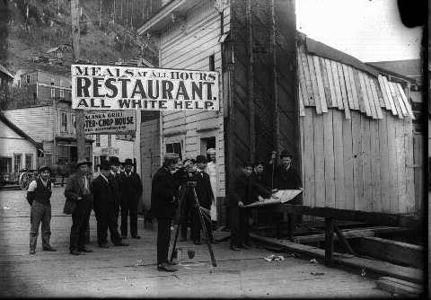
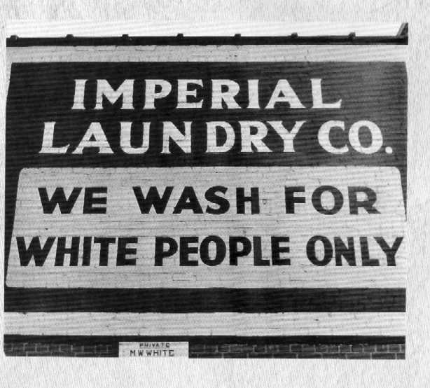
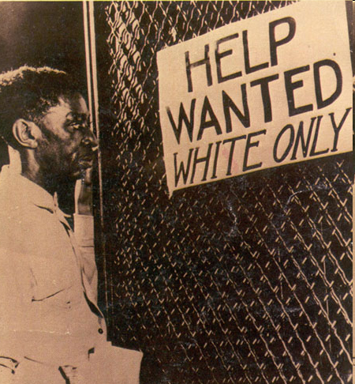
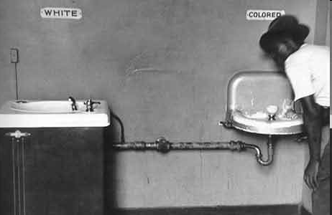
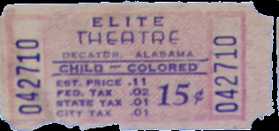
Jim Crow Laws
Some examples of Jim Crow laws are the segregation of public schools, public places and public transportation, and the segregation of restrooms and restaurants for whites and blacks.
Jim Crow laws were state and local laws that enforced racial segregation in the Southern United States. All were enacted in the 18802 by white Democratic-dominated state legislatures after the Reconstruction period. The laws were enforced until 1965.

Slide 7
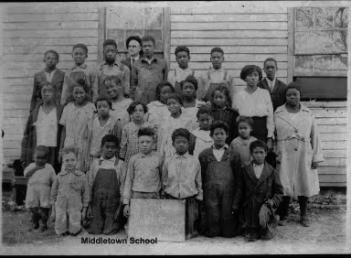
Jim Crow Laws & Education
One of the most detrimental effects was that on the education of African American children in the South.
THINK & DISCUSS:
What are the possible reasons as to why this area of segregation has been considered the most detrimental?
Notes:
Students can share their answers in pairs, or discuss as a class.

Slide 8
Separate & Equal Education?
Education was the main battleground in the movement for equal opportunity. For millions of children, the American public schools movement opened new opportunities. But millions of others were excluded because of their race or ethnicity.
Prior to the Civil War, very little public education existed in the South. After the war, southern states created a dual educational system based on race. The vast majority of southern communities created separate schools for black children.

Slide 9
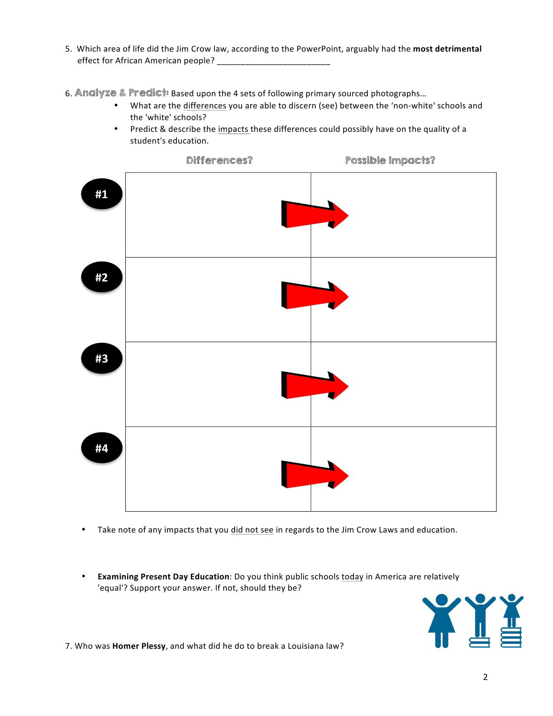
Separate & Equal Education? YOU DECIDE…
Analyze & Infer:
Based upon the following primary based photographs, what are the differences you are able to discern (see) between the “colored” or ‘non-white’ schools and the 'white’ schools?
Also, infer and describe the possible impacts that these differences could possibly have had on the quality of a student's education.

Slide 10
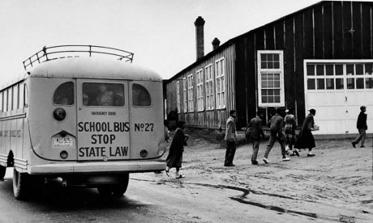
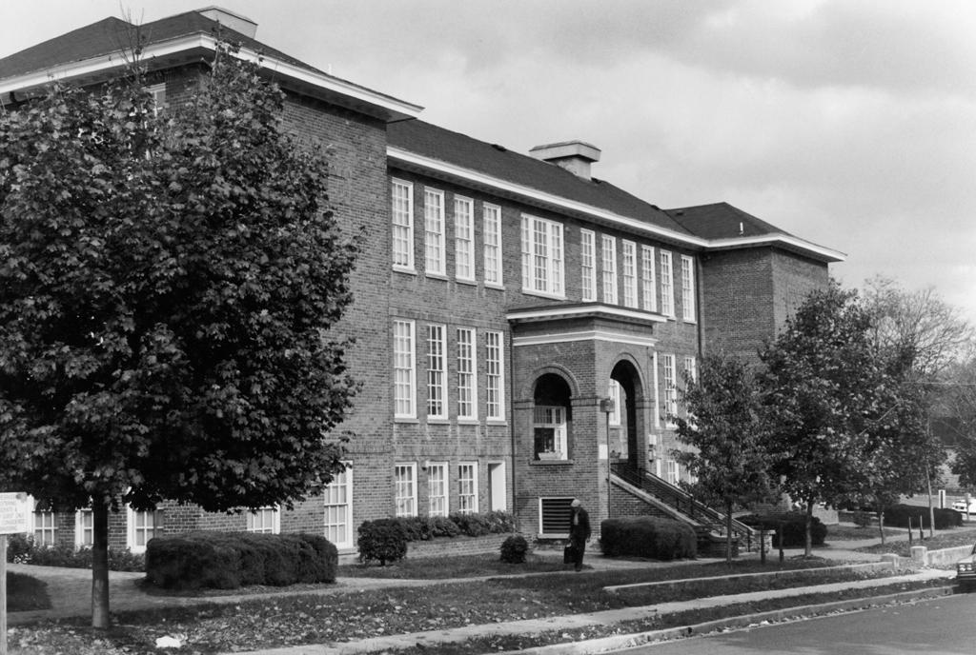
Contrasting Two Worlds of Education…
#1.

Slide 11
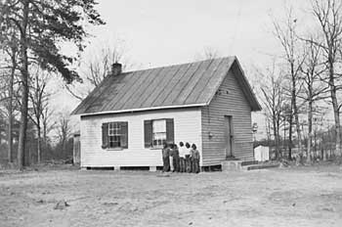
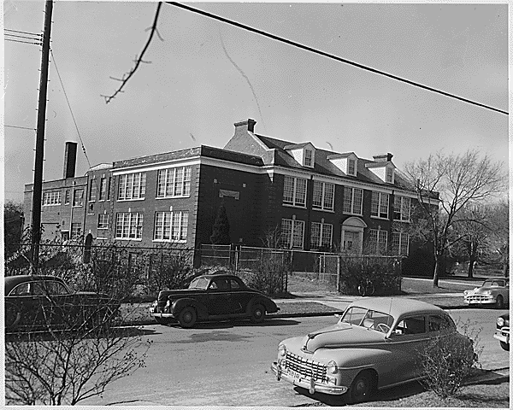
#2.

Slide 12
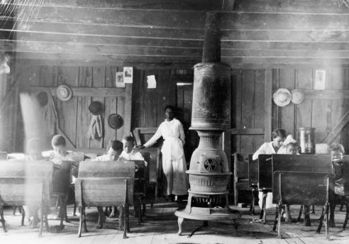
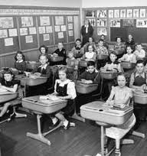
Let’s go inside…
#3.

Slide 13
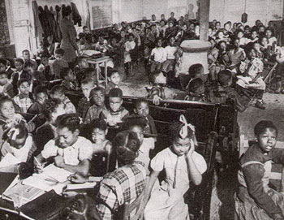
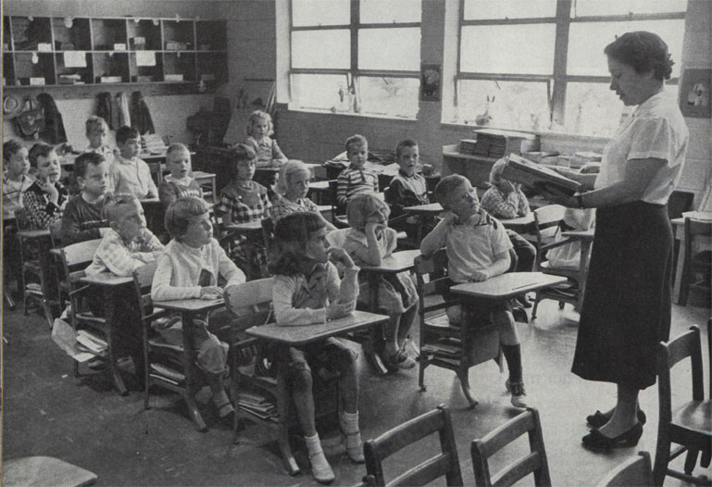
#4

Slide 14
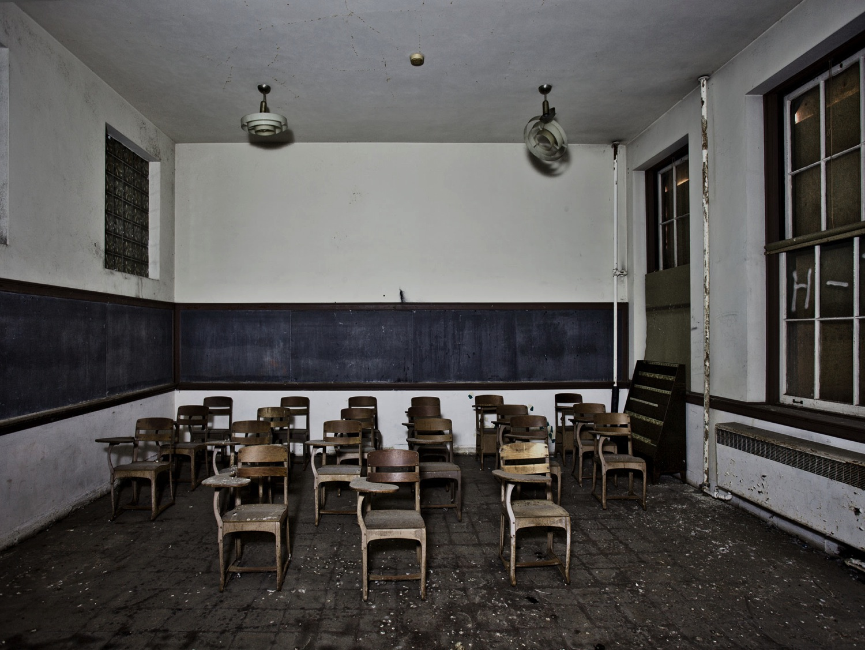
Jim Crow & Education
The system left black schools grossly unequal to whites in almost all respects.
Average public expenditures for white schools exceeded expenditures for black schools.
Teachers in white schools generally received higher pay than did teachers in black schools.
Take note of any impacts that you did not see in regards to the Jim Crow Laws and education.

Slide 15
Jim Crow & Education
The conditions of black schools were substandard due to the over crowding, lack of supplies, poorly constructed schoolhouses & poorly trained teachers.
Segregated education was designed to confine these children to a subservient role in society and second-class citizenship.
This left millions of black children at a great disadvantage.

Slide 16
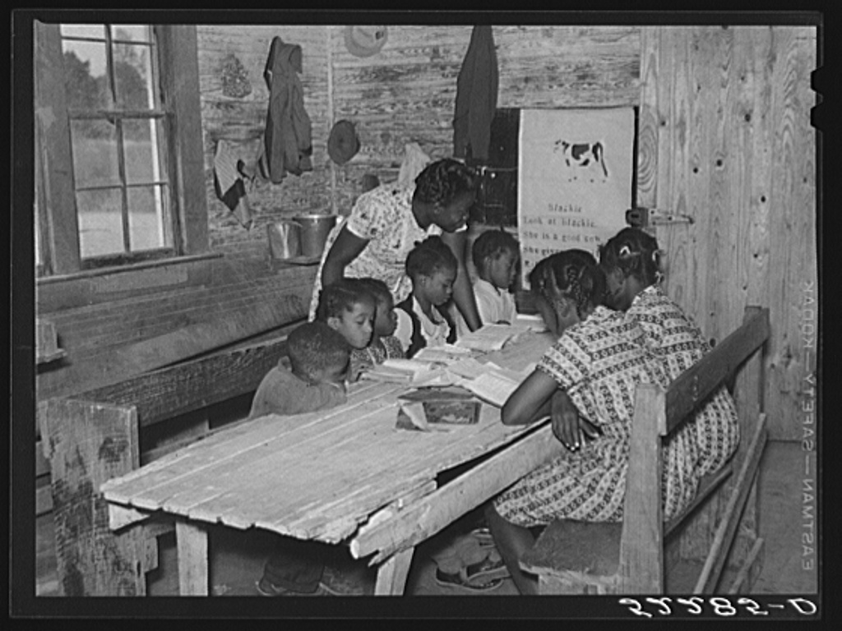
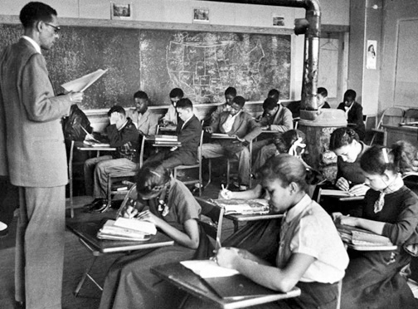
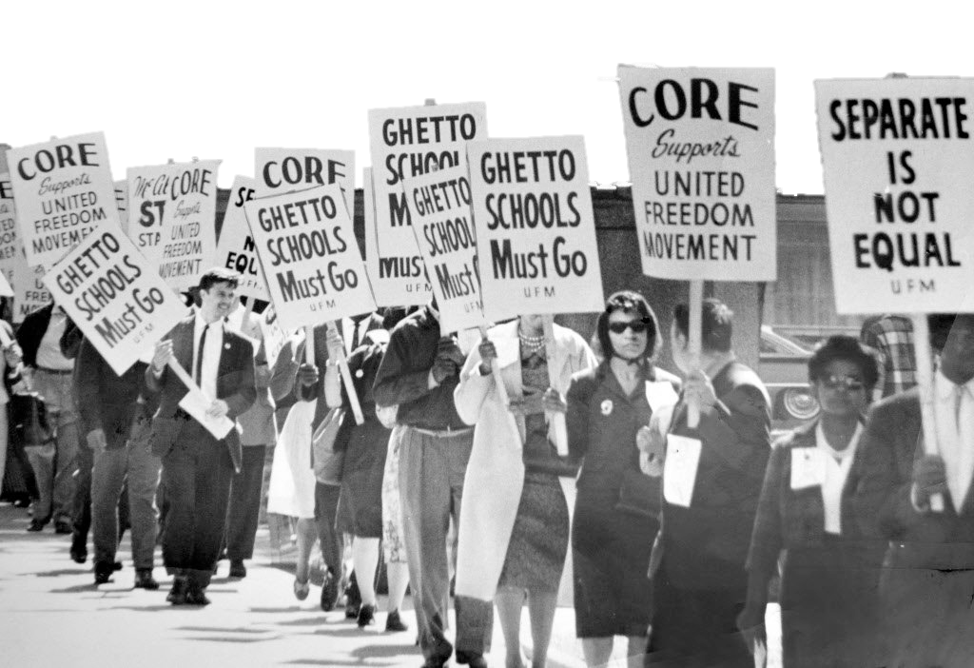
African American educational institutions were funded by a variety of sources, including black churches, white churches, local community fundraisers, state governments, and northern philanthropists.
Despite these challenges, the commitment of African American teachers and parents to education never faltered. They established a tradition of educational self-help and were among the first southerners to campaign for universal public education.

Slide 17
Jumping ahead to current day…

Slide 18
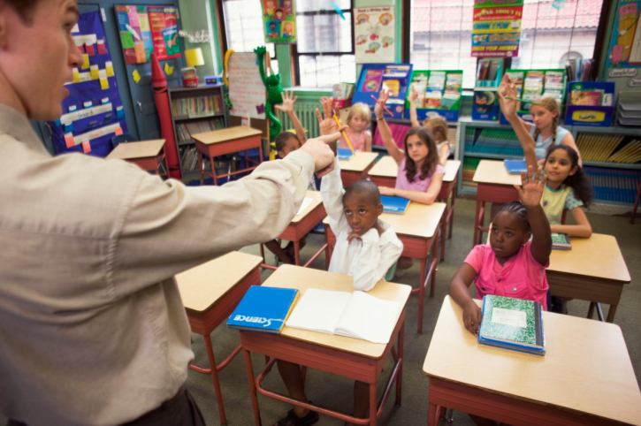
Present Day Education
Do you think public schools today in America are relatively ‘equal’?
If not, why aren’t they? And should they be?

Slide 19
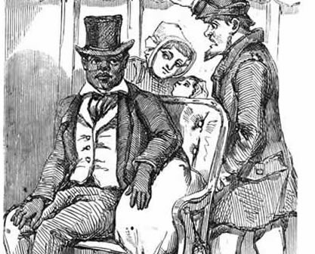
Plessy V. Ferguson,1896
THINK & DISCUSS the following statement:
Plessy broke the law, therefore, he should be found guilty in a court of law.
On June 7, 1892, 30-year-old Homer Plessy, who was seven-eighths Caucasian, was jailed for breaking the law & sitting in the ‘White’ car of the East Louisiana Railroad. Plessy could easily pass for white but under Louisiana law, he was considered black despite his light complexion and, therefore, required to sit in the ‘Colored’ car.
When Louisiana passed the Separate Car Act, legally segregating common carriers in 1892, a black civil rights organization decided to challenge the law in the courts. Plessy deliberately sat in the white section and identified himself as black. He was then arrested.
Agree or
Disagree?
Plessy’s act of civil disobedience helped inspire future generations of the Civil Rights Movement.
Notes:
Remind students to Identify any examples you see in the PowerPoint that show ‘Oppression’, and distinguish at which level it applies.

Slide 20
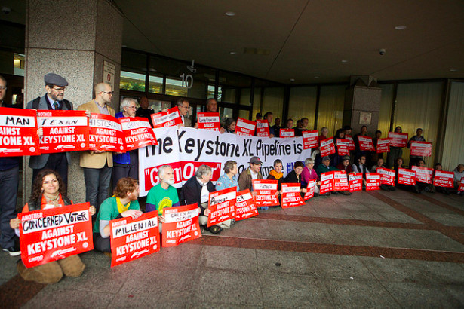
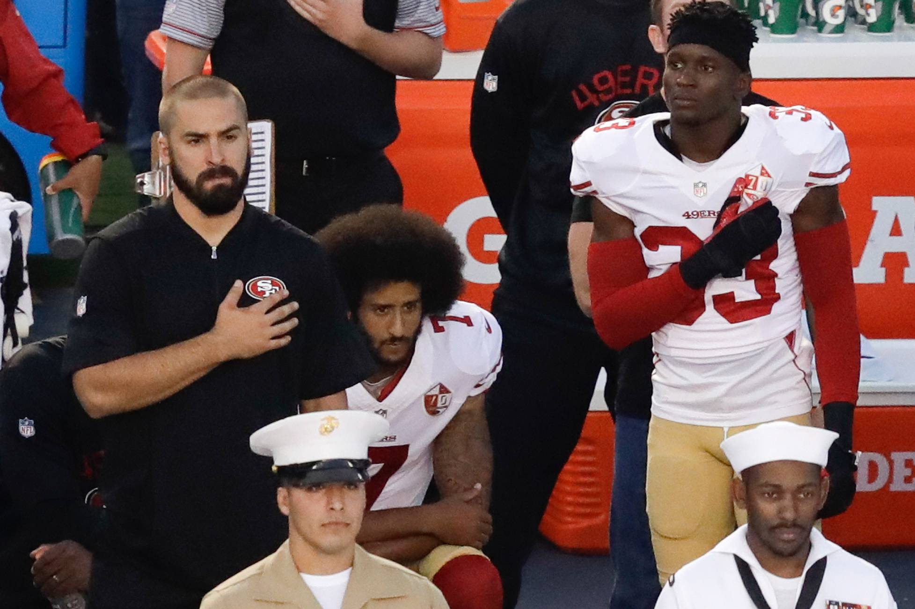
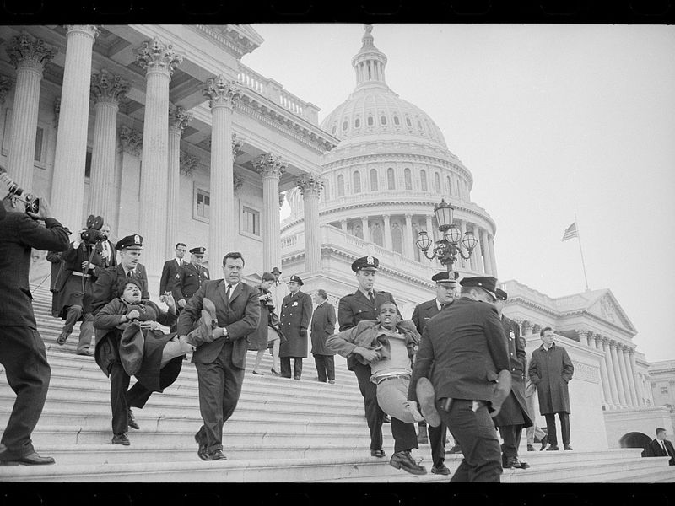
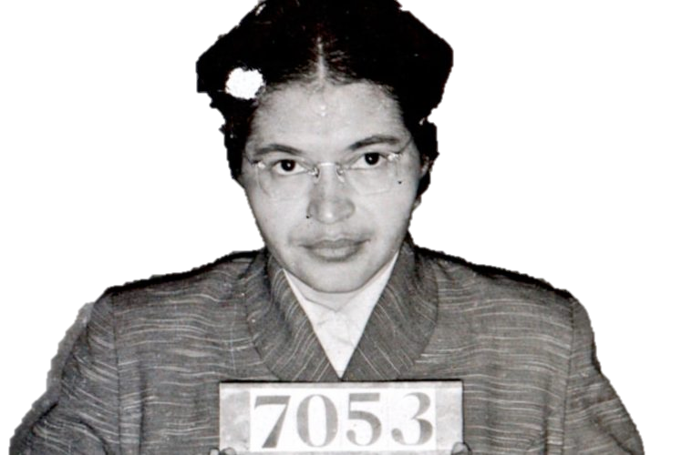
PREDICT, WRITE & DISCUSS:
Based upon these pictures, what is
‘civil disobedience’?
Video up next:
Take notes
Notes:
Students can share their answers in pairs, or discuss as a class.

Slide 21
Henry David Thoreau: Civil Disobedience
5:30 min

Slide 22
THINK & DISCUSS:
What does it take to make a
BIG societal change?
For example, if you wanted to institute a new rule saying that
teachers in your school would not be allowed to assign homework…
What would you have to do? Would this change happen easily?
Would it take a long time? What steps might they take in order to
get a new rule like this in place? Can an individual make a difference?
Notes:
Students can share their answers in pairs, or discuss as a class. Explain that throughout history, there have been times when people felt so deeply about a political or social issue, they resisted the status quo—the current state of affairs—in some manner. Some of these strategies were effective, some were not.

Slide 23
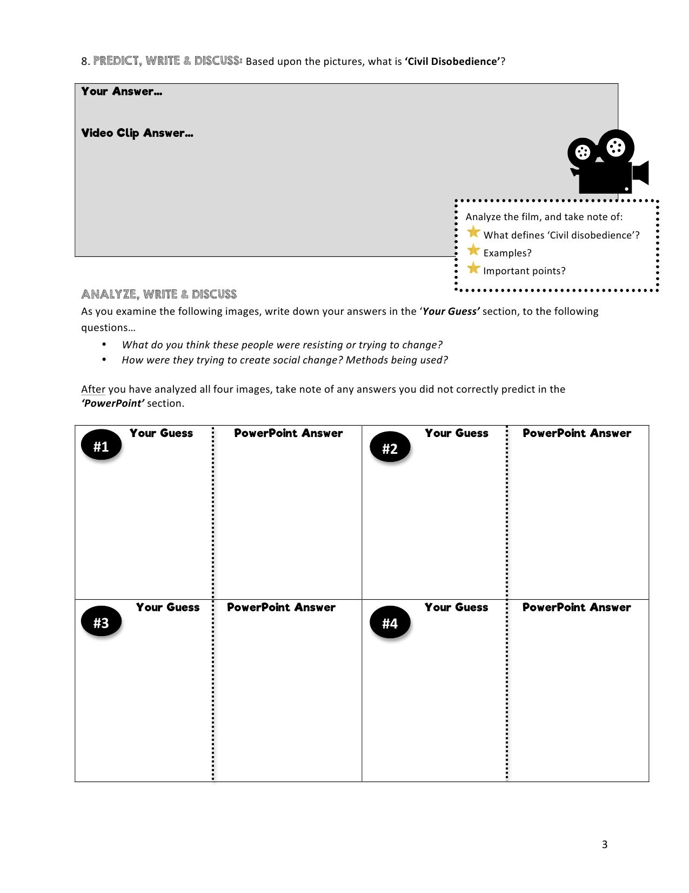
ANALYZE, WRITE & DISCUSS:
As you examine the following images, write down your answers to the following questions…
What do you think these people were resisting or trying to change?
How were they trying to create social change? Methods being used?
Notes:
Tell your students that you will be briefly examining the different ways people have behaved in an effort to bring about big societal changes.

Slide 24
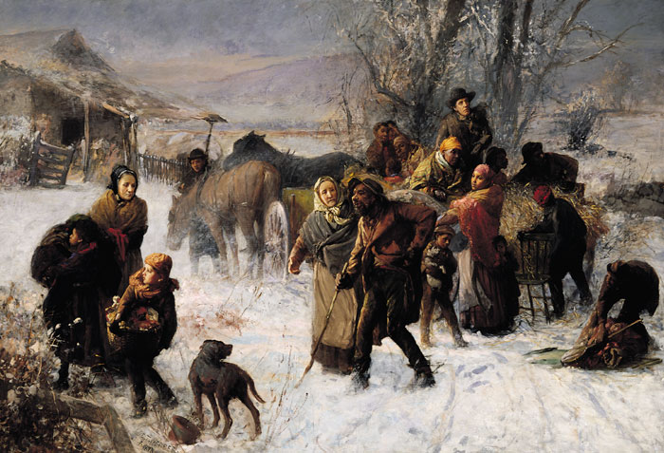
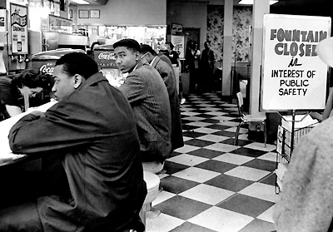
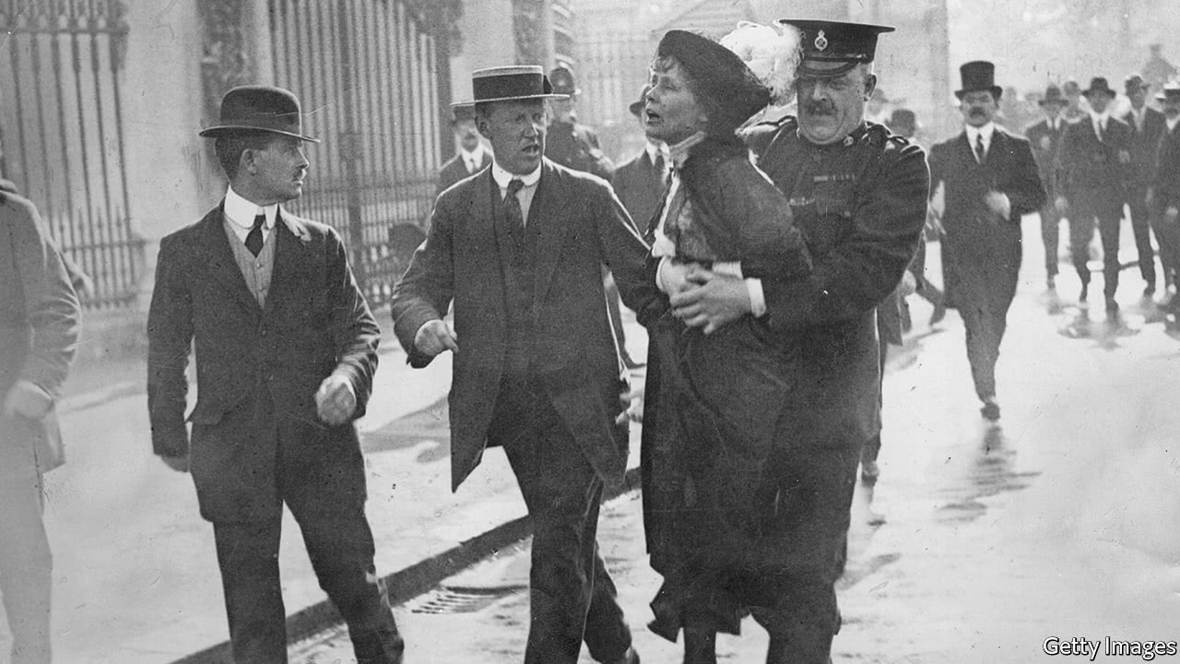
#1.
#2.
#3.
#4.
Notes:
Have students silently analyze each image (without sharing their responses).

Slide 25
#1.
#2.
#3.
#4.
Boston Tea Party
Angry over the Tea Act, Colonists dressed as Native Americans and raided British ships in the Boston Harbor. Dumped tea into the harbor. Colonists kept informed about what was happening in the colonies by exchanging letters and sharing information.
Conductors in the Underground Railroad resisted the repressive laws that held slaves in bondage. The nation’s first great movement of civil disobedience since the American Revolution, it engaged thousands of citizens in the active subversion of federal law. The federal government had passed Fugitive Slave Acts as early as 1793 that allowed slave catchers to come north and force runaways back into slavery.
Discuss your responses, then answers will be provided. Ensure to add in any information to your T-Chart section titled ‘PowerPoint’ Answer…
Sit-in movement, nonviolent movement of the U.S. civil rights era that began in Greensboro, North Carolina, in 1960. The sit-in, an act of civil disobedience, was a tactic that aroused sympathy for the demonstrators. African Americans (later joined by white activists), usually students, would go to segregated lunch counters, sit in all available spaces, request service, and then refuse to leave when denied service because of their race. In addition to creating disruptions and drawing unwanted publicity, the action caused economic hardship for the owners of the businesses, because the sit-in participants took up spaces that normally were filled by paying customers. Although the first lunch-counter sit-in began with just four participants, the attention paid to the protest created a movement that spread across the South in 1960 and 1961 to include 70,000 black and white participants. It affected 20 states and resulted in the desegregation of many local businesses in those communities.
A vocal leader of the twentieth century women’s suffrage movement, Alice Paul advocated for and helped secure passage of the 19th Amendment to the US Constitution, granting women the right to vote. For eighteen months suffragists picketed the White House. Instead of protecting the women’s right to free speech and peaceful assembly, the police arrested them on the bogus charge of obstructing traffic. Paul was sentenced to jail for seven months, where she organized a hunger strike in protest. Doctors threatened to send Paul to an insane asylum and force-fed her, while newspaper accounts of her treatment garnered public sympathy and support for suffrage. By 1918, Wilson announced his support for suffrage. It took two more years for the Senate, House, and the required 36 states to approve the amendment.

Slide 26
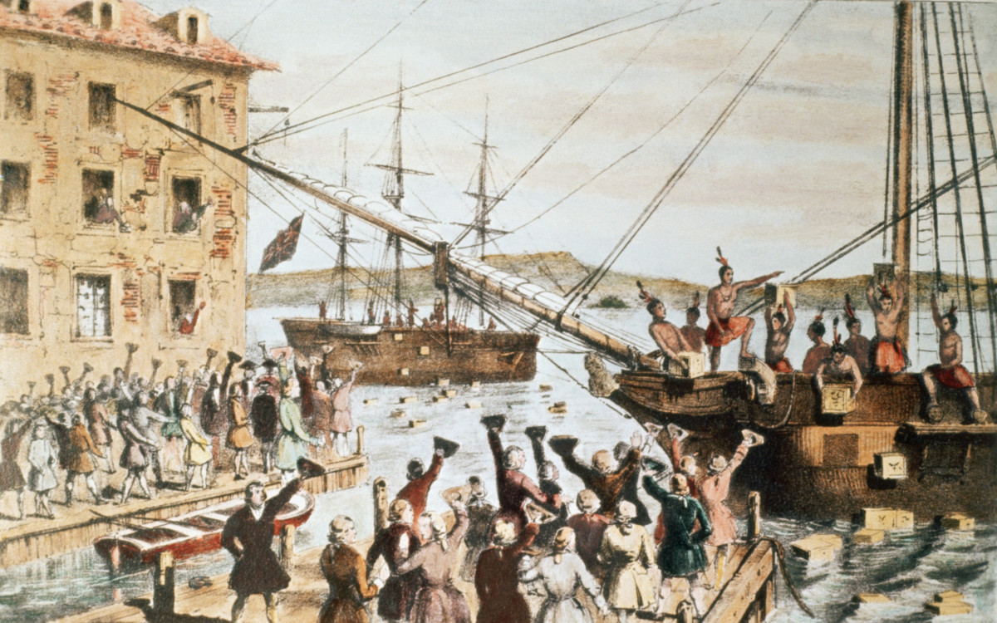
THINK & DISCUSS:
What similarities and differences do you notice in the images? Did the Boston Tea Party resolve all of the American colonies’ arguments with Great Britain? Did the slaves escaping on the Underground Railroad end slavery? Did one woman’s arrest at the White House get women the right to vote?
Do they think these individual acts brought about big changes? Why or why not?

Slide 27
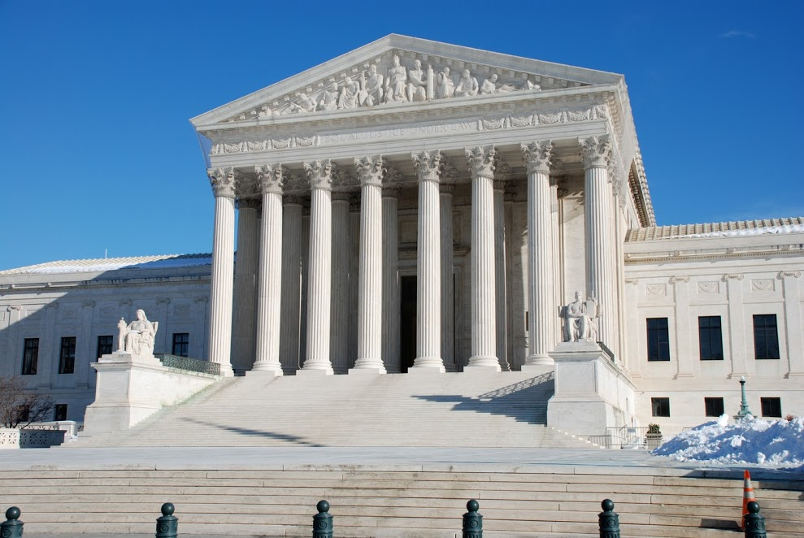
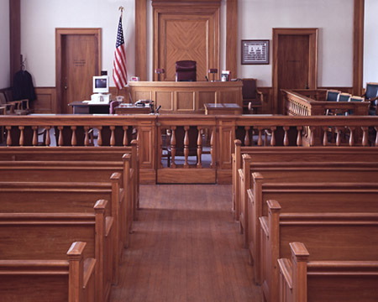
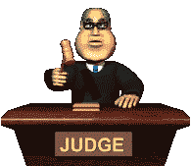
THINK & DISCUSS:
What do you think the Supreme Court decided? Was Louisiana's law mandating racial segregation on its trains an unconstitutional infringement on the equal protection clauses of the Fourteenth Amendment?
The case went all the way to the United States Supreme Court. Plessy's lawyer argued that the Separate Car Act violated which amendment…
Back to Homer Plessy…
The state law is within constitutional boundaries. The majority, upheld state imposed racial segregation.
The justices based their decision on the
that separate facilities for blacks and whites satisfied the
Fourteenth Amendment so long as they were equal.
In short, segregation does not in itself constitute unlawful
discrimination.
‘Separate But Equal’
14th Amendment
As a class, discuss what the outcome was.
Did the Court make the right decision? Why or why not?

Slide 28
Brown V. Board of Education
State-sponsored school segregation was declared unconstitutional by the Supreme Court of the United States in 1954 Brown V. Board of Education.
Generally, the remaining Jim Crow laws were overruled by the Civil Rights Act of 1964 & the Voting Rights Act of 1965.
Video up next:
Take notes
Notes:
Remind students to Identify any examples you see in the PowerPoint that show ‘Oppression’, and distinguish at which level it applies.

Slide 29
The Little Rock Nine
6 min

Slide 30
How many years were the Jim Crow Laws in effect?
Jim Crow Law in effect….
1860
1876
1950
1954
1960
1964
1965
The Jim Crow laws were racial segregation laws enacted between 1876 and 1965 in the United States at the state and local level
The Supreme Court rules on the landmark case Brown v. Board of Education of Topeka, Kans., unanimously agreeing that segregation in public schools is unconstitutional. The ruling paves the way for large-scale desegregation.
Civil Rights Act of 1964 and the Voting Rights Act of 1965.
Marshall, Thurgood,
1908–93, U.S. lawyer

Slide 31
Analyzing Political Cartoons
JIM CROW LAWS
FOR
AGAINST
1.
2.
3.
4.
Identify whether the author was for or against the Jim Crow Laws.
Describe the details in the cartoon that you think support the author's position.

Slide 32
#1.
#2.
#3
#4.
Notes:
#1. Against Jim Crow
John Tinney McCutcheon was a famous cartoonist in the early 1900s. Many of his political cartoons were published in newspapers, especially the Chicago Tribune, and in subsequent books.
This image, depicting the real (not theoretical) impact of "Jim Crow" laws in public transportation, is cropped from a larger political cartoon entitled "Mississippi at the St. Louis Fair."
#2. Pro- Jim Crow
#3. Against Jim Crow
#4. Against Jim Crow
Mauldin drew this specific cartoon to represent the slow speed at which states were enforcing integration of schools. In this cartoon, there are 3 black children trying to open a huge door labeled ‘school segregation’ which is barely open. The words ‘inch by inch’ are written at the bottom of the cartoon. The door is a metaphor for how large the problem of school segregation is. The children are so small compared to the door, implying that blacks have an immense amount of work to do before they will be able to open the door and break down segregation. However, the door is slightly open. This refers to how the Brown v. Board decision, among other events, had just begun the process to end segregation.

Slide 33
3 Level Chart: What examples did you see in the presentation?
Individual
Institutional
Societal-
Cultural

Slide 34
Analyze and take notes on film…
• As the film unfolds, write in your notes any examples of ‘oppression’ that you see, and identify at which level the examples fits.
• Also take note of any examples you see of 'resistance'.
Notes:
If needed, discuss with your students the concept or act of ‘resistance’.

