Slide 1
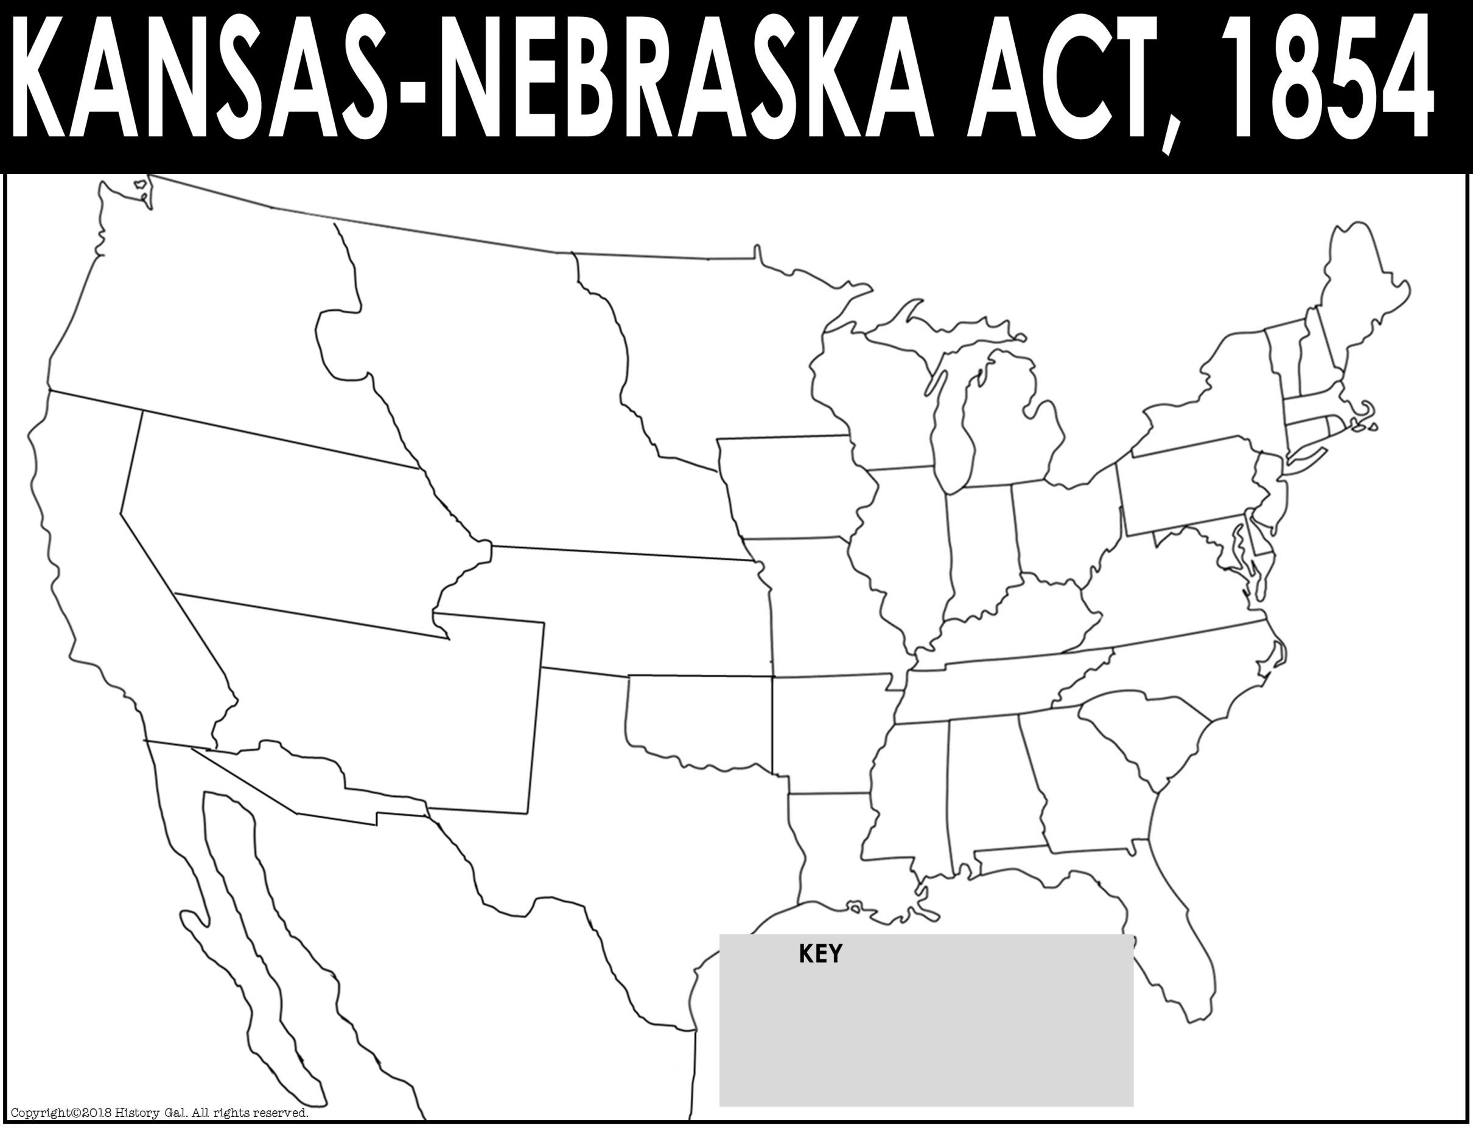
Canada
New Hampshire
Oregon Territory
Maine
Minnesota Territory
Vermont
Nebraska
Territory
Mass.
Wisconsin
Rhode
Island
Michigan
New York
Pennsylvania
Conn.
Utah
Territory
Iowa
New Jersey
Ohio
Delaware
Illinois
Indiana
Kansas
Territory
Maryland
California
Virginia
Missouri
Kentucky
North Carolina
New Mexico
Territory
Missouri Compromise Line
Tennessee
Unorganized Territory
Arkansas
South Carolina
Alabama
Georgia
Mississippi
Texas
Louisiana
Atlantic Ocean
Mexico
Florida
Pacific
Ocean

Slide 2
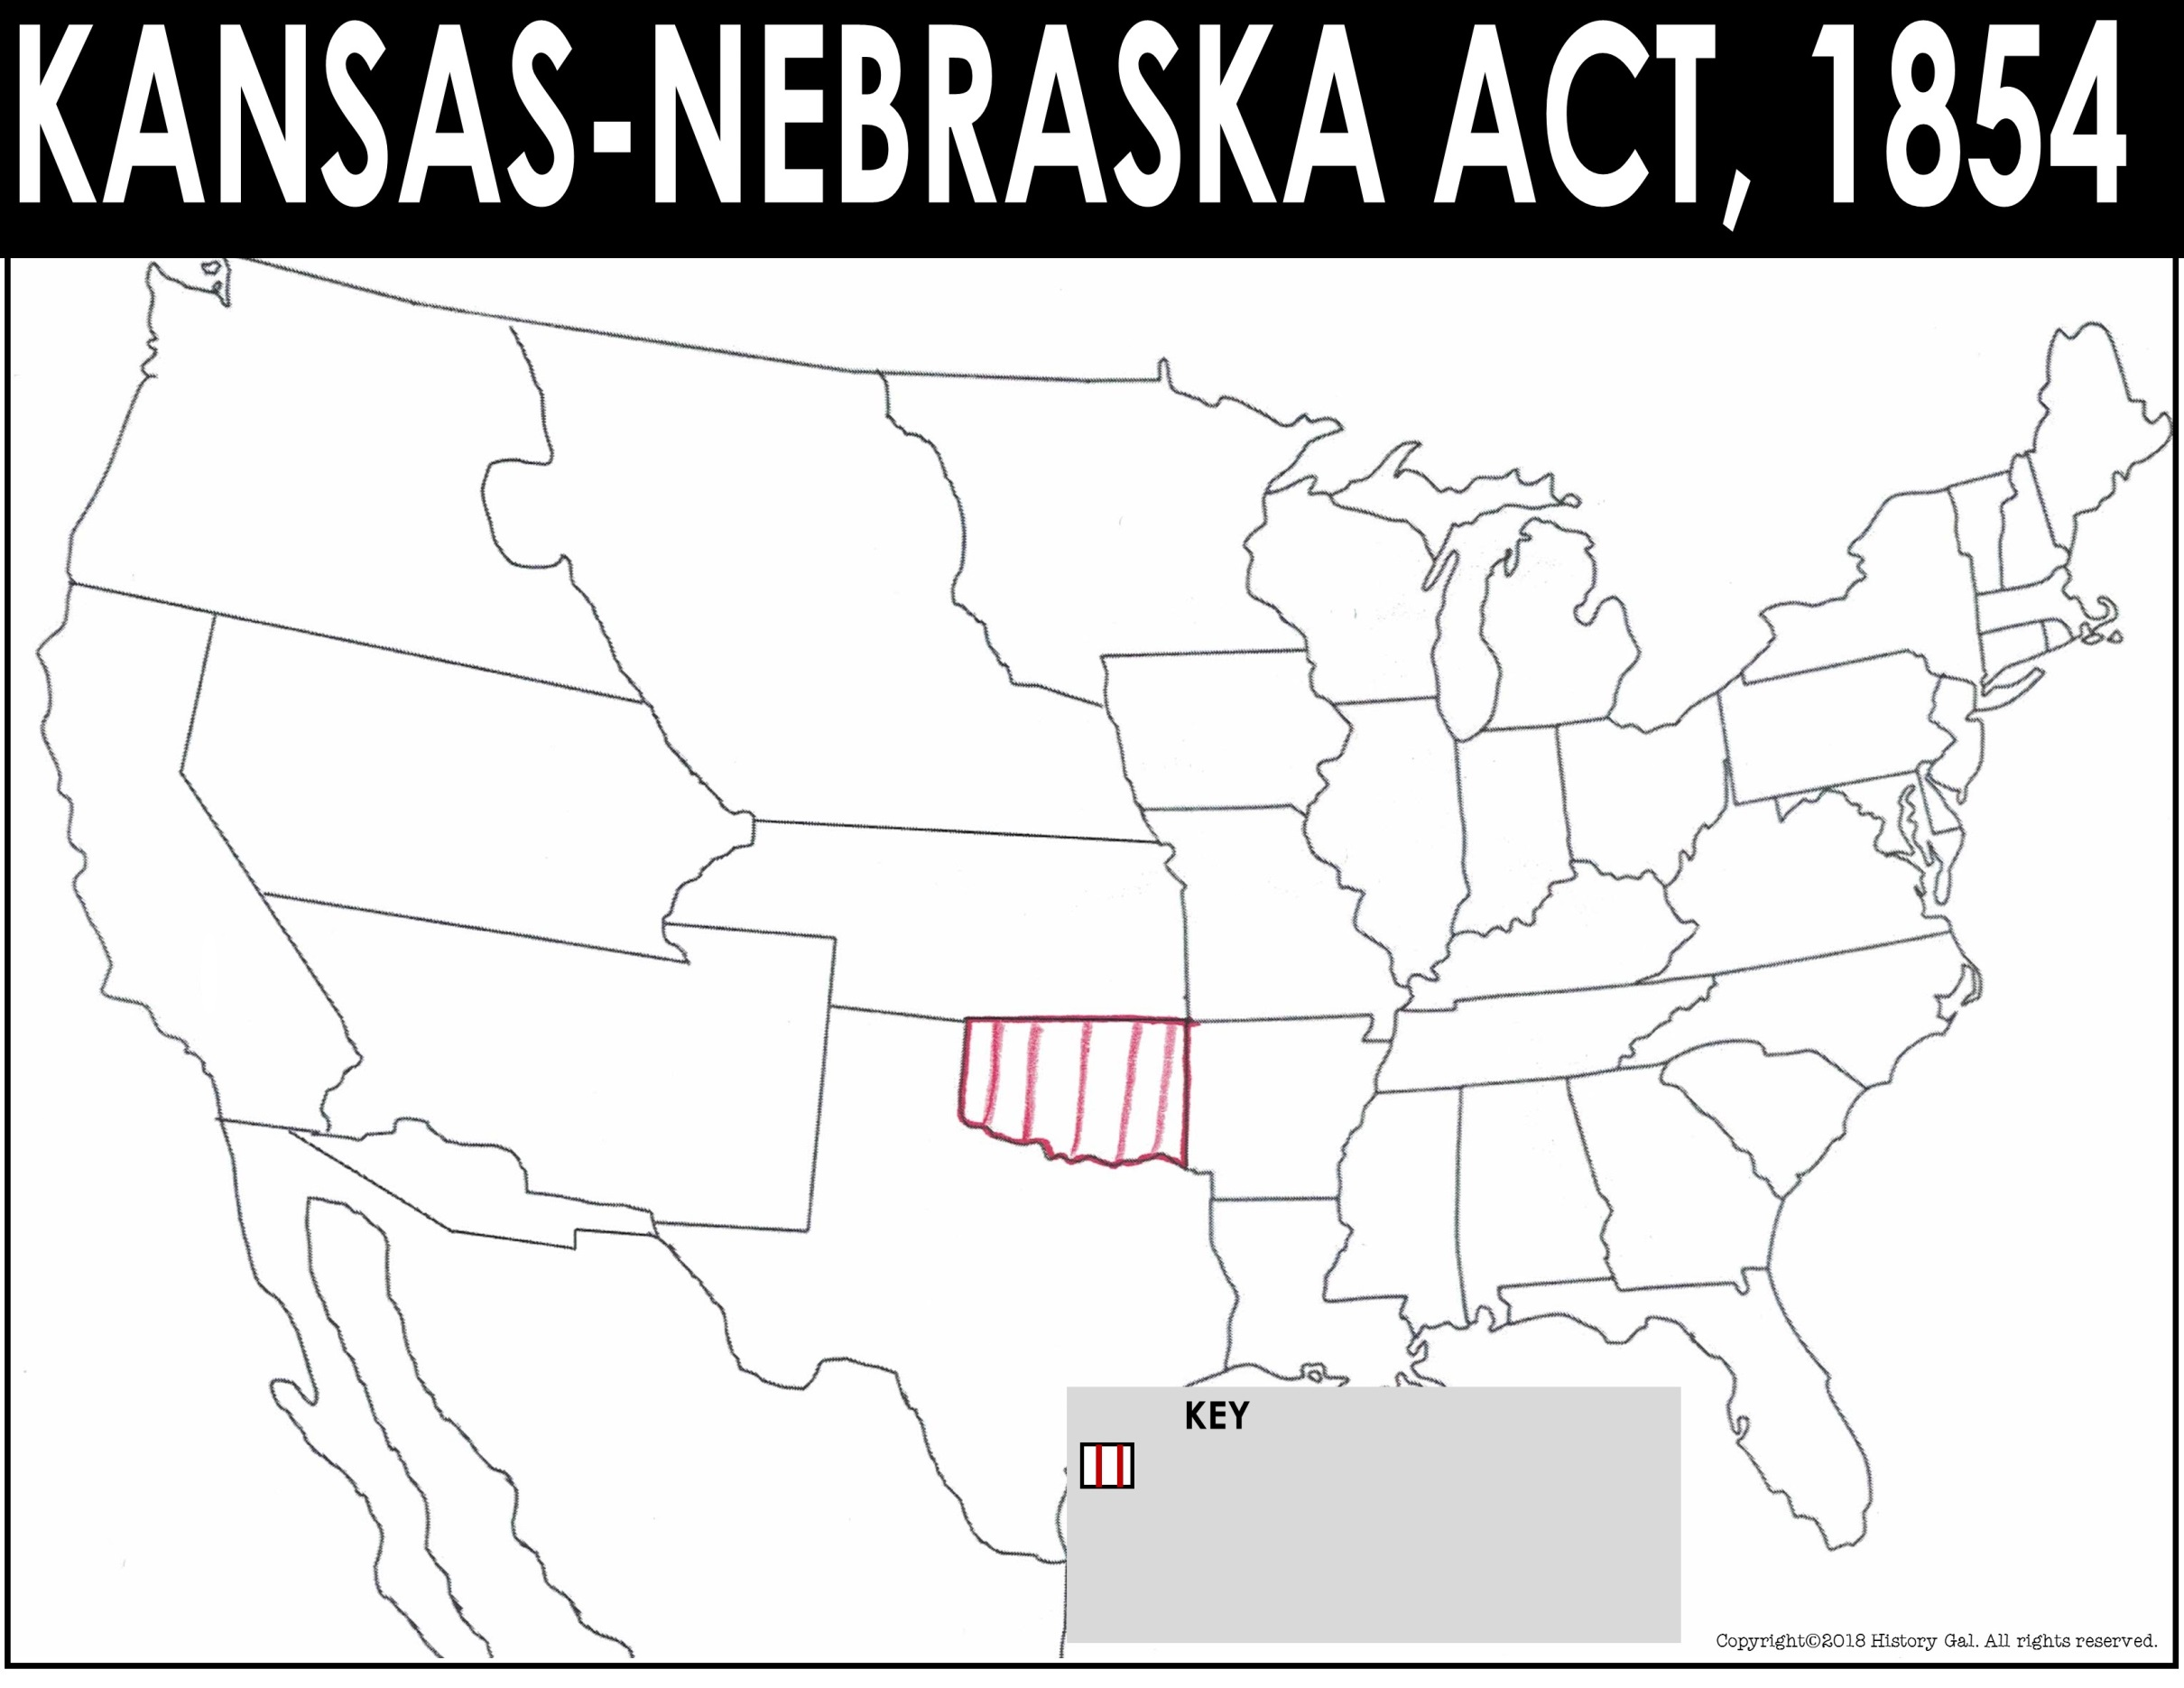
Canada
New Hampshire
Oregon Territory
Maine
Minnesota Territory
Vermont
Nebraska
Territory
Mass.
Wisconsin
Michigan
New York
RI
Iowa
Pennsylvania
Conn.
Utah
Territory
Ohio
NJ
Illinois
Delaware
Indiana
Maryland
California
Kansas
Territory
Virginia
Missouri
Kentucky
North Carolina
New Mexico
Territory
Missouri Compromise Line
Unorganized Territory
Tennessee
Arkansas
South Carolina
Alabama
Georgia
Mississippi
Texas
Atlantic Ocean
Louisiana
Mexico
Florida
Pacific
Ocean
Territory allowed to have slavery by the Missouri Compromise

Slide 3
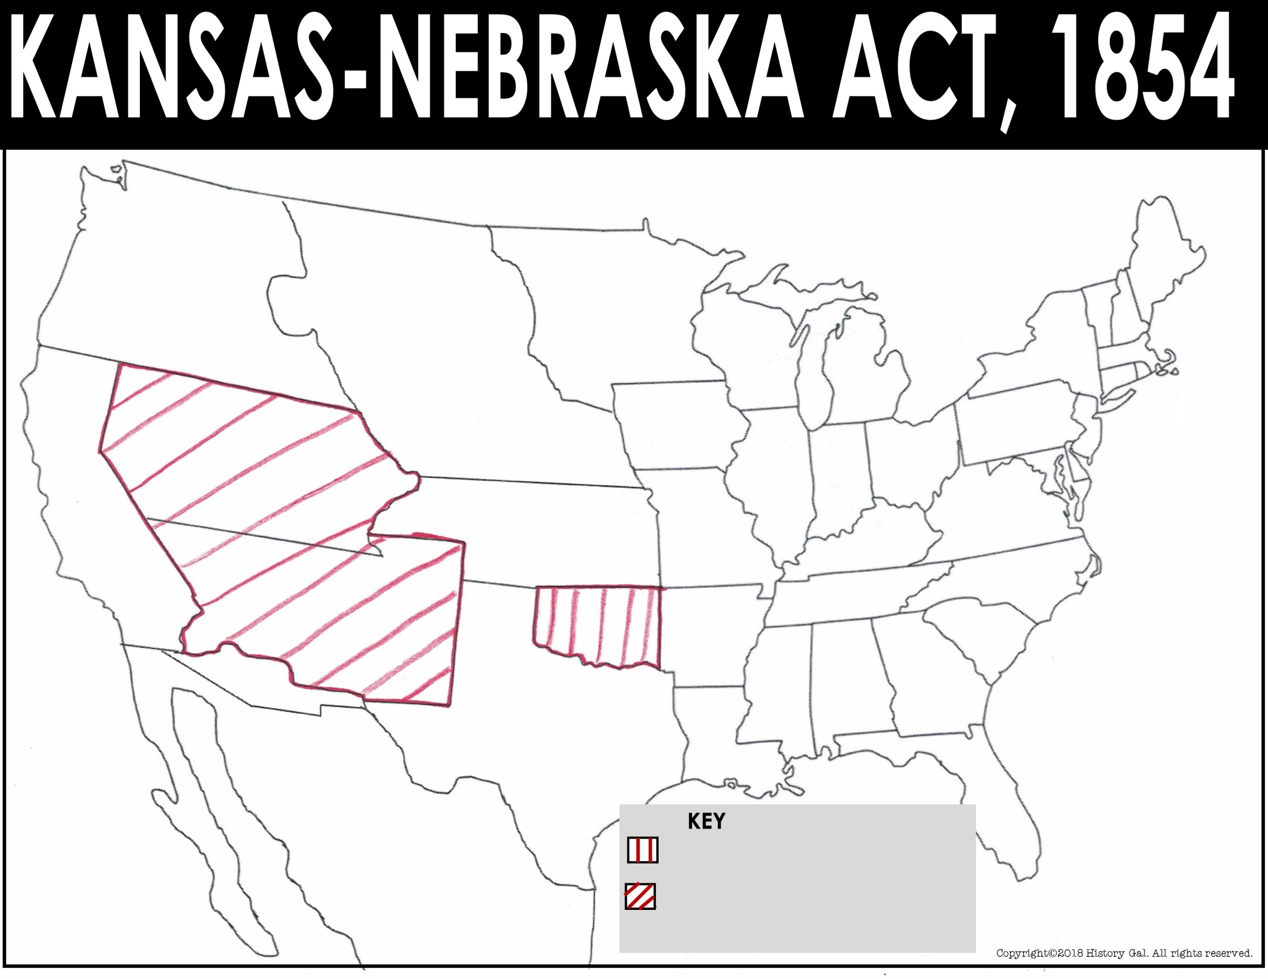
Canada
New Hampshire
Oregon Territory
Maine
Nebraska
Territory
Minnesota Territory
Vermont
Mass.
Wisconsin
New York
Michigan
Rhode
Island
Utah
Territory
Iowa
Pennsylvania
Conn.
New Jersey
Illinois
Delaware
Indiana
Ohio
California
Kansas
Territory
Maryland
Kentucky
Virginia
Missouri
North Carolina
New Mexico
Territory
Missouri Compromise Line
Tennessee
Unorganized Territory
Atlantic Ocean
Arkansas
South Carolina
Alabama
Georgia
Mississippi
Texas
Louisiana
Mexico
Florida
Pacific
Ocean
Territory allowed to have slavery by the Missouri Compromise
Territory OPENED to slavery by the Compromise of 1850

Slide 4
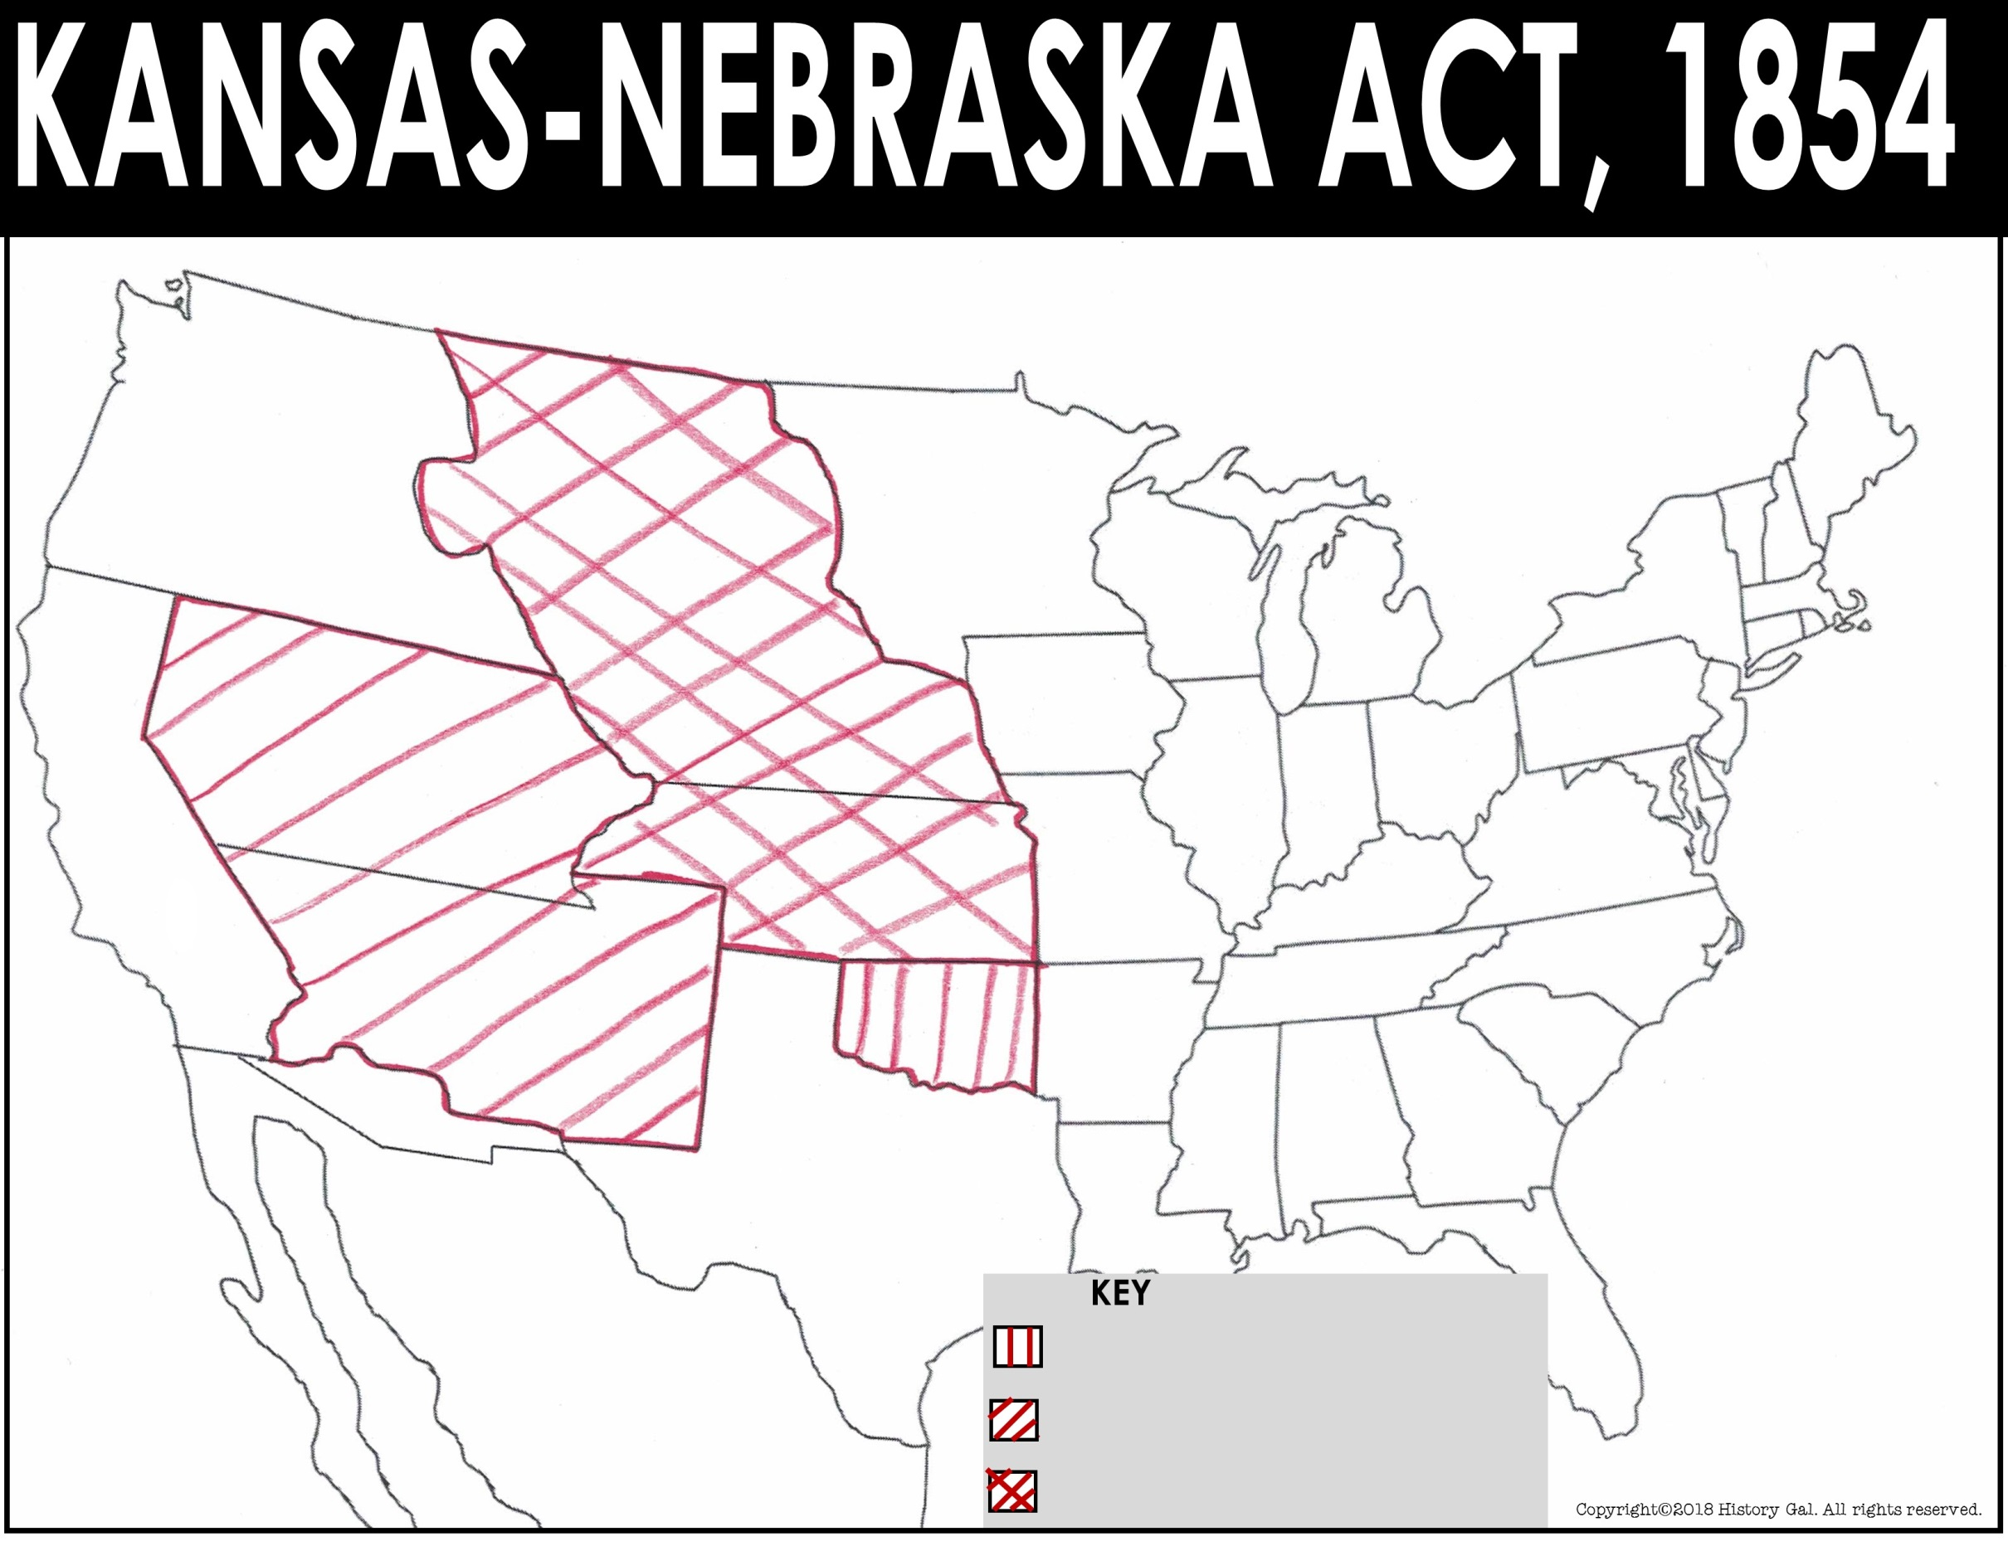
Canada
Oregon Territory
New Hampshire
Maine
Nebraska
Territory
Minnesota Territory
Vermont
Mass.
Wisconsin
New York
Rhode
Island
Michigan
Utah
Territory
Iowa
Pennsylvania
Conn.
Ohio
New Jersey
Indiana
Delaware
Illinois
California
Kansas
Territory
Virginia
Maryland
Missouri
Kentucky
North Carolina
New Mexico
Territory
Missouri Compromise Line
Atlantic Ocean
Unorganized Territory
Tennessee
Arkansas
South Carolina
Alabama
Georgia
Mississippi
Texas
Louisiana
Mexico
Florida
Pacific
Ocean
Territory allowed to have slavery by the Missouri Compromise
Territory OPENED to slavery by the Compromise of 1850
Territory OPENED to slavery by the Kansas-Nebraska Act

Slide 5
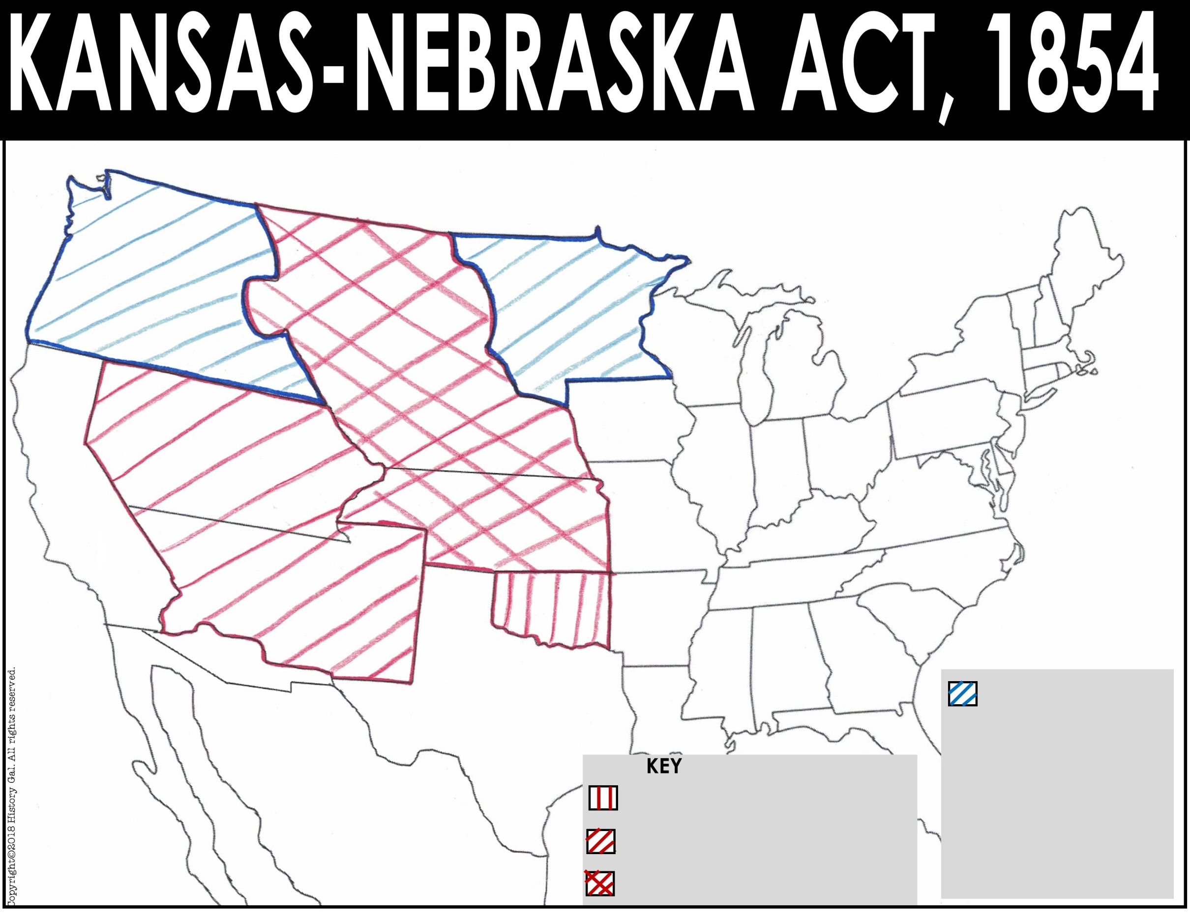
Canada
Oregon Territory
New Hampshire
Maine
Nebraska
Territory
Minnesota Territory
Vermont
Mass.
Wisconsin
New York
Michigan
Rhode
Island
Utah
Territory
Iowa
Pennsylvania
Conn.
Ohio
New Jersey
Indiana
Delaware
Illinois
Maryland
California
Kansas
Territory
Virginia
Missouri
Kentucky
North Carolina
New Mexico
Territory
Missouri Compromise Line
Tennessee
Atlantic Ocean
Unorganized Territory
Arkansas
South Carolina
Alabama
Georgia
Mississippi
Texas
Territory CLOSED to slavery
Louisiana
Mexico
Florida
Territory allowed to have slavery by the Missouri Compromise
Territory OPENED to slavery by the Compromise of 1850
Territory OPENED to slavery by the Kansas-Nebraska Act

Slide 6
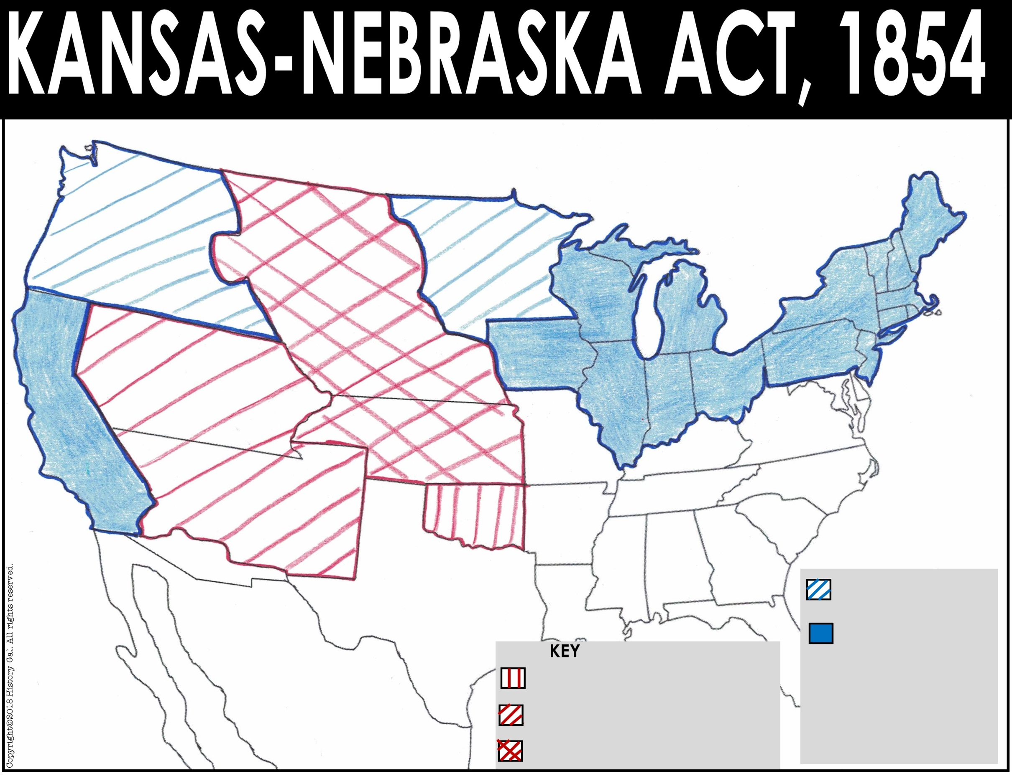
Canada
Oregon Territory
New Hampshire
Maine
Nebraska
Territory
Minnesota Territory
Vermont
Mass.
Wisconsin
New York
Rhode
Island
Michigan
Utah
Territory
Iowa
Pennsylvania
Conn.
Illinois
Ohio
New Jersey
Indiana
Delaware
California
Kansas
Territory
Virginia
Maryland
Missouri
Kentucky
North Carolina
New Mexico
Territory
Missouri Compromise Line
Tennessee
Atlantic Ocean
Unorganized Territory
Arkansas
South Carolina
Alabama
Georgia
Mississippi
Texas
Territory CLOSED to slavery
Louisiana
Mexico
FREE states
Florida
Pacific
Ocean
Territory allowed to have slavery by the Missouri Compromise
Territory OPENED to slavery by the Compromise of 1850
Territory OPENED to slavery by the Kansas-Nebraska Act

Slide 7
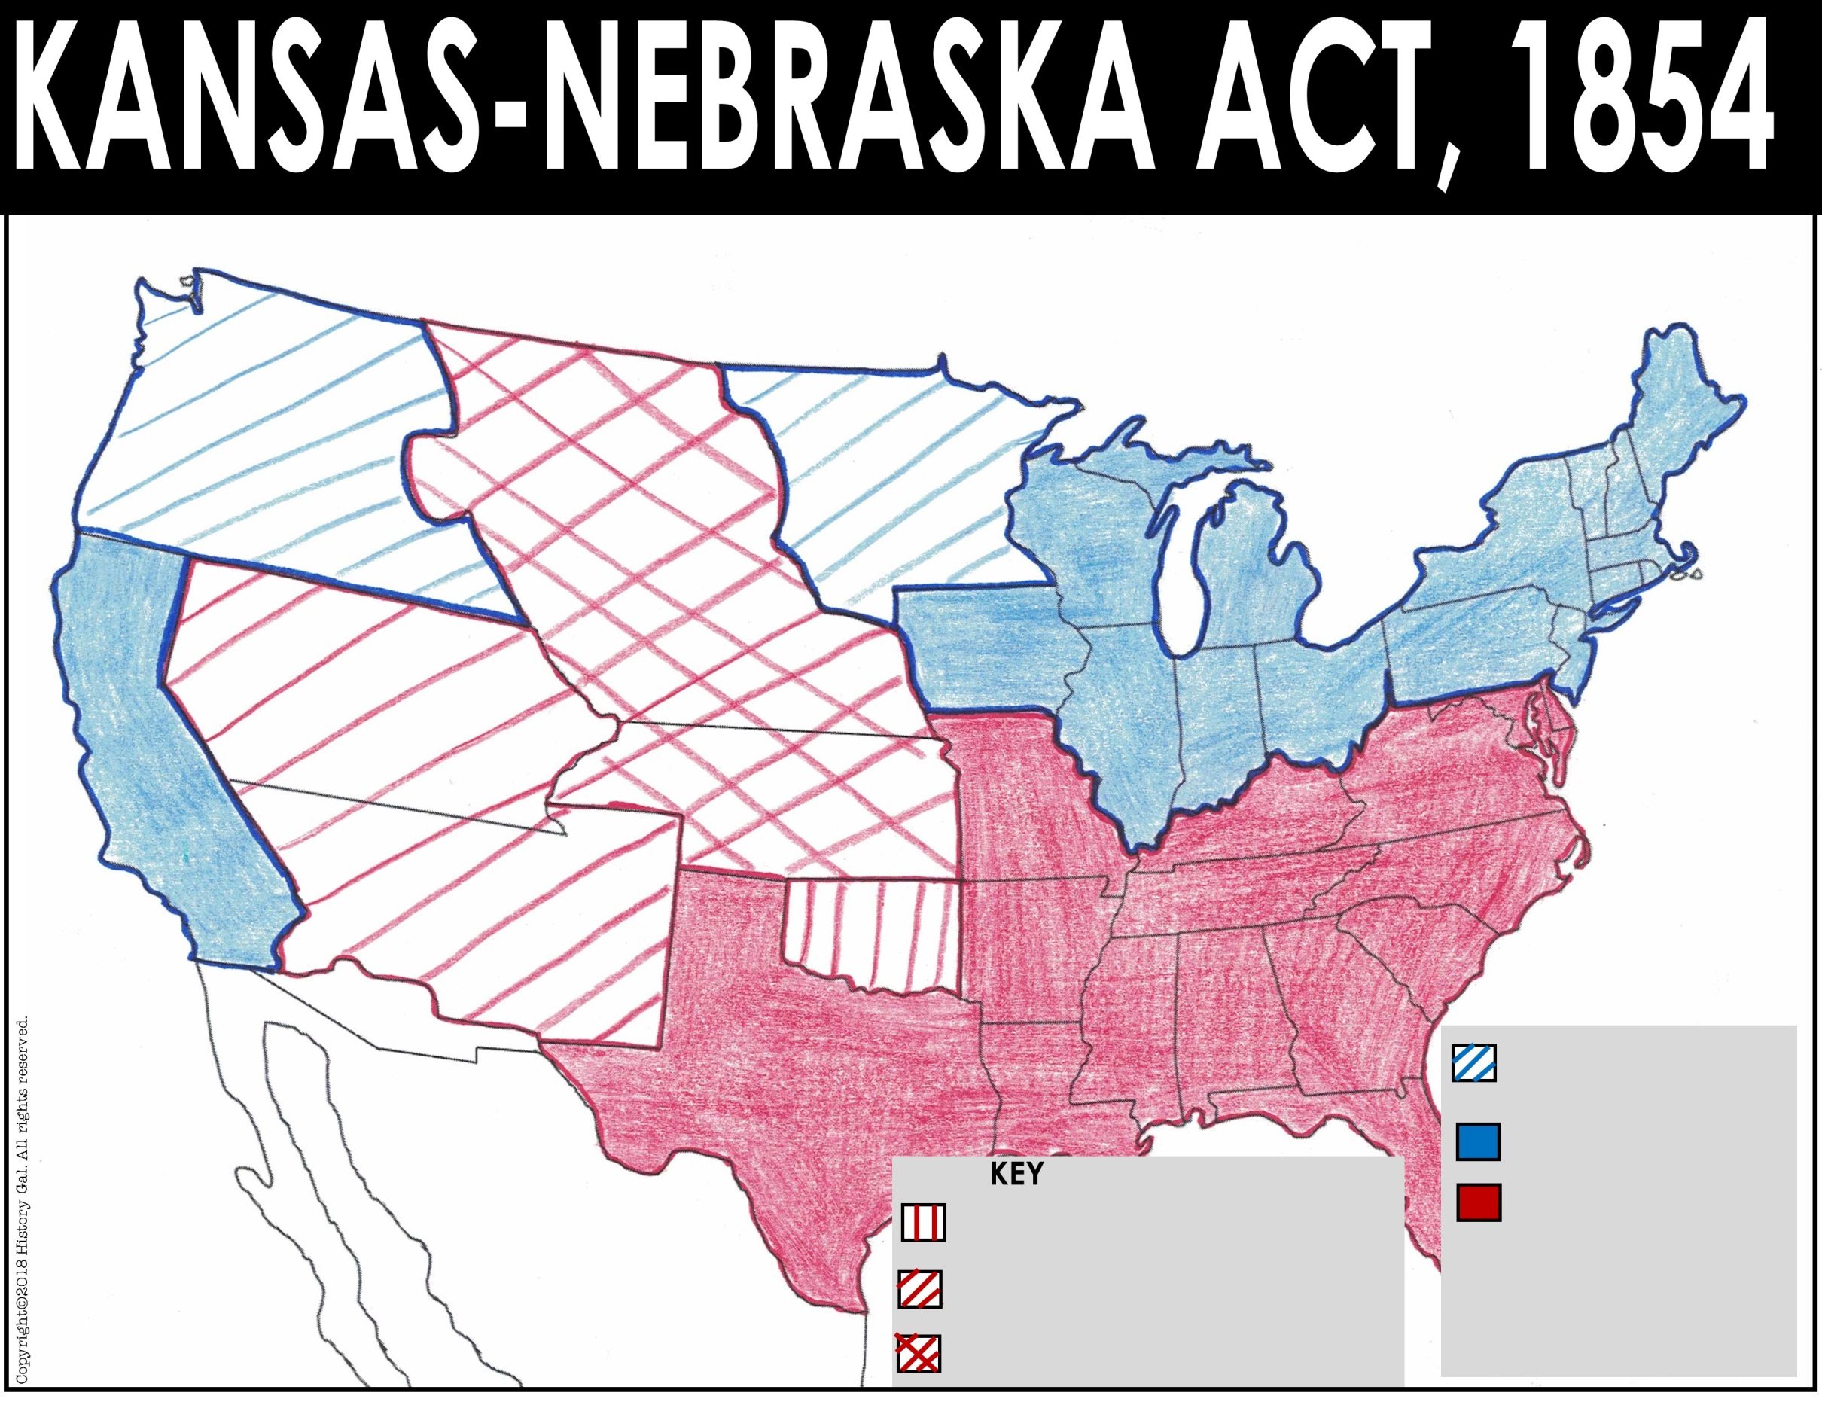
Canada
Oregon Territory
New Hampshire
Maine
Nebraska
Territory
Minnesota Territory
Vermont
Mass.
Wisconsin
New York
Rhode
Island
Michigan
Iowa
Conn.
Utah
Territory
Pennsylvania
New Jersey
Illinois
Ohio
Delaware
California
Indiana
Maryland
Kansas
Territory
Virginia
Missouri
Kentucky
North Carolina
New Mexico
Territory
Atlantic Ocean
Missouri Compromise Line
Tennessee
Unorganized Territory
South Carolina
Arkansas
Alabama
Georgia
Texas
Mississippi
Louisiana
Territory CLOSED to slavery
Mexico
FREE states
Florida
Pacific
Ocean
Territory allowed to have slavery by the Missouri Compromise
SLAVE states
Territory OPENED to slavery by the Compromise of 1850
Territory OPENED to slavery by the Kansas-Nebraska Act

Slide 8
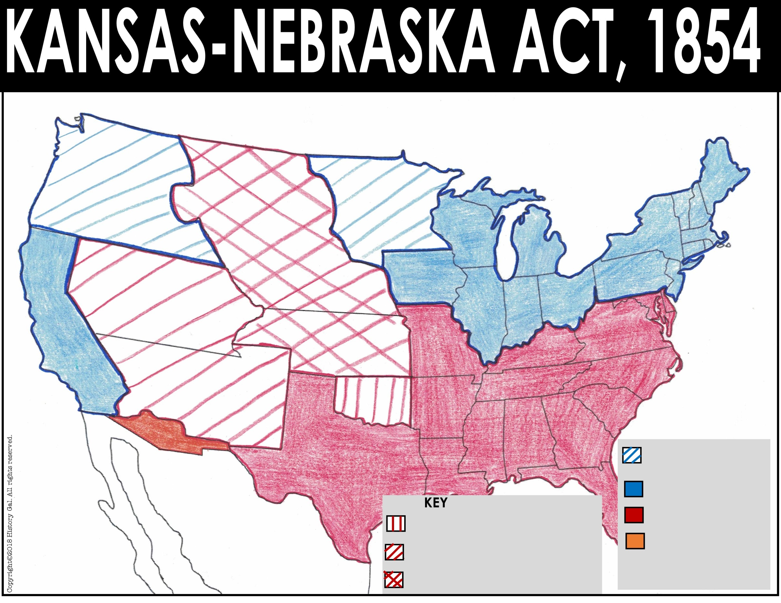
Canada
Oregon Territory
New Hampshire
Maine
Nebraska
Territory
Minnesota Territory
Vermont
Mass.
Wisconsin
New York
Rhode
Island
Michigan
Utah
Territory
Iowa
Pennsylvania
Conn.
Ohio
New Jersey
Illinois
Delaware
California
Indiana
Maryland
Kansas
Territory
Virginia
Missouri
Kentucky
North Carolina
Missouri Compromise Line
Atlantic Ocean
New Mexico
Territory
Unorganized Territory
Tennessee
Arkansas
South Carolina
Alabama
Georgia
Texas
Mississippi
Louisiana
Territory CLOSED to slavery
Mexico
FREE states
Florida
Pacific
Ocean
Territory allowed to have slavery by the Missouri Compromise
SLAVE states
Territory OPENED to have slavery by the Compromise of 1850
Gadsden Purchase
Territory OPENED to have slavery by the Kansas-Nebraska Act

