Slide 1

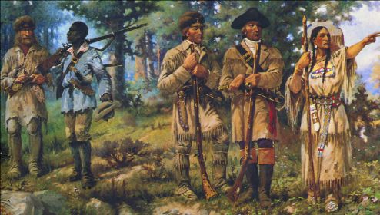
Growth & Expansion
When you see the pencil appear, fill in the information in red on your info-graphic guided notes page.

Slide 2
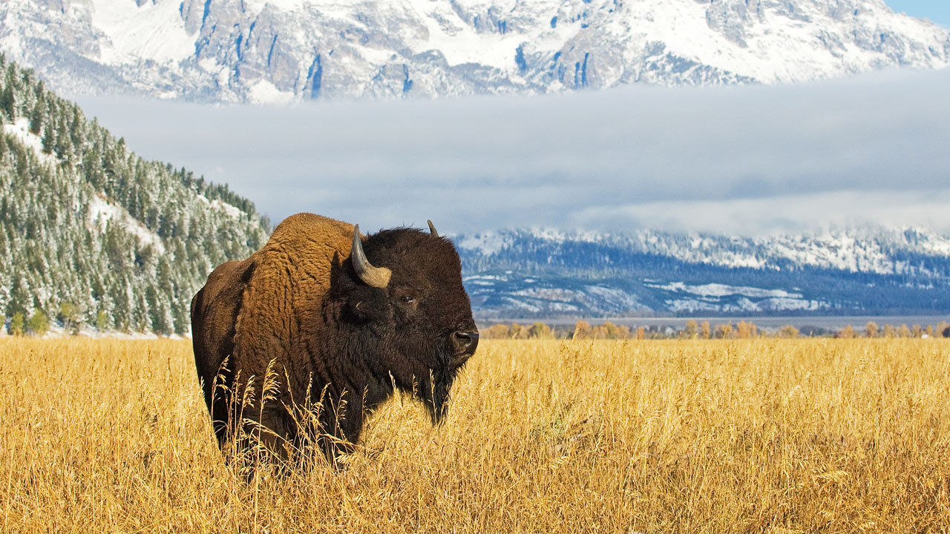
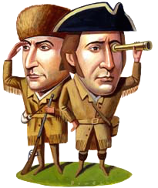
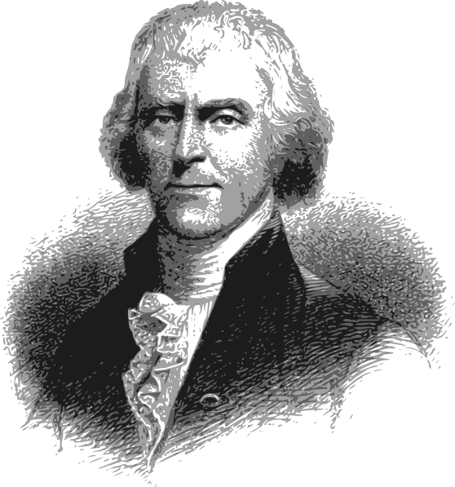
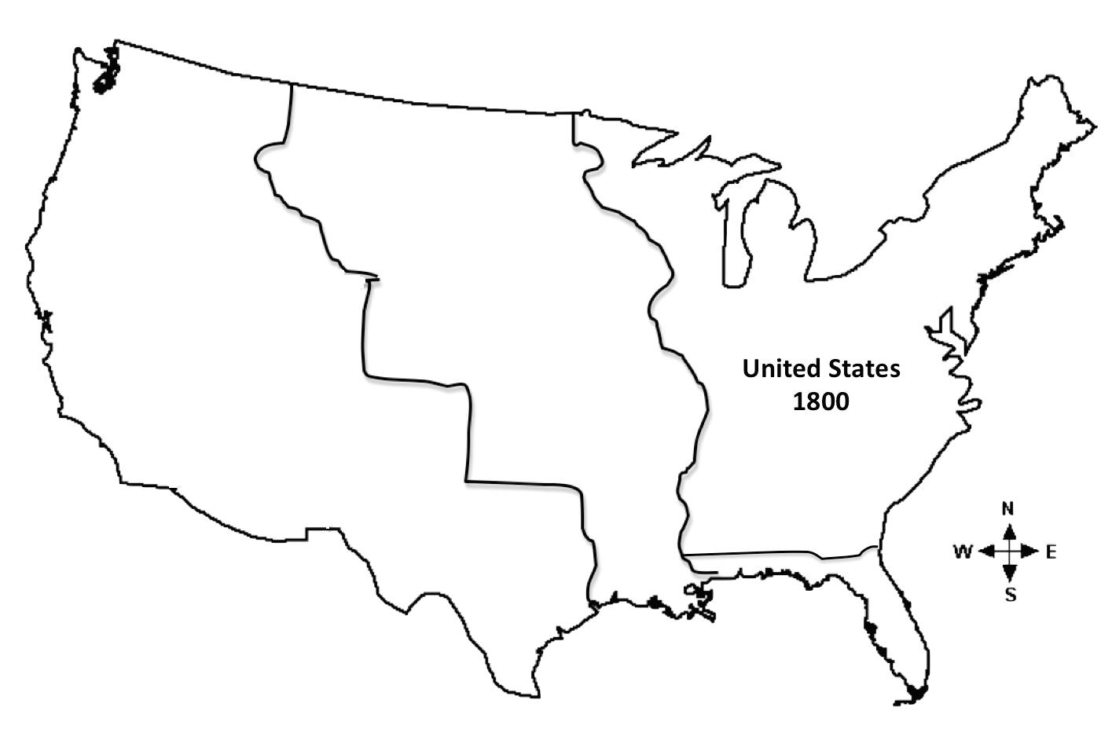
Thomas Jefferson
3rd President, made the Louisiana Purchase
1803
Bought from France
$15 Million
Doubled the size of the U.S.

Slide 3
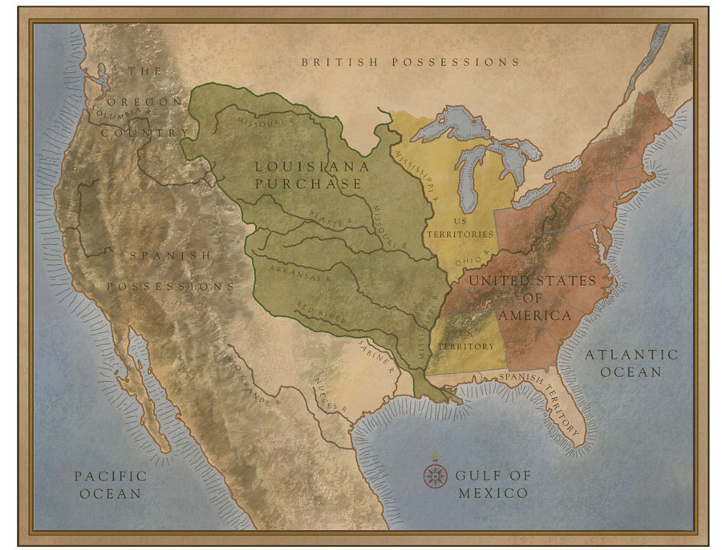
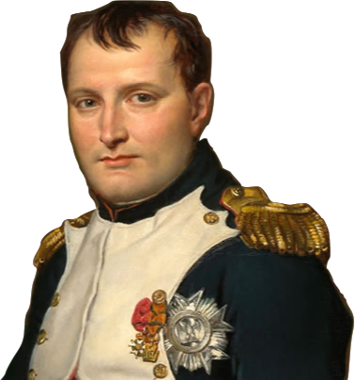
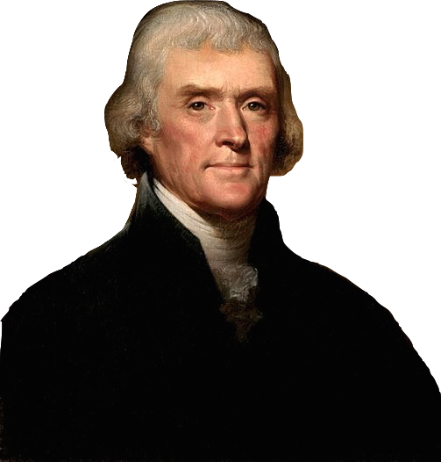
The first chance for the U.S. to expand was into the territory west of the Mississippi River owned by France and known as “Louisiana”.
France needs money to take over Europe. I will sell you all of the Louisiana Territory for $15 million.
We’d like to buy the port of New Orleans for $7.5 Million.
By 1800, thousands of farmers had settled in territories west of the Appalachian Mountains and used the Mississippi River to transport their crops to the port at New Orleans. Thomas Jefferson offered to buy New Orleans from France. France offered all of Louisiana instead.
Wow! Do I have the power to make such a big purchase? I’d better ask Congress…

Slide 4
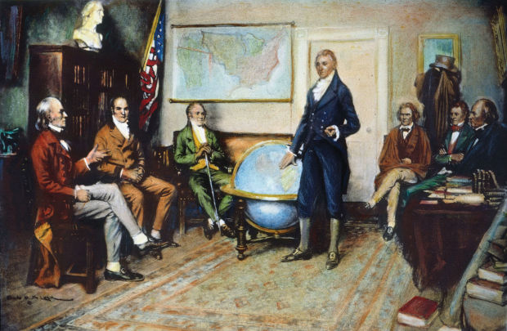
Most Americans thought the offer from France was too good to refuse. However, not everyone approved. Some felt the U.S. should turn France down. The Constitution did not give the President power to buy land and this troubled Jefferson.
For the Purchase
Against the Purchase
Less than 3 cents an acre!
$15 Million was a lot of money.
Double the size of the country!
Too much land to govern.
Complete control of the Mississippi River!
New states to share power.
Obtained without war or bloodshed!
Unconstitutional.
1803
Jefferson didn’t want to miss out on a historic opportunity. In 1803, the Senate voted to ratify the Louisiana Purchase.

Slide 5
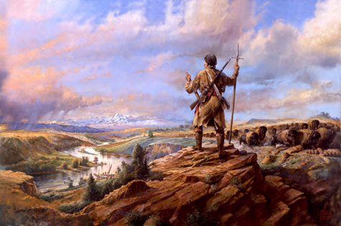
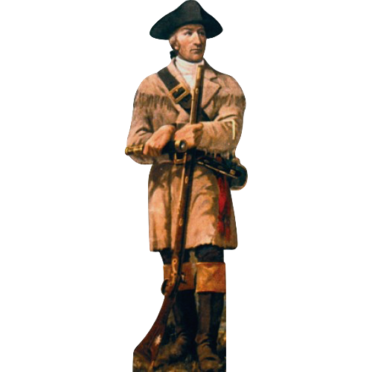
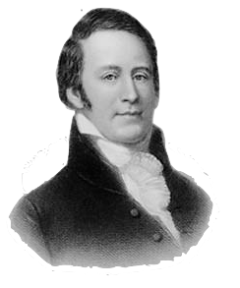
Meriwether Lewis
Chosen to lead the expedition into the Louisiana Territory.
In 1804, President Jefferson ordered his private secretary, Meriwether Lewis, to lead an expedition into the new Louisiana Territory. Lewis chose his friend William Clark to help lead the 45-member expedition group.

Slide 6
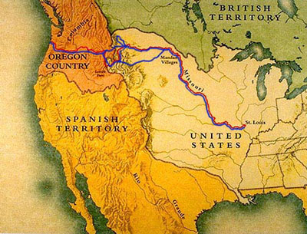
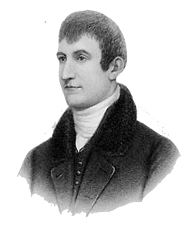
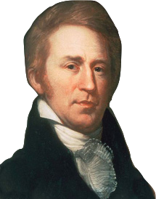
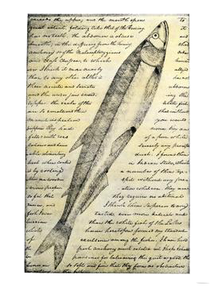
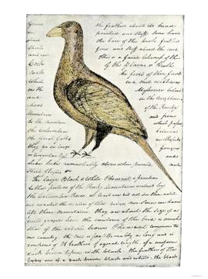
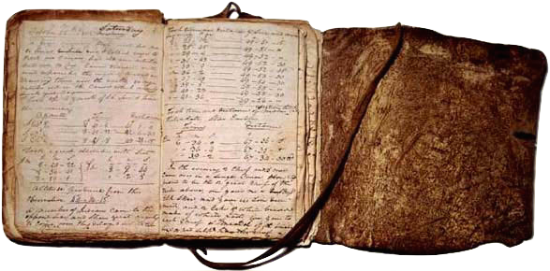

William Clark
Wrote journals and maps from the expedition.
The Lewis & Clark Expedition started in St. Louis, Missouri and followed the Missouri River to the Rocky Mountains. From there, the explorers made their way to the Pacific Ocean.

Slide 7
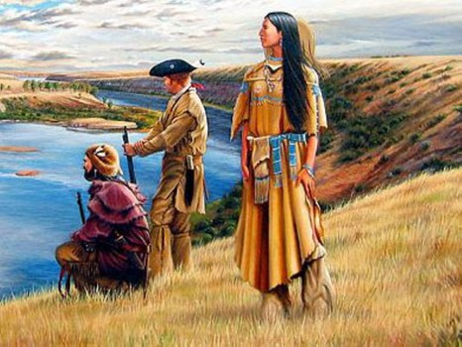
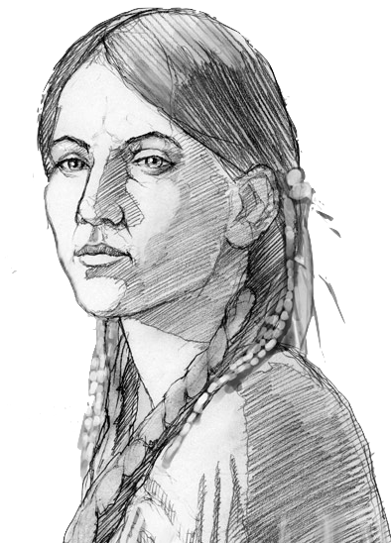
Sacagawea
In the winter of 1804, the Lewis & Clark Expedition had reached North Dakota. They stayed with the Mandan Indian tribe and a French fur trader joined them. He brought his 16-year-old wife, Sacagawea and their infant son. Sacagawea had been kidnapped from her Shoshone tribe as a child. She would help guide the expedition through the Rocky Mountains and prove to be invaluable as a translator to other native tribes the group encountered.
16 year old guide and translator for the expedition.

Slide 8
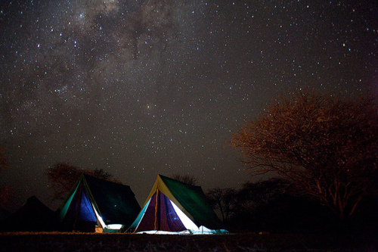

The True Story of Sacagawea by TedEd, available on YouTube
https://www.youtube.com/watch?v=PnT0k9wdDZo

Slide 9
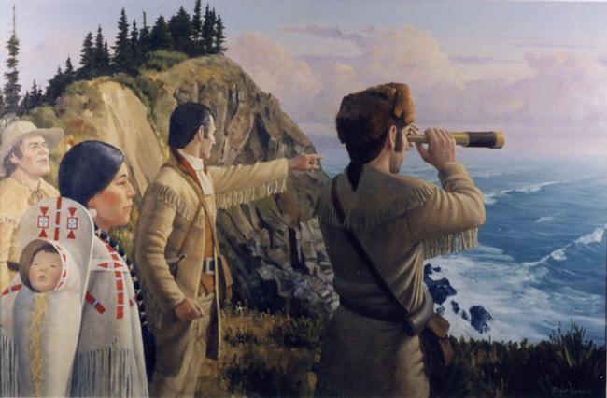


Lewis & Clark Expedition:
Mapped a route to the Pacific.
Established relationships with Indians.
Brought back information about the West and its peoples.
Helped prepare the way for more explorers and settlers.
1800
Thousands of farmers were settling land west of the Appalachian Mtns and transporting crops down the Mississippi River to New Orleans.
1803
1805
1806
Lewis & Clark returned from their expedition and Zebulon Pike set out to explore more of the Louisiana Territory and the Spanish-owned Southwest.
Louisiana Purchase was made
Lewis & Clark reached the Pacific

Slide 10
Optional Video Links
Manifest Destiny
https://www.youtube.com/watch?v=YLmUhT9QOlE
Elbow Room
https://www.youtube.com/watch?v=Bs2w4lwQRtc
The True Story of Sacagawea
https://www.youtube.com/watch?v=PnT0k9wdDZo
Lewis & Clark Expedition: National Geographic
https://www.youtube.com/watch?v=LbRCY4oRY1o

