Slide 1
Migration and Immigration
The Gilded Age brought about urban migration (urbanization) as well as large-scale immigration from certain regions of Europe. Push and Pull factors help explain immigration and urbanization.
Terms to know:
Rural – living in the country
Urban – living in the city
Migration – movement within a country
Immigration – movement between countries
Push factors – reasons for leaving
Pull factors – reasons for coming
Nativism – bigotry from established Americans toward immigrants
Americanization – replacing home culture with American culture
Urbanization – population movement from rural to urban
Ghetto – ethnically concentrated enclaves in major cities

Slide 2
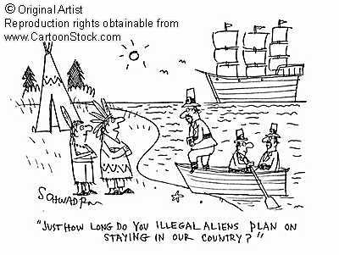
What is an immigrant?
Migration and Immigration

Slide 3
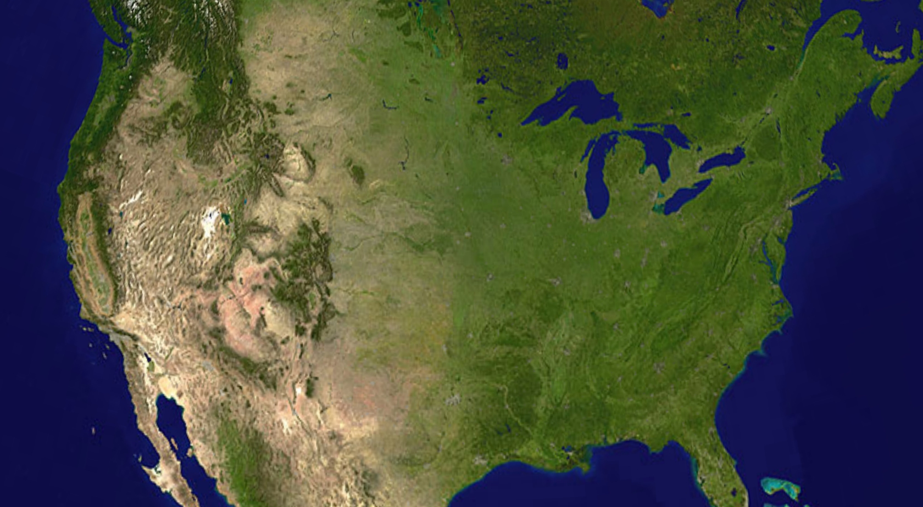
1st wave of immigration: Native Americans that immigrated from Asia, pre-Columbian
2nd wave of immigration: European explorers; e.g. Spanish, English, French (1500s)
3rd wave of immigration: English Puritans (1630s-1700s) & other Western Europeans
4th wave of immigration: Southern/Eastern Europeans and Asians (1890s-1900s)
Gilded Age (Eastern and Southern Europeans) late 1800s
Native Migration from Asia
Colonial Settlement (English) late 1600s
Columbus (Spanish) 1492

Slide 4
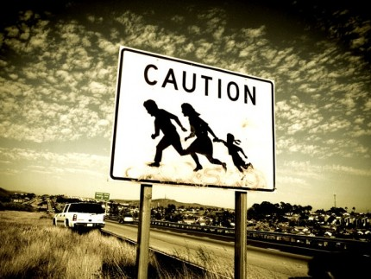
In the last 300 years, immigrants to North America have come from all over the world

Slide 5
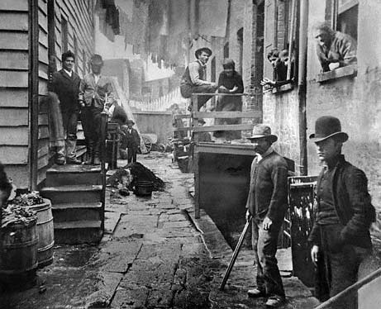
Nativism – bigotry from established Americans toward immigrants

Slide 6
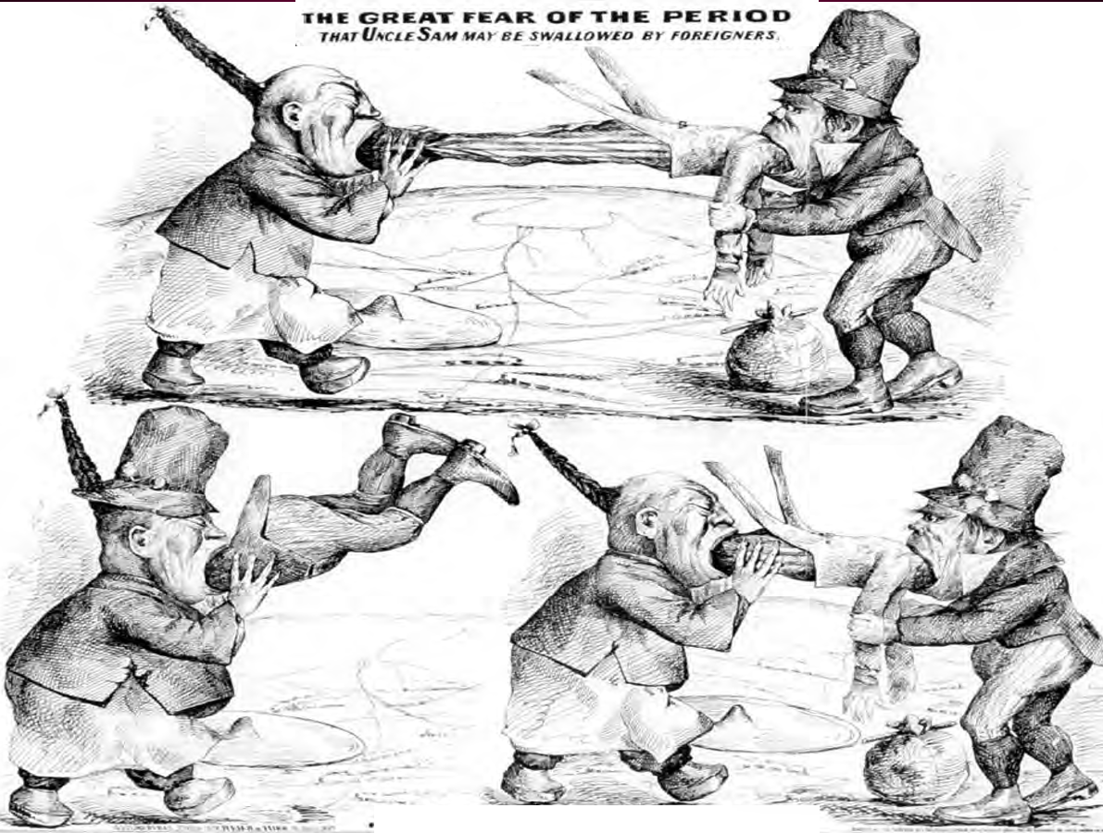
1
2
3

Slide 7
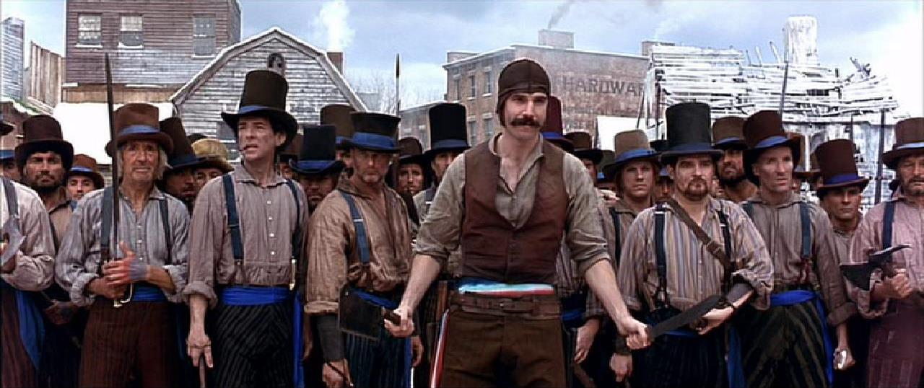
Nativism – bigotry from established Americans toward immigrants
Both Nativist and immigrant groups often formed gangs to protect territory. Nativists believed that immigrants were bad for America, driving down the average wages since many unskilled immigrants were willing to work for very little money. (preview clip for language)
http://www.youtube.com/watch?v=ADmX9eMEV9U

Slide 8
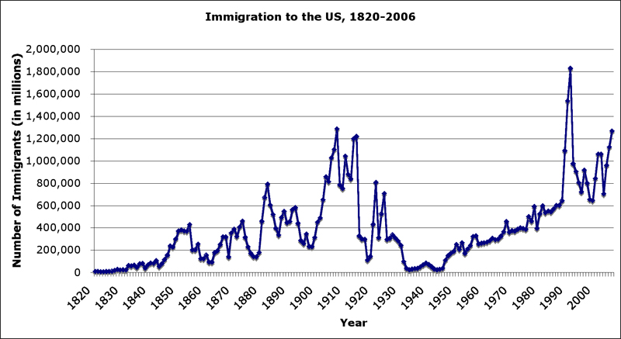
As with most migrants in American history, the hope of better socio-economic conditions was the major force, although persecution at home or forced military service were important factors for many, especially those who were in minority groups where they lived. There are always push-and-pull factors involved. Push (reasons for leaving) may be general like economic dislocation, war, persecution, dissatisfaction with life, or personal like familial division of land, family crises, or trouble with authorities. Pull (reasons for choosing the U.S.) factors were often based on hopes that were not always realistic. They included: better jobs, freedom from persecution, from war, etc. Often the Push and Pull was the same. Most immigrants were propelled by both push and pull factors.
Push = reasons for leaving a home country
Pull = reasons for coming to a new country
Gilded age

Slide 9
Won't it be nice when we get to America? In America there are not cats! But back home in mother Russia...Aaah...Our Family was travelling through the snow to Minsk, Suddenly Papa saw those huge paw prints, When I heard him screaming I fainted dead away, And I woke up an orphan, Oy vay. But... but?
(CHORUS) But there are no cats in America, And the streets are paved with cheese, Oh there are no cats in America, So set your mind at ease
You think a-things were a-bad in a-Russia, you should a-see things in a-my country! Times were hard in Sicily we had a-no provolone, The Don he was a tabby with a taste for my brother Tony, When Mama went to plead a-for him the Don said he would see her, We found her rosary on the ground, poor Mama mia. But...
CHORUS
Sure, that's sad, but sadder still...When I was but a lad I lost my true love fair, A calico, he caught us by surprise, In a flash of teeth and fur her tail was all he left of her, 'Neath a heather is where Tura Lura lies But…
CHORUS X 2
That's why
we sail
these seas!
http://www.youtube.com/watch?v=1_4kU9cwgXM
What do ‘cats’ represent?
What does ‘cheese’ represent?
What do paw prints, Don & Calico represent?

Slide 10
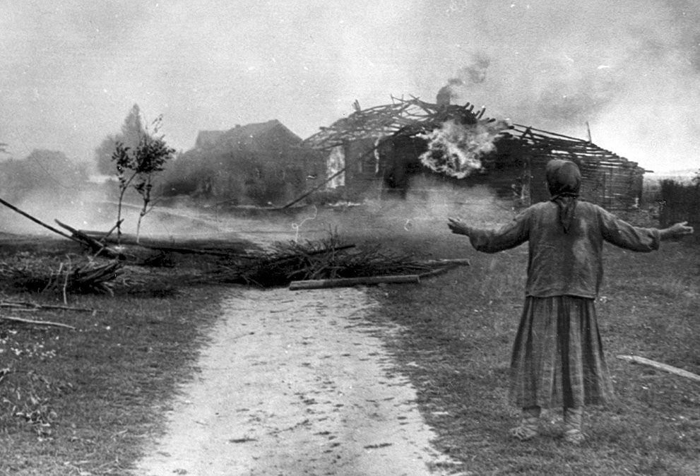
The persecution of Jews in Russia is just one of many examples of ‘push’ factors that sent unprecedented numbers of European immigrants fleeing to other countries. In 1882, Russian Tsar Alexander III sought to ‘cleanse’ the Russian countryside of Jewish communities. These actions have been popularized in films such as Ellis Island (1984) and An American Tail (1986).
http://www.youtube.com/watch?v=pfVmxm3ROgg
http://www.youtube.com/watch?v=0FJkNReyalY

Slide 11
Gilded Age in the Movies: An American Tale
Supposed to take place in the 1880’s
Main family are “Jewish-Russian” mice (The Mousekewitz Family)
Family moves to NYC to avoid persecution in Russia
They find work in a sweatshop
The ‘cats’ in Russia represent either anti-Semitists or rich landowners (Kulaks)
The ‘cats’ in America represent nativists and/or wealthy owners
Other characters discuss their lives ‘back home’ (Ireland, Sicily, Eastern Europe, etc.)
Migration and Immigration

Slide 12
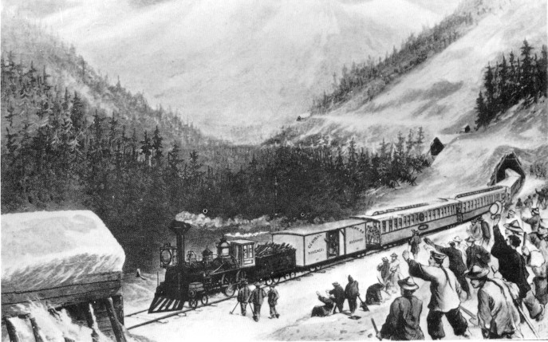
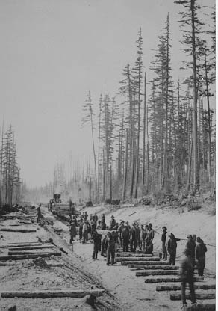
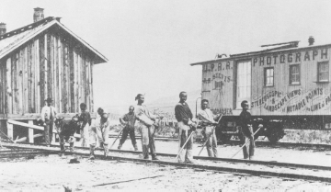
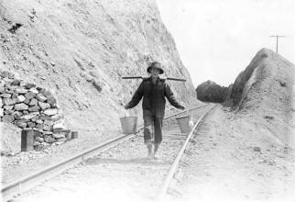
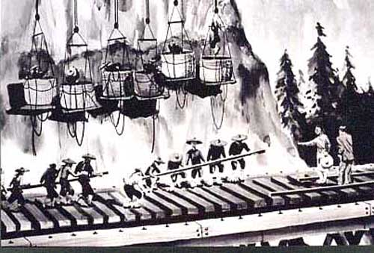
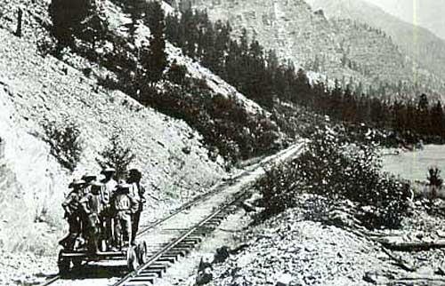
The 1882 Chinese Exclusion Act was a congressional law suspending Chinese immigration for 10 years. An 1884 amendment tightened provisions that allowed previous immigrants to leave and return, and clarified that the law applied to ethnic Chinese regardless of their country of origin. The act was renewed for 10 more years in 1892, and again in 1902 (with no end date). The1943 Magnuson Act, allowing a national quota of 105 Chinese immigrants per year, although large scale Chinese immigration did not occur until the passage of the Immigration Act of 1965.
Migration and Immigration

Slide 13
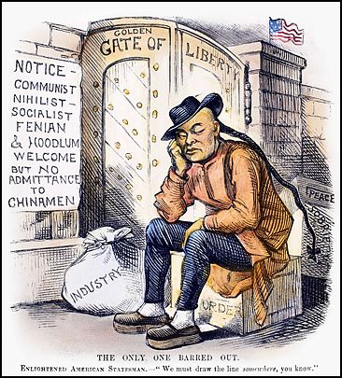

Slide 14
May 28th, 1909 –
A Chinese aristocrat in California poses for a picture. He has allowed his fingernails to grow to several inches in order to demonstrate his position in society; namely that he is so wealthy that he doesn’t need to use his hands for work or manual labor.

Slide 15
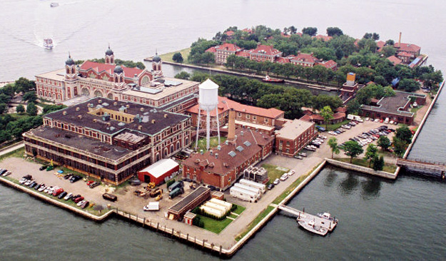
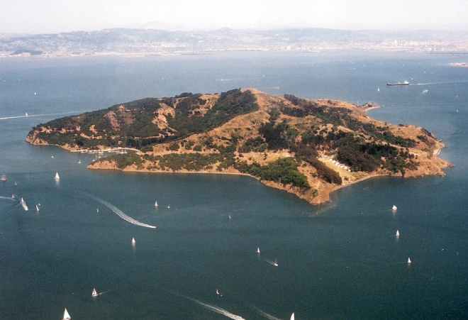
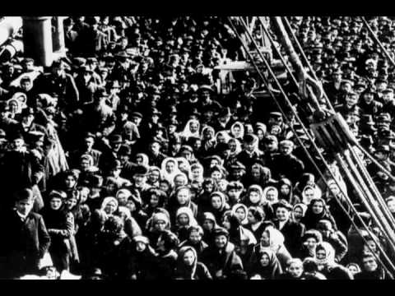
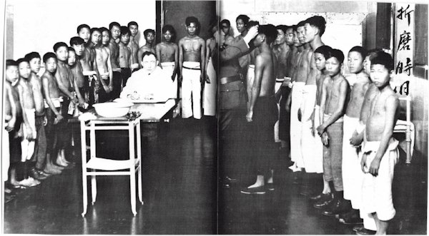
NY’s Ellis Island & SF’s Angel Island
http://www.youtube.com/watch?v=5rz5whByOts
http://www.youtube.com/watch?v=4CycdXpV2mo
Ellis Island:
major processing center on the east coast (large number of European immigrants)
Angel Island: major processing center on the west coast (large number of Asian immigrants)
Migration and Immigration

Slide 16
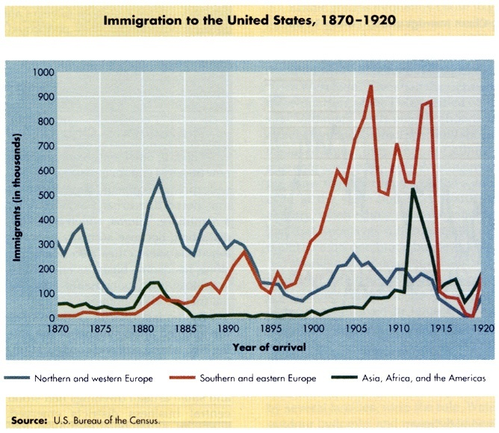
1 When were the peak years for ‘Old Immigrants’ (Northern & Western Europe)?
2 Which countries in Europe would be considered Northern & Western Europe?
3 When were the peak years for ‘New Immigrants’ (Southern & Eastern Europe)?
4 Which countries in Europe would be considered Southern & Eastern Europe?
5 When were the peak years for Asian, African & Latino immigrants?
6 Why did many immigrants tend to concentrate in ghettos or ethnic enclaves?
Migration and Immigration

Slide 17
Many Chinese immigrants worked in the west for the Central Pacific RR
Many Irish immigrants worked in the east for the Union Pacific RR
Most laborers who worked on the RRs were immigrants
Migration and Immigration

Slide 18
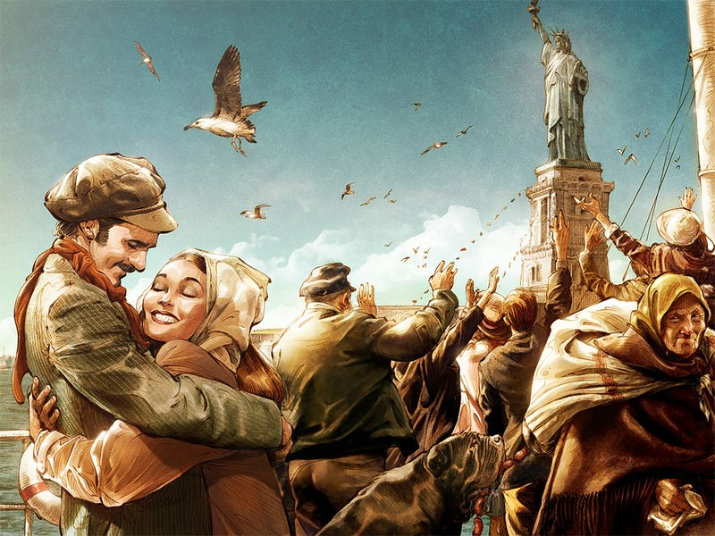
How did they get here?
During the Gilded Age, immigrants in America could arrange to have family members make the journey as well. For example, a Polish immigrant living in Detroit could go to a store in the ethnic community and purchase a combination ticket from a Hamburg-Amerika Line agent that would be delivered to the relative/friend in Krakow. This ‘combo’ ticket would provide rail transportation to Hamburg, accommodations in Hamburg while waiting for a ship, trans-Atlantic passage, and rail travel from New York to Detroit.
Migration and Immigration

Slide 19
How did they get here?
The development of transportation networks greatly influenced Gilded-Age immigration. As railroads—and cheaper and cheaper fares—spread through Europe, places with secure transportation to seaports multiplied. Oceanic transport changed dramatically in the years just before the Gilded Age. As late as 1856 more than 95 percent of European immigrants came to America by sail. Less than twenty years later (1873) more than 95 percent came on steamships.
Migration and Immigration

Slide 20
Ethnic groups had their own patterns
Many Scandinavian Immigrants
Many Irish Immigrants
Many Chinese Immigrants
Many immigrants settled in urban centers. Ever since the census began listing the foreign-born separately in 1850, they have been more likely to live in cities (especially large cities). Regionally, immigrants favored the northeastern and north central states. Ethnic groups had distinct patterns: Irish and Canadians favored New England, Italians and Russians the mid-Atlantic states, Germans near Pennsylvania and Ohio, and Scandinavians in Minnesota and Wisconsin.
Many German Immigrants
Many Italian and Russian Immigrants
Migration and Immigration

Slide 21
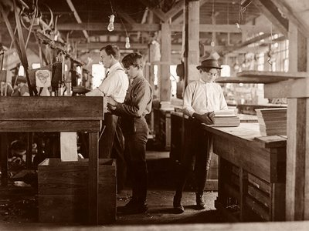
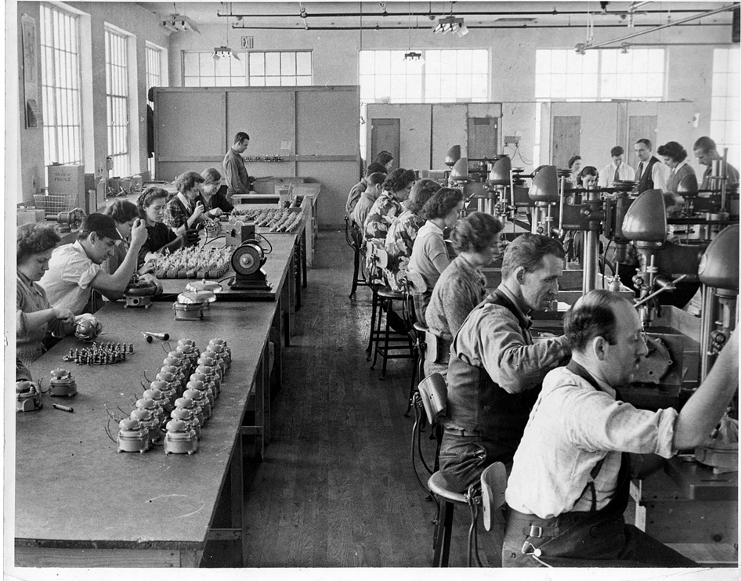
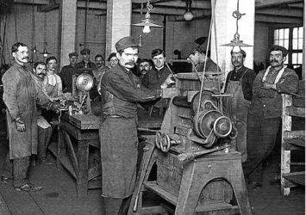
What did they do?
Since the Gilded Age was an era of industrialization, most immigrants worked unskilled industrial jobs. ‘Unskilled’ simply means that little to no schooling is necessary to do the job. Most immigrants took jobs that were hazardous, difficult and low-paying. These workers were, in historian Carl Wittke’s words, “we who built America”. It was not just immigrant men who worked, because immigrant women and children were much more likely to be in the labor force than those who were native-born.
Migration and Immigration

Slide 22
What did they do?
The agricultural sector, which had once included a majority of immigrants, was still attractive to some, especially those who came with some wealth and resources. Even with free arable western land, which was rapidly disappearing, the costs of establishing a farm was only available to a few Gilded-Age immigrants. Even immigrants who had agricultural backgrounds in their home countries (e.g. Swedes) tended toward industrial employment.
Migration and Immigration

Slide 23
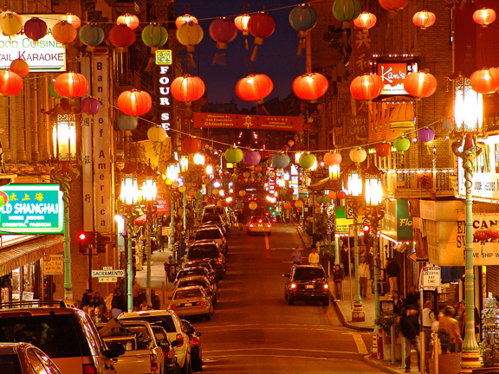
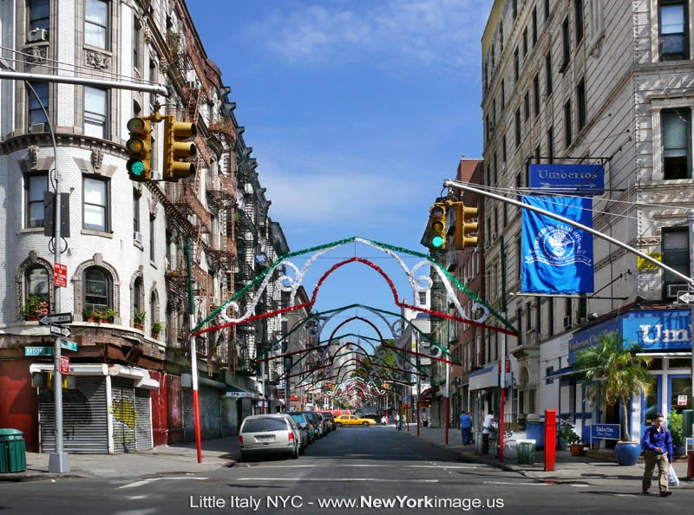
How did they live?
Most immigrants during the Gilded-Age, like their predecessors, lived in ethnic enclaves whenever they could. In these ghettos, they could speak their own languages, worship and live with familiar rituals, and recreate a version of the world they left. The Chinese for example, were confined in parts of cities that came to be called ‘Chinatowns’ as early as 1857. In the Gilded Age, as the Chinese moved East, Chinatowns sprang up in places such as Butte, Montana, as well as in NY, SF, Boston, and other cities. Enclaves for Europeans developed as well, with names like “Kleindeutschland” for Germans and “Little Italy” for Italians and Sicilians.
Chinatown (SF, CA)
Little Italy (NYC, NY)
Migration and Immigration

Slide 24
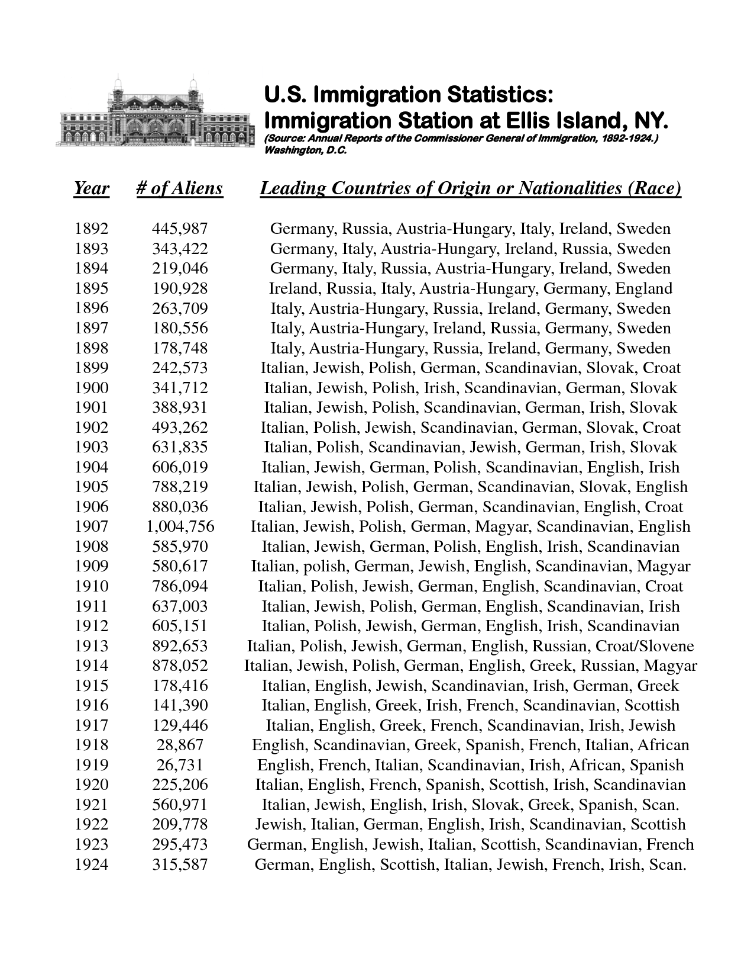
Ellis Island (New York)
People from which countries came in the highest numbers over this 32-year span?
Why was there such a decrease in immigrants in 1918?
Migration and Immigration

Slide 25
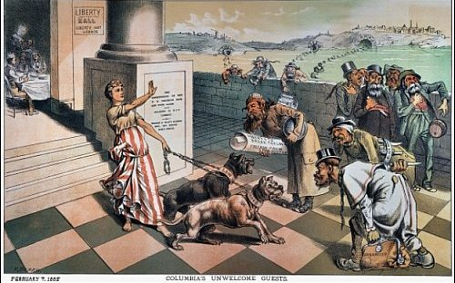
Compare and contrast the following two political cartoons…

Slide 26
Compare and contrast the following two political cartoons…

