Slide 2
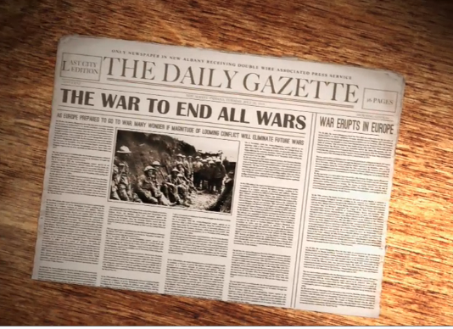
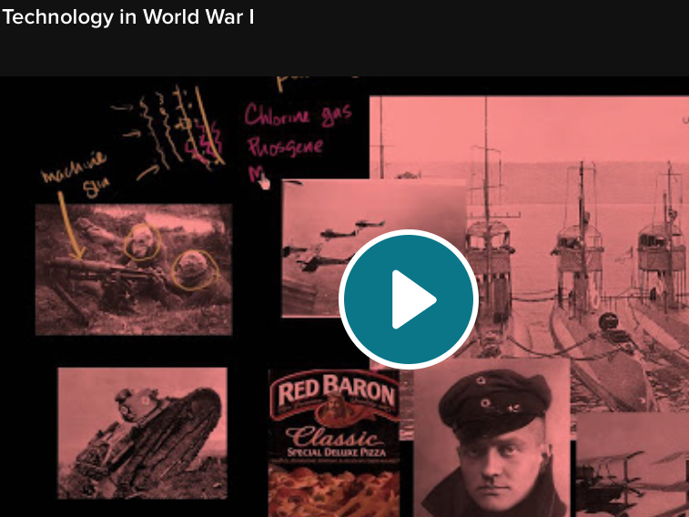
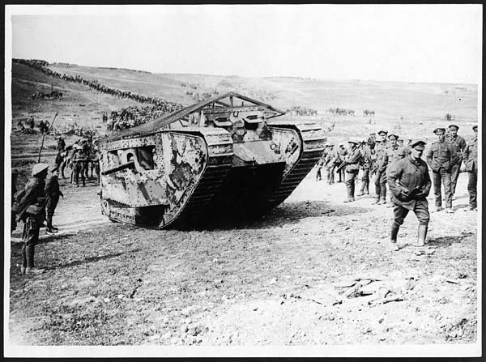
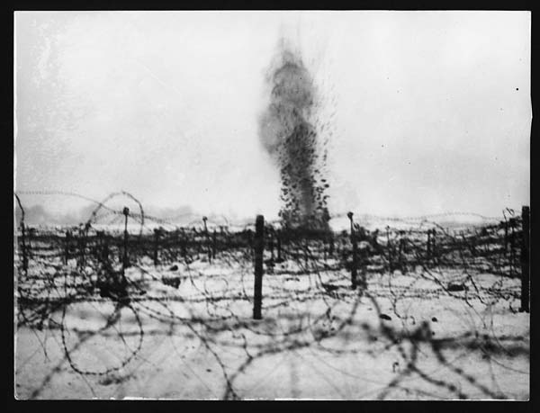
Watch the video
Watch the video
1914-1918
First man-made catastrophe of the 20th century
17 million people were killed, more than any other war in history
New technologies and weapons the world had never seen
Scientists and inventors worked tirelessly to improve current technologies/weapons and to invent more powerful ones
Notes:
**Click the video. The link takes you to History Channel at www.history.com/topics/world-war-i/world-war-i-history/videos/bet-you-didnt-know-world-war-i?m=528e394da93ae&s=undefined&f=1&free=false
It gives an overview of WWI.
**Click on the second video. The link takes you to Kahn Academy at www.khanacademy.org/humanities/history/euro-hist/world-war-I-fighting/v/technology-in-world-war-I
It is about the new weapons and technology of WWI.

Slide 3
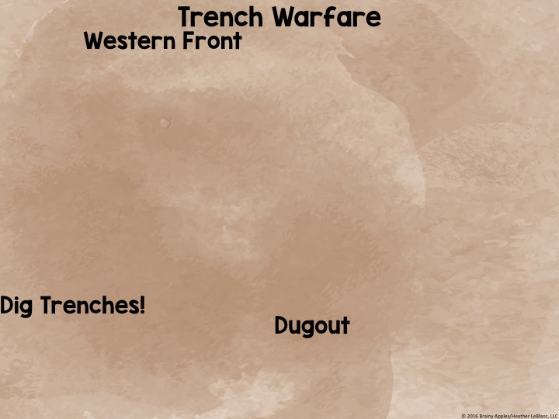
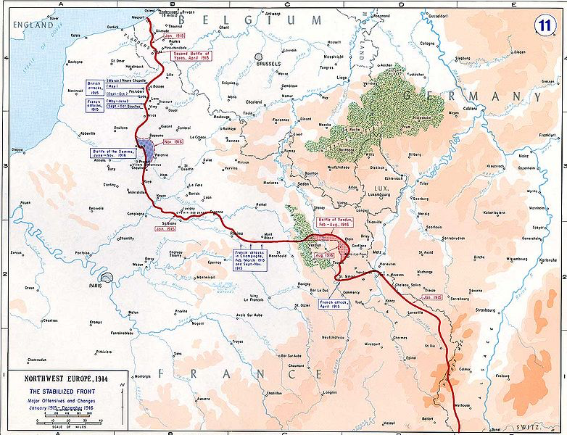
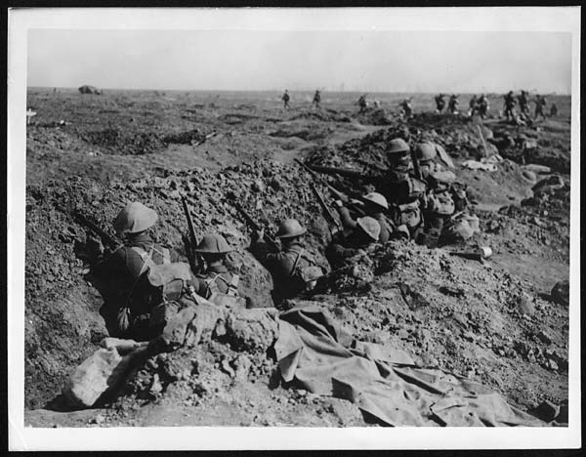
Location of most battles
Bordered France, Belgium, and Germany
Landscape here was very flat → European Plain
No natural protection from enemy fire
Dug trenches to protect themselves from enemy gunfire and artillery
protective hole dug into the ground

Slide 4
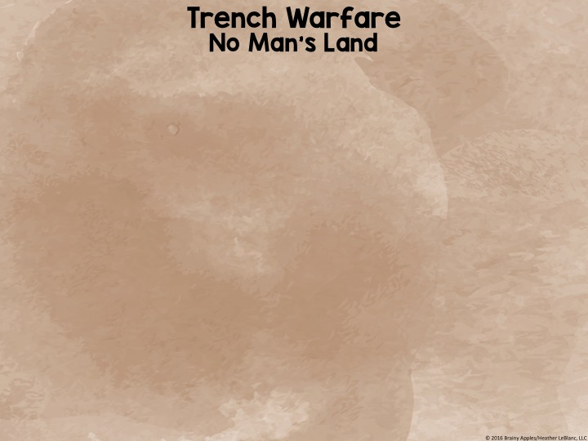
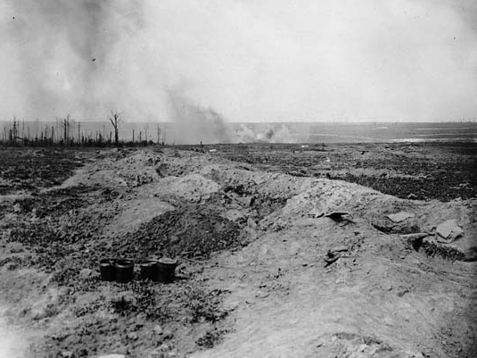
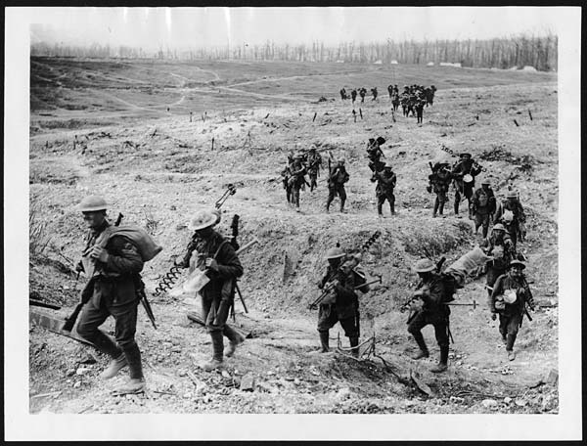
Area between trenches
No protection from enemy fire
Barbed wire, huge craters
Try to cross = almost certain death
Setting up barbed wire was a dangerous job.
The land was reduced to a barren field.

Slide 5
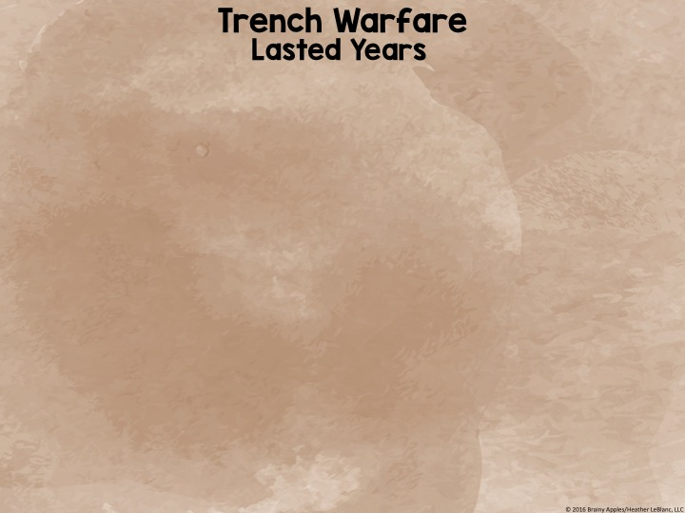
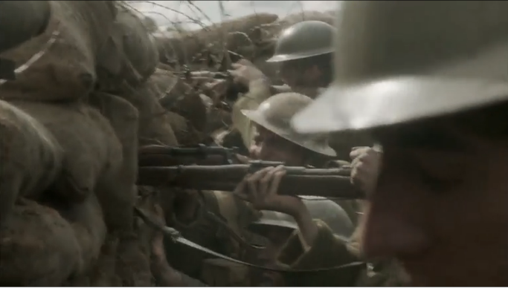
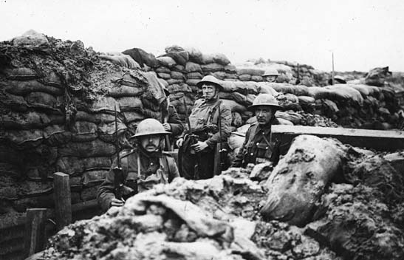
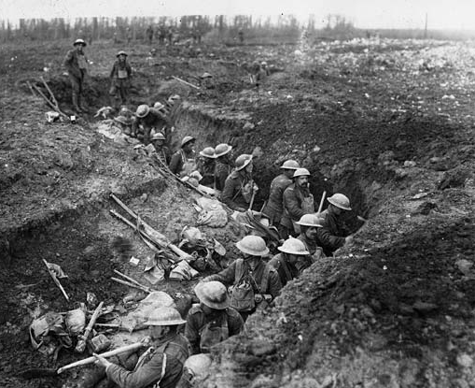
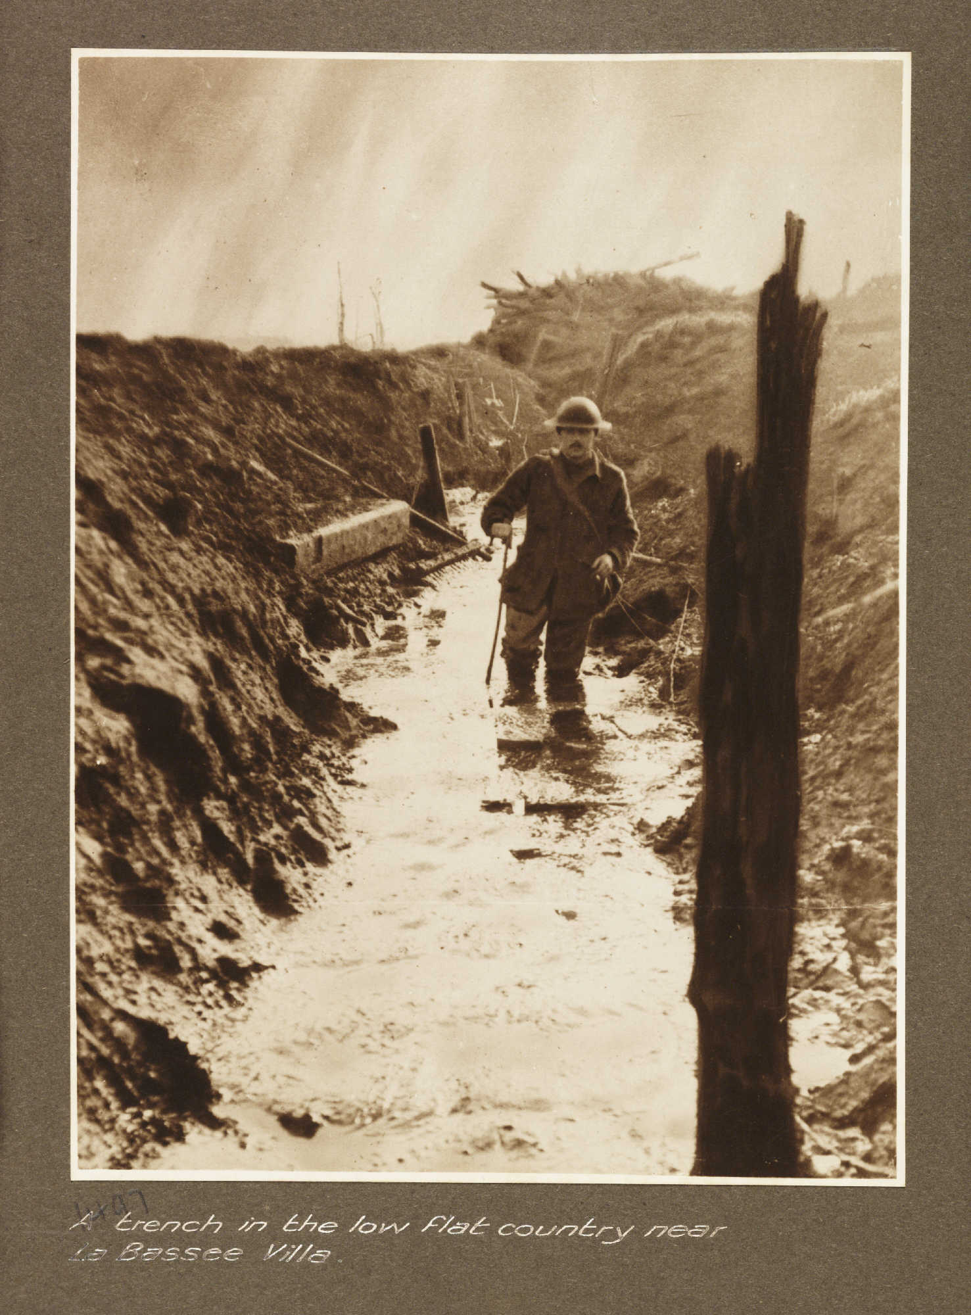
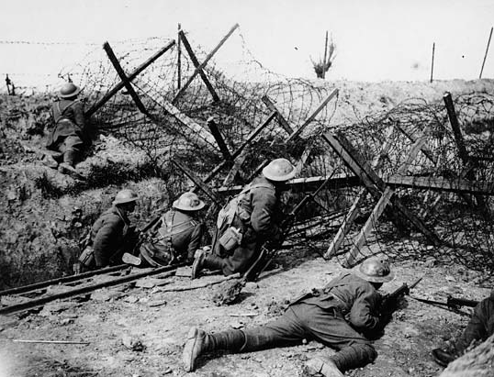
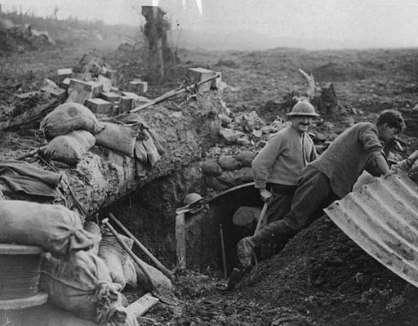
Watch the video
Neither side could advance → stalemate
Millions of soldiers were killed
Notes:
**Click on the video. The link takes your to History Channel at www.history.com/topics/world-war-i/world-war-i-history/videos/life-in-a-trench?m=528e394da93ae&s=undefined&f=1&free=falsefor
It is about life in the trenches.

Slide 6
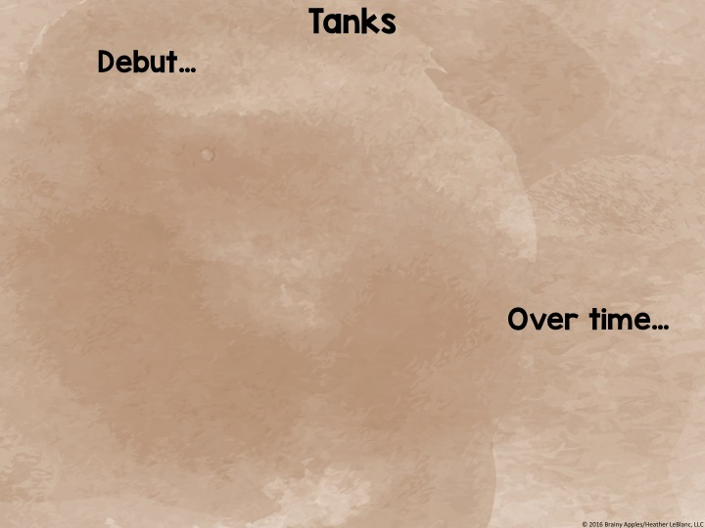
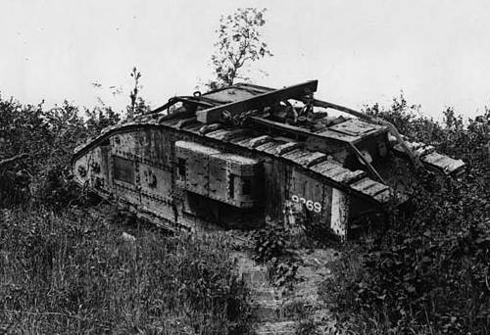
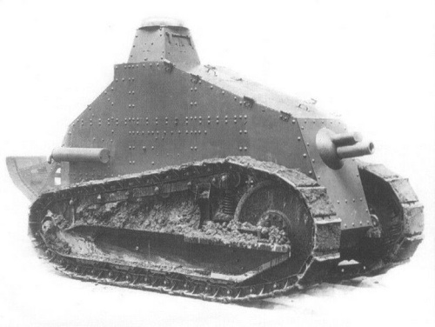
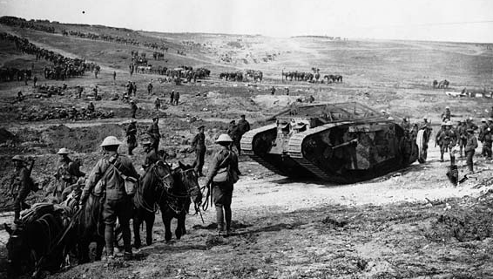
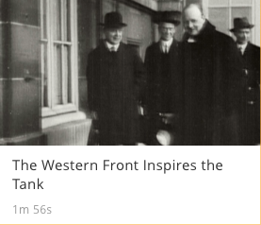
September 1916
Used by Allies
Very hard to steer
Unreliable → broke down on battlefield
Watch the video
Became very effective
Used regularly in battle
Helped break through German front lines
Notes:
**Click on the video. The link takes you to History Channel at www.history.com/shows/wwi-the-first-modern-war/season-1/episode-1/the-western-front-inspires-the-tank
It is a short clip on how ineffective tanks first were to how they became very helpful in fighting the war.

Slide 7
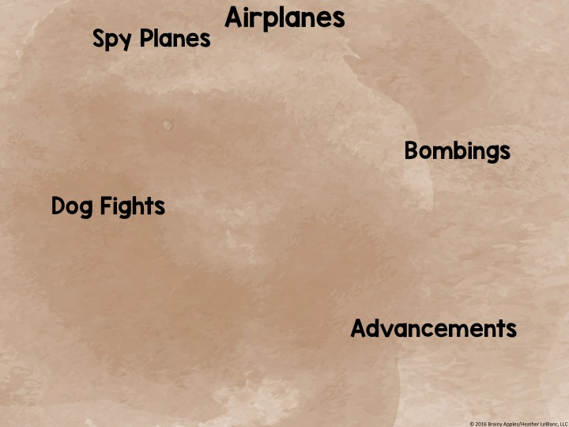
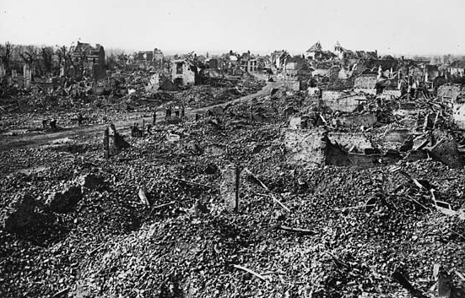
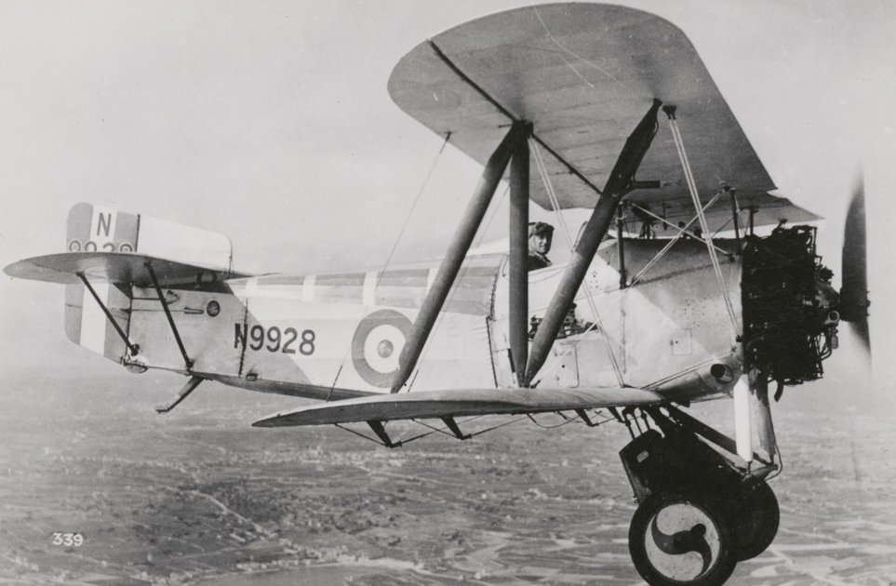
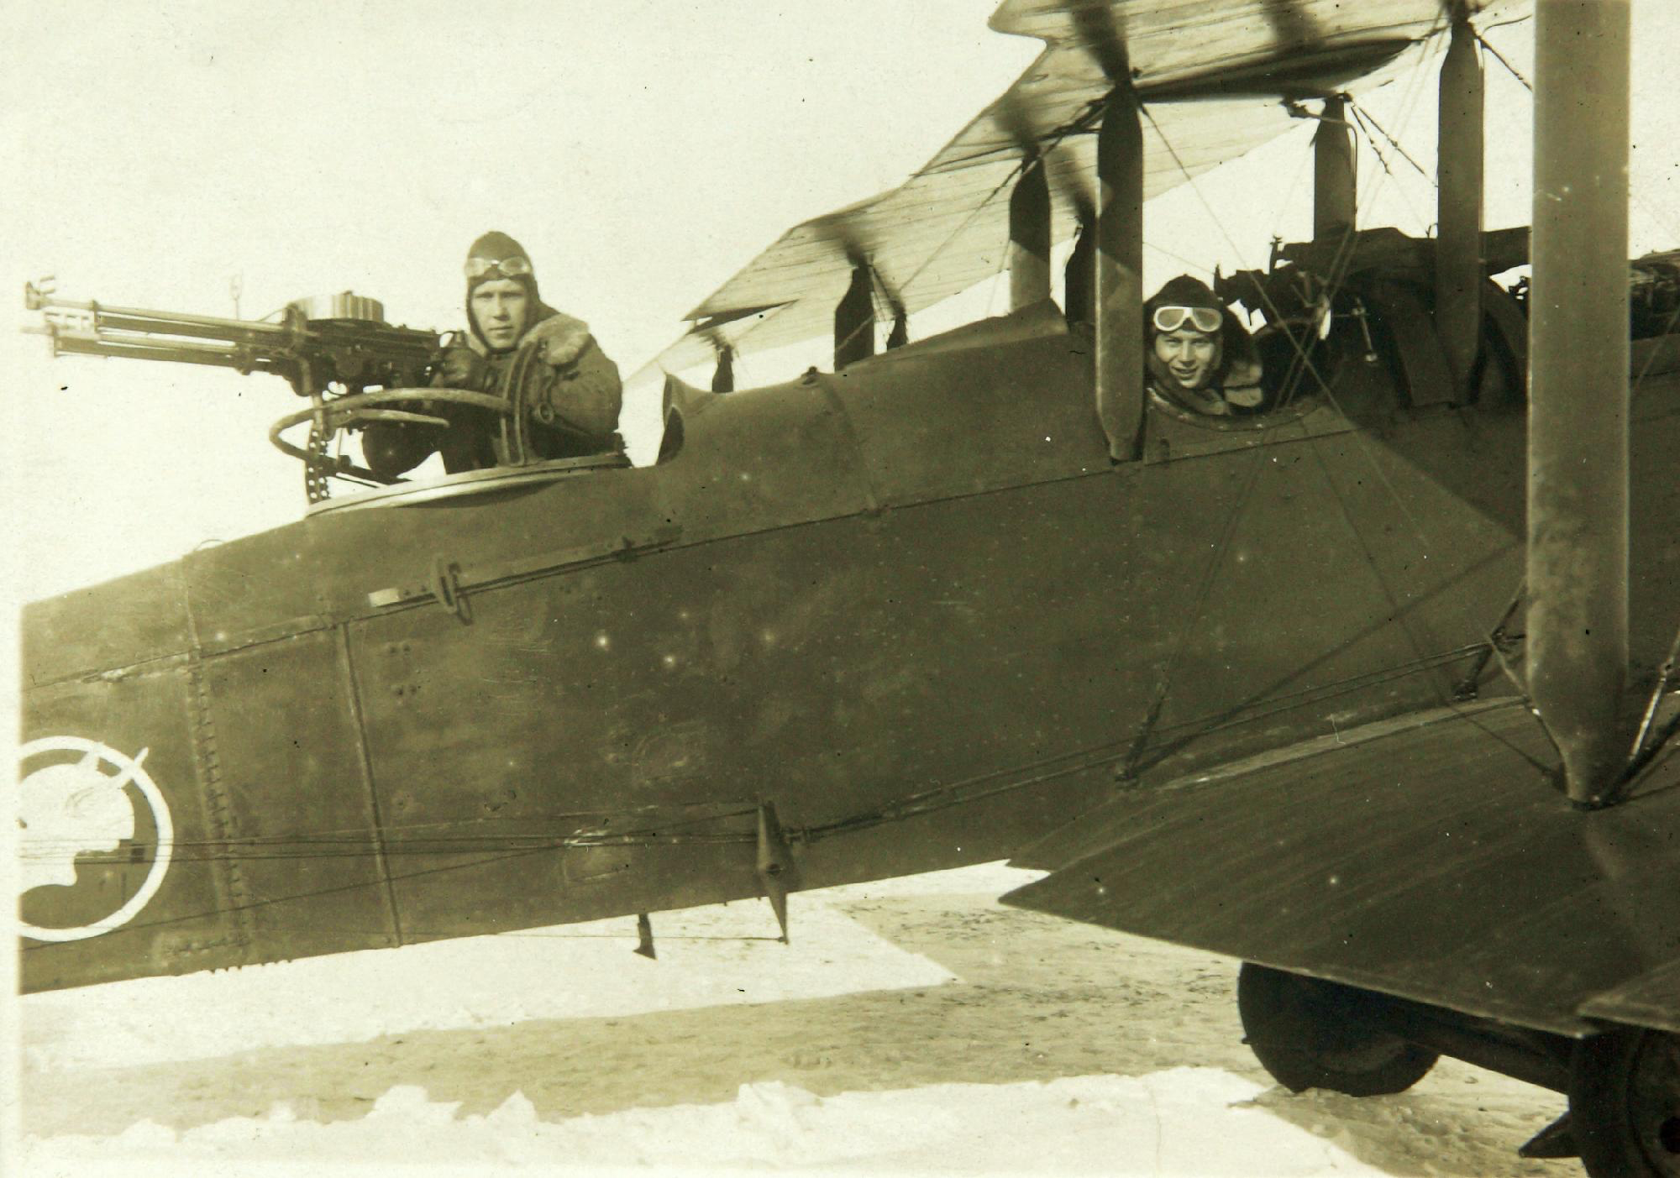
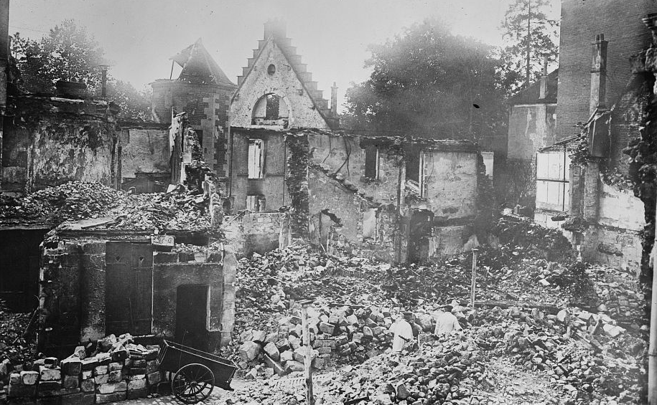
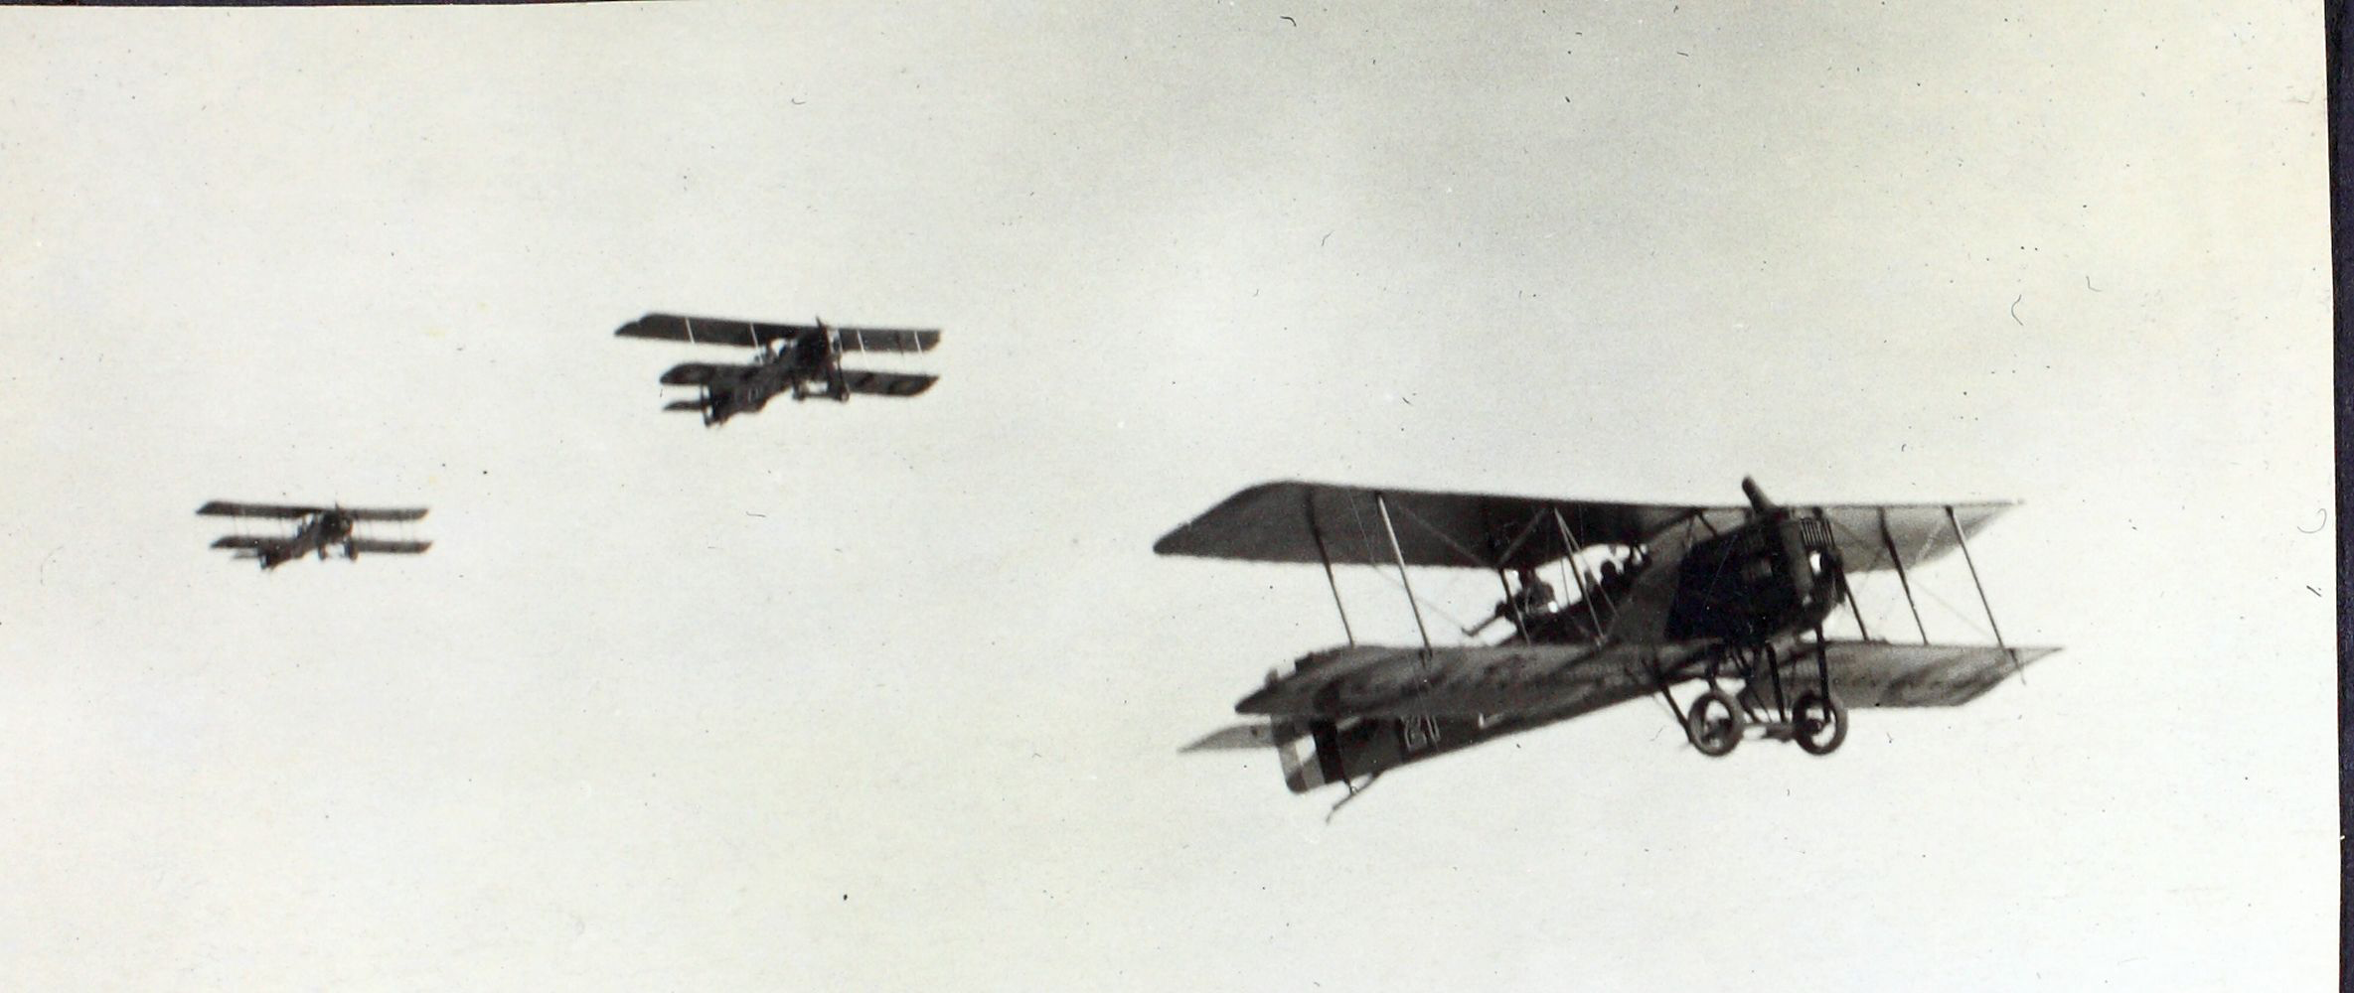
Collect intelligence about the enemy
Dropped bombs and cities and troops
Machine guns were mounted on the planes
Enemy planes would fight each other in the air
Allied and Central Powers wanted airplanes that were fast, easier to maneuver, and stronger
Better airplanes = more success

Slide 8
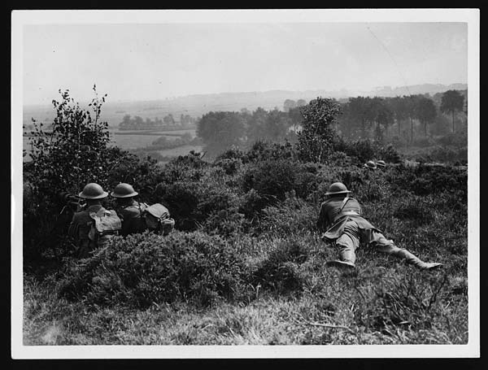
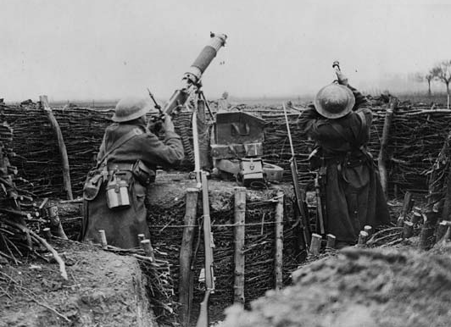
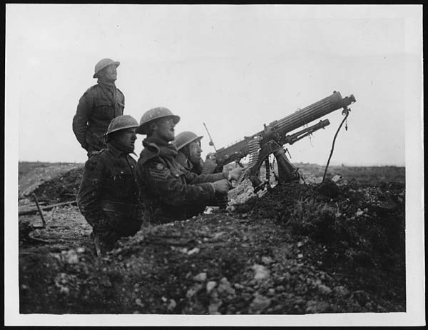
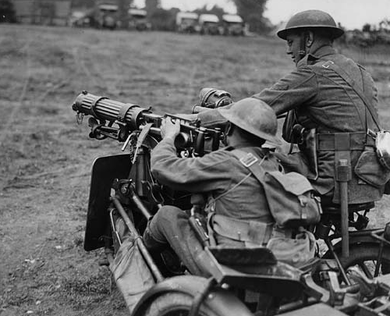
Invented by British
500 bullets per minute
6 men to operate it
Very effective
Placed along Western Front to defend against the enemy

Slide 9
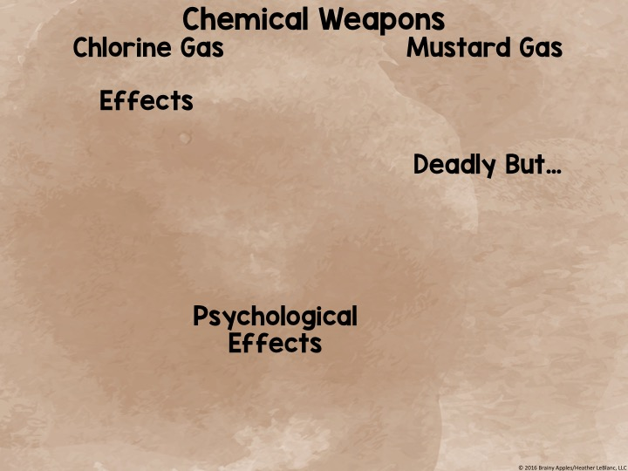
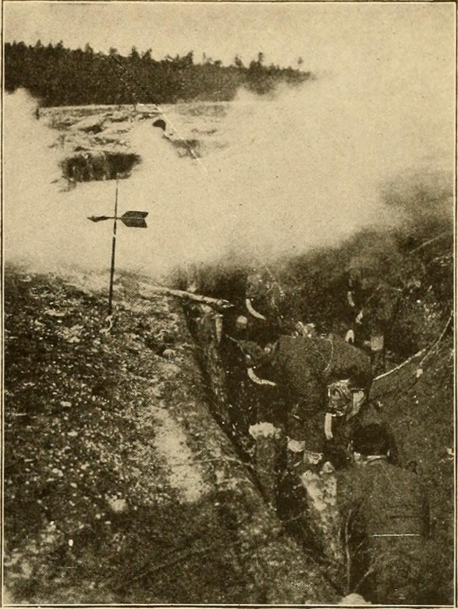
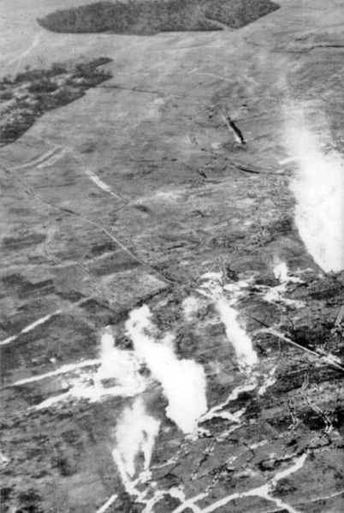
First used by Germans in 1915
Used by Allied and Central Powers
Could take up to 12 hours to take effect
Death could take 5 weeks!
Affect eyesight → cause blindness
Affect lungs → cause suffocation
Affect skin → cause rashes and burning
Affect nose → cause burning
Gases were largely ineffective
Why? Weather conditions & how it was delivered
Wind changes = kill own troops
Soldiers spent much of their days worrying about and guarding against this terrifying death
© 2016 Brainy Apples/Heather LeBlanc, LLC

Slide 10
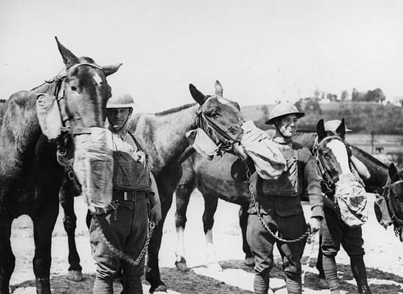
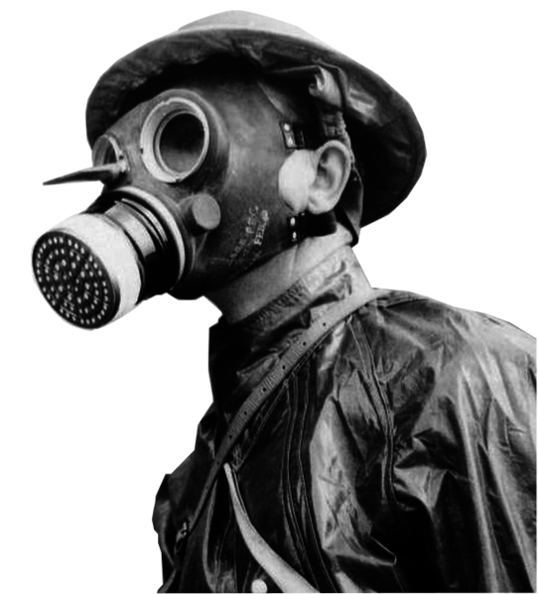
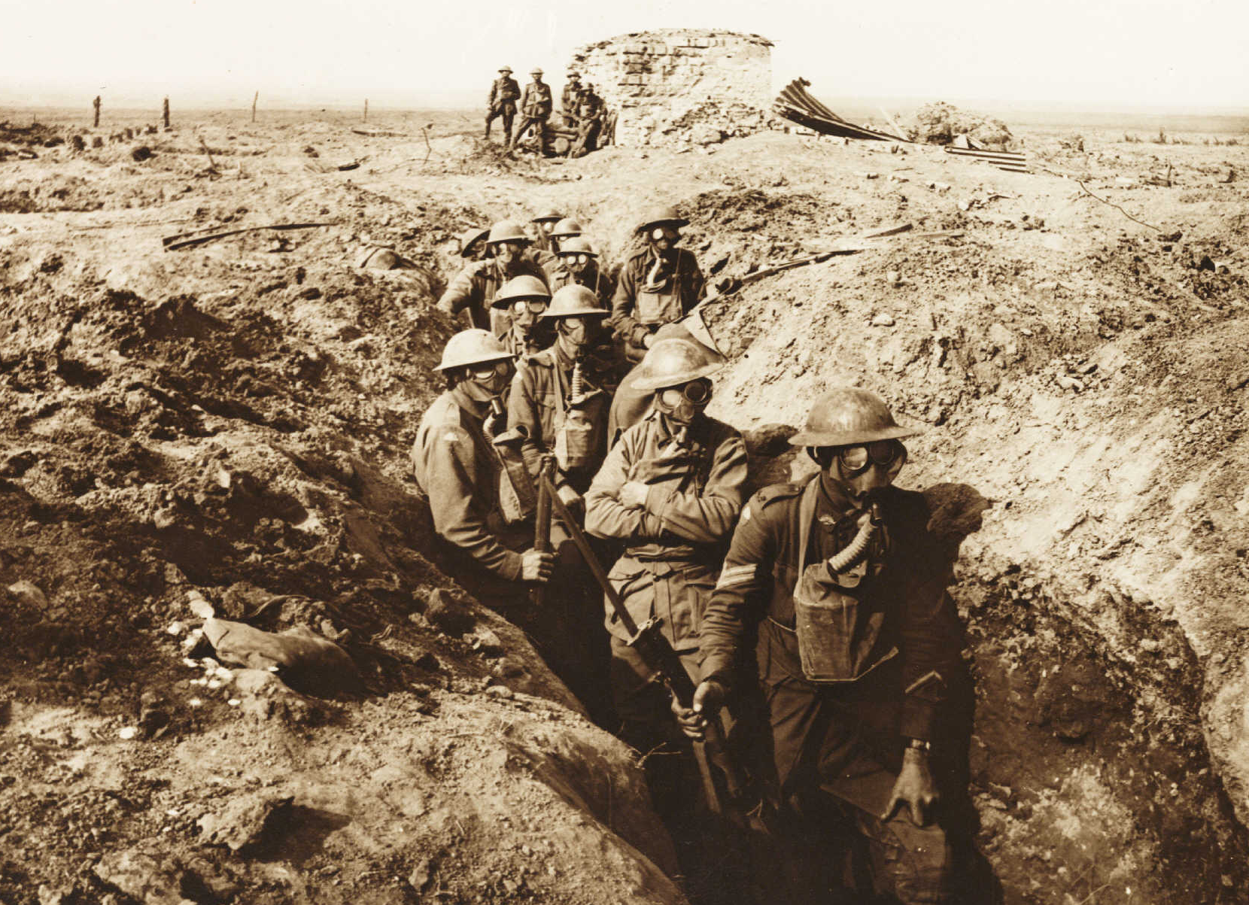
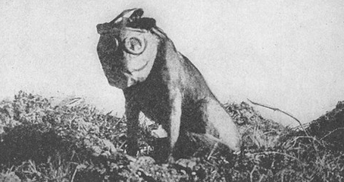
Made chemical weapons almost useless
Horses, mules, and dogs wore gas masks to stay protected

Slide 11
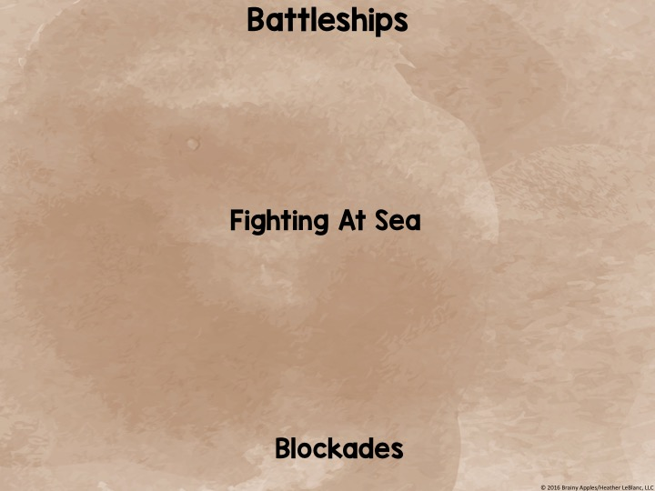
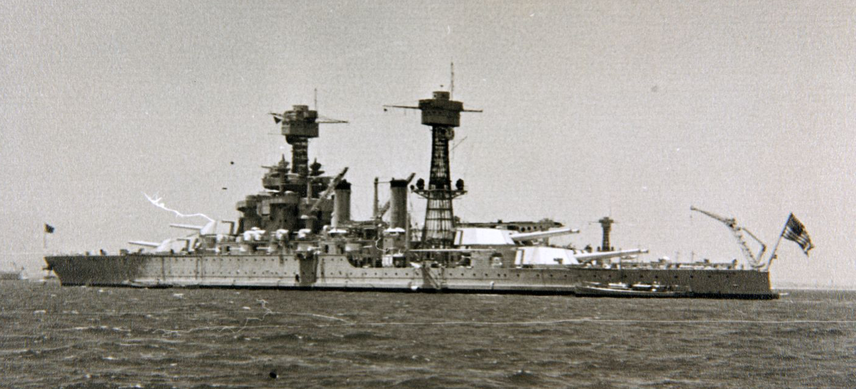
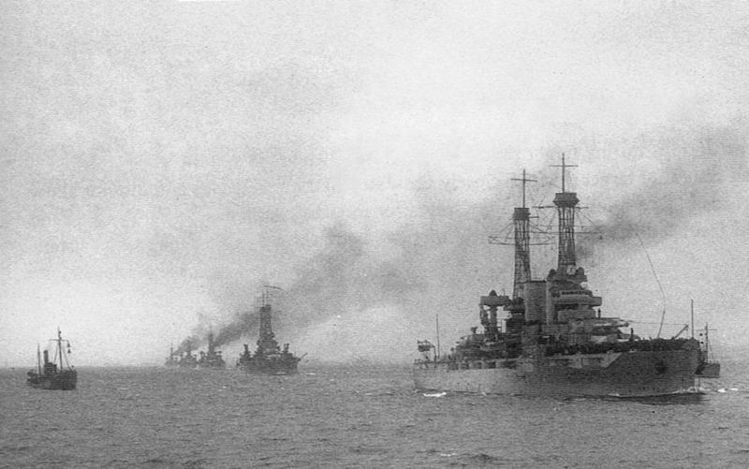
Had long-range guns
Attack other ships and land targets from safe distances
Allies prevented supplies and food from reaching Germany
© 2016 Brainy Apples/Heather LeBlanc, LLC

Slide 12
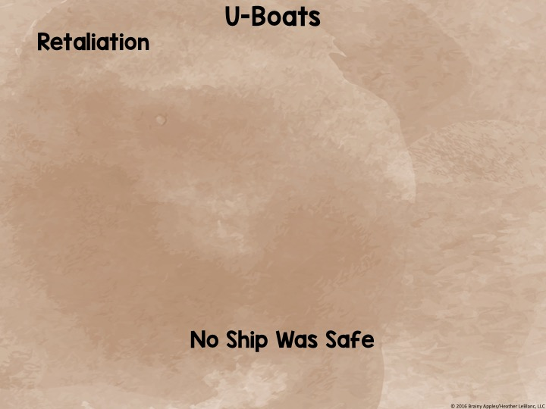
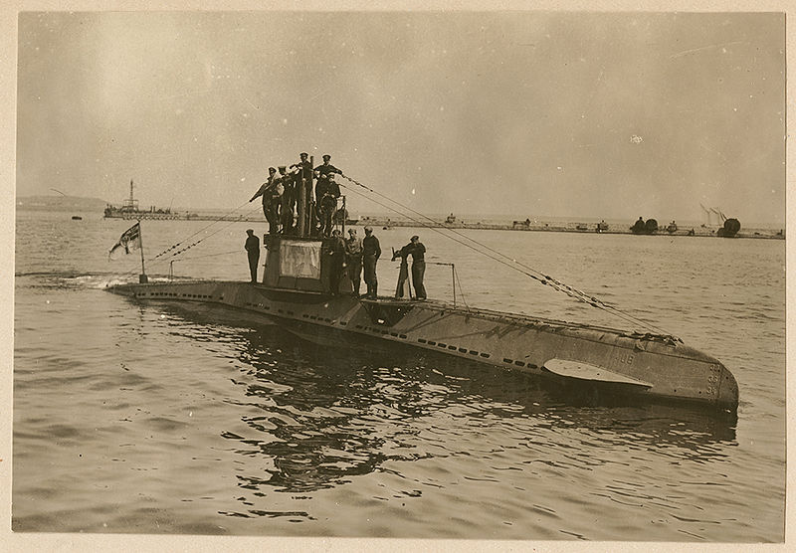
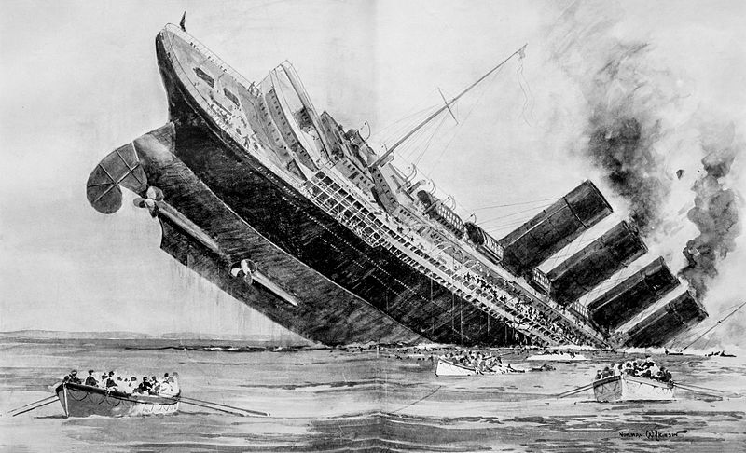
Used by Germans
Submarines
Sneak up on Allies and attack with torpedoes
Germans also attacked Allied passenger (non-military) ships
Sinking of Lusitania → British passenger ship → about 1,200 on board and killed (128 Americans) → Major reason US entered WWI
© 2016 Brainy Apples/Heather LeBlanc, LLC

