Slide 1

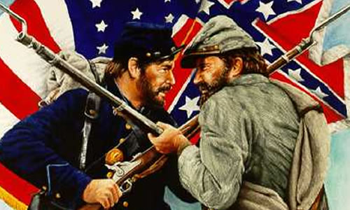
When you see the pencil appear, fill in the information in red on your info-graphic guided notes page.

Slide 2
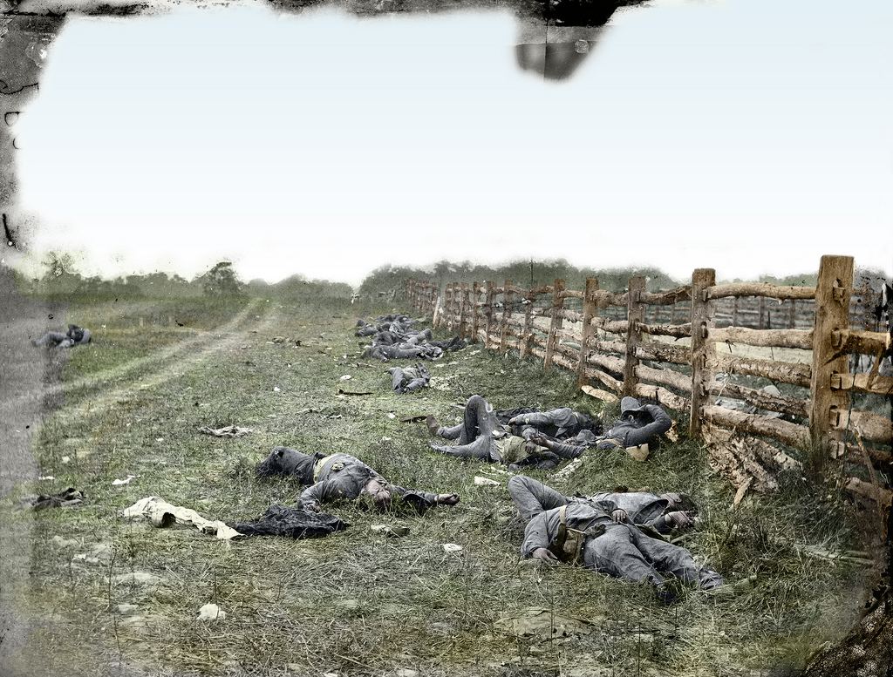
When Confederate soldiers fired upon U.S. troops stationed at Fort Sumter in South Carolina in April of 1861, both sides knew a war had begun.
But both sides were confident that their side would quickly be victorious. Most Americans assumed the war would last no more than 90 days.
After the First Battle of Bull Run, both the Union and Confederate armies realized this war would be much longer and far more devastating than they anticipated.
As more battles were fought, the strengths and weaknesses of both armies became obvious.

Slide 3
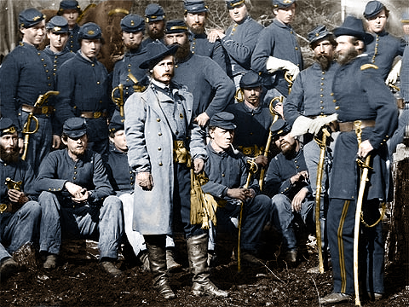

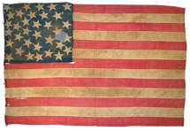



Population
22 Million overall
4 Million men ages 15-40

Slide 4
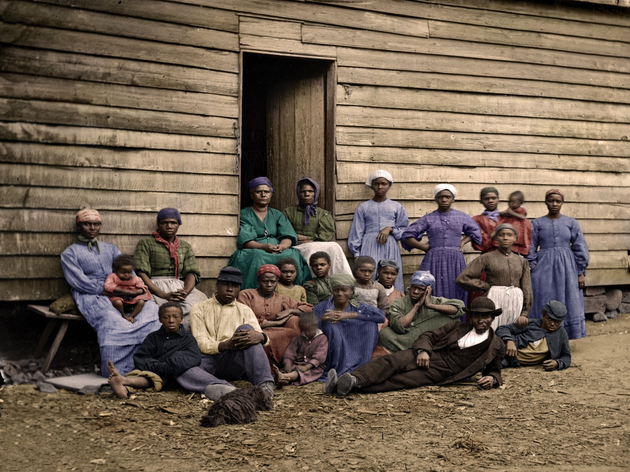
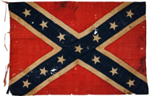
Population
9 Million overall
1.2 Million white men ages 15-40

Slide 5
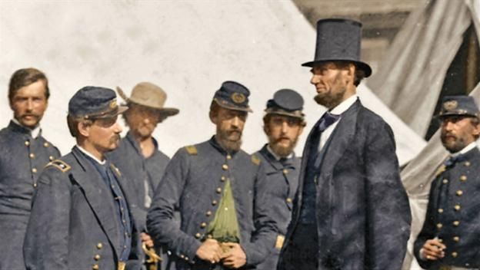
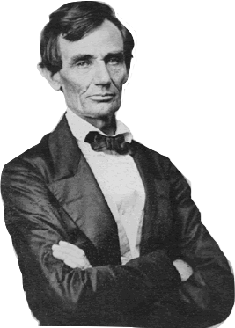
Leadership
Lincoln acted with confidence.
Prevented border states from seceding.
Had a talent for managing men.

Slide 6
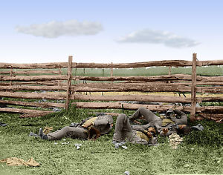
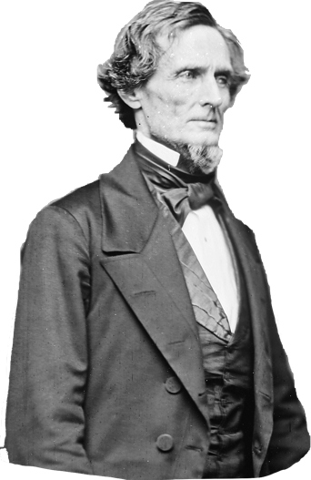
Leadership
Jefferson Davis didn’t have Lincoln’s energy & authority. Struggled to get the full support of all 11 Confederate states.

Slide 7
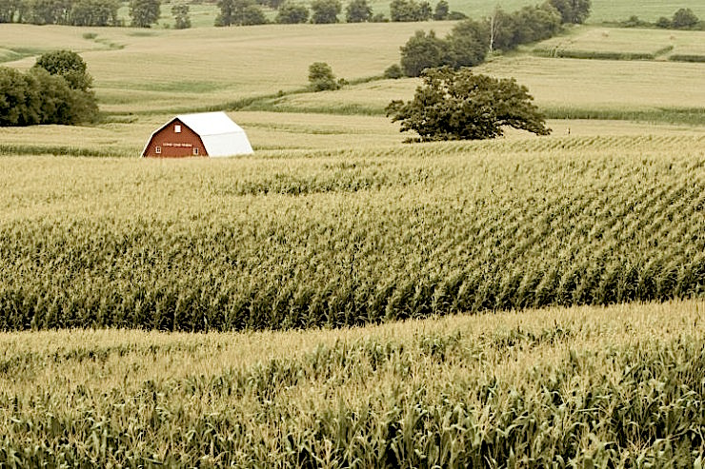
Food Production
65% of the nation’s farmland.
Could keep citizens and soldiers better fed.

Slide 8
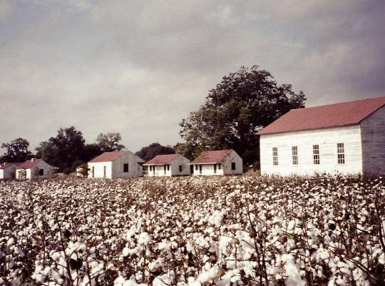
Food Production
35% of the nation’s farmland.
Southern soldiers lacked food.
Southern cities had bread riots.

Slide 9
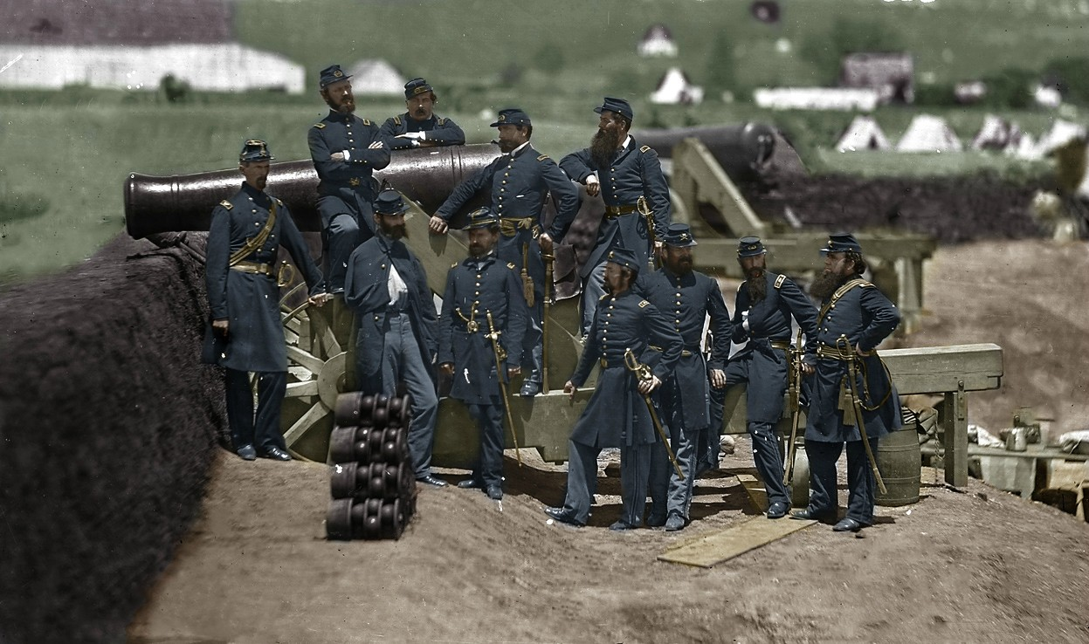
Iron & Steel Production
93% of the Nation’s Iron and Steel

Slide 10
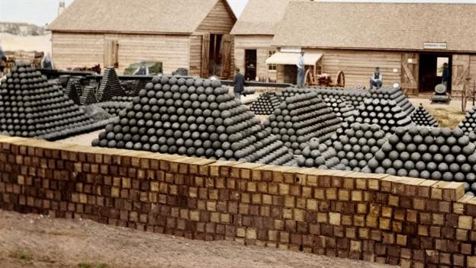
Iron & Steel Production
7% of the nation’s iron and steel

Slide 11
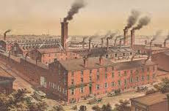
Factories
Large cities with factories
More workers to make weapons, ammunition, uniforms, etc.
Produced 5,000 rifles a day

Slide 12
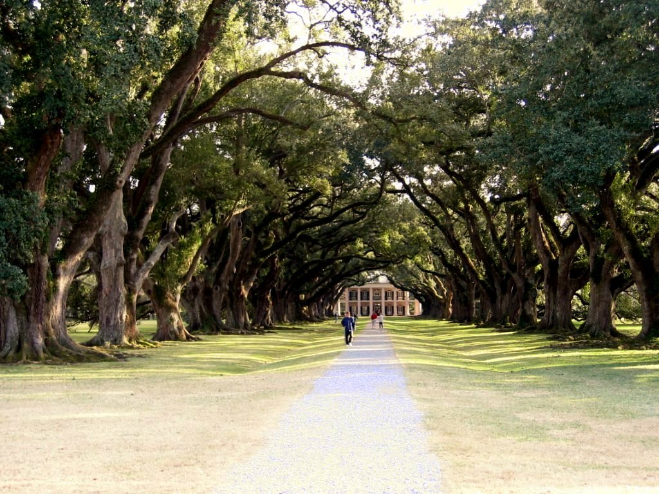
Factories
Few factories and workers.
Confederate soldiers lacked clothing and supplies.
Produced 300 rifles a day.

Slide 13
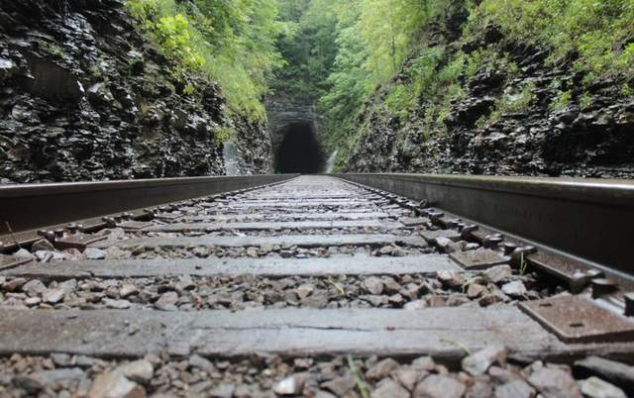
Railroad Mileage
Extensive rail system
Could move soldiers & supplies wherever needed.

Slide 14
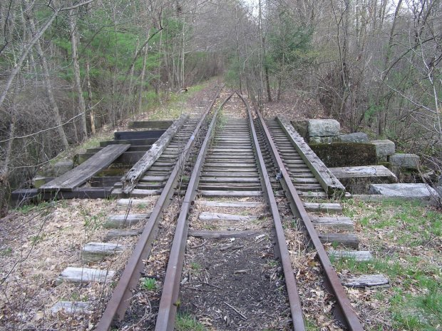
Railroad Mileage
Had access to 28% of the nation’s railroads

Slide 15
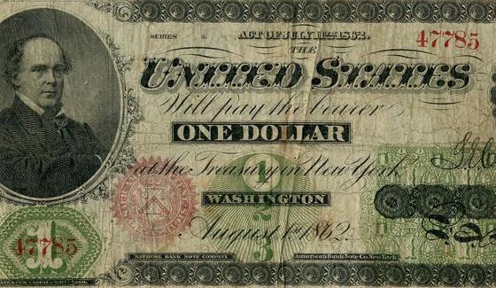
Economy
Strong banking system
Controlled 70% of the nation’s wealth
Used income tax to raise money

Slide 16
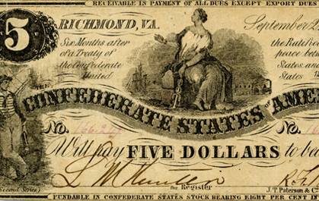
Economy
Controlled 30% of the nation’s economy
Some states resisted taxation
High Inflation- paper money worthless

Slide 17
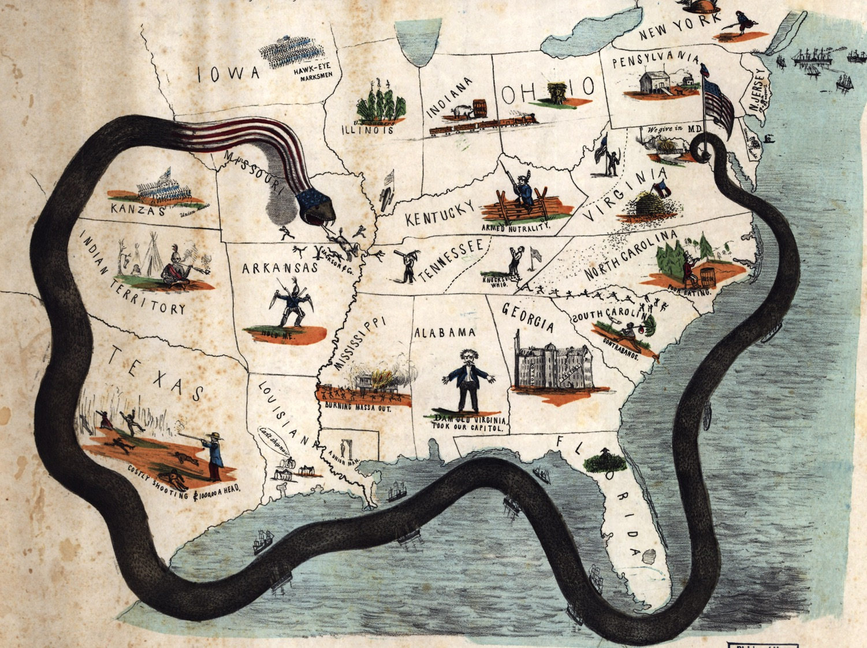
Naval Power
Union had the established Navy
Used the “Anaconda Plan” to create a blockade disrupting the South’s trade

Slide 18
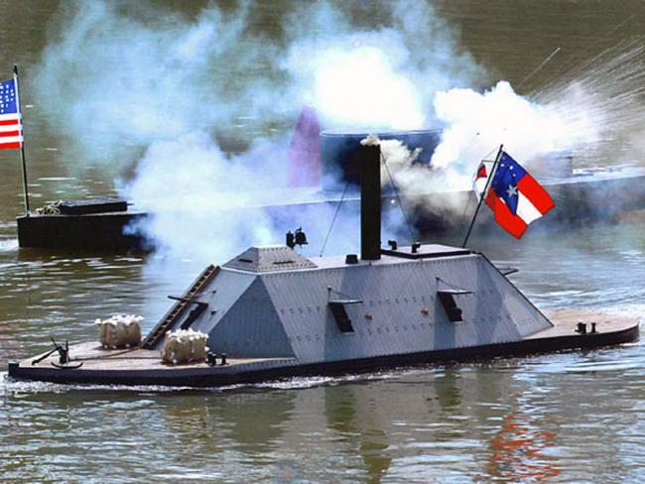
Naval Power
Had few warships
Could not break the North’s naval blockade.

Slide 19
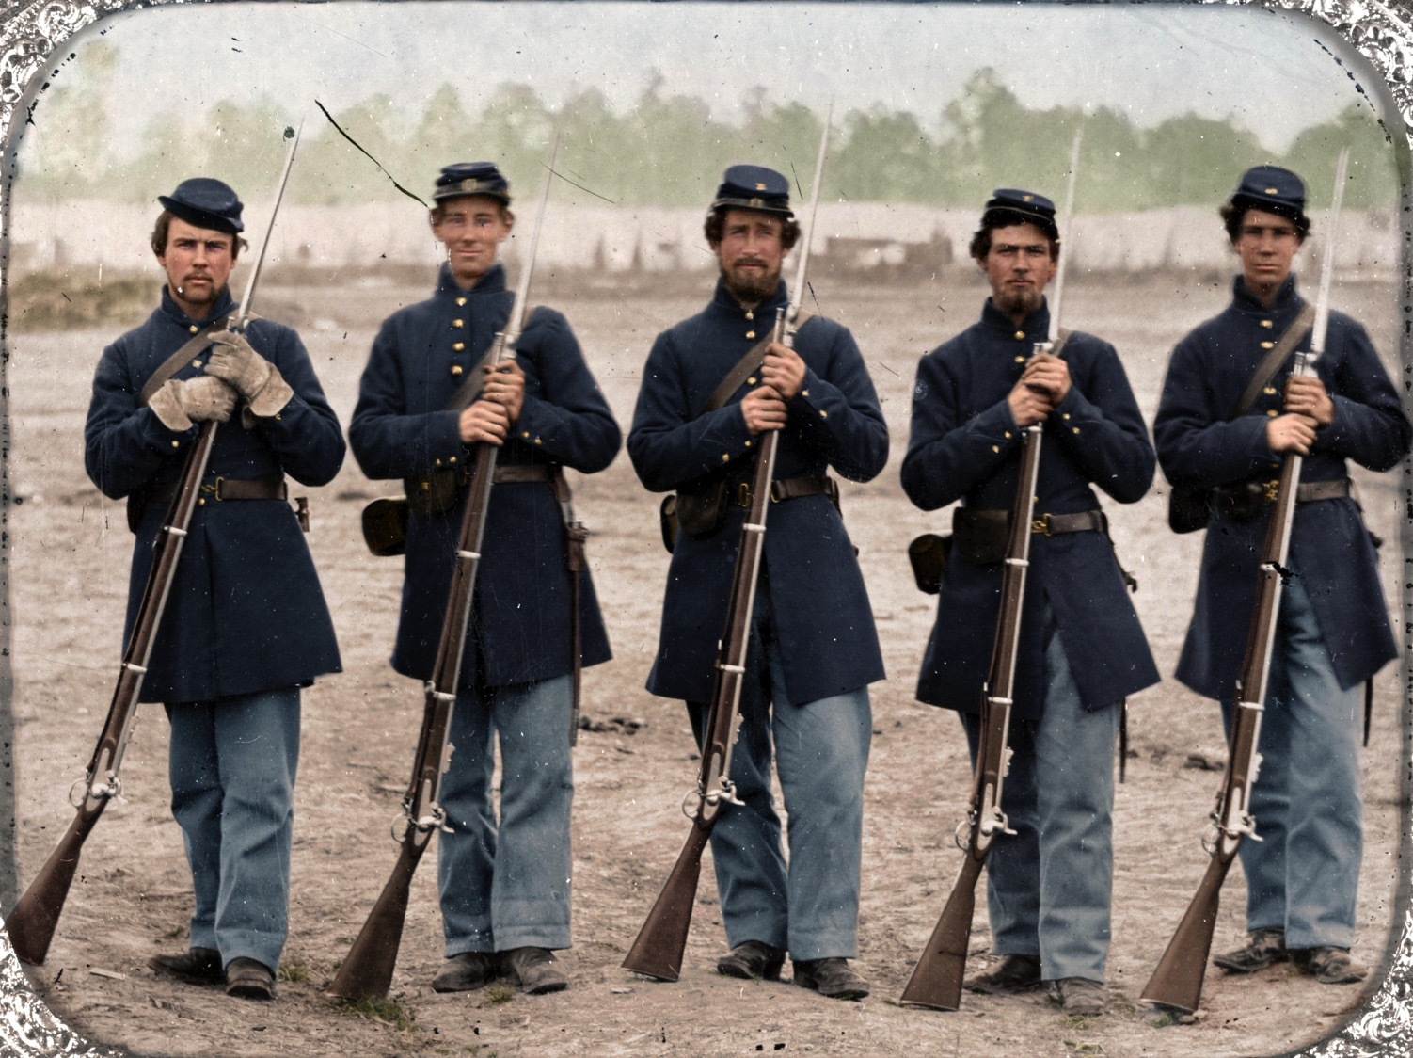
Military
Few experienced officers
Most soldiers were from cities and lacked training.

Slide 20
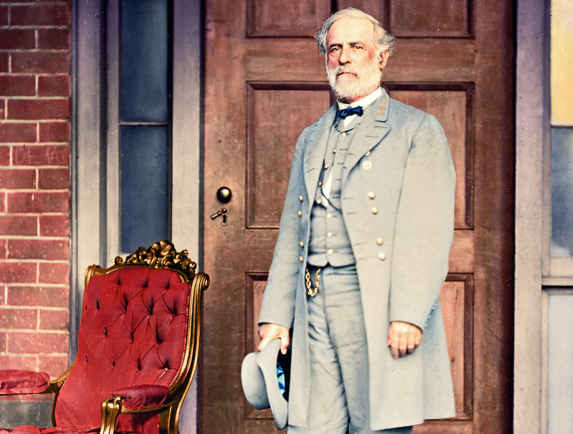
Military
Most skilled officers joined the Confederate army.
Southern soldiers were better trained and familiar with horses and guns.

Slide 21
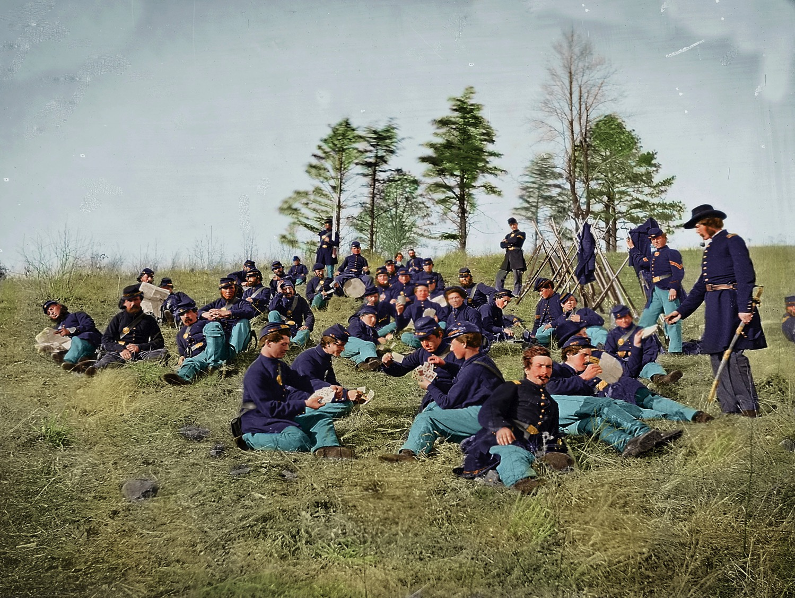
Familiarity with the Land
Most battles were fought in the South.
Were not familiar with the land.

Slide 22
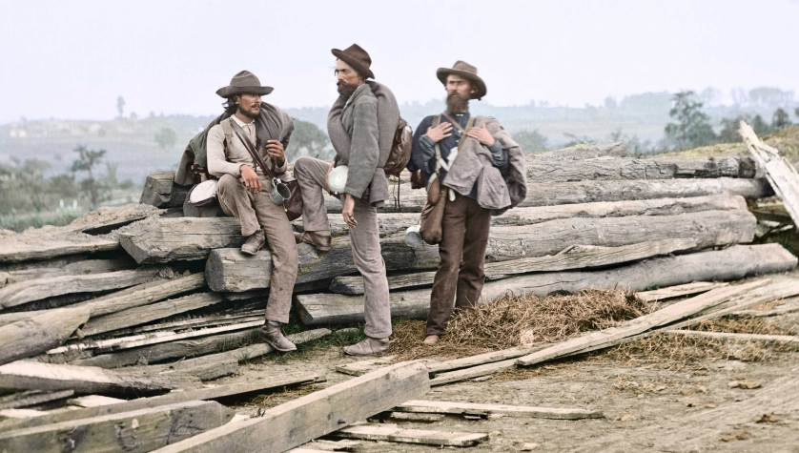
Familiarity with the Land
Knew the land well.
Were fighting to defend their homes.

Slide 23
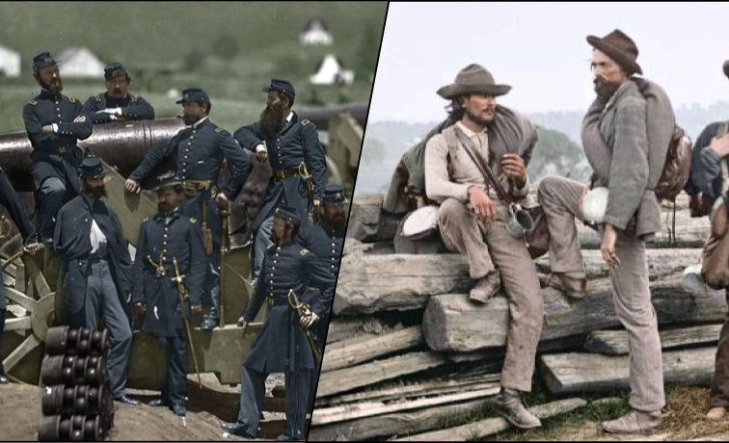
TOTAL POINTS
24
12
While the Union army had twice the advantage, the Confederacy made up for it in determination and tenacity. The South was not going to give up easily.

