Slide 1
Nuremberg Trial Simulation
Court Briefs

Slide 3
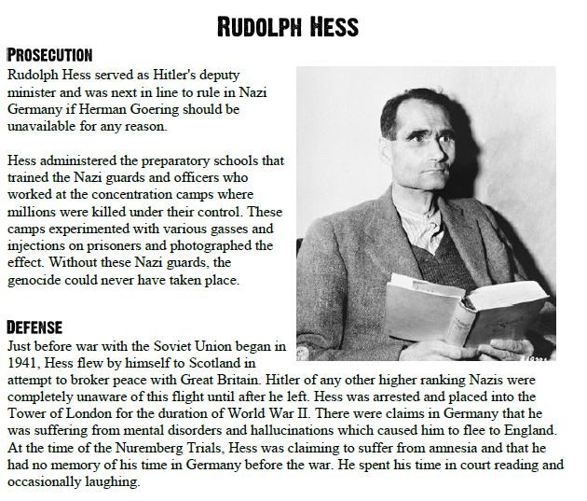

Slide 5
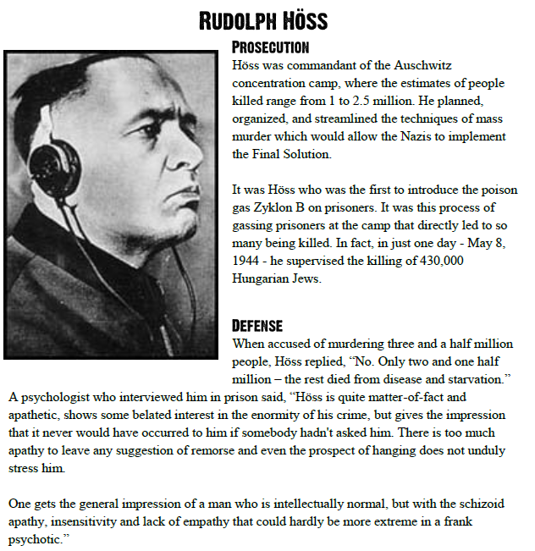

Slide 6
