Slide 1
Progressive Era Mind Map
Instructions & Resources

Slide 2
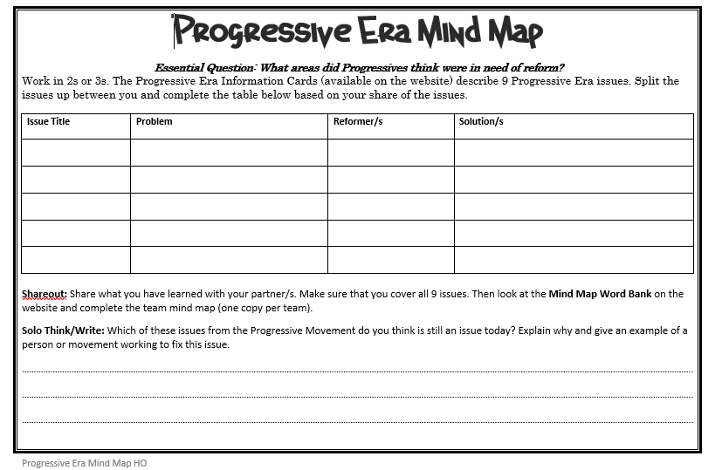
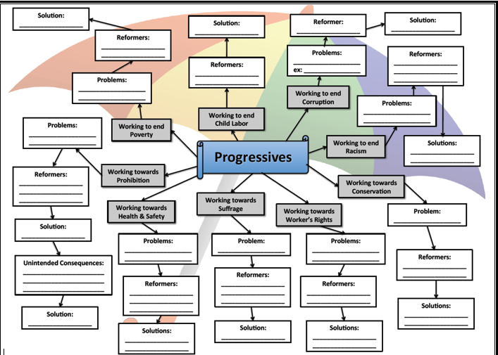
Activity Agenda
In pairs, split the Information Cards between you and complete the table on page 1 of your white worksheet (one white worksheet each).
Share what you have learned with your partner: Issue title, Problem, Reformer/s, Solution/s.
Complete the yellow Mind Map (one per pair).
Complete the Solo Think/Write on the bottom of page 1 of your white sheet.
Complete the Personal Social Issue Mind Map on page 2 of your white sheet.
Staple both white sheets behind the yellow sheet to hand in.

Slide 3
EQ: What areas did Progressives think were in need of reform?
Work in pairs.
You will need a computer each, so your elbow partner is best.
Pick up a Progressive Era Mind Map Handout – one per person.
Navigate to Ch4.1 Activity 3 Progressive Era Mind Map

Slide 4
Progressive Era Information Cards
Open the PDF – everyone has to be at his/her own computer.
There are 9 issues to research. Split them up between your team.
Complete the table on your worksheet – only your share of the issues.

Slide 5
Share Out
Share what you have learned with your partner/s. Make sure that you cover all 9 issues.
Pay close attention to your team – you’ll need this information to complete the team’s mind map.
Issue title
Problem
Reformer/s
Solution/s

Slide 6
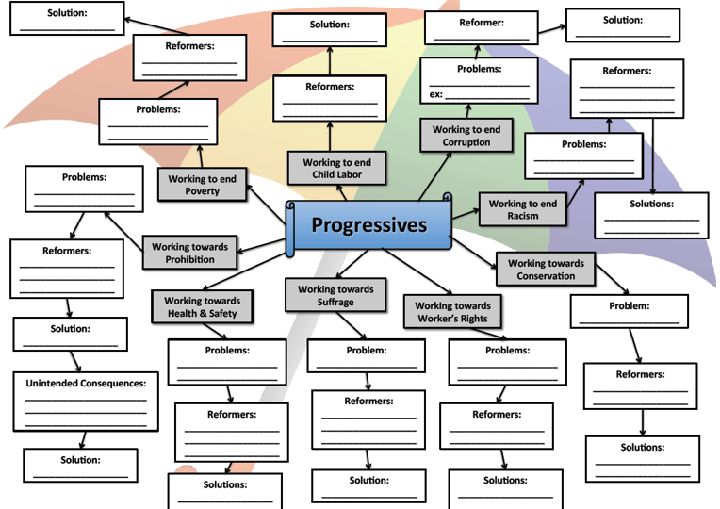
Team Progressive Era Mind Map
One member of each team – come down and pick up a Team Mind Map.
Use the Progressive Era Word Bank to complete the mind map.
Feel free to refer back to the Information cards.
Remember – only one map per team.

Slide 8
Solo Think/Write
Complete your write-up.

Slide 9
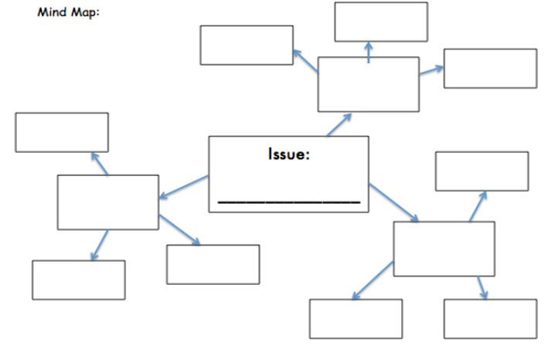
Personal Social Issue Mind Map
Using the issue in the Solo Think/Write that you have identified as most important to our society today, create your own mind map to identify the issue, problems caused by that issue, modern reformers working on this issue, and ideas or opinions about solutions.
Refer to the example on the website if you’re unsure about how to lay out your thoughts.

Slide 10
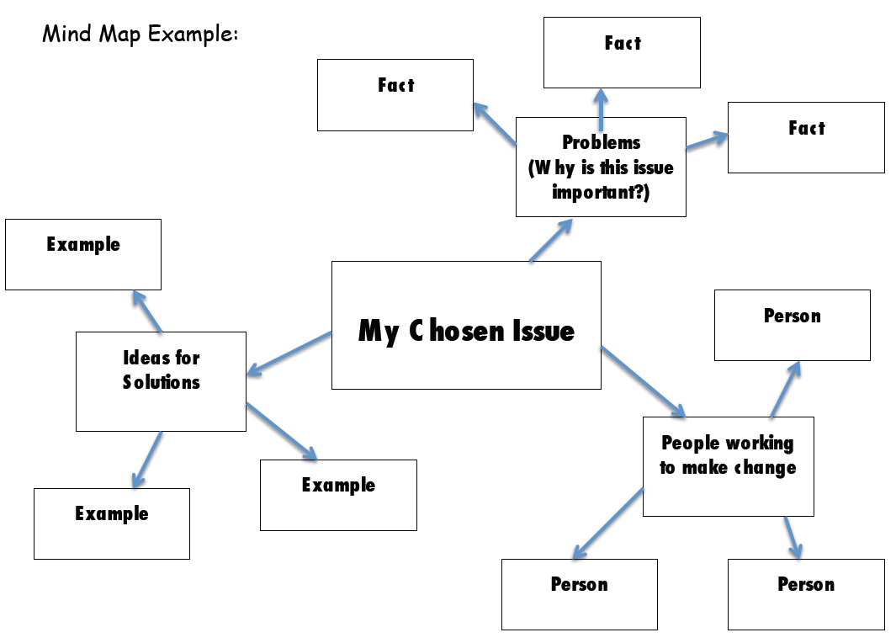

Slide 11
To hand in:
Please staple each team member’s sheet behind the team’s mind map. So the Team Mind Map is on top.
Make sure that everyone’s name is visible.

