Slide 1
Name:

Slide 2
Name:
Insert a pyramid shape and use the lines to segment it off. Create new text boxes to label.

Slide 3
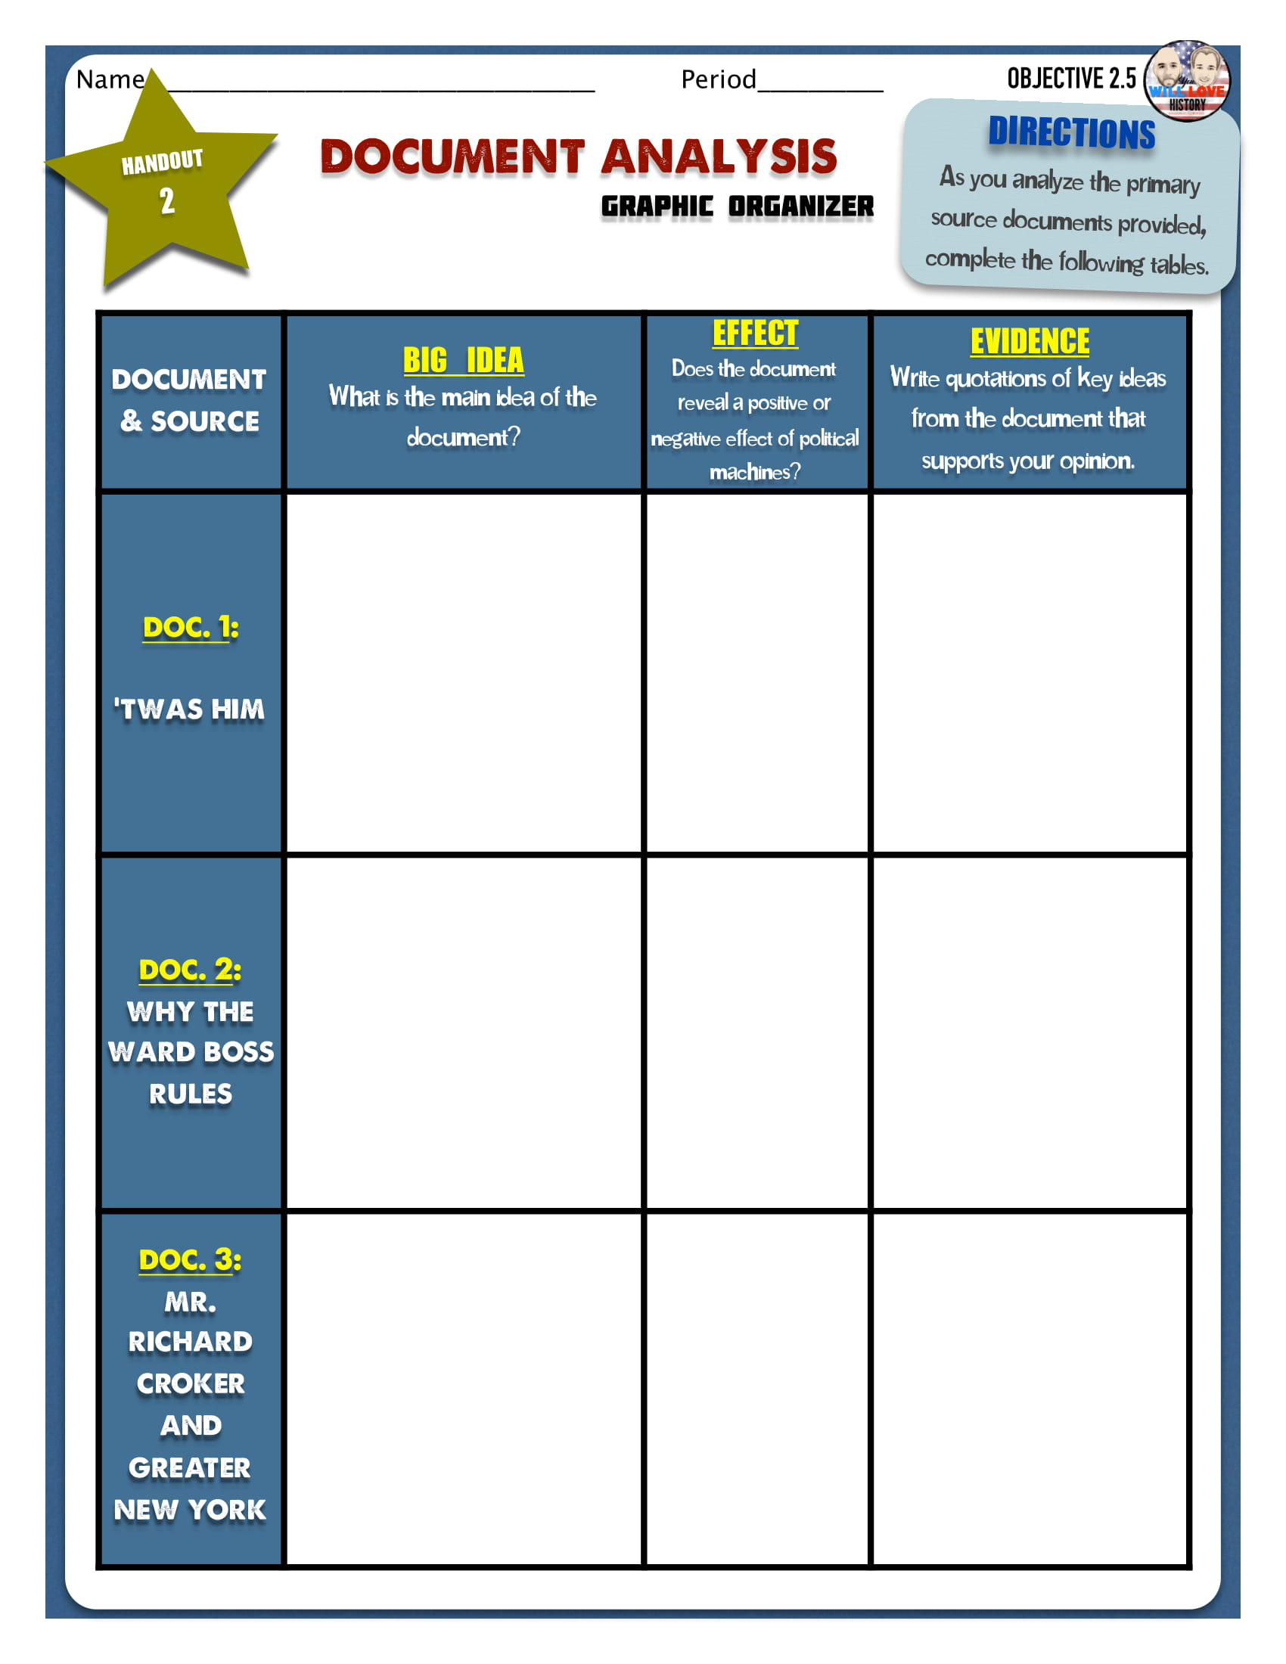
Name:

