Slide 1
Primary vs. Secondary Sources
How do I know which is which?

Slide 2
Primary Sources
a document or physical object that was written or created during the time under study.
These sources were present during an experience or time period and offer an inside view of a particular event.

Slide 3
Primary Sources
ORIGINAL DOCUMENTS (excerpts or translations acceptable): Diaries, speeches, manuscripts, letters, interviews, news film footage, autobiographies, official records
CREATIVE WORKS: Poetry, drama, novels, music, art
RELICS OR ARTIFACTS: Pottery, furniture, clothing, buildings

Slide 4
Primary Sources
Diary of Anne Frank - Experiences of a Jewish family during WWII
The U.S. Constitution – United States History
A journal article reporting NEW research or findings
Weavings and pottery - Native American history
Plato's Republic - Women in Ancient Greece

Slide 5
Secondary Sources
interprets and analyzes primary sources
These sources are one or more steps removed from the event.
Secondary sources may have pictures, quotes or graphics of primary sources in them.

Slide 6
Secondary Sources
PUBLICATIONS: Textbooks, magazine articles, histories, criticisms, commentaries, encyclopedias

Slide 7
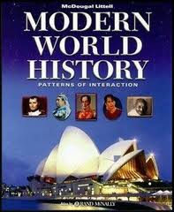
Secondary Sources
Your textbook!
Wikipedia
World War II in HD (footage is primary, commentary is secondary)
A book about the hidden meanings in The Diary of Anne Frank

Slide 8
What is History, then?
History is…
Someone taking primary sources and playing detective

Slide 9
What do detectives do?
Look at evidence and
Use it to tell a story of what probably happened.

Slide 10
So
Primary sources are evidence.
Historians are detectives.
Secondary sources are theories based on the evidence.

Slide 11
Give 10 detectives a crime scene, and they may come up with ten different theories of what happened there.

Slide 12
Take 10 historians to the same archeological site, and they may come up with 10 different theories of what happened there.

Slide 13
In this class, you are the historians
How do you see it?

Slide 14
You will look at evidence and draw your own conclusions.

Slide 15
Here’s how you’ll do it:
A
P
P
A
R
T
S

Slide 16
A
Author
Identify the author.
Who made/wrote this? Do we have any way of knowing?
I will not sleep in class
I will not sleep in class
I will not sleep in class
I will not sleep in class
I

Slide 17
P
Place & Time
Where was this made/written?
When was this made/written?

Slide 18
P
Prior Knowledge
What did you know about this before looking at it?

Slide 19
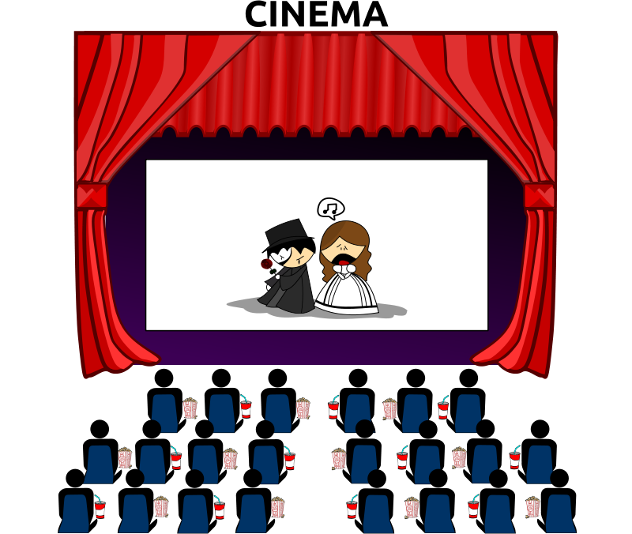
A
Audience
Who was this made/written for?
Is it trying to convince somebody of something?
Can you trust it?

Slide 20
R
Reason
Why was it created?
To enforce laws?
To preach morals?
To Entertain?

Slide 21
T
The Main Idea
What is it about?
What happened here?
The Main Idea

Slide 22
S
Significance
Why is this important?
What does it tell us about the people it was written for? Their morals? How they lived? What they enjoyed?

Slide 23
Let’s Do One Together
Ancient Egyptian Instrument

