Slide 1
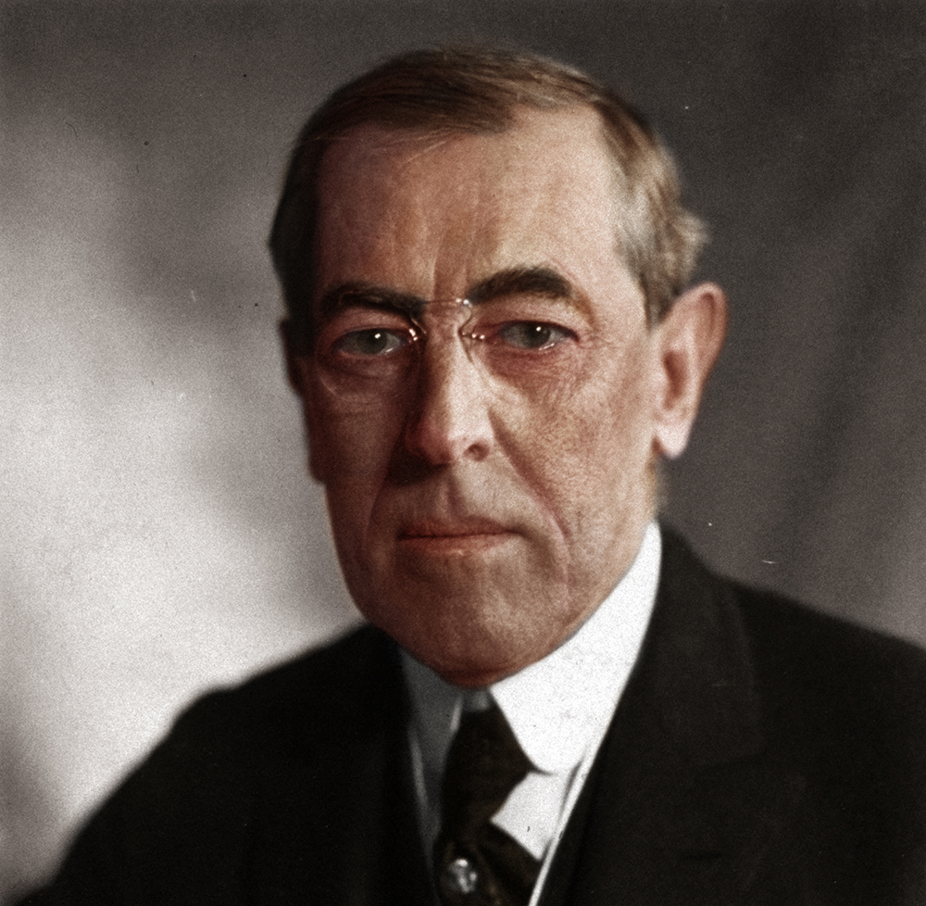
PROGRESSIVE ERA PRESIDENTS CHART
Protecting Social Reform (Protection of Citizens)
Creating Economic Reform (business & welfare)
Conservation
PROGRESSIVE
ERA
PRESIDENTS
Teddy Roosevelt
William Howard Taft
Woodrow Wilson

