Slide 1
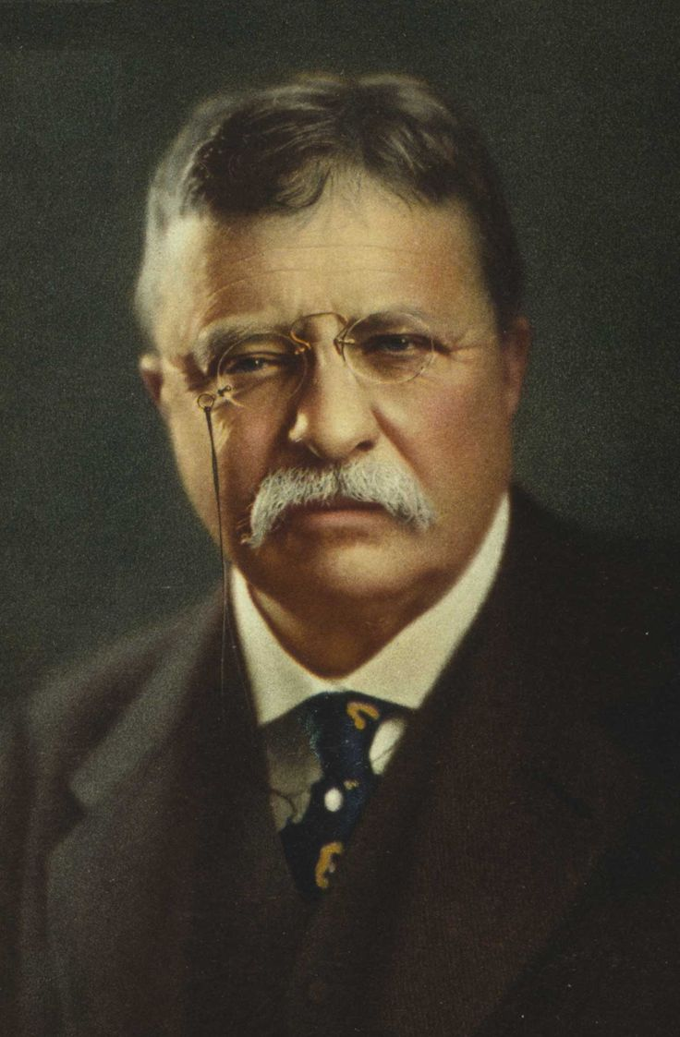
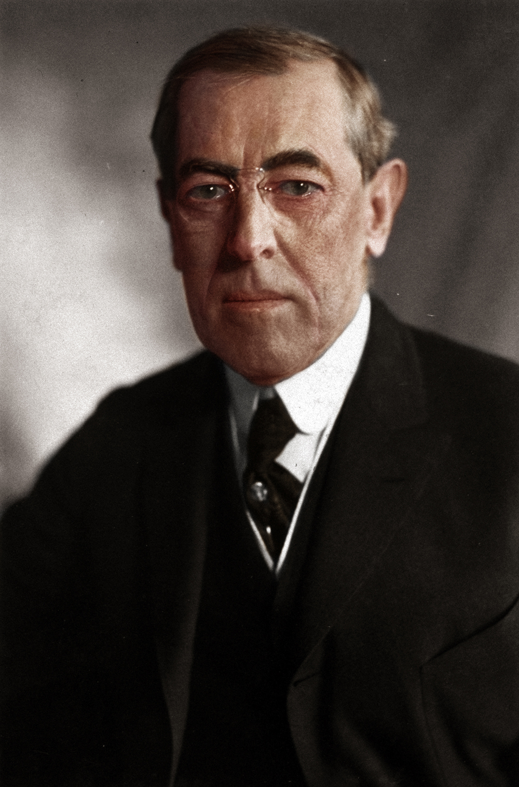
PROGRESSIVE
PRESIDENTS
1900 - 1917

Slide 2
I. PROGRESSIVE PRESIDENTS
1. Teddy Roosevelt
1. Labor -
a. 1902 Coal Strike by the United Mine Workers of America(UMW)
- TR threatened govt
takeover of mine trusts.
- trusts cave
- Significance: 1st time
govt sides w/unions
When the president spared a bear cub on a hunting expedition, a toymaker marketed a popular new product, the teddy bear.
Roosevelt as a
calvary Rough Rider
Notes:
Teddy Roosevelt Biography: As a child Teddy had asthma and poor vision. His father encouraged Teddy to work out using exercising equipment and boxing. Teddy drove himself to accomplish demanding physical feats. As a teenager, he mastered marksmanship and horseback riding. At Harvard College, Roosevelt boxed and wrestled.
Roosevelt had been in New York politics serving various positions. Teddy grabbed national attention, advocating for the Spanish American war in 1898. He volunteered in a cavalry brigade called the Rough Riders. He gained huge popularity for its role in the battle at San Juan Hill in Cuba. Roosevelt returned a hero and was soon elected governor of New York. It was in New York, Teddy made a huge effort to root out corruption and "machine politics." Roosevelt was doing all that he could to clean up politics in New York, so much so, that Republican boss Thomas Collier Platt forced Roosevelt to be then President William McKinley’s running mate for vice president in the 1900 election. Platt thought Roosevelt was out of control so he asked McKinley to take him. Remember being a vice-president is basically a useless job. Especially back then - you wait for the president to die.
Assassination: And that’s what happens. McKinley was shot at the World’s Fair by an anarchist, and Roosevelt became president of the United States. He became the country’s youngest president. He was 42 years old. President Kennedy is the nation’s youngest elected president at 43 years old. Republicans were in shock that Roosevelt had become president. American business moguls were too. The stock market took a huge a dive, Roosevelt reassured congress that he will continue with McKinley’s policies
Strike: One of the first tests for Roosevelt came with the Pennsylvania Coal Strike in 1902. Workers wanted 20% pay raise and a 9 hour work-day, instead of 10 hour work day. The owners wouldn’t even arbitrate(or talk) to the union representatives. It was beginning to become a national emergency because winter was coming and the nation was running out of coal. Schools and factories were going to have to shut down if they couldn’t be powered or heated. Roosevelt brought both sides to the White House hoping to bring a solution to this situation. But the mine owners wouldn’t budge - they wanted Roosevelt to send in troops as others had done in the past. Roosevelt was furious and threatened to have the government take over the mines from the owners. Under the threat, the mine owners gave in.
Significance: This marked the first time government had sided with labor. Labor received a 10% pay raise and a 9 hour work week. Roosevelt didn't believe he sided with one side or the other. He believed he intervened on the side of fairness. If big business victimized workers, then Roosevelt would see to it that the common people received what he called, “a Square Deal.”
Trust Buster: By 1900, trusts—legal bodies created to hold stock in many companies—controlled about four-fifths of the industries in the United States. Some trusts used shady and illegal business practices. Many trusts lowered their prices to drive competitors out of the market and then took advantage of the lack of competition to jack prices up even higher. Although Congress had passed the Sherman Antitrust Act in 1890, the act’s vague language made enforcement difficult and were ineffective.
In 1902, Roosevelt made newspaper headlines as a trustbuster when he ordered the Justice Department to sue the Northern Securities Company, which had established a monopoly over northwestern railroads. In 1904, the Supreme Court dissolved the company. Although the Roosevelt administration filed 44 antitrust suits, winning a number of them and breaking up some of the trusts, it was unable to slow the merger movement in business.

Slide 3
I. PROGRESSIVE PRESIDENTS
1. Teddy Roosevelt
1. Labor -
a. 1902 Coal Strike by the United Mine Workers of America(UMW)
TR threatened govt
takeover of mine trusts.
- trusts cave
- Significance: 1st time
govt sides w/unions
b. Square Deal: TR’s program that protects the common people against corporations
When the president spared a bear cub on a hunting expedition, a toymaker marketed a popular new product, the teddy bear.
Roosevelt as a
calvary Rough Rider
Notes:
Original video link: https://youtu.be/P2nmmMEdc0w
Teddy Roosevelt Biography: As a child Teddy had asthma and poor vision. His father encouraged Teddy to work out using exercising equipment and boxing. Teddy drove himself to accomplish demanding physical feats. As a teenager, he mastered marksmanship and horseback riding. At Harvard College, Roosevelt boxed and wrestled.
Roosevelt had been in New York politics serving various positions. Teddy grabbed national attention, advocating for the Spanish American war in 1898. He volunteered in a cavalry brigade called the Rough Riders. He gained huge popularity for its role in the battle at San Juan Hill in Cuba. Roosevelt returned a hero and was soon elected governor of New York. It was in New York, Teddy made a huge effort to root out corruption and "machine politics." Roosevelt was doing all that he could to clean up politics in New York, so much so, that Republican boss Thomas Collier Platt forced Roosevelt to be then President William McKinley’s running mate for vice president in the 1900 election. Platt thought Roosevelt was out of control so he asked McKinley to take him. Remember being a vice-president is basically a useless job. Especially back then - you wait for the president to die.
Assassination: And that’s what happens. McKinley was shot at the World’s Fair by an anarchist, and Roosevelt became president of the United States. He became the country’s youngest president. He was 42 years old. President Kennedy is the nation’s youngest elected president at 43 years old. Republicans were in shock that Roosevelt had become president. American business moguls were too. The stock market took a huge a dive, Roosevelt reassured congress that he will continue with McKinley’s policies
Strike: One of the first tests for Roosevelt came with the Pennsylvania Coal Strike in 1902. Workers wanted 20% pay raise and a 9 hour work-day, instead of 10 hour work day. The owners wouldn’t even arbitrate(or talk) to the union representatives. It was beginning to become a national emergency because winter was coming and the nation was running out of coal. Schools and factories were going to have to shut down if they couldn’t be powered or heated. Roosevelt brought both sides to the White House hoping to bring a solution to this situation. But the mine owners wouldn’t budge - they wanted Roosevelt to send in troops as others had done in the past. Roosevelt was furious and threatened to have the government take over the mines from the owners. Under the threat, the mine owners gave in.
Significance: This marked the first time government had sided with labor. Labor received a 10% pay raise and a 9 hour work week. Roosevelt didn't believe he sided with one side or the other. He believed he intervened on the side of fairness. If big business victimized workers, then Roosevelt would see to it that the common people received what he called, “a Square Deal.”
Trust Buster: By 1900, trusts—legal bodies created to hold stock in many companies—controlled about four-fifths of the industries in the United States. Some trusts used shady and illegal business practices. Many trusts lowered their prices to drive competitors out of the market and then took advantage of the lack of competition to jack prices up even higher. Although Congress had passed the Sherman Antitrust Act in 1890, the act’s vague language made enforcement difficult and were ineffective.
In 1902, Roosevelt made newspaper headlines as a trustbuster when he ordered the Justice Department to sue the Northern Securities Company, which had established a monopoly over northwestern railroads. In 1904, the Supreme Court dissolved the company. Although the Roosevelt administration filed 44 antitrust suits, winning a number of them and breaking up some of the trusts, it was unable to slow the merger movement in business.

Slide 4
I. PROGRESSIVE PRESIDENTS
1. Teddy Roosevelt
2. Trust Buster
a. Interstate Commerce Commission (ICC) expanded for regulation of RRs.
b. Hepburn Act -1906 -
- strengthens the ICC
- ended free passes
c. Only prosecutes “bad” trusts
We don’t wish to destroy corporations, but we do wish to make them... serve the public good.
Notes:
In his 1902 state of the Union, Roosevelt gave high priority to breaking up monopolies or what he called, ‘trustbusting’. Later that summer, he called for a ‘square deal’ for all Americans and denounced special treatment for corporate leaders. He said, “We don’t wish to destroy corporations, but we do wish to make them... serve the public good.”
Railroad Regulation: Soon Roosevelt went after the big railroad trusts. Although the Interstate Commerce Commission was already set up to regulate the railroad trusts, it had no real power. Railroads granted rebates to their most valued customers. The great oil and livestock companies paid the rates stated by the railroads, but demanded rebates on those payments. The giants paid less for rail service than farmers and other small operators.
Congress passed the Elkins Act in 1903, which made it illegal for railroad officials to give, and shippers to receive, rebates for using particular railroads. The act also specified that railroads could not change set rates without notifying the public.
The Hepburn Act of 1906 strictly limited the distribution of free railroad passes, a common form of bribery. They were used to bribe congressmen into passing or blocking bills that benefited or hurt railroad trusts’ profits. It also gave the ICC power to set maximum railroad rates. Although Roosevelt had to compromise with conservative senators who opposed the act, its passage boosted the government’s power to regulate the railroads
Bad Trusts: According to Roosevelt, “Bad” trust was a monopoly that charged high prices and produced low quality goods. “Good trusts” were trusts that consolidated industries in order to give the consumer better prices. Roosevelt believed the government had to regulate bad trusts. These companies have to give an explanation with the gov. each time they raise prices.

Slide 5
I. PROGRESSIVE PRESIDENTS
1. Teddy Roosevelt
3. Consumer Protection
a. Upton Sinclair’s The Jungle
b. Meat Inspection Act of 1906 - regulates all meat crossing state lines.
“A man could run his hand over these piles of meat and sweep off handfuls of dried dung of rats. These rats were nuisances, and the packers would put poisoned bread out for them, they would die, and then rats, bread, and meat would go into the hoppers together.” - The Jungle
Upton Sinclair
Notes:
When muckraking journalist Upton Sinclair began research for a novel in 1904, his focus was the human condition in the stock- yards of Chicago. Sinclair’s book shocked readers in about the sickening conditions of the meatpacking industry. Here’s an excerpt: “A man could run his hand over these piles of meat and sweep off handfuls of dried dung of rats. These rats were nuisances, and the packers would put poisoned bread out for them, they would die, and then rats, bread, and meat would go into the hoppers together.” - The Jungle
President Theodore Roosevelt, like many other readers, was nauseated by Sinclair’s account. The president invited the author to visit him at the White House, where Roosevelt promised that “the specific evils you point out shall, if their existence be proved, and if I have the power, be eradicated.”
Sinclair’s book pushed others to write about dangerous patent medicines, many laced with cocaine, opium or alcohol. They said they were good for the entire family.

Slide 6
I. PROGRESSIVE PRESIDENTS
1. Teddy Roosevelt
3. Consumer Protection
a. Upton Sinclair’s The Jungle
b. Meat Inspection Act of 1906 - regulates all meat crossing state lines.
c. Pure Food and Drug Act - stopped the mislabeling of food & drugs.
Notes:
Original Video Link: https://youtu.be/PmKqQmAilEk
FDA: Before any federal regulations were established for advertising food and drugs, manufacturers had claimed that their products accomplished everything from curing cancer to growing hair. In addition, popular children’s medicines often contained opium, cocaine, or alcohol. In a series of lectures across the country, Dr. Harvey Washington Wiley, chief chemist at the Department of Agriculture, criticized manufacturers for adding harmful preservatives to food and brought needed attention to this issue.
In 1906, Congress passed the Pure Food and Drug Act, which halted the sale of contaminated foods and medicines and called for truth in labeling. Although this act did not ban harmful products outright, its requirement of truthful labels reflected the progressive belief that given accurate information, peo- ple would act wisely. C

Slide 7
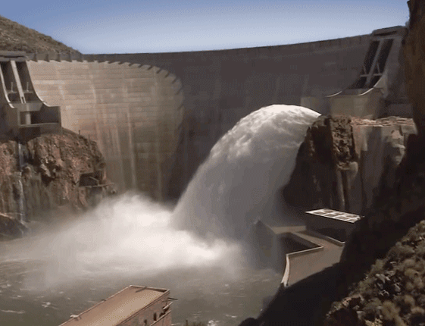
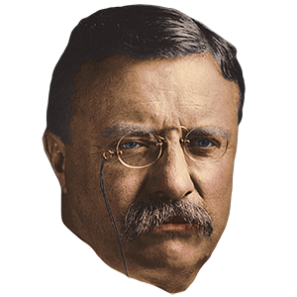
I. PROGRESSIVE PRESIDENTS
1. Teddy Roosevelt
4. Conservation
a. Newlands Act or National Reclamations Act (1902)
- money from public land sales pay for construction of dams & irrigation in dry west
b. 200 million acres set aside as nat. forests, mineral reserves & power sites
Roosevelt Dam
Notes:
Conservation: Roosevelt was a conservationist - a modern day environmentalist - He graduated from Harvard in Biology with plans to become a Naturalist - a modern day environmentalist, but he got married and realized he needed to make money.
Before Roosevelt’s presidency, the federal government had paid very little attention to the nation’s natural resources. The government stood by while private interests gobbled up the shrinking wilderness. Pioneer farmers leveled the forests and plowed up the prairies. Ranchers allowed their cattle to overgraze the Great Plains. Coal companies cluttered the land with trash and waste from mines. Lumber companies ignored the effect of their logging operations on flood control and neglected to plant trees to replace those they had cut down. Cities dumped untreated sewage and industrial wastes into rivers, poisoning the streams and creating health hazards
Newlands act - Under the National Reclamation Act of 1902, known as the Newlands Act, money from the sale of public lands in the West funded large-scale irrigation projects, such as the Shoshone Dam in Wyoming and Roosevelt Dam in Arizona, Phoenix wouldn’t exist without it. It also allowed for farming in the dry west - without it, there wouldn’t be any agriculture in the west outside of the costal states.
Despite opposition, Roosevelt set aside 200 million acres as national forests and mineral reserves. He created 54 wildlife reserves, 16 national monuments and five new national parks. Some historians have said, if it wasn’t for Roosevelt, the Grand Canyon would be lined with Condos. The Newlands Act established the precedent that the federal government would manage the precious water resources of the West.
His problem was that he pledged in the election of 1904 that he wouldn’t run again. He had served out most of McKinley’s term and a term of his own. If he ran again & succeeded, he would have been president for 11 years, the longest in history. So at height of his popularity - he sticks with his pledge, but chooses a successor. That successor is William Howard Taft. - Democrats run William Jennings Bryan - I think this is the 3rd time they’ve run this guy. Taft wins - and thats who we will talk about next.

Slide 8
I. PROGRESSIVE PRESIDENTS
2. William Howard Taft
Taft’s Reforms
1. Protected millions of acres of land
2. Set up safety standards for mines & RRs
3. 8 hr work-day for Fed. employees
4. Pushed for 16th & 17th Amdts
5. Brought 90 anti-trusts suits vs. TR’s 45
Notes:
At first Taft stumbled. Taft campaigned on lowering tariffs which progressives loved because it lowered prices on imported goods. He signed the Payne-Aldrich Tariff, which was a compromise, and people felt like Taft had gone back on his word. On the issue of conservation, Progressives felt betrayed by Taft on the issue conservation/management of public lands. Taft’s choice for Secretary of the Interior, Richard A Ballinger, angered conservationists. Ballinger opposed conservation policies on federal lands West, siding with business interest that sought UNRESTRICTED development. In 1909, Ballinger had sold several million acres of public land in Alaska to business men and eventually into the hands of J.P. Morgan. When a left over Roosevelt aid publicly protested, Taft fired him. Taft’s critics said the he was letting commercial interests exploit the natural resources that rightfully belonged to the public.
Despite the controversies that hurt Taft’s presidency, Taft did accomplish many items on the progressive agenda. Taft eventually sets aside millions acres of land.
- Set up safety standards for mines and railroads
- set up 8 hr work-day for Fed. employees
- pushed for 16th & 17th Amdts
- Brought 90 anti-trusts suits vs. Roosevelt’s 45. Taft had brought 90 anti-trust cases in 4 years vs Roosevelt’s 47 in 7 years. Taft didn’t differentiate between good trusts and bad trusts - Taft went after all trusts, including one that Roosevelts’ administration approved of.
Let’s try a little review
What was the 16th Amendment? - National Income Tax
What was the 17th Amendment? - Direct election of senators
What was the 18th Amendment? - Prohibition of alcohol
What was the 19th Amendment? - women’s suffrage.
How about the 13th Amendment? - freed African Americans from slavery
14th Amendment? African Americans are citizens - and can’t have civil rights taken away
15th Amendment? African Americans right to vote

Slide 9
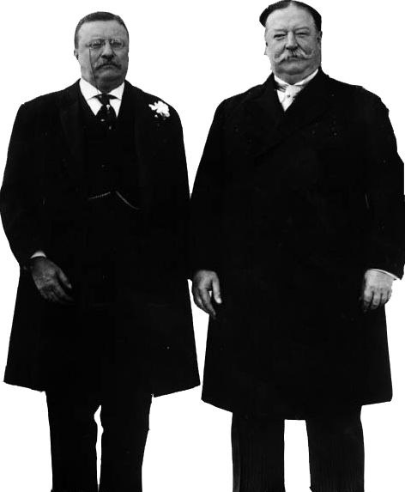
I. PROGRESSIVE PRESIDENTS
2. William Howard Taft
TR Runs for Pres. Election of 1912
1. TR won Rep Primaries
- Taft get nominee
2. TR started new Progressive Party - called Bull Moose party
- New Nationalism - woman suffrage, 8-hour workday, child labor laws, govt to regulate bzns
3. Dems choose progressive, Woodrow Wilson
4. TR split the Republican ticket - Wilson Won
Notes:
Despite Taft’s progressive accomplishments, his blunders on conservation and tariffs had progressives feeling betrayed by Taft. Progressive Republicans split the Republican party in half, and began working with the almost 100% progressive democratic party.
Roosevelt returned from his trip to Africa before the midterm elections in 1910. At first, he refrained from criticizing his old friend, but it wasn’t long before Roosevelt was defending progressive reforms and backing progressive candidates. He called for business regulation, welfare laws, workplace protection for women and children, income and inheritance taxes, and voting reform. His plan was called, “New Nationalism.” The congressional midterms brought down the old conservative Republicans who didn’t believe in progressive reforms. Progressive Democrats gained control of the House of Representatives for the first time in 18 years. They also took the Senate, and now progressive Democrats and Republicans were firmly in place in both houses.
Bull Moose Party: Roosevelt 2 years later take on Taft as the Republican nominee for president, but the old party bosses were still in control, and despite wide popular support, Taft got the nomination. Roosevelt supporters cried fraud and started their own party, the Progressive Party, Roosevelt would be their nominee. When asked whether he was physically fit to run for president, Roosevelt exclaimed “I feel fit as a bull moose!” The Progressive Party would be called the Bull Moose Party.
Shot: Roosevelt ran a vigorous campaign. While making a speech in Milwaukee, there was an assassination attempt and Roosevelt was shot in the chest, a bullet lodged in his lung. Instead of rushing to the hospital, Roosevelt insisted on continuing with his speech for another hour and a half before going. He said to the crowd, “Friends, I shall ask you to be as quiet as possible. I don’t know whether you fully understand that I have just been shot: but it takes more than that to kill a Bull Moose.” He then showed the crowd his bloodstained shirt, and continued his speech.
New Nationalism: Roosevelt ran on New Nationalism. The central issue Roosevelt argued, was human welfare versus property rights. He insisted that only a powerful federal government could regulate the economy and guarantee social justice. Roosevelt believed that the concentration in industry was not necessarily bad, if the industry behaved responsibly. He wanted executive agencies (not the courts) to regulate business. The federal government should be used to protect the laboring men, women and children from what he believed to be exploitation. In terms of policy, the New Nationalism supported child labor laws and minimum wage laws for women.
The Democratic nominee was Woodrow Wilson, reform governor of New Jersey. Wilson’s campaign slogan was, New Freedom - It meant he planned on enforcing antitrust laws without threatening competition.

Slide 10
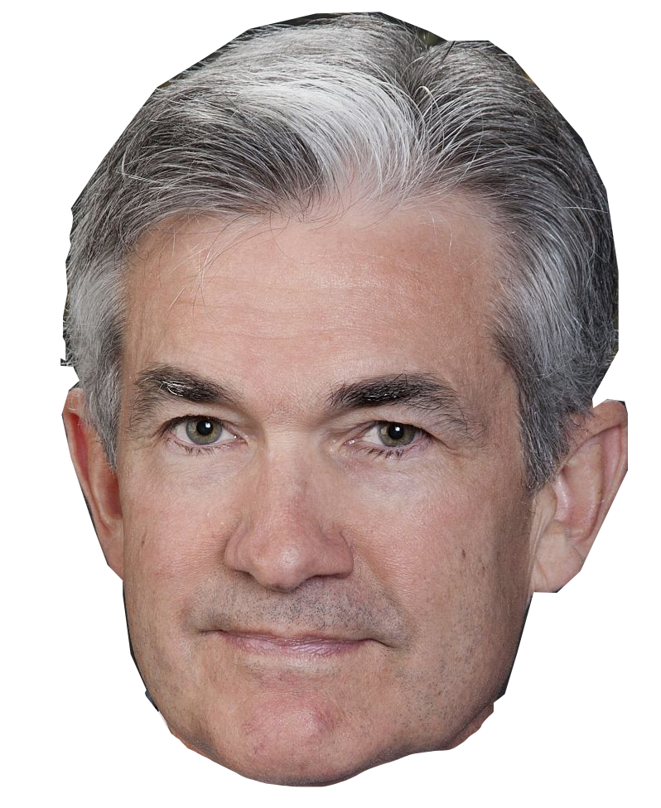
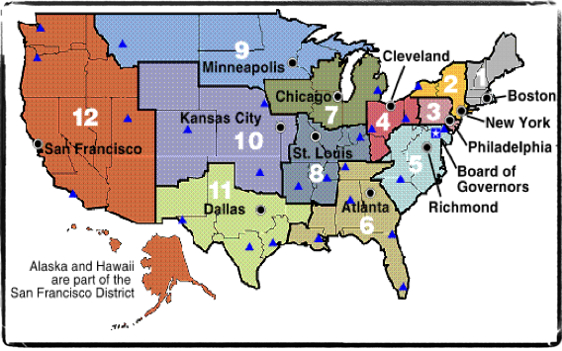
3. Woodrow Wilson
1. Underwood Act
- lowered tariffs - cheaper products for consumers
2. Federal Income Tax
3. Banking Reform
- Federal Reserve Act (1913)
- created 12 regional banks
- regulates interest rates
Fed Chair: Jerome Powell
President Woodrow Wilson
Notes:
Woodrow Wilson had been the president of Princeton University. He was and is our only president with a PhD. (political science) He was then a governor of New Jersey and had the reputation as a dedicated reformer.
Tariffs: Wilson’s first priority was to lower the tariffs. Progressives believed tariffs represented the power of the trusts, that they helped create monopolies by protecting manufactures owners, and hurt everyday American consumers by creating higher prices.
- Every time government tried to lower tariffs, conservative Republicans and lobbyist who represented these large trust would block or water down anti-tariff bills. Growing frustrated, Wilson then went over Congress’s head. He went to the American people. He told Americans, if you want lower tariffs, tell your congressmen. RESULT - Wilson was able to lowers tariffs by 40% and the income that was lost by high tariffs was offset by taxes on corporations and an income tax on the very wealthy using the new ratified 16th Amendment - federal income tax that legalized a graduated federal income tax, which provided money by taxing individual earnings and corporate profits.
Income Tax: Under this graduated tax, larger incomes were taxed at higher rates than smaller incomes. The tax began with a modest tax on family incomes over $4,000, and ranged from 1 percent to a maximum of 6 percent on incomes over $500,000. By 1917, the government was receiving more money on the income tax than it had ever gained from tariffs. Today, income taxes on corporations and individuals represent the federal government’s main source of revenue.
Banking: Wilson set out to reform the banking system. He wanted to promote competition in the industry and to ease the frequent panics and recessions that destabilized the U.S. economy. Bankers were not happy. In 1913, congress passed the Federal Reserve Act, creating the Federal Reserve System. It divided the country into 12 districts, each with a federal reserve regional banks run by the Fed Reserve Board - which was appointed by the president. The Federal Reserve banks were the central banks for their regions - the banks of the bankers. Every national bank was required to become a member of the Federal Reserve Bank in its district and to deposit some of its capital and cash reserves in that bank. Member banks could borrow from the Federal Reserve to meet short-term demands. This helped to prevent bank failures that occurred when large numbers of depositors withdrew funds during an economic panic.
The system also created a new national currency known as Federal Reserve notes. The Federal Reserve could now expand or contract the amount of currency in circulation according to economic needs.
The Federal Reserve regulates credit and money supply by setting the interest rates it charges member banks. It sells and buys government bonds, and issues paper currency backed by government credit. Today it is used to try to offset recessions and inflation and is currently headed by Fed Chair Jerome Powell.

Slide 11
3. Woodrow Wilson
1. Underwood Act
- lowered tariffs - cheaper products for consumers
2. Federal Income Tax
3. Banking Reform
- Federal Reserve Act (1913)
- created 12 regional banks
- regulates interest rates
4. Clayton Antitrust Act (1914) to break up trusts
5. Federal Trade Commission
(FTC) investigation & enforcement
6. Appointed progressive Louis D. Brandeis to Supreme Crt.
Jerome Powell
President Woodrow Wilson
Notes:
Clayton Antitrust Act: During Wilson’s administration, Congress enacted two key antitrust measures. The first, the Clayton Antitrust Act of 1914, sought to strengthen the Sherman Antitrust Act of 1890. The Clayton Act prohibited corporations from acquiring the stock of another if doing so would create a monopoly; if a company violated the law, its officers could be prosecuted.
The Clayton Act also specified that labor unions and farm organizations not only had a right to exist but also would no longer be subject to antitrust laws. Therefore, strikes, peaceful picketing, boycotts, and the collection of strike benefits became legal. In addition, injunctions against strikers were prohibited unless the strikers threatened damage that could not be remedied. Samuel Gompers, president of the American Federation of Labor (AFL), saw great value to workers in the Clayton Act. He called it a Magna Carta for labor, referring to the English document, signed in 1215, in which the English king recognized that he was bound by the law and that the law granted rights to his subjects.
Federal Trade Commission Act: The second major antitrust measure, the Federal Trade Commission Act of 1914, set up the Federal Trade Commission (FTC). This “watchdog” agency was given the power to investigate possible violations of regulatory statutes, to require periodic reports from corporations, and to put an end to a number of unfair business practices. Under Wilson, the FTC administered almost 400 cease-and- desist orders to companies engaged in illegal activity.

