Slide 1
…………………………………………………………………………………………. ………………………………………………………………………………………….
…………………………………………………………………………………………. ………………………………………………………………………………………….
…………………………………………………………………………………………. ………………………………………………………………………………………….
…………………………………………………………………………………………. …………………………………………………………………………………………. ………………………………………………………………………………………….
…………………………………………………………………………………………. …………………………………………………………………………………………. ………………………………………………………………………………………….

Slide 2
Notes:
Be sure to make a copy and rename the file in your own Google Drive upon sharing it. It is important to do this to ensure changes are not made in my own file {A Social Studies Life}. Please do not publish on the web or create a publicly shared link. This resource is licensed for single use only. Any questions, please email me at asocialstudieslife@gmail.com.

Slide 3
Notes:
Be sure to make a copy and rename the file in your own Google Drive upon sharing it. It is important to do this to ensure changes are not made in my own file {A Social Studies Life}. Please do not publish on the web or create a publicly shared link. This resource is licensed for single use only. Any questions, please email me at asocialstudieslife@gmail.com.

Slide 4
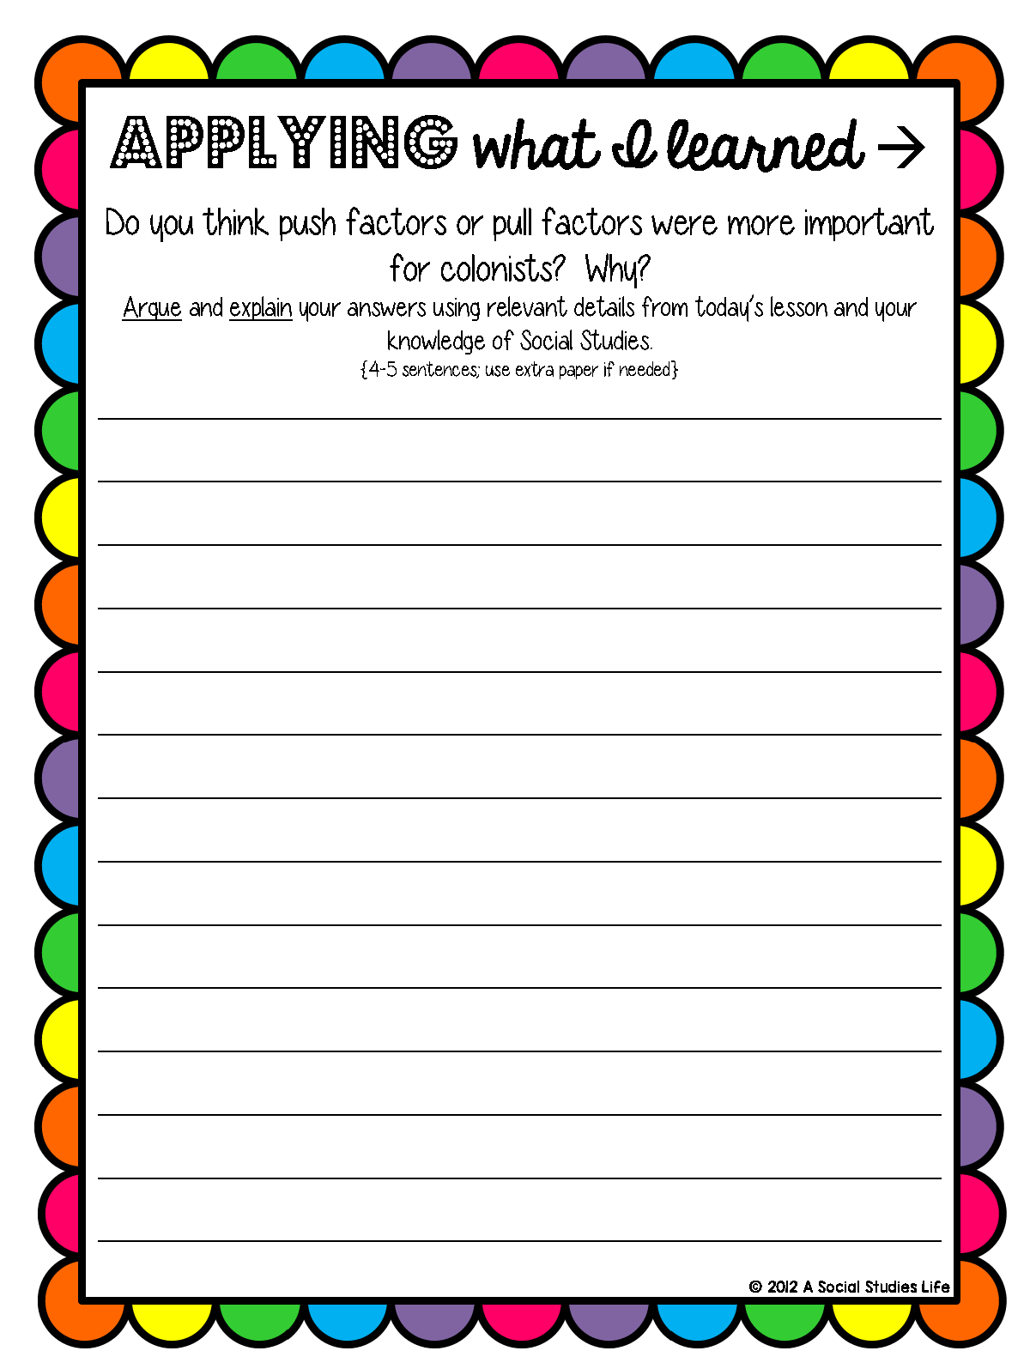
Quick Look-Back
……………………………………………………………………………………………
……………………………………………………………………………………………
……………………………………………………………………………………………
……………………………………………………………………………………………
……………………………………………………………………………………………
……………………………………………………………………………………………
……………………………………………………………………………………………
……………………………………………………………………………………………
……………………………………………………………………………………………
……………………………………………………………………………………………
……………………………………………………………………………………………
……………………………………………………………………………………………
……………………………………………………………………………………………
……………………………………………………………………………………………
……………………………………………………………………………………………
Notes:
Be sure to make a copy and rename the file in your own Google Drive upon sharing it. It is important to do this to ensure changes are not made in my own file {A Social Studies Life}. Please do not publish on the web or create a publicly shared link. This resource is licensed for single use only. Any questions, please email me at asocialstudieslife@gmail.com.

Slide 5
Notes:
Be sure to make a copy and rename the file in your own Google Drive upon sharing it. It is important to do this to ensure changes are not made in my own file {A Social Studies Life}. Please do not publish on the web or create a publicly shared link. This resource is licensed for single use only. Any questions, please email me at asocialstudieslife@gmail.com.

