Slide 1

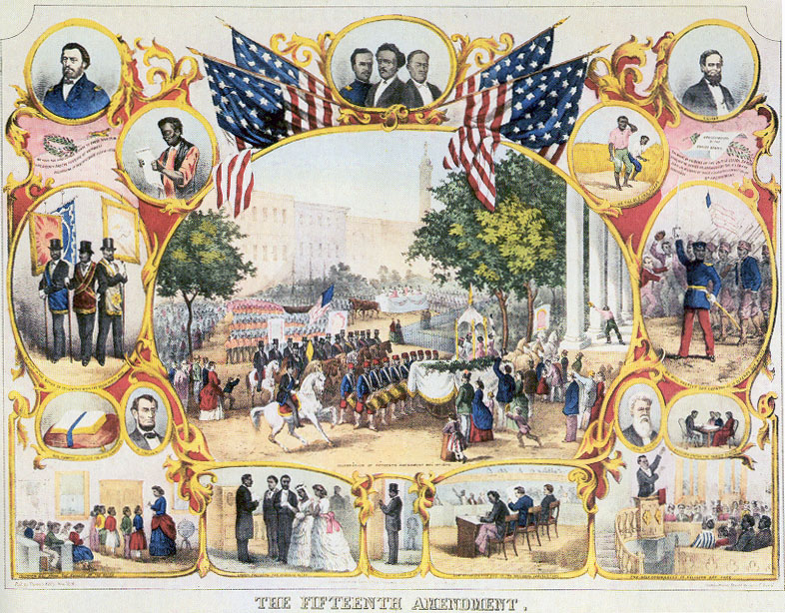
Civil War & Reconstruction
When you see the pencil appear, fill in the information in red on your info-graphic guided notes page.

Slide 2
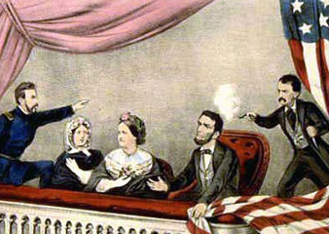

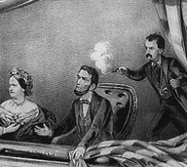
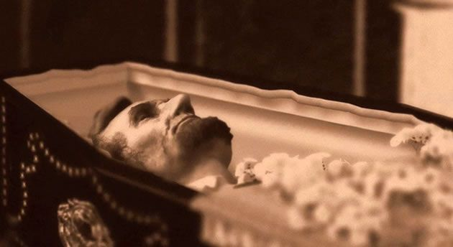
Five days after General Lee surrendered to General Grant and the war officially ended, President Abraham Lincoln was shot and killed by a Southern sympathizer named John Wilkes Booth.
The President was assassinated while attending a play at Ford’s Theater in Washington D.C.
The nation that was already in ruins from a long, violent Civil War, was now mourning the death of the President and they would never have the chance to know how Lincoln planned on rebuilding the war-torn country.
Assassinate
April 14th 1865- five days after the war ended, John Wilkes Booth shot and killed President Lincoln.

Slide 3
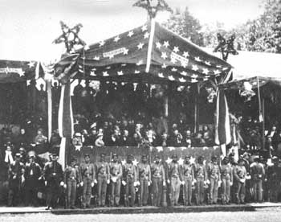

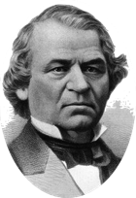
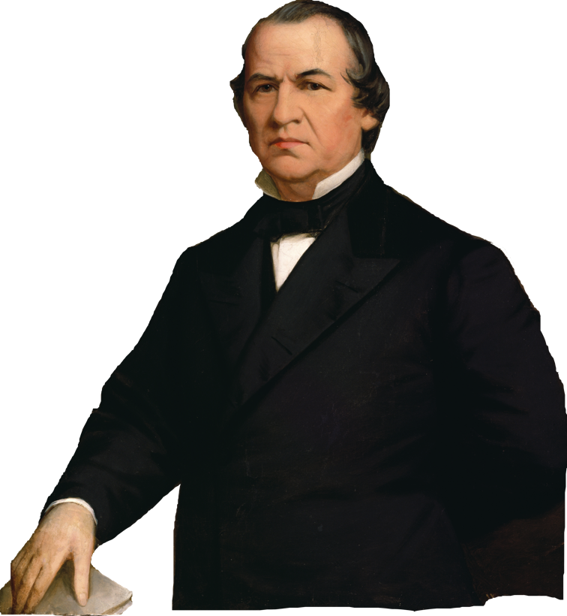
Andrew Johnson
Vice President Andrew Johnson became President after Lincoln’s death in April of 1865.
President Johnson felt it was the job of the president to carry out the work of Reconstruction to reunite the United States and rebuild the South after the Civil War.
Johnson was a southerner from Tennessee and had a racist streak. His idea of Reconstruction was aimed at getting white Southern farmers back in business. He was less concerned about the millions of blacks who had few skills and education and now needed jobs.
Became president when Lincoln was assassinated. Began Presidential Reconstruction.

Slide 4
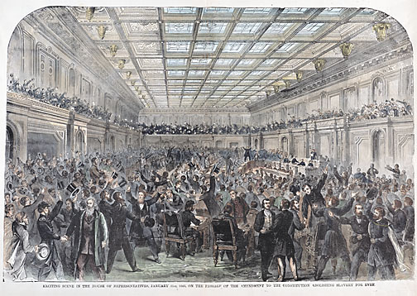

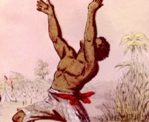
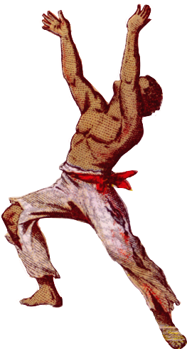
President Johnson’s reconstruction plan was announced in May of 1865. Former Confederate states could rejoin the Union when they had accomplished the following:
Write a new state Constitution
Elect a new state government
Repeal its act of secession
Cancel its war debts
Ratify an amendment to the Constitution to abolish slavery
All former Confederate states had accomplished this by the fall of 1865, The 13th Amendment to the U.S. Constitution officially banned slavery in every part of the United States. It was ratified in December of 1865. Once this happened, Johnson announced reconstruction was complete.
13th Amendment
Change to the Constitution to officially ban slavery in the United States. December 1865

Slide 5
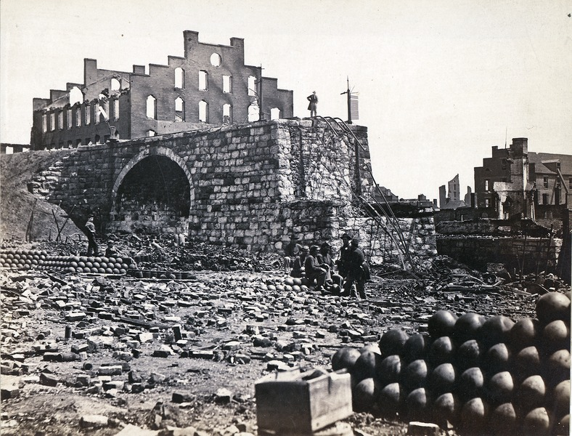

Congress disagreed with President Johnson. They felt it was the responsibility of Congress to carry out Reconstruction.
The northern Republican congressmen felt Southern states needed strong measures in place to be sure the new governments established in former slave states were based on equality.
President Johnson ignored congress regarding Reconstruction and carried out his own methods for rebuilding the nation. Congress went as far as holding impeachment hearings for the President.
Johnson escaped removal from office by just one vote.
Time when the South was rebuilt and brought back into the Union.

Slide 6
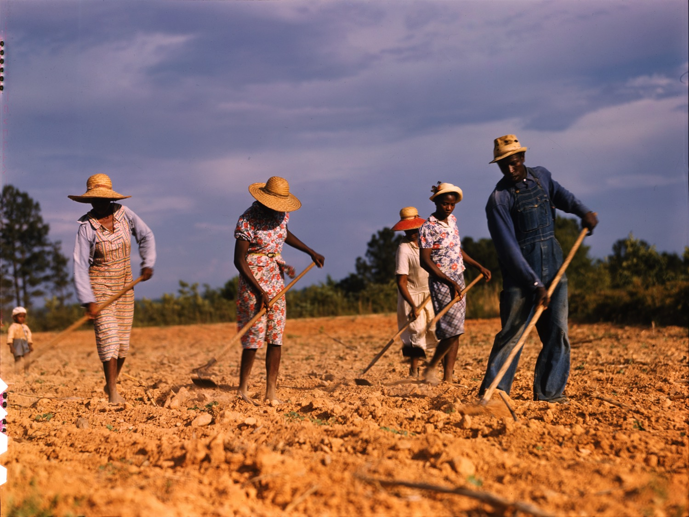

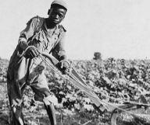
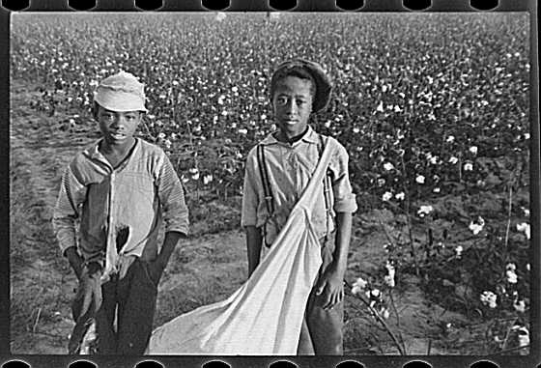
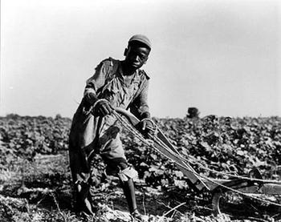
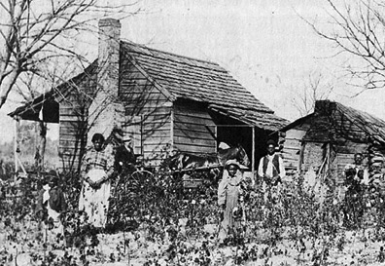
While the government argued over how to implement reconstruction, Southerners were working to rebuild and begin new lives.
Newly freed slaves lacked education and skills for high paying jobs. Former slave owners needed workers to farm their land but the economic collapse of the South meant they had very little money to pay workers.
The “solution” that formed out of these circumstances is known as sharecropping. Poor whites and former slaves rented land from plantation owners to farm.
Two main problems existed in sharecropping. Former slaves were always in debt to the land owners and they still were not getting an education to improve their circumstances.
Sharecropping
Poor whites and former slaves rented out land from planters to farm. Kept former slaves in poverty and debt.

Slide 7
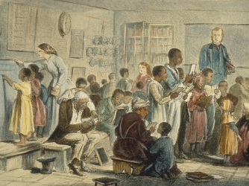
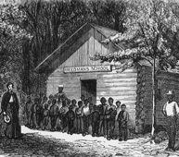
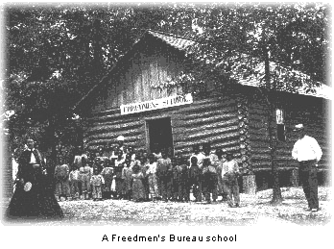
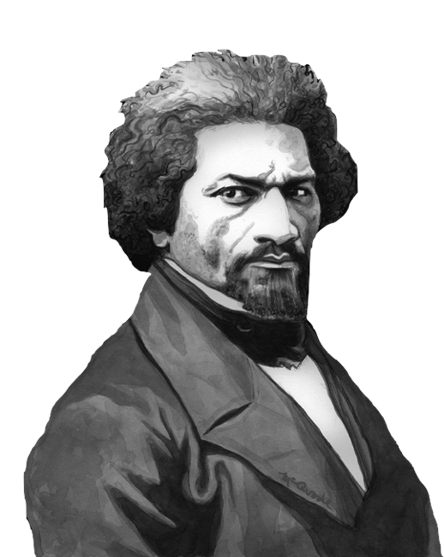
Frederick Douglass described the problems faced by former slaves, called “freedmen” after the 13th Amendment, once slavery ended.
Under slavery, slave owners provided everything their slaves needed. Housing, food, and clothing were all a part of owning slaves. Once slavery ended former, slaves were left with no way to provide for their basic needs.
In response, Congress established the “Freedmen’s Bureau”. This agency was set up to provide short term help to former slaves with access to food and medical care. They helped arrange for wages and even helped distribute some land to get former slaves on their feet.
The longest lasting impact of the Freedmen’s Bureau was with education. They opened schools to teach thousands of former slaves, young and old.
Freedmen’s Bureau
Provided short term aide in food and medical care and long term help in education for former slaves.

Slide 8
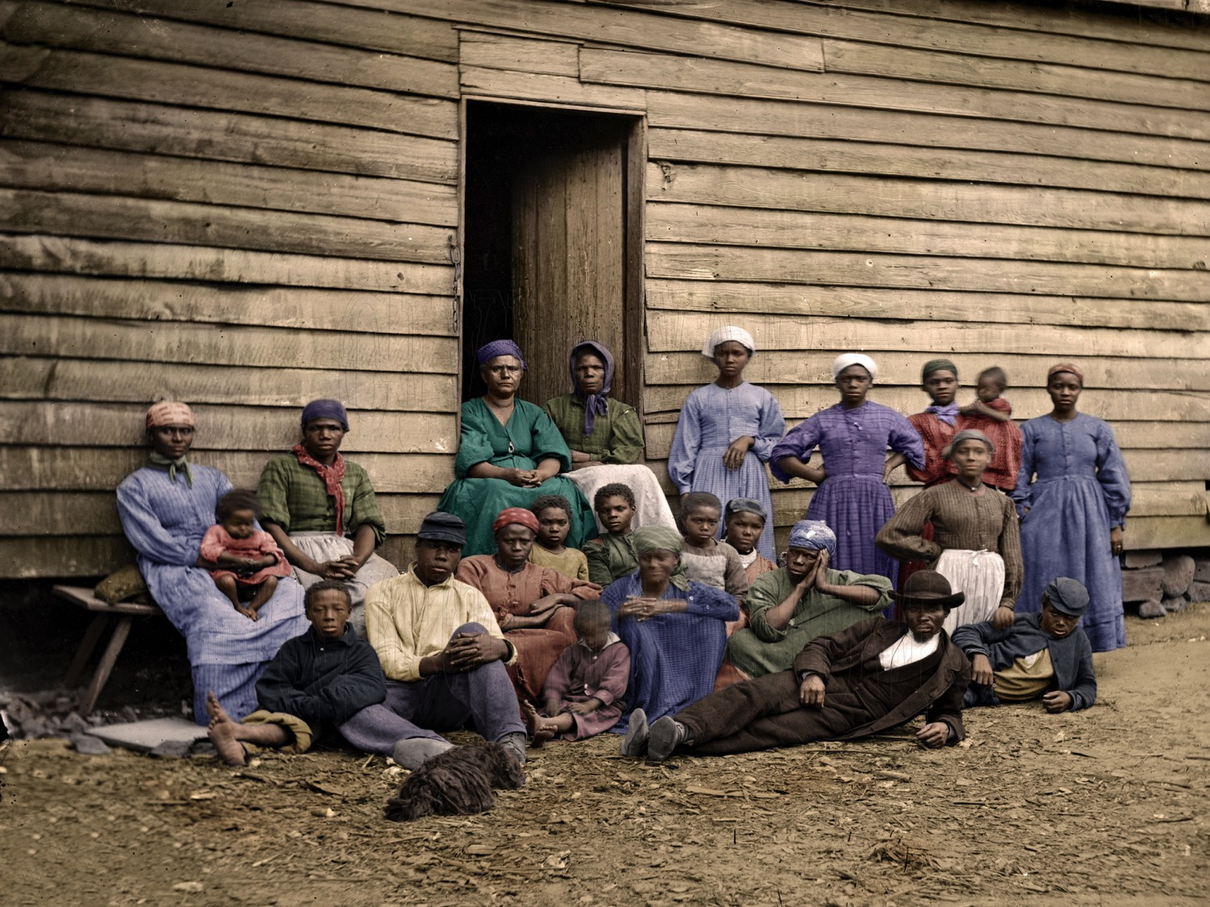
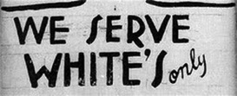
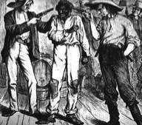
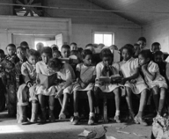
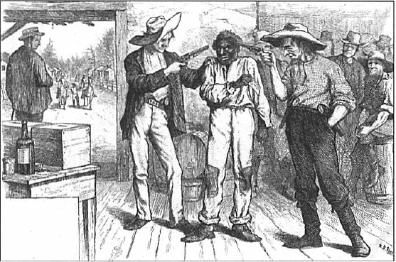
It wasn’t surprising when the newly elected governments in former Confederate states began to look very much like the old governments run by the same people who led the South before the war.
Once back in office, these governments began to pass legislation to restrict and control former slaves. They passed laws called “black codes” meant to limit the civil rights and freedoms of African Americans.
These laws denied former slaves voting rights. They could not serve on juries. Blacks who were unemployed could be arrested and sent to work for plantation owners. Black codes limited blacks to working low paying jobs.
States also passed laws requiring segregation of blacks and whites in public places.
Black Codes
Laws passed in former Confederate states to limit rights and freedoms of African Americans.
Segregation
Legalized separation of people in public places based on race and skin color.

Slide 9
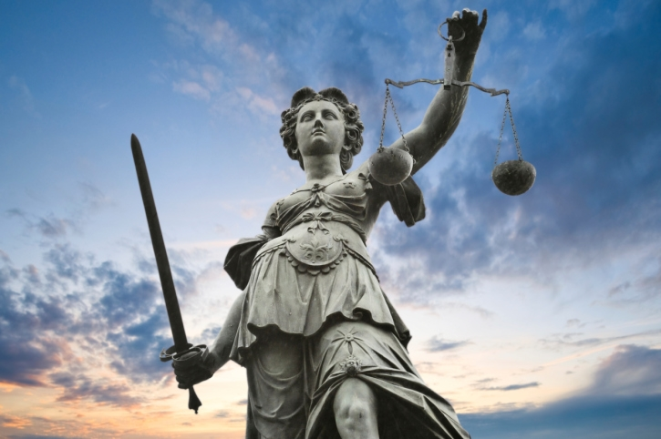

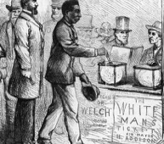
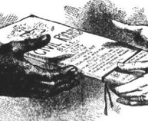
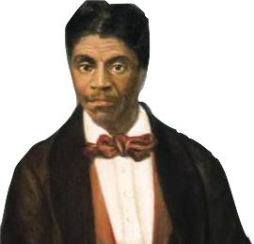
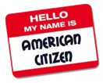

Republicans in Congress were alarmed at the return of power to former Southern leaders. The issue remained that the Supreme Court had ruled blacks were not citizens in the Dred Scott decision less than a decade earlier. Southern states did not have to recognize citizenship of former slaves.
Congress passed the Civil Rights Act of 1866 to declare freedmen to be full citizens with the same civil rights as whites. President Johnson vetoed the law, but an angry Congress overrode his veto.
Congress took civil rights even further by ratifying the 14th Amendment. This amendment granted citizenship to all people born or naturalized in the United States and guaranteeing equal protection of the laws. This meant Southern states had to recognize former slaves as citizens and could not pass laws to treat them differently.
Civil Rights
Rights guaranteed by the Constitution to citizens, especially equal treatment under the law.
14th Amendment
Civil Rights amendment- granted citizenship to former slaves and provided equal protection of the law.

Slide 10
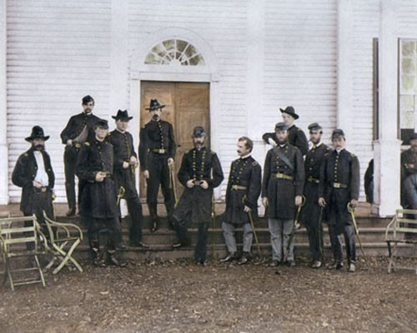
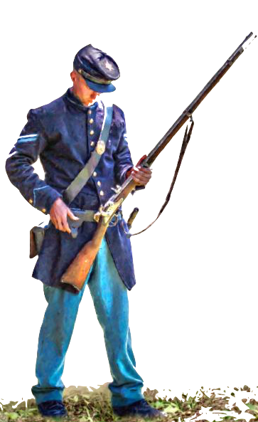
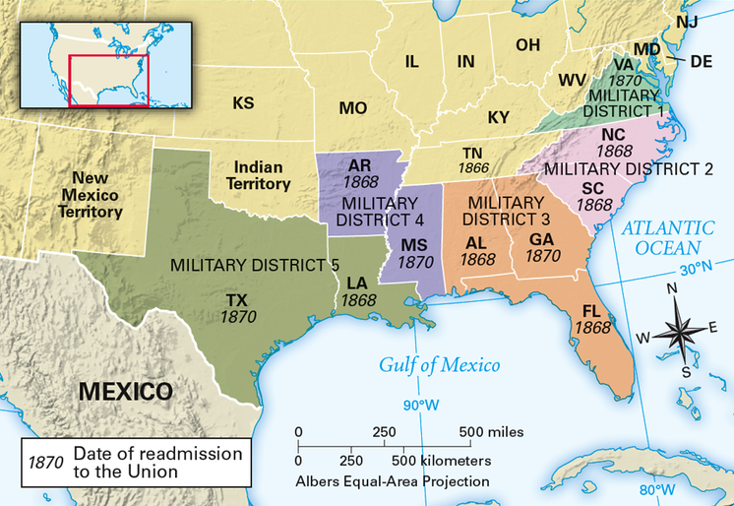
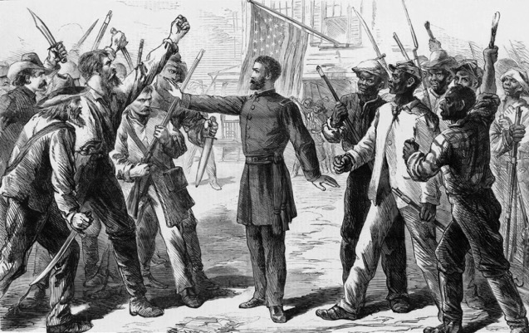
In early 1867, Congress overrode President Johnson’s veto and established the Military Reconstruction Act. This plan divided the South into districts governed by a military general and supported by federal troops.
New Southern governments were no longer allowed to resemble the old Confederate governments. Only Southerners loyal to the Union would be allowed to vote. The military helped millions of former slaves register to vote.
Many Southerners felt stripped of their rights as citizens and looked for ways to restrict former slaves even further.

Slide 11
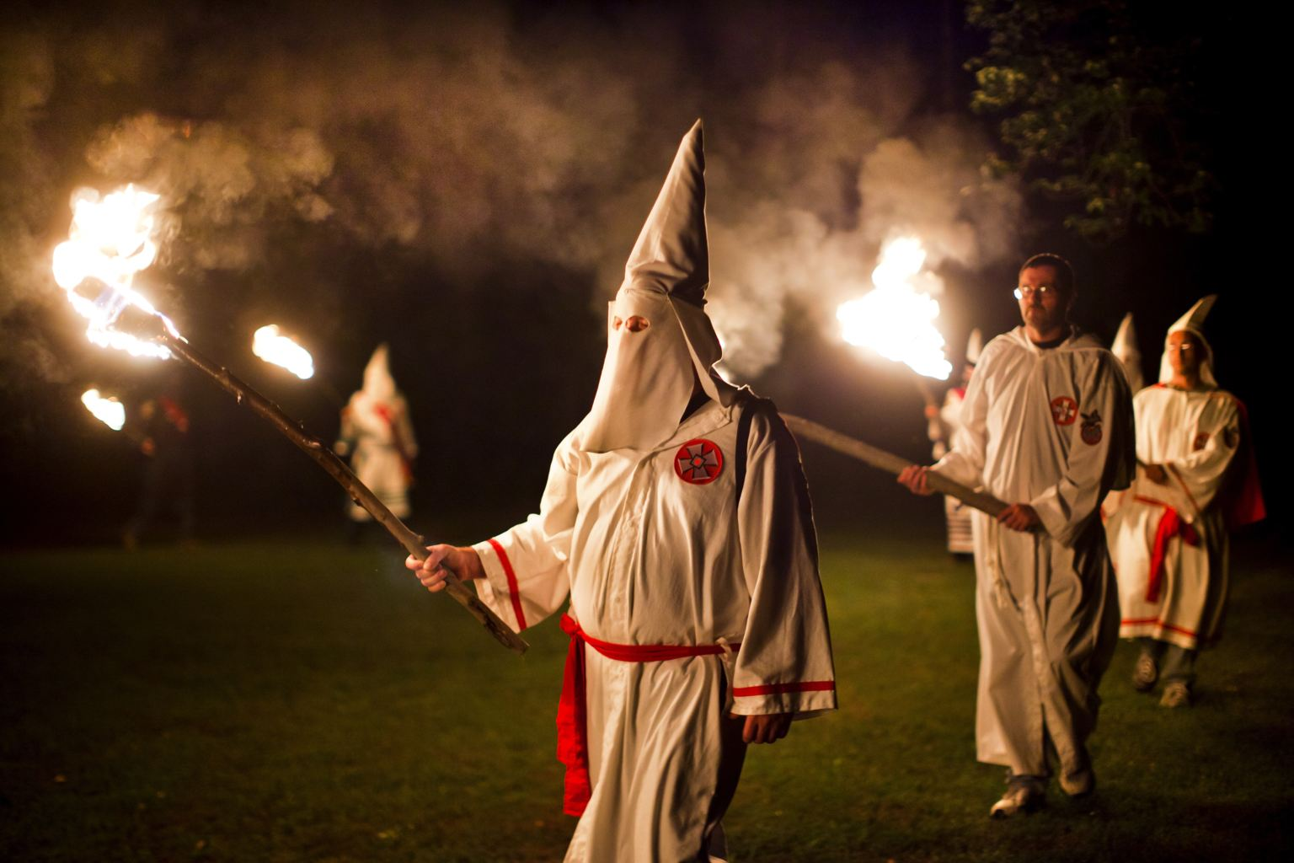
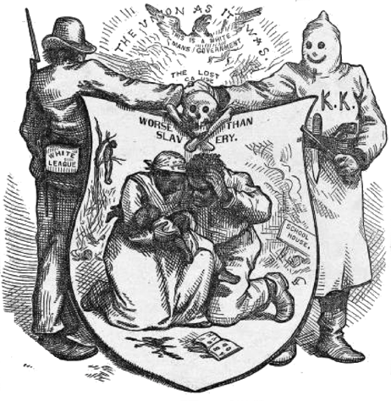
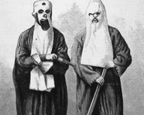
Ku Klux Klan
Racist secret society formed in 1866. Used violence and intimidation to try and keep former slaves powerless.
Democrats tried to lure African Americans away from the Republican party. When that didn’t work, they tried to pass laws from keeping former slaves from being able to vote.
In areas across the South, whites formed secret organizations to intimidate blacks and keep former slaves politically powerless. The most infamous of these secret societies was the Ku Klux Klan. Keeping their identities a secret by dressing in long, hooded white robes, the Klansmen armed with guns and swords worked to intimidate and threaten black voters. They would threaten, beat, tar and feather, and even murder blacks who did not heed their warnings.

Slide 12
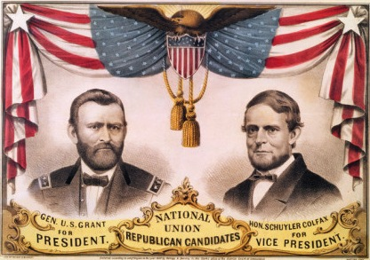
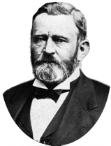
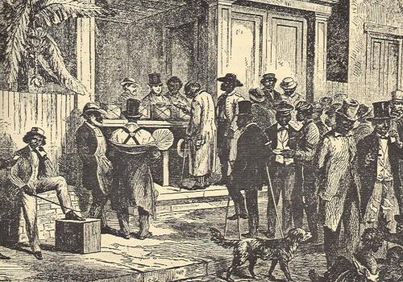
Ulysses S. Grant
African Americans were new voters in the election of 1868. Poor Southerners viewed the Democratic Party as the party of wealthy planters. Both of these groups of Southern voters supported the Republican Party. Wealthy Southerners viewed any white person who would support the Republican party as a traitor.
The military presence in the South had helped millions of former slaves register to vote. In response, black candidates were elected to new Republican-led state governments.
In the election of 1868, these new Southern voters helped elect Republican candidate, Ulysses S. Grant. Grant supported reconstruction and promised to protect the rights of African Americans. His opponent, Horatio Seymour, promised to end reconstruction and return power to traditional white democrat leaders.
Became the 18th President in 1869. Believed Congress should enact Reconstruction.

Slide 13
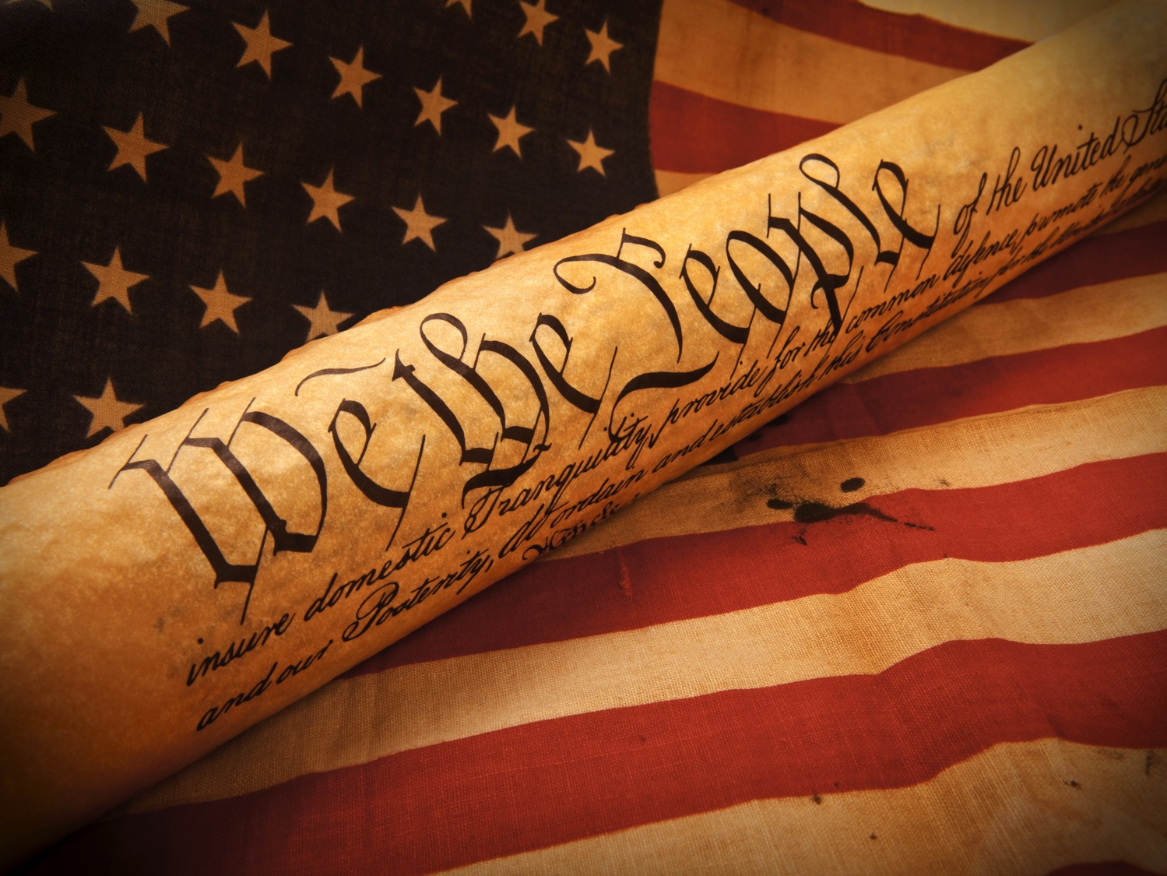
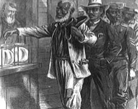
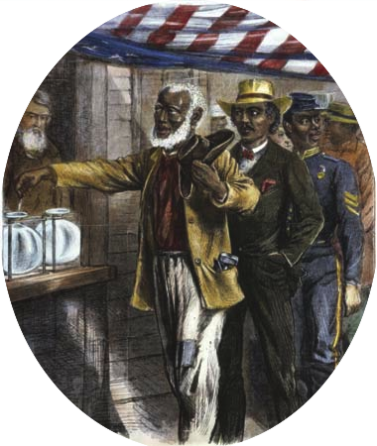
President Grant encouraged Congress to pass the 15th Amendment. This change to the Constitution would make it unlawful to try and deny any person their right to vote based on their race, skin color, or former slave status.
The 15th Amendment was ratified in 1869 and Abolitionists felt they had accomplished their goals. However, even with this Constitutional amendment in place, Southern states would find ways to resist and tried to make it difficult for former slaves to vote.
Some states required all citizens, black and white, to pay a poll tax in order to vote. This kept poor people from being able to participate in elections. Other states required citizens to pass a literacy test to prove they were educated enough to vote. This meant uneducated blacks were denied voting rights.
In spite of all the progress made, the fight for Civil Rights would continue for another century.
15th Amendment
Declared people could not be denied the right to vote based on race or color or for being a former slave.

Slide 14
Optional Video Links
America Story of Us: Abraham Lincoln
https://www.youtube.com/watch?v=Bjxbb-tjSAA
History Channel Blood & Glory: African Americans after the War
https://www.youtube.com/watch?v=GnEKiw7LPvw
John Green Crash Course History: Reconstruction
https://www.youtube.com/watch?v=nowsS7pMApI
Reconstruction- Black Codes & 14th Amendment
https://www.youtube.com/watch?v=rvoX97s8fhI
PBS 60 Second Presidents: Andrew Johnson
https://www.youtube.com/watch?v=H11SE9M2oMY

