Slide 1
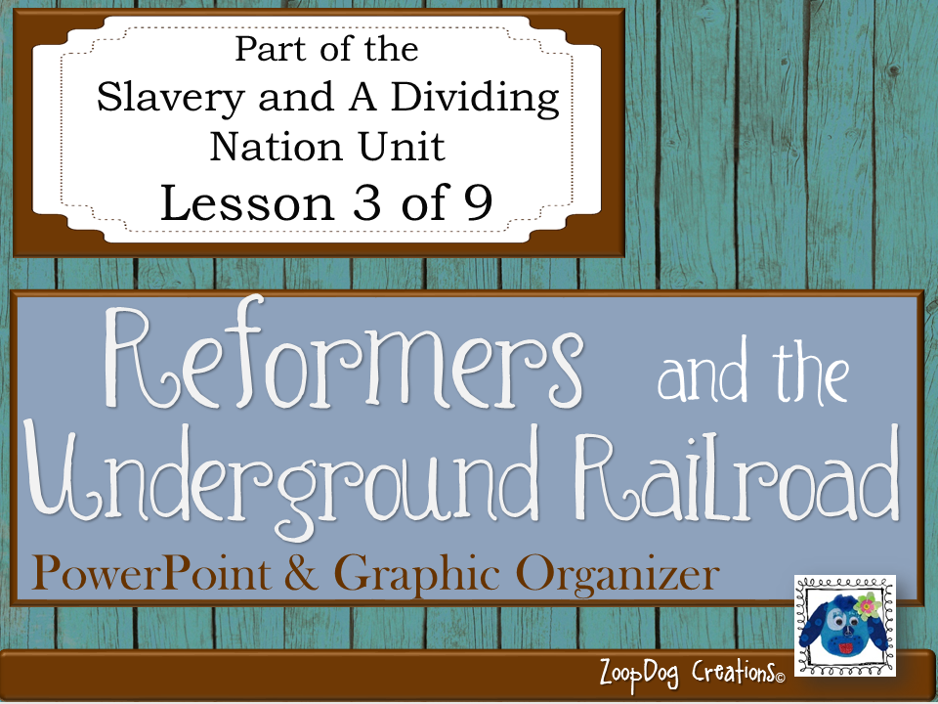

Slide 2
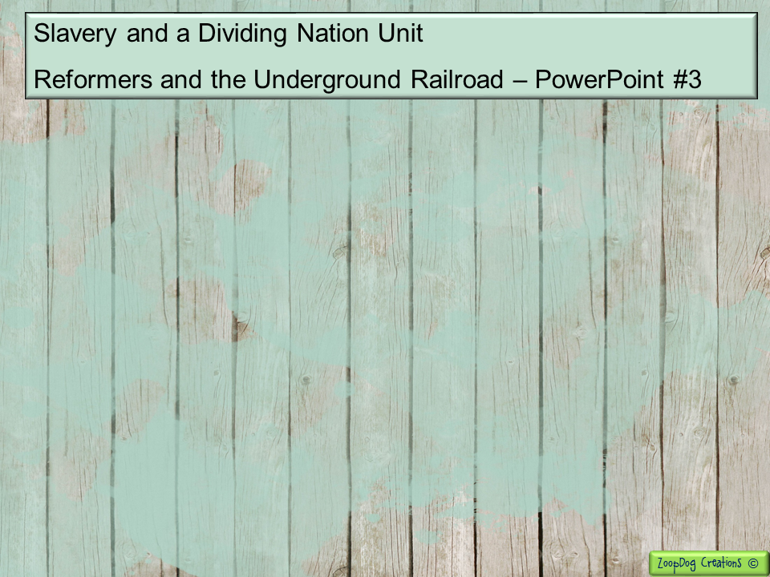
VOCABULARY Abolitionist – American Colonization Society – Reformer – Frederick Douglass – William Lloyd Garrison – Underground Railroad – Harriet Tubman –

Slide 3
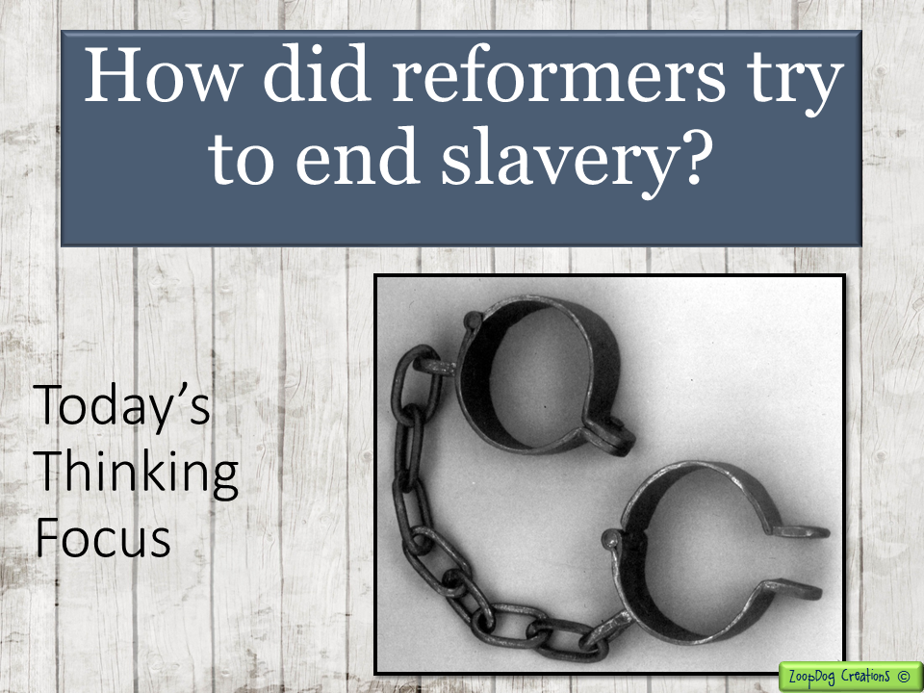

Slide 4

The US population increases during this time, more people are working in factories and leaving their farms. More people are moving West.
Better roads are created, steamboats, covered bridges, turnpikes, to accommodate the many people traveling West.
Tariffs are passed to keep American factories from going bankrupt, but this angers the South – contributing to a growing sense of sectionalism in the country.
With the tariffs a separation between the North and South becomes wider. The Economy of the South depends on cotton and slave labor. The Economy of the North depends on industry and paid labor.
Slave codes are passed by many southern states to discourage black slaves from rebelling or running away. A slave, Nat Turner goes on a killing spree, murdering his master’s family and 60 other white southerners. Over 200 innocent slaves are killed in the aftermath.

Slide 5
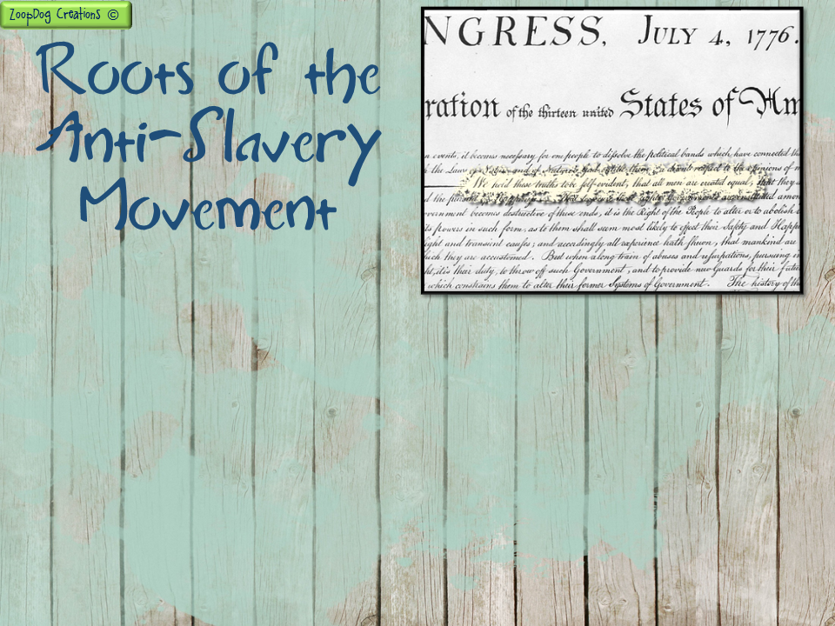
Thomas Jefferson wrote in the Declaration of Independence, “all men are created equal.” But the statement when it was written applied to only WHITE men.
In the 1800s many Americans began to challenge this racist belief. These people were called reformers – activists who challenged the existing state of political and social ideas and thoughts.
Religious beliefs led some Americans to speak out against slavery.
Since colonial times Quakers had said that it was a sin for one human being to own another. They preached that all men and women were equal in the eyes of God.

Slide 6
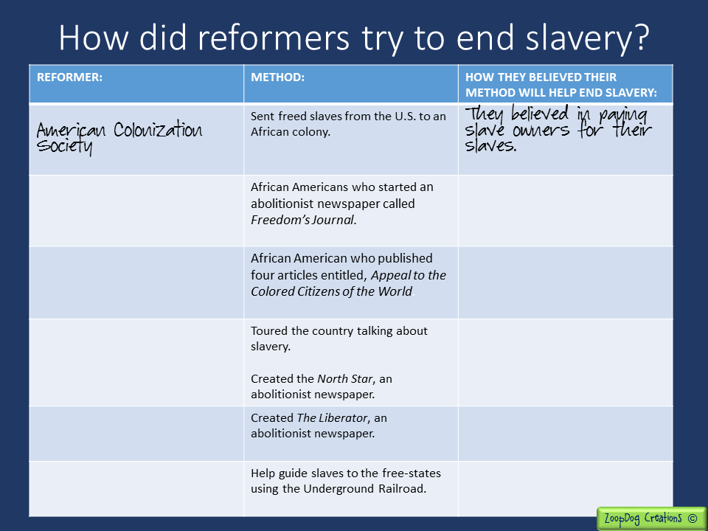
Write-in the names of the reformers in this column as you read about them in the PowerPoint presentation. (The first one is done for you).
In this column, write what each reformer believed needed to be done to help end slavery?

Slide 7
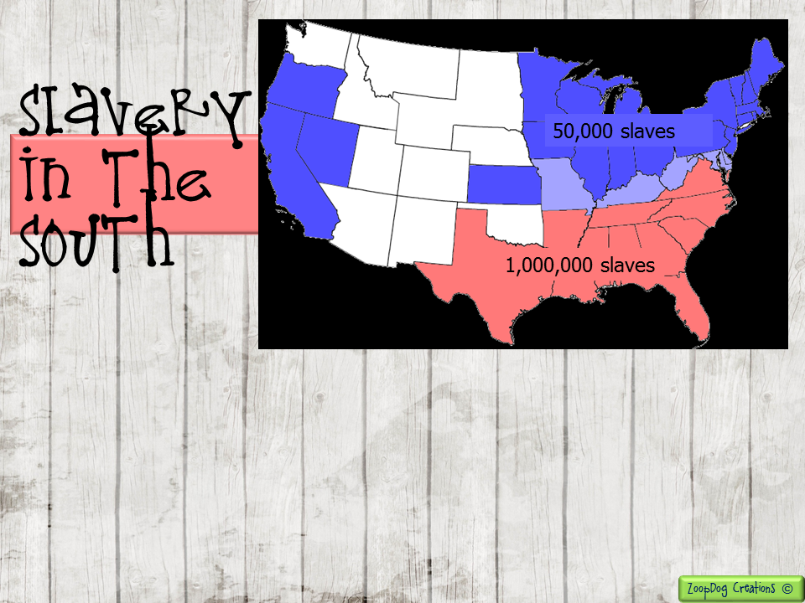
In 1800, the North had only 50,000 slaves.
By 1804, all states from Pennsylvania to New England had promised to free their slaves, essentially ending slavery in this region of the country.
The South had over ONE MILLION slaves, and those numbers continued to grow!

Slide 8
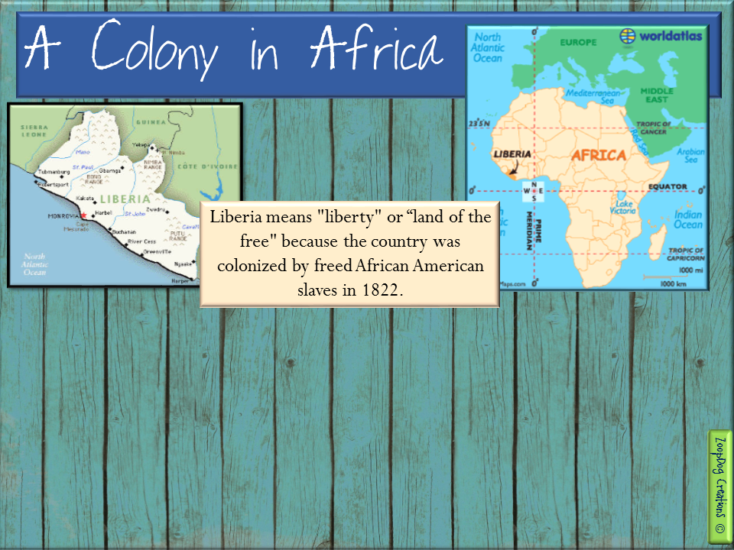
Some Americans believed the United States should establish an independent colony in Africa where freed slaves could be transported back to Africa.
Supporters of this idea founded the American Colonization Society in 1817. Five years later, President Monroe helped the society found the nation of Liberia in Western Africa - a colony where freed slaves could live.

Slide 9
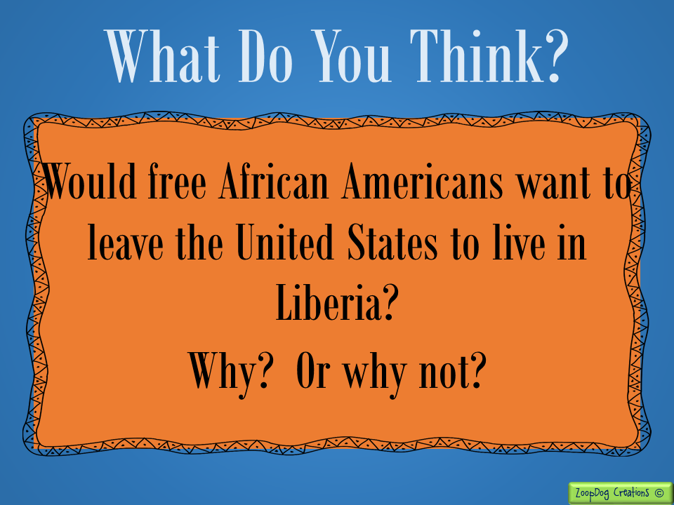

Slide 10
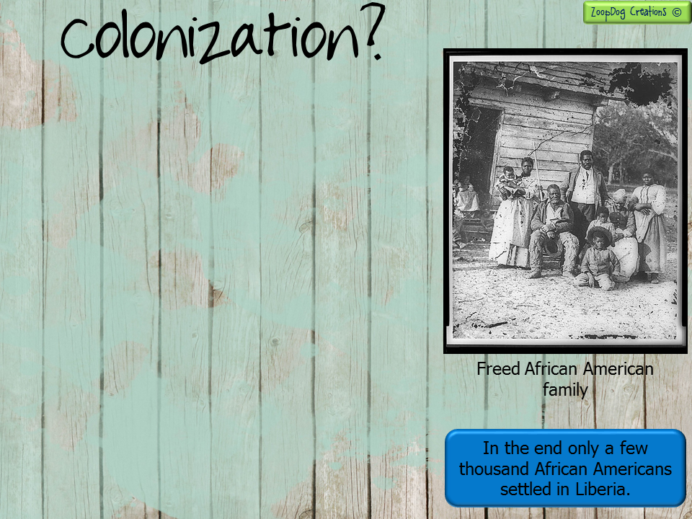
Many white southerners supported the colonization movement because it did not call for an end to slavery.
The American Colonization Society promised to pay slave owners who freed their slaves.
Some African Americans also favored colonization. They felt they would never have equal rights in the U.S.
MOST African Americans opposed the movement. Nearly all African Americans enslaved or free, were born in the US. They wanted to stay in their homeland. Most had never been to Africa like their forefathers who were kidnapped and brought to America.

Slide 11
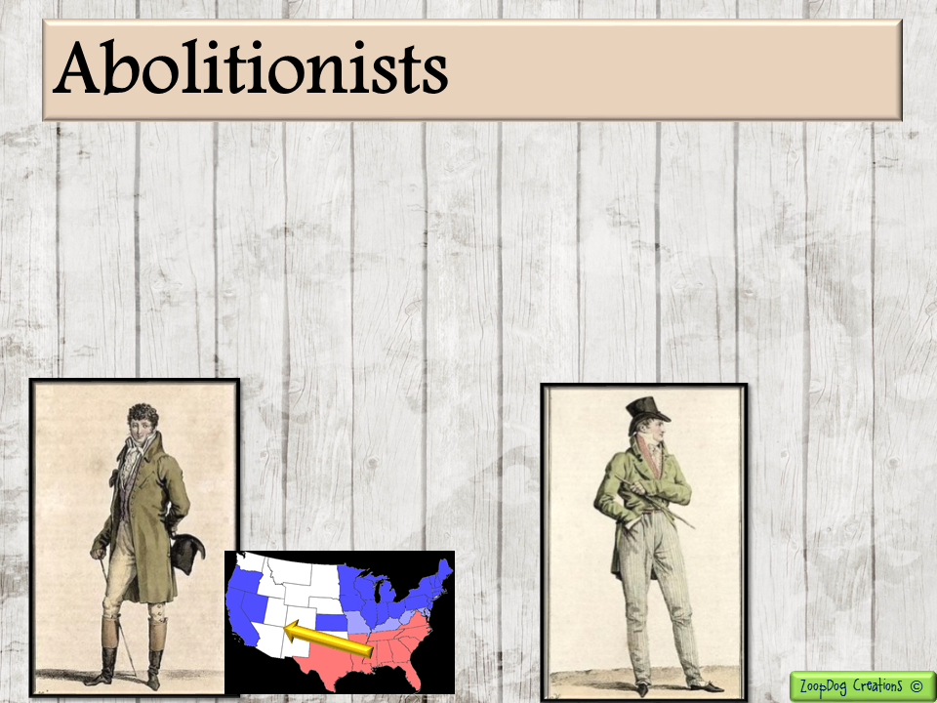
Some Americans felt the American Colonization Society was not a BOLD enough approach to slavery. They felt it didn’t attack the institution of slavery directly.
Another group of Americans that did fight slavery head-on were the abolitionists. Abolitionists were people who wanted to abolish or do away with slavery.
Some abolitionists believed slavery would eventually die out if the institution was not allowed to spread to the western states.
Some abolitionists demanded that slavery end everywhere, NOW!

Slide 12
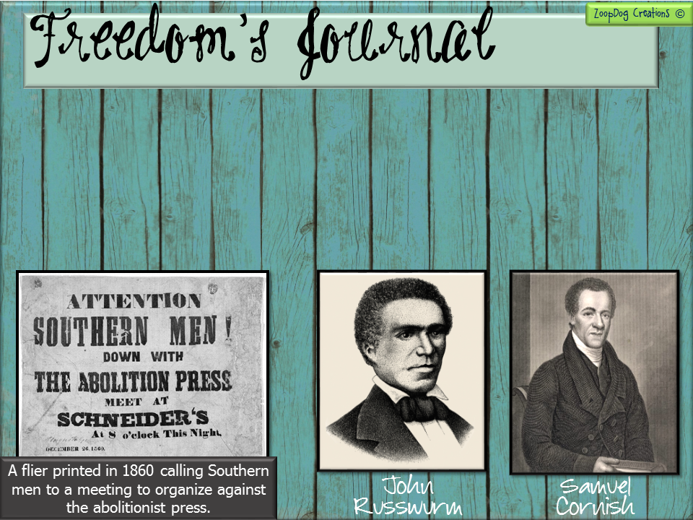
African Americans also joined the abolitionist movement. Some used the legal system to end slavery through lawsuits and petitions.
In the 1820s, Samuel Cornish and John Russwurm started a abolitionist newspaper called Freedom’s Journal.
The believed that if Americans read about the horribly way slaves were treated they would join the abolitionist cause.

Slide 13
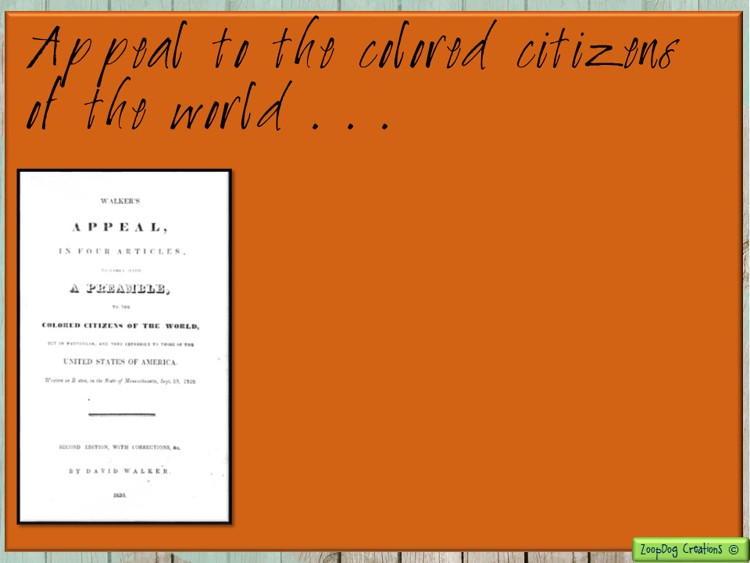
In 1829, an African American named David Walker published four articles entitled, Appeal to the Colored Citizens of the World.
In his articles he encouraged black slaves to free themselves by any means necessary.
Walker believed it was everyone's responsibility to fight for racial equality. He used religious and political beliefs to back up his ideas.
At the time, many abolitionists thought his views were extreme. Some people were fearful of the reaction that the pamphlet would cause.

Slide 14
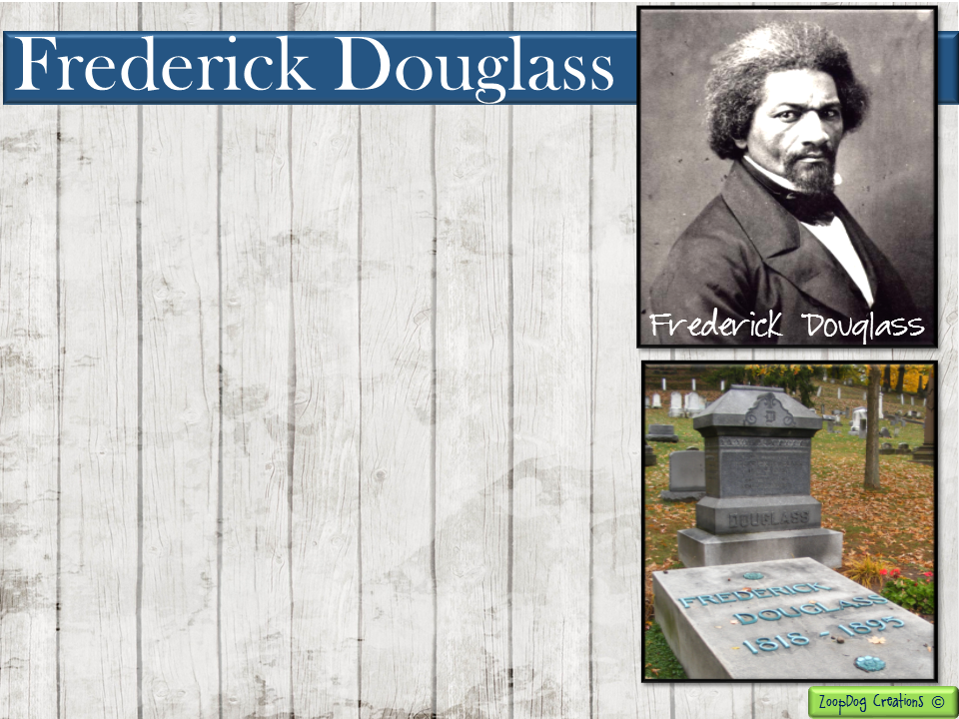
Frederick Douglass was the best known African American abolitionist.
Douglas was born into slavery in Maryland. As a child, he disobeyed the slave codes and secretly taught himself to read.
In 1838, Douglass escaped from slavery and made his way north to Boston.
One day he attended an anti-slavery meeting and felt the need to speak out. He talked about the horrors he had endured and witnessed as a slave.
Douglass’ talk about the injustice of being owned by another had brought tears to the audiences’ eyes. Soon he began lecturing around the country.

Slide 15
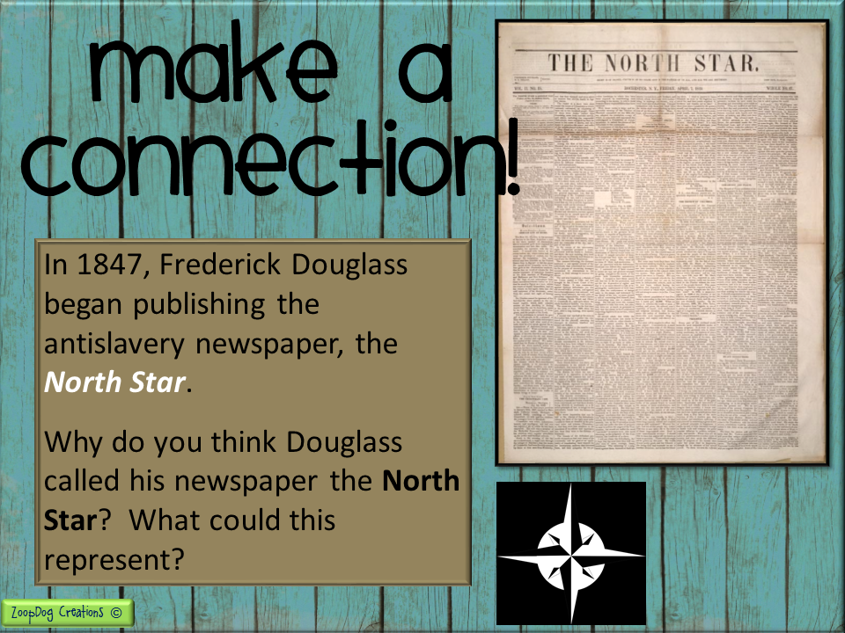
HINT! It has to do with ships and the night sky.

Slide 16
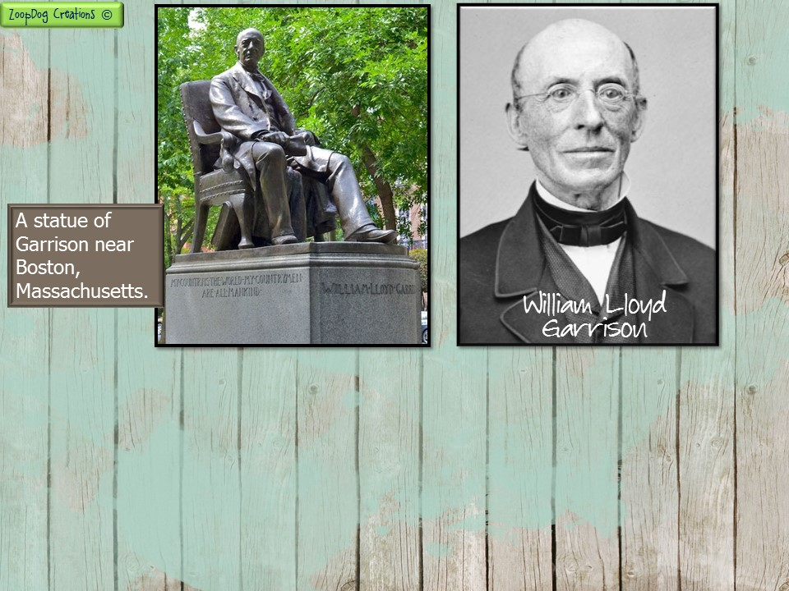
William Lloyd Garrison was the most outspoken
white abolitionist. He was dramatic and fiery
and spoke his controversial opinions openly and without apology.
Garrison was born in Massachusetts and as a young boy loved journalism and the written word.
At age 25, he joined the anti-slavery movement and began writing articles about the injustices of slavery in the United States.

Slide 17
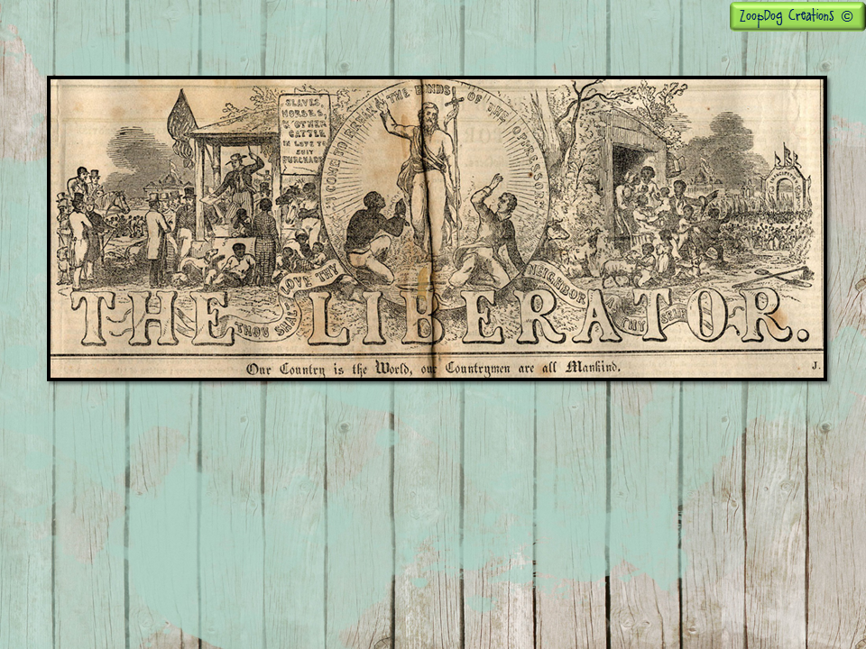
A year later, in 1831, Garrison launched his own antislavery paper, The Liberator, with his friend Isaac Knapp. In it he proclaimed that slavery was an evil to be ended immediately.
In the 1870s, Garrison also became a prominent voice for the woman suffrage movement, (women’s right to vote).

Slide 18
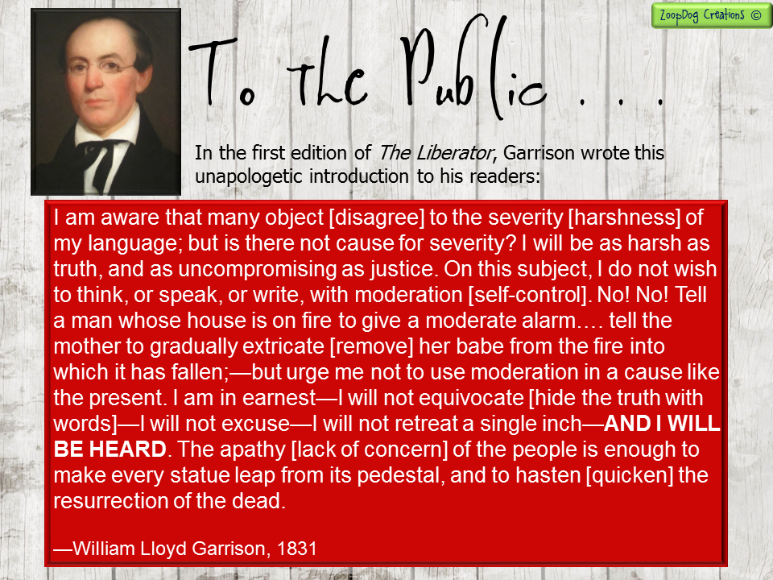

Slide 19
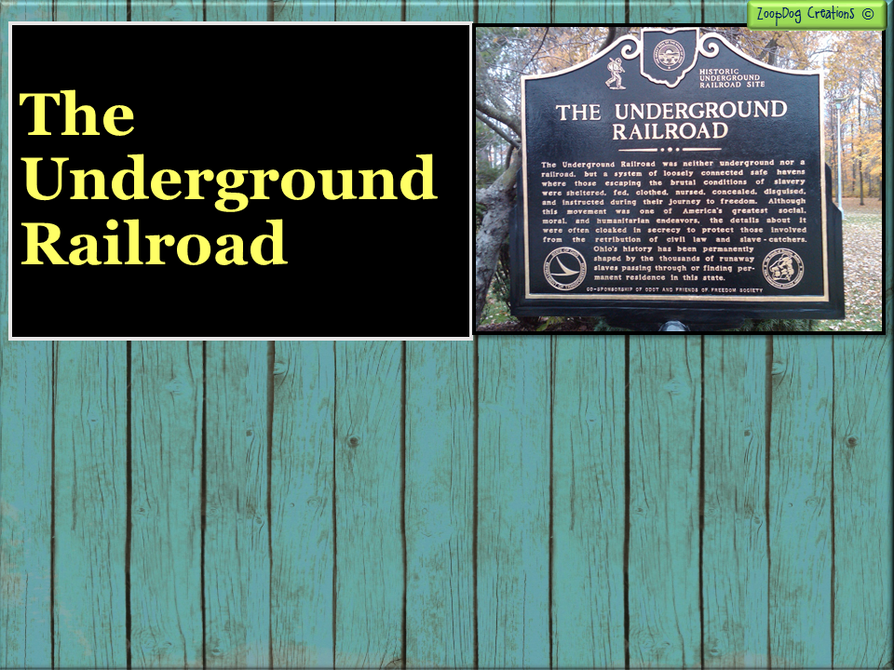
While some abolitionists were speaking publicly across the country, and some were writing articles about the horrors of slavery. Other abolitionists were fighting quietly and risking prison and death to help African Americans escape slavery.
These quiet abolitionists were men and women, white and black who worked together to form the Underground Railroad, a network of abolitionists who secretly helped slaves reach freedom in the North or Canada.

Slide 20
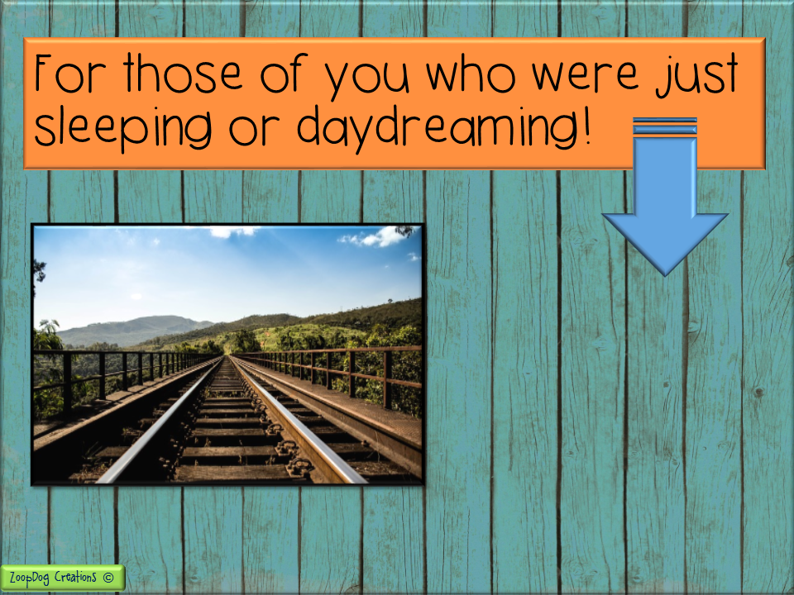
The Underground Railroad is
NOT
a real railroad!

Slide 21
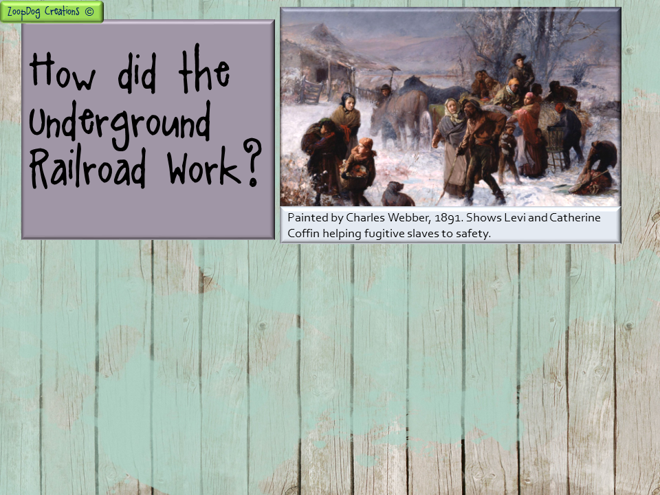
The Underground Railroad was a series of secret routes aided by a network of abolitionists who provided “safe houses” for slaves to stay as they traveled north to freedom.
The “conductor” guided runaway slaves to “stations” where they could spend the night. Some stations were the homes of abolitionists, while others were churches or even caves.
Wagons with false bottoms, and other ingenious ways were used by conductors to smuggle runaways to safety.

Slide 22
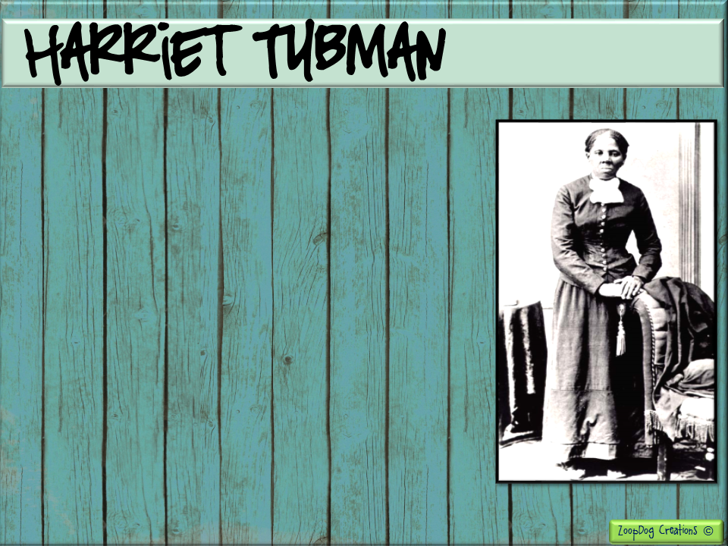
Harriet Tubman was born a slave on a plantation in Maryland. Her birth name was Araminta "Minty" Ross.
As a child she was beaten severely by her master and suffered a skull fracture. She was left for days without medical attention.
Tubman’s head injury caused her to endure epileptic seizures and headaches the rest of her life. She had visions and vivid dreams where she claimed God spoke to her.

Slide 23
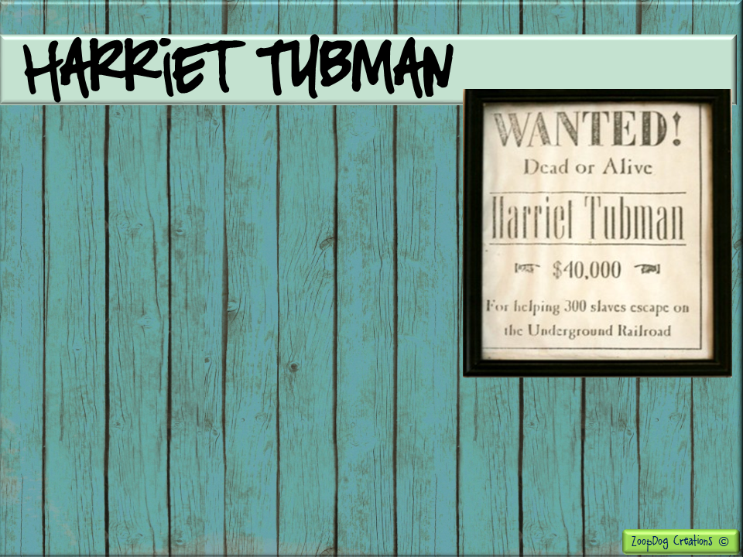
Tubman escaped slavery and then risked her freedom and her life, returning to the South nineteen times to guide more than 300 slaves, including her parents, to freedom.
Tubman was nicknamed “Black Moses,” after the ancient Hebrew leader who led the Israelites out of slavery in Egypt.
At one point, slave owners offered a $40,000 reward for her capture!

Slide 24
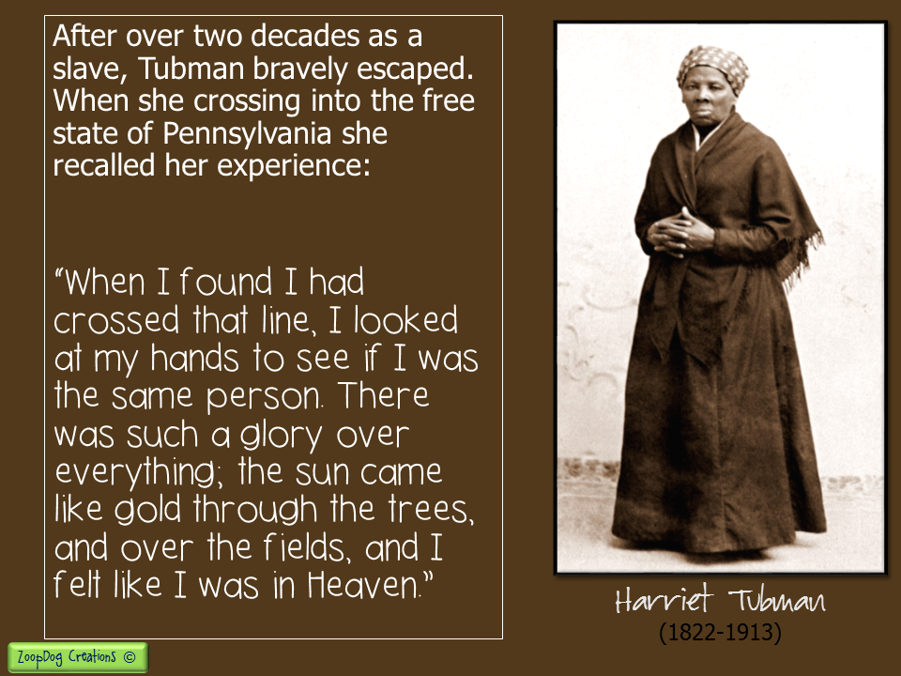

Slide 25
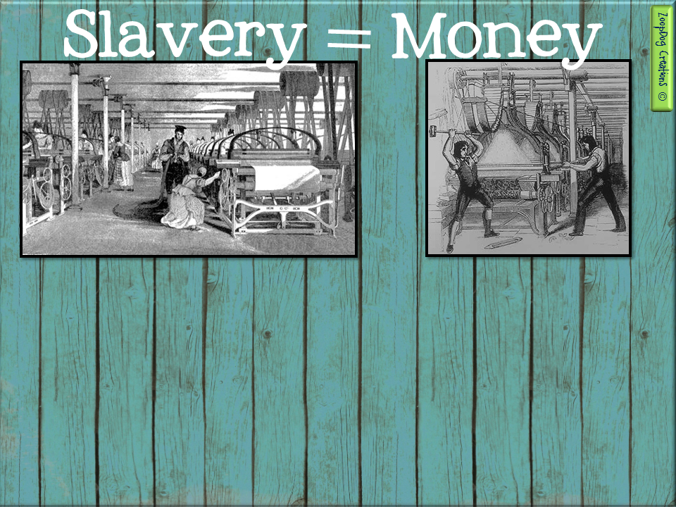
Northern mill owners feared the price of cotton would become more expansive!
Northern workers feared their jobs would be taken by African Americans.
It wasn’t just white southerners who defended the institution of slavery. Many northerners also wanted to keep slavery.
Northern mill owners, bankers, and merchants depended on cotton from the South. These northern businessmen didn’t want slavery to end in the south because it would make cotton more expensive, and they would lose money.
Some northern workers also opposed ending slavery. They feared that African Americans would come north and take their jobs by working for lower pay.

Slide 26
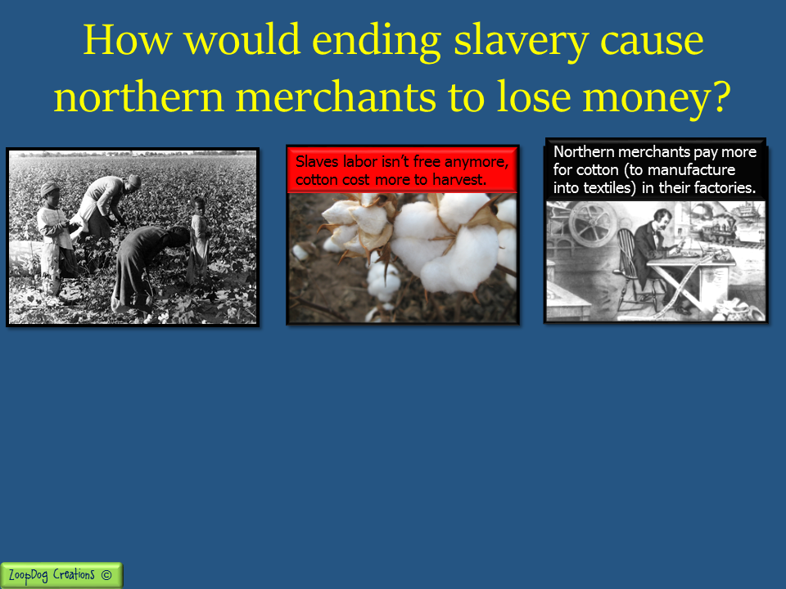
$
$
If slavery ended and slaves working in the fields were suddenly PAID for their labor by southern planters, then . . .
Cotton would cost more to grow and harvest because southern planters now have to pay their workers a wage (this takes away from the planters’ profits).
Southern planters would raise the price of cotton to make up for their lost profits. Northern merchants would then have to pay more for cotton and they lose profits!

Slide 27
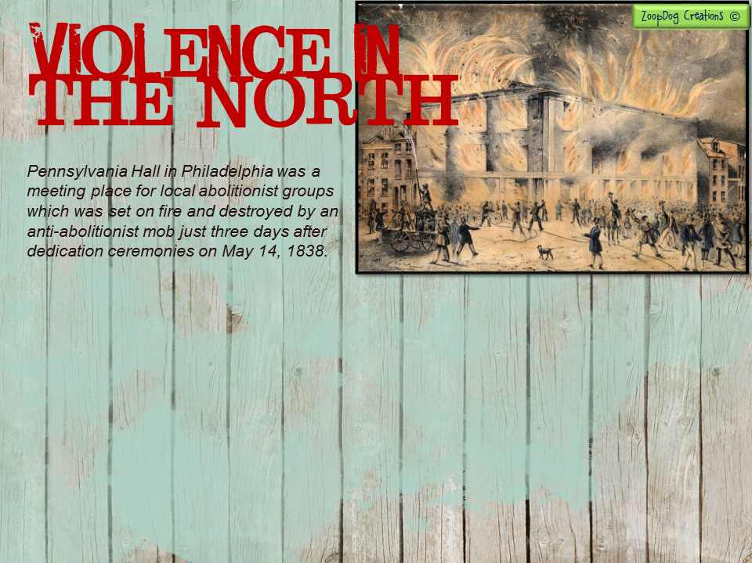
In New York and other northern cities, supporters of slavery had little patience for abolitionists.
At times, crowds of pro-slavery men broke up antislavery meetings, or attacked the homes of abolitionists.
Sometimes the attacks became so violent and distasteful that the actions themselves convinced onlookers to become abolitionists.
One night, a Boston mob dragged William Lloyd Garrison through the streets at the end of rope. A witness wrote . . . “I am an abolitionist from this very moment.”

Slide 28
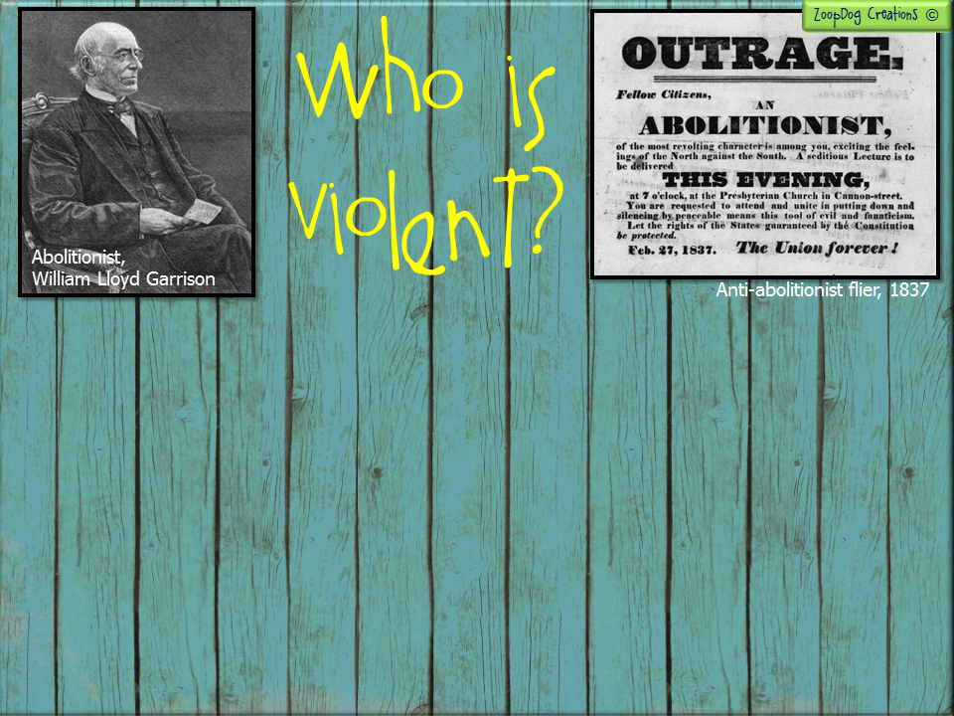
Just as not all northerners were abolitionists, not all white southerners favored slavery. Some bravely spoke out against it. Others moved North rather than live in a slaveholding state.
Most white southerners, however, were disturbed by the growing abolitionist movement. They accused abolitionists of preaching violence and believed if they would stop trying to convince their slaves to runaway and rebel, they would all live peacefully.
Many southerners blamed Nat Turner’s revolt on William Lloyd Garrison. (Garrison had founded The Liberator in 1831, only a few months before Turner’s rebellion).

Slide 29
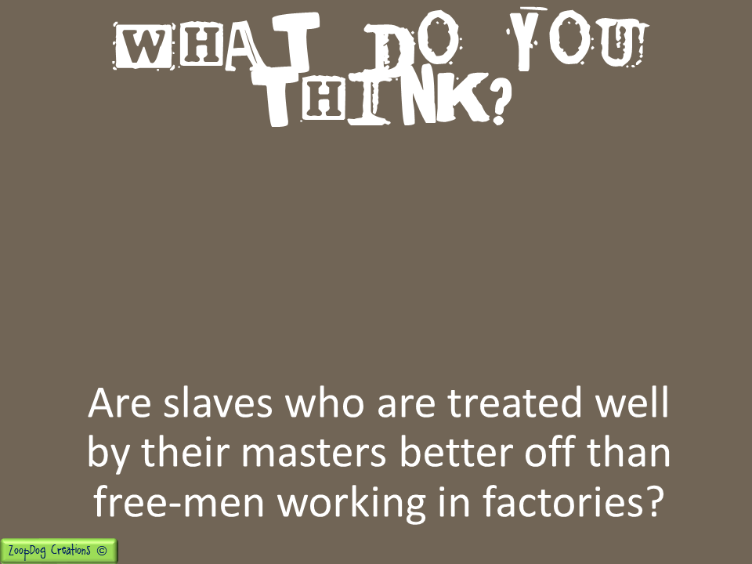
Many slave owners reacted to the abolitionist crusade by defending slavery even more. One slave owner wrote that if slaves were treated well, they would, “love their master and serve him . . . faithfully.”
Other slave owners argued that slaves were better off than northern workers who labored long hours in dusty, airless factories.

Slide 30
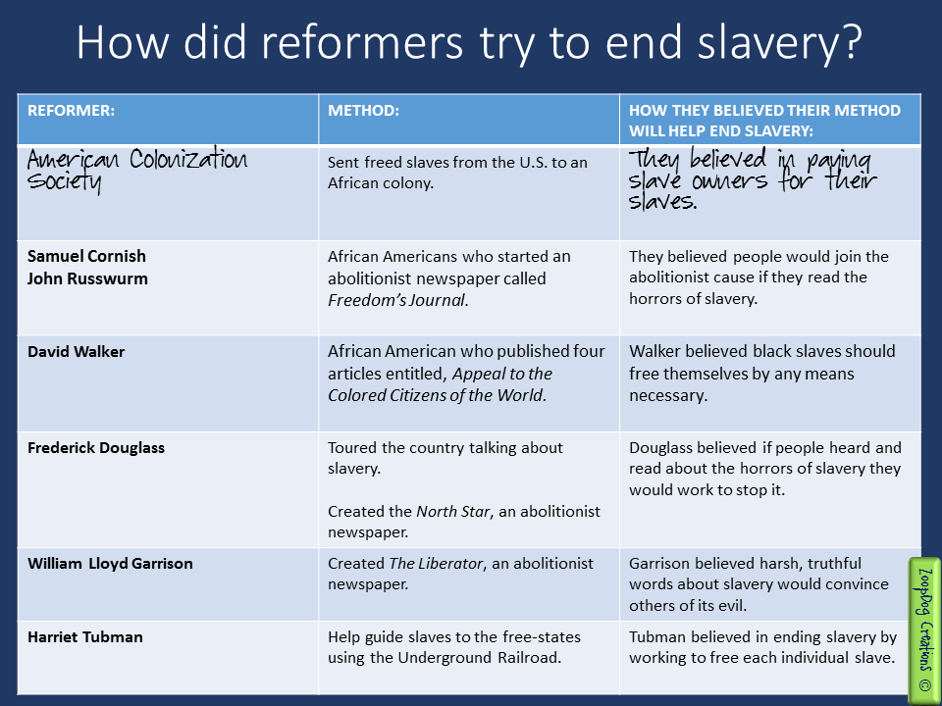

Slide 31


Slide 32


Slide 33


