Slide 1
Servitude and Slavery

Slide 2
The Main Ideas
To meet their growing labor needs, Europeans hired indentured servants and enslaved millions of Africans in forced labor in the Americas.
What were the effects of the Atlantic system on African, European, & American societies & their environments?
What was the relationship between the spread of Sugar plantations and the growth of the slave trade?
Explain capitalism vs. mercantilism, and their roles in the development of the Atlantic System
What were the different roles & influences of Western Europe & Arabs in sub-Saharan Africa 1550 – 1800?

Slide 3

Terms and Names
Indentured Servants
Triangular Trade
Atlantic Slave Trade
Middle Passage

Slide 4
The Planters’ First Labor Source:
White Indentured Servitude
For the first three quarters of the seventeenth century, Virginia tobacco planters relied on white indentured servants from Europe to fill the bulk of their labor needs.
Master paid for cost of trans-Atlantic transportation for servant
Servant agreed to provide labor for fixed period of indenture (typically seven years).
This system of labor was subsidized by the British crown, which awarded the planters a "headright" or land allotment of 50 acres for each servant imported.

Slide 5
Legal Status of
Indentured Servants v. Slaves
Like slaves, indentured servants were considered the chattel property of the masters who had purchased their indentures and could be bought, sold, and inherited.
Unlike slaves, indentured servants enjoyed basic rights shared by all of the king’s subjects. Their children were considered free. Also, at the end of their terms, servants received “freedom dues,” which included land, farming implements, etc. Many went on to become small freeholders.

Slide 6
Indentured Servitude
6
One half to two thirds of all immigrants to Colonial America arrived as indentured servants.
At times, as many as 75% of the population of some colonies were under terms of indenture. .
Labor shortages in England and in the colonies.
Criminals convicted of a capital crime in England could be transported in lieu of a death sentence.
Servitude also could result from indebtedness, where a person, their spouse or parents owed money, and the person was sold into servitude to recover the debt.

Slide 7
In 1668 white servants outnumbered black slaves more than 5 to 1 in the Chesapeake Region.
By the 1700, the ratio had been reversed. Why?

Slide 8
Decline of Indentured Servants
Beginning in the 1680s, planters began turning away from indentured servitude to slave labor, particularly in the Chesapeake colonies.
A steep decline in white immigration from England, as economic conditions improved and new provisions were made for the poor.
A sharp increase in the availability of enslaved laborers, thanks to British domination of the African slave trade and the establishment of the slavetrading Royal African Company.
Rising life expectancy/declining mortality rates made slaves a better investment
Competition from other colonies for European labor

Slide 9
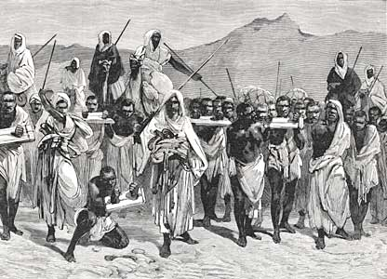
Origins of the Slave Trade
Slavery historically existed in many parts of the world
Spread of Islam into Africa increased slavery there
  Slaves often had legal rights and some social mobility
  Slavery in Africa was not hereditary; children were considered free

Slide 10
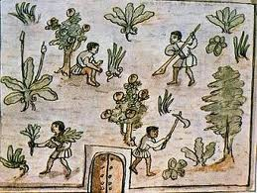
Origins of the Atlantic Slave Trade
European landowners needed a large supply of workers on American plantations

Slide 11
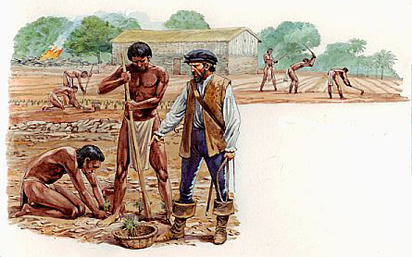
Origins of the Atlantic Slave Trade
Spanish attempts to use Native Americans as laborers were not successful
    Large death rate due to disease and overwork
    Bartolome de la Casas convinces Spanish to stop using Native Americans
English use of Indentured Servants was expensive
    People who worked for a set period in exchange for passage to the Americas

Slide 12
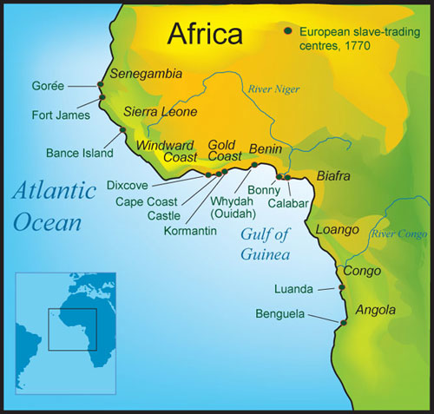
Origins of the Atlantic Slave Trade
Europeans began buying large numbers of Africans to fill labor shortages in Americas
Most slaves came from coast of West Africa
  Were supplied by African rulers in exchange for guns or trade goods
  Kidnapped by Europeans on slave raids

Slide 13
Mercantilism and Capitalism
System of royal monopoly control of colonies & their trade & manufacturing as practiced by Spain & Portugal in the 15th & 16th centuries proved to be inefficient & expensive
In the 17th and 18th centuries, the two new institutions of capitalism & mercantilism established the framework within which government-protected private enterprise participated in the Atlantic economy
The mechanisms of early capitalism (Dutch) included banks, joint-stock companies, stock exchanges, and insurance

Slide 14
Mercantilism & Capitalism – cont’d
Mercantilism was TOTAL control of Trade & not allowing Manufacturing in Colonies, resulting in colonies being dependent upon the mother country. The instruments of mercantilism included chartered companies, such as the Dutch West India Company & the French Royal African Company, & the use of military force to pursue commercial dominance.
The French & English eliminated Dutch competition from the Americas by in a series of wars between 1652 & 1678. The French & English then revoked the monopoly privileges of their chartered companies but continued to use high tariffs to prevent foreigners from gaining access to trade with their colonies.

Slide 15
The Atlantic Circuit
(Columbian Exchange)
The Atlantic Circuit was a clockwise network of trade routes going from Europe to Africa, from Africa to the plantation colonies of the Americas (the Middle Passage), and then from the colonies to Europe. If all went well, a ship would make a profit on each leg of the circuit
The Atlantic Circuit was supplemented by a number of other trade routes: Europe to the Indian Ocean; Europe to the West Indies; New England to the West Indies; and the “Triangular Trade” among New England, Africa, and the West Indies
As the Atlantic system developed, increased demand for sugar in 17th & 18th Century Europe was associated with an increase in the flow of slaves from Africa to the New World

Slide 16
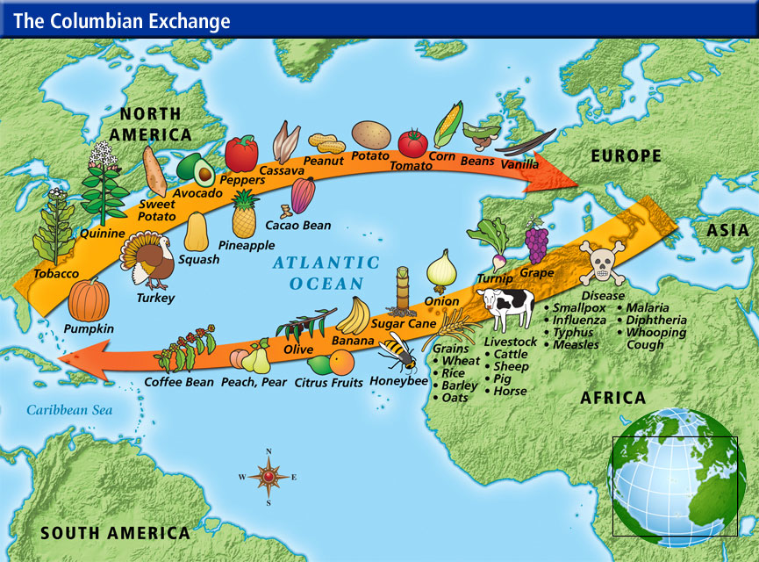

Slide 17
Origins of the Slave Trade
High demand for labor!
  Plantations- estates where cash crops such as sugar or tobacco were grown on large scale.
Shortage of Labor (Why?)
  Planter had first used Native Americans as workers, but European diseases had killed millions of them.
Indentured servants were too expensive!
Notes:
Diseases kill of local Native American tribes
9,395,000

Slide 18
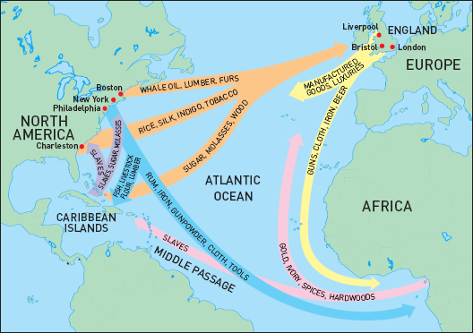
Triangular Trade
Trade routes that linked the Americas, Europe, Africa, and the West Indies
Sea routes formed a triangle

Slide 19
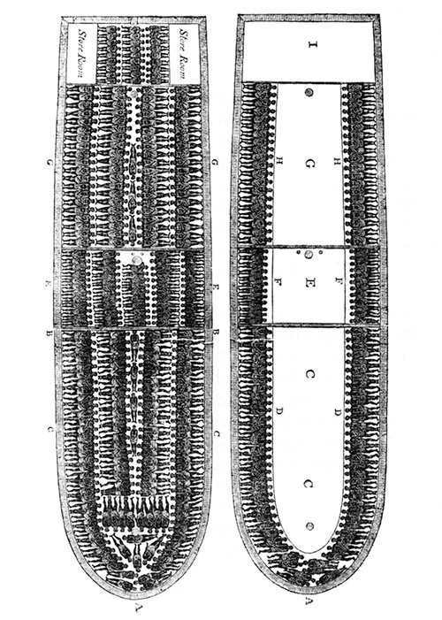
The Middle Passage
The voyage from Africa to the Americas on slave ships
Hundreds of captive Africans were crammed into tight quarters below deck in terrible conditions
Millions died from disease, brutal mistreatment, and suicide on the trip

Slide 20
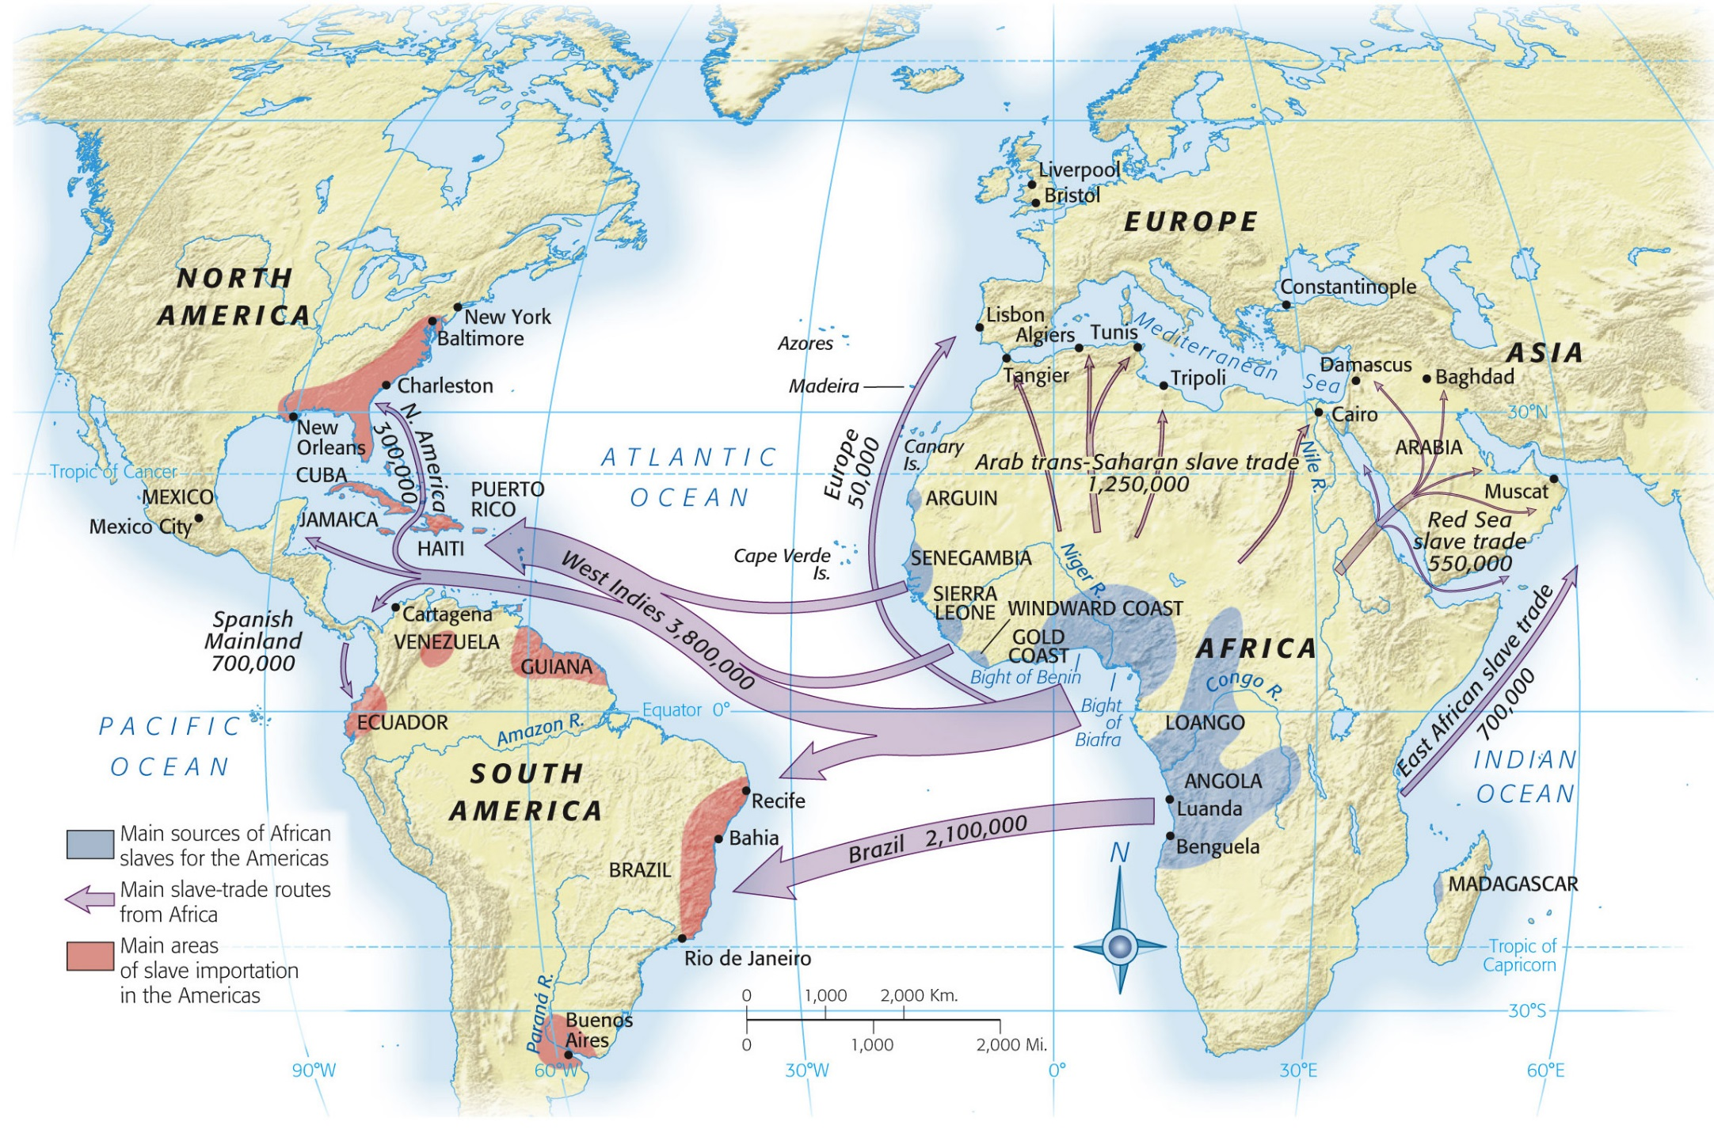
Africa, the Atlantic, and Islam

Slide 21
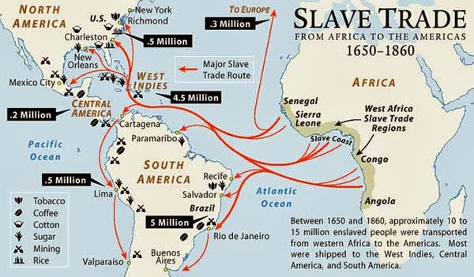

Slide 22
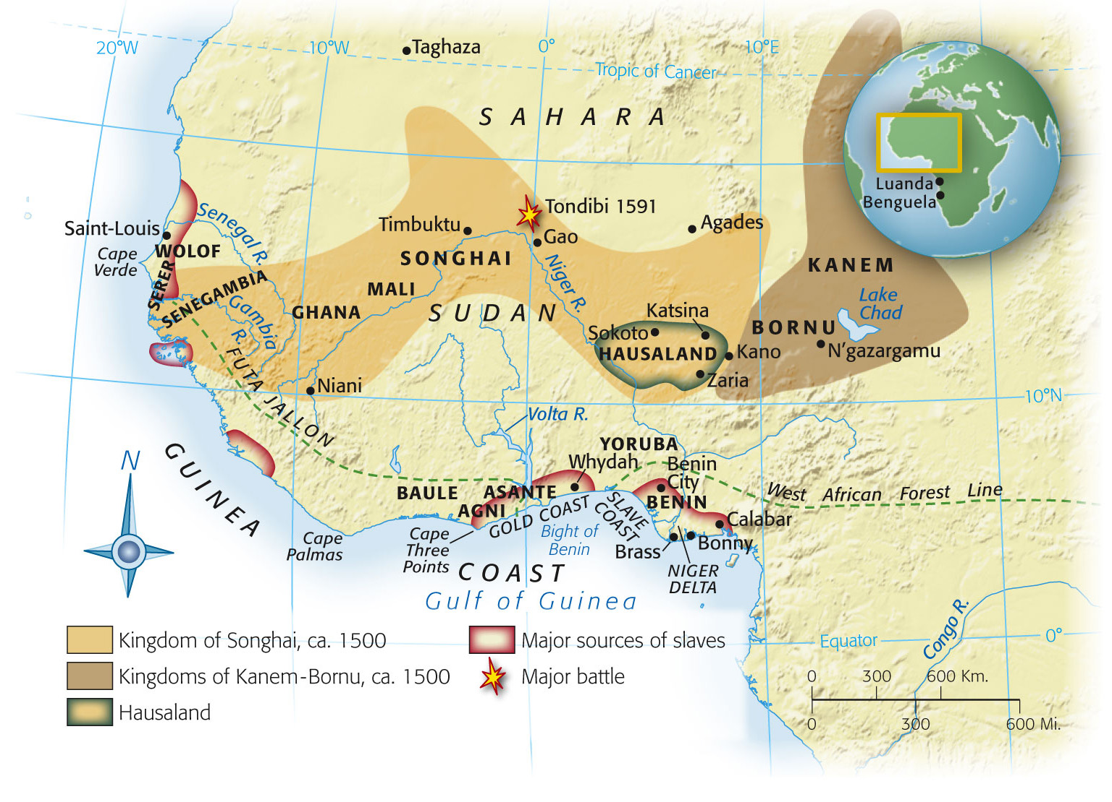

Slide 23
The Desire for Africans
There were several advantages in using Africans:
  They had been exposed (and were immune) to European diseases
  They had experience in farming
  Africans had no friends or family in America to help them escape.
  Enslaved Africans provided a permanent source of labor - even their children were enslaved.

Slide 24
The Desire for Africans
This trade for slaves became the Atlantic Slave Trade
Between 1500 and 1600, about 300,000 slaves were taken to the Americas.
During the next 100 years, the number jumped to 1.5 million, and by 1870 the number was about 11 million.

Slide 25
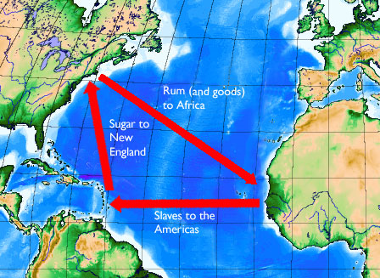

Slide 26
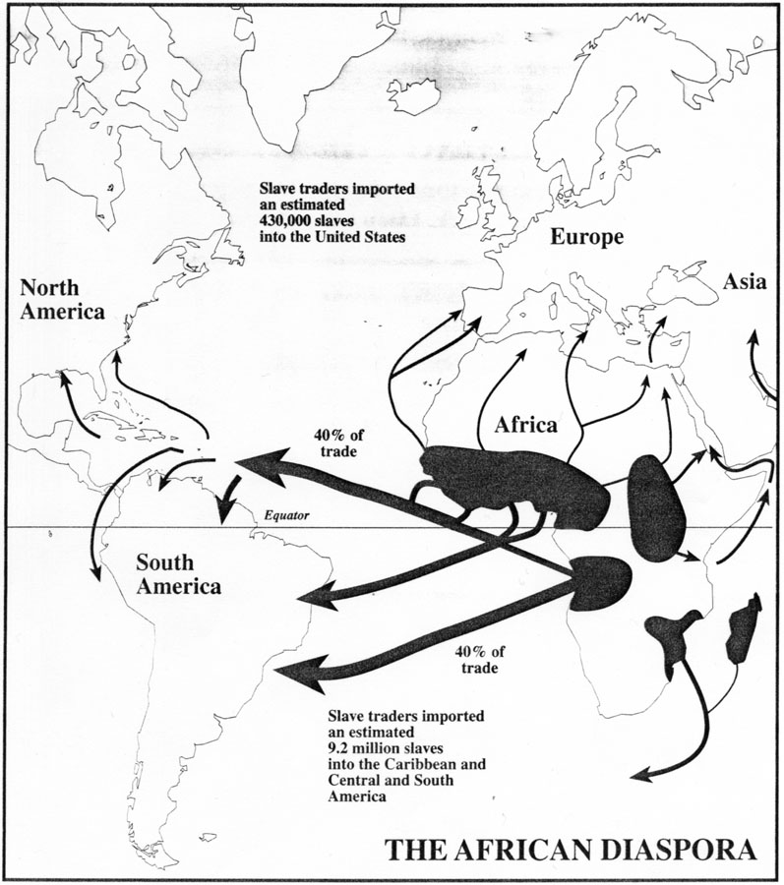
Where did the captured Africans end up?

Slide 27
Conclusion
Nine to eleven million Africans brought to the Americas during three centuries of trade
  Millions more died
  Most arrived between 1701 and 1810
  Only 600,000 reached the British colonies of north America

