Slide 1
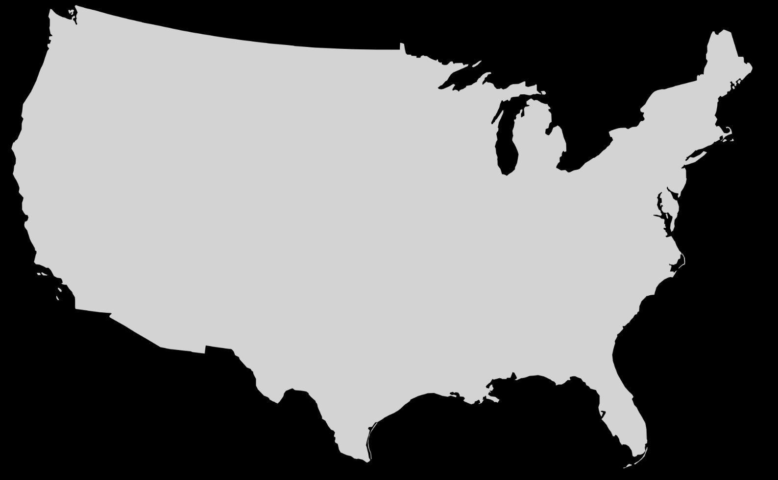
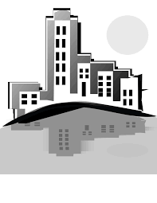
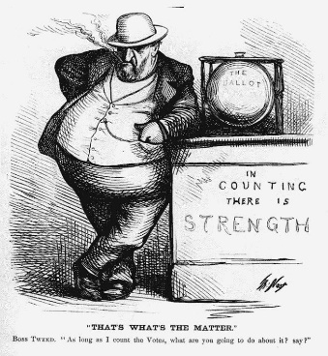
Social Issues
Name:
Push Factors
Pull Factors
innovation
industrialization
Immigration
Urbanization
Unsafe living conditions
Tenements:
Immigration
Stations
Ellis Island
Angel Island
Galveston Island
Minorities
Women
African Americans
Plessy v. Ferguson
Jim Crow Laws
Chinese Exclusion Act
New
Immigrants
Political machines
Tammany Hall
Political bosses
William “Boss” Tweed
Political Issues
Define patronage:

