Slide 1
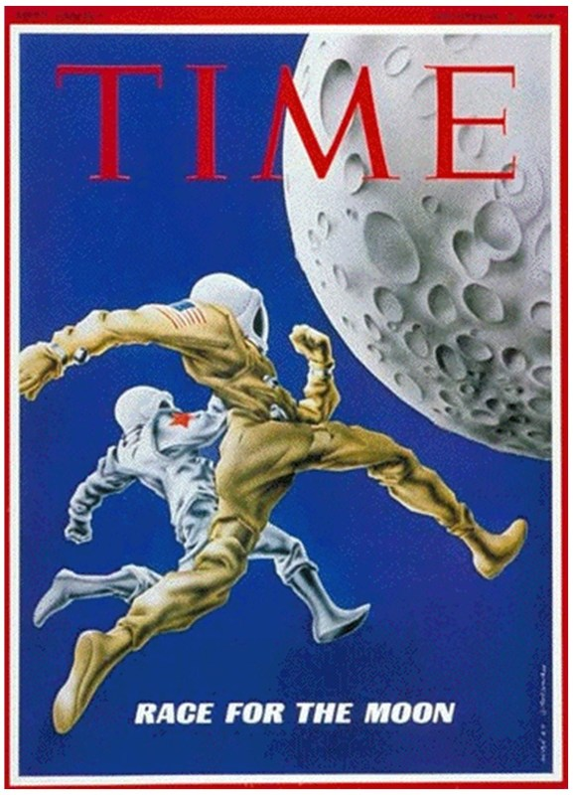
Space Race Timeline and Digital Newspaper Project
Instructions
Complete the interactive timeline on the next page by “dragging and dropping” the events into the correct order and on the correct side (left or right) of the timeline. You can learn about each event by clicking on it and also by using the links at the top.
After completing your timeline, select one event from the list and create a newspaper front page about it. You can use the included template or create your own version. Either way, your newspaper must include: * A name of your newspaper. * The date of your event. * An appropriate headline * Two pictures of your event * A caption for each of your pictures * An article describing the significance of your event.

Slide 2
Timeline of the Space Race
Directions: After learning about the Space Race and its key events complete the timeline below by dragging and dropping the listed events into the correct order along the timeline. If they were Soviet accomplishments, drag them to the right and if they were American accomplishments, they go on the left of the timeline.
Year
1955
1960
Hubble Telescope Launched
1965
Sputnik I
The First Man on the Moon
1970
Mars Rover Lands on Mars
First Man in Space
1975
Kennedy Pledges to Put a Man on the Moon
1980
First American Woman in Space
1985
First GPS Satellite Launched
The Voyager Program
1990
1995
First Dog in Space
First American in Orbit
2000

Slide 3
Date of your event here
Name Your Newspaper Here
Your Headline Should Go Here
Type Your Article here…..
Write a caption for the image above here….
Write a caption for the image above here….

