Slide 2
During the 1920’s through the mid 1950’s Billboard magazine was not around. There were no “hit charts” or any means of keeping track of either record sales or how many times people requested a song to be played on the radio. The person, (http://digitaldreamdoor.com/pages/best_songs-1920s.html), who chose these songs, selected these rankings based off how long each song remained popular. He also took into consideration how much of an impact the songs made to society and music.

Slide 4
Position Number | Song Title & Performer | Via SafeShare | Via YouTube
1 | “Swanee" – Al Jolson | https://safeshare.tv/x/ss57fc1ca7e3df4 | https://www.youtube.com/watch?v=VB5_FScm41Q
2 | “West End Blues" – Louis Armstrong | https://safeshare.tv/x/r8Kft3w-7DI | https://www.youtube.com/watch?v=r8Kft3w-7DI
3 | “Rhapsody in Blue'" - Paul Whiteman featuring George Gershwin | https://safeshare.tv/x/s35IqfLn1Pk | https://www.youtube.com/watch?v=s35IqfLn1Pk
4 | “Ain’t Misbehavin’'" - Fats Waller | https://safeshare.tv/x/7QfO-zeUzWI | https://www.youtube.com/watch?v=7QfO-zeUzWI
5 | "T For Texas (Blue Yodel #1)" – Jimmie Rodgers | https://safeshare.tv/x/ss57fc1b7b4d635 | https://www.youtube.com/watch?v=qEIBmGZxAhg
Notes:
If you find a video link that no longer works….search for a new link on YouTube and replace it here on this slide. Then let your teacher know so they can change their copy.:)

Slide 5
Position Number | Song Title & Performer | Via SafeShare | Via YouTube
6 | “In the Jailhouse Now" – Jimmie Rodgers | https://safeshare.tv/x/p3L2qf3q-ok | https://www.youtube.com/watch?v=p3L2qf3q-ok
7 | “The Prisoner’s Song" - Vernon Dalhart | https://safeshare.tv/x/V0tg5u9y2Ps | https://www.youtube.com/watch?v=V0tg5u9y2Ps
8 | “The St. Louis Blues" - Bessie Smith | https://safeshare.tv/x/ss57fc1a042e7a7 | https://www.youtube.com/watch?v=JpVCqXRlXx4
9 | “Ol’ Man River" - Paul Robeson/Al Jolson | https://safeshare.tv/x/ijHjvFAz0lo | https://www.youtube.com/watch?v=ijHjvFAz0lo
10 | “Makin’ Whoopee" - Eddie Cantor | https://safeshare.tv/x/87Xh3rlLy3Q | https://www.youtube.com/watch?v=87Xh3rlLy3Q
Notes:
If you find a video link that no longer works….search for a new link on YouTube and replace it here on this slide. Then let your teacher know so they can change their copy.:)

Slide 6
Position Number | Song Title & Performer | Via SafeShare | Via YouTube
11 | “Crazy Blues" – Mamie Smith | https://safeshare.tv/x/ss57fc1cfb79c4f | https://www.youtube.com/watch?v=qaz4Ziw_CfQ
12 | “My Blue Heaven" – Paul Whiteman Orchestra | https://safeshare.tv/x/xFurKUxafRk | https://www.youtube.com/watch?v=xFurKUxafRk
13 | “Sonny Boy”- Al Jolson | https://safeshare.tv/x/tUdAVuHK0eo | https://www.youtube.com/watch?v=tUdAVuHK0eo
14 | “Dardanella”- Ben Selvin | https://safeshare.tv/x/oTCTBhRTxyw | https://www.youtube.com/watch?v=oTCTBhRTxyw
15 | “It Had to Be You" – Isham Jones/Marion Harris | https://www.youtube.com/watch?v=Tlw6Zl3t4vw | https://www.youtube.com/watch?v=Tlw6Zl3t4vw
Notes:
If you find a video link that no longer works….search for a new link on YouTube and replace it here on this slide. Then let your teacher know so they can change their copy.:)

Slide 7
Position Number | Song Title & Performer | Via SafeShare | Via YouTube
16 | “Pine Top's Boogie Woogie" – Pine Top Smith | https://safeshare.tv/x/fDp9cOLxYv0 | https://www.youtube.com/watch?v=fDp9cOLxYv0
17 | “Whispering" – Paul Whiteman | https://safeshare.tv/x/XmaY2tJXRAg | https://www.youtube.com/watch?v=XmaY2tJXRAg
18 | “My Mammy" - Al Jolson | https://safeshare.tv/x/nR4SGKgfUl0 | https://www.youtube.com/watch?v=nR4SGKgfUl0
19 | “Down Hearted Blues" – Bessie Smith | https://safeshare.tv/x/ss57fc205b93875 | https://www.youtube.com/watch?v=go6TiLIeVZA
20 | “Charleston" - Arthur Gibbs | https://safeshare.tv/x/FlR1ePU2U28 | https://www.youtube.com/watch?v=FlR1ePU2U28
Notes:
If you find a video link that no longer works….search for a new link on YouTube and replace it here on this slide. Then let your teacher know so they can change their copy.:)

Slide 12
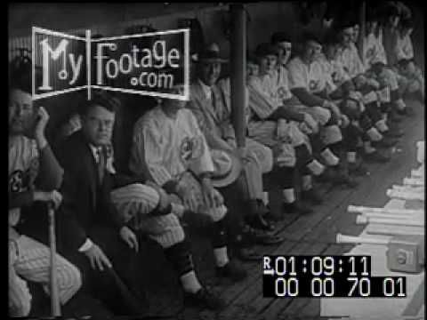
Notes:
If you find a video link that no longer works….search for a new link on YouTube and replace it here on this slide. Then let your teacher know so they can change their copy.:)

Slide 15
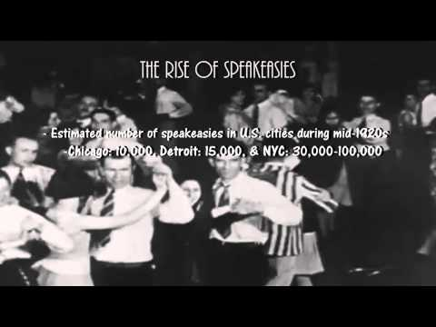
Notes:
If you find a video link that no longer works….search for a new link on YouTube and replace it here on this slide. Then let your teacher know so they can change their copy.:)

Slide 18
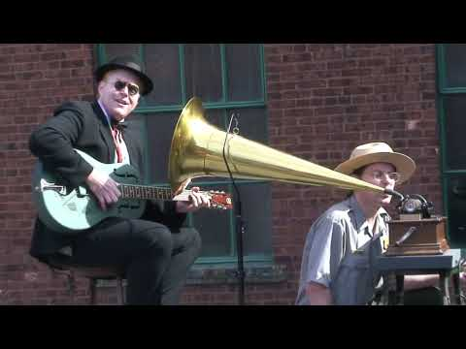
Notes:
If you find a video link that no longer works….search for a new link on YouTube and replace it here on this slide. Then let your teacher know so they can change their copy.:)

Slide 19
Notes:
Click here to see a gramophone in action! If you find a video link that no longer works….search for a new link on YouTube and replace it here on this slide. Then let your teacher know so they can change their copy.:)

Slide 20
Notes:
If you find a video link that no longer works….search for a new link on YouTube and replace it here on this slide. Then let your teacher know so they can change their copy.:)

Slide 22
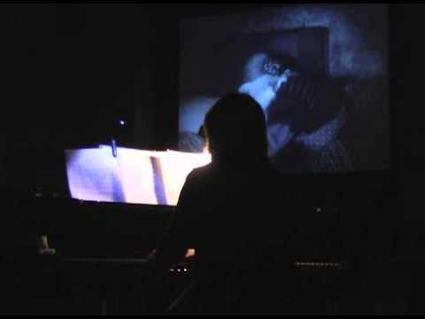

Slide 26
Notes:
If you find a video link that no longer works….search for a new link on YouTube and replace it here on this slide. Then let your teacher know so they can change their copy.:)

Slide 28
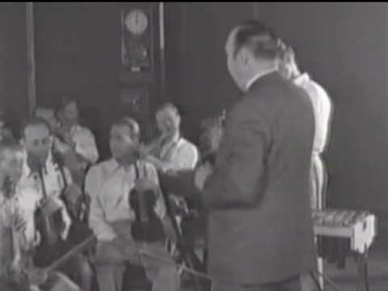
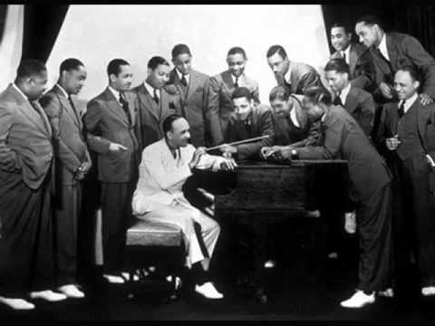
Notes:
If you find a video link that no longer works….search for a new link on YouTube and replace it here on this slide. Then let your teacher know so they can change their copy.:)

Slide 31
Notes:
If you find a video link that no longer works….search for a new link on YouTube and replace it here on this slide. Then let your teacher know so they can change their copy.:)

Slide 33
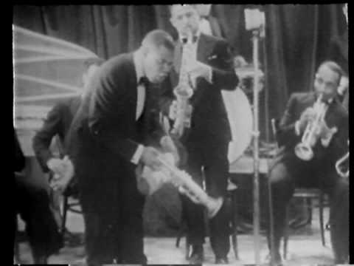
Notes:
If you find a video link that no longer works….search for a new link on YouTube and replace it here on this slide. Then let your teacher know so they can change their copy.:)

Slide 34
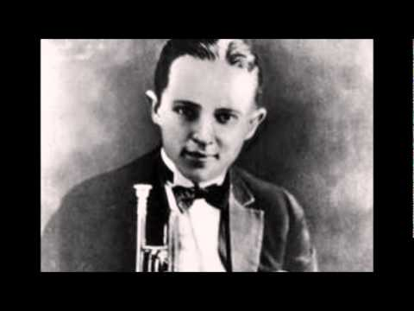
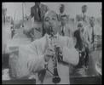
Notes:
If you find a video link that no longer works….search for a new link on YouTube and replace it here on this slide. Then let your teacher know so they can change their copy.:)

Slide 38
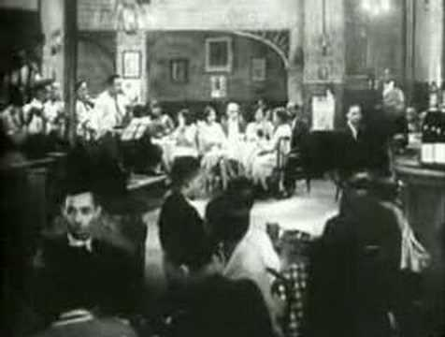
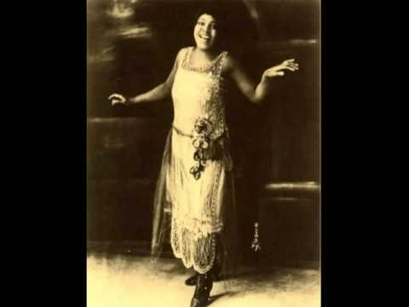
Notes:
If you find a video link that no longer works….search for a new link on YouTube and replace it here on this slide. Then let your teacher know so they can change their copy.:)

Slide 39
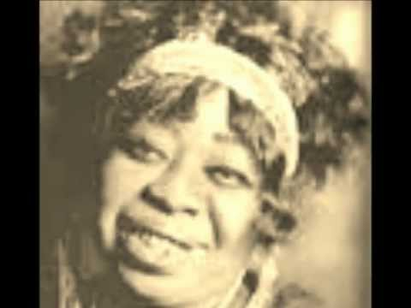
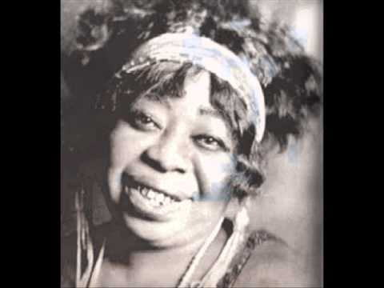
Notes:
If you find a video link that no longer works….search for a new link on YouTube and replace it here on this slide. Then let your teacher know so they can change their copy.:)

Slide 40
Notes:
If you find a video link that no longer works….search for a new link on YouTube and replace it here on this slide. Then let your teacher know so they can change their copy.:)

Slide 41
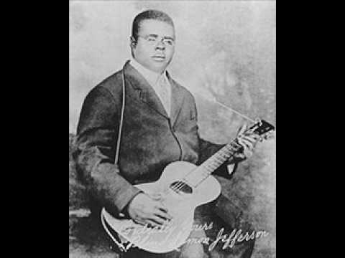
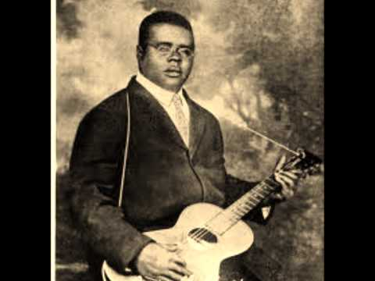
Notes:
If you find a video link that no longer works….search for a new link on YouTube and replace it here on this slide. Then let your teacher know so they can change their copy.:)

Slide 45
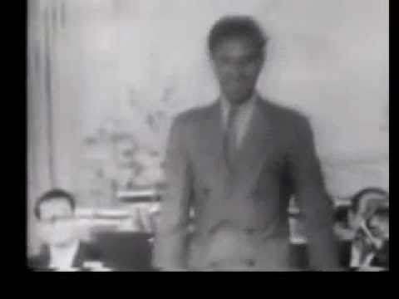
Notes:
If you find a video link that no longer works….search for a new link on YouTube and replace it here on this slide. Then let your teacher know so they can change their copy.:)

Slide 46
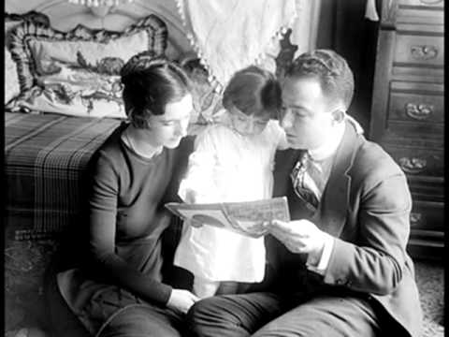
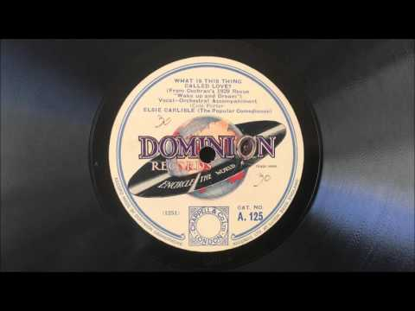
Notes:
If you find a video link that no longer works….search for a new link on YouTube and replace it here on this slide. Then let your teacher know so they can change their copy.:)

Slide 49
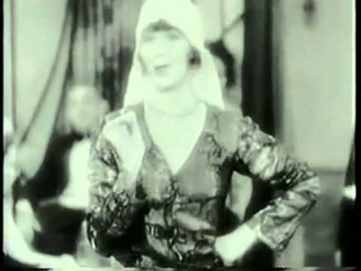
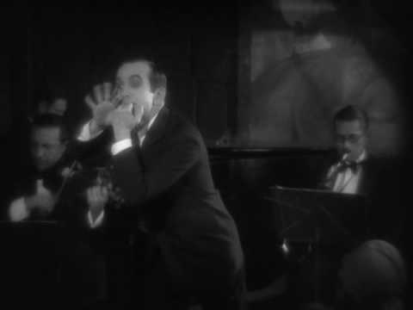
Notes:
If you find a video link that no longer works….search for a new link on YouTube and replace it here on this slide. Then let your teacher know so they can change their copy.:)

Slide 50
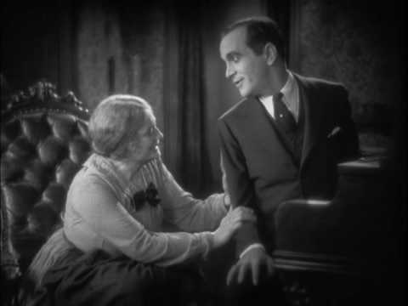
Notes:
If you find a video link that no longer works….search for a new link on YouTube and replace it here on this slide. Then let your teacher know so they can change their copy.:)

