Slide 2
(http://digitaldreamdoor.com/pages/best_songs-1940s.html),

Slide 4
Position Number | Song Title & Performer | Via SafeShare | Via YouTube
1 | “White Christmas” - Bing Crosby | https://safeshare.tv/x/UD43sQ5TBhc | https://www.youtube.com/watch?v=A9ibhWgMlso
2 | “The Christmas Song” - Nat “King” Cole | https://safeshare.tv/x/ss596f9fdf7cf80 | https://www.youtube.com/watch?v=hwacxSnc4tI
3 | “ God Bless the Child” - Billie Holiday | https://safeshare.tv/x/ss57fc09dd341cc | https://www.youtube.com/watch?v=Wc4JvGfRLpA
4 | “Take the “A” Train” - Duke Ellington | https://safeshare.tv/x/ss57fc0a7f95827 | https://www.youtube.com/watch?v=cb2w2m1JmCY
5 | “Star Dust” - Artie Shaw | https://safeshare.tv/x/P0NNxby9F7I | https://www.youtube.com/watch?v=P0NNxby9F7I
Notes:
If you find a video link that no longer works….search for a new link on YouTube and replace it here on this slide. Then let your teacher know so they can change their copy.:)

Slide 5
Position Number | Song Title & Performer | Via SafeShare | Via YouTube
6 | “Swing On a Star” - Bing Crosby | https://safeshare.tv/x/9CDs067081E | https://www.youtube.com/watch?v=9CDs067081E
7 | “You Always Hurt the One You Love” - Mills Brothers | https://safeshare.tv/x/ss57fc0aea066e3 | https://www.youtube.com/watch?v=mS9U75YC-jA
8 | “Boogie-Woogie Bugle Boy” - Andrews Sisters | https://safeshare.tv/x/ss57fc0b08ed6ce | https://www.youtube.com/watch?v=8of3uhG1tCI
9 | “Chattanooga Choo Choo” - Glenn Miller | https://safeshare.tv/x/ss57fc0b58d2250 | https://www.youtube.com/watch?v=-XQybKMXL-k
10 | “Paper Doll” - Mills Brothers | https://safeshare.tv/x/ss596fa12f53c82 | https://www.youtube.com/watch?v=Sppx_yZs4DY
Notes:
If you find a video link that no longer works….search for a new link on YouTube and replace it here on this slide. Then let your teacher know so they can change their copy.:)

Slide 6
Position Number | Song Title & Performer | Via SafeShare | Via YouTube
11 | “Rudolph, The Red-Nosed Reindeer” - Gene Autry | https://safeshare.tv/x/j11rwc6Sf4o | https://www.youtube.com/watch?v=4j4HOMjnDws
12 | “Sentimental Journey” - Les Brown & Doris Day | https://safeshare.tv/x/ss57fc0d5b7a129 | https://www.youtube.com/watch?v=0ycj2SwFG3w
13 | “ I’ll Be Seeing You” - Bing Crosby | https://safeshare.tv/x/JSIodQjUSmg | https://www.youtube.com/watch?v=1ld7pkvZPQk
14 | “I’ll Never Smile Again” - Tommy Dorsey | https://safeshare.tv/x/kEPnhszmKuo | https://www.youtube.com/watch?v=kEPnhszmKuo
15 | “Riders in the Sky (A Cowboy Legend)” - Vaughn Monroe | https://safeshare.tv/x/ais2uSUwIuY | https://www.youtube.com/watch?v=ais2uSUwIuY
Notes:
If you find a video link that no longer works….search for a new link on YouTube and replace it here on this slide. Then let your teacher know so they can change their copy.:)

Slide 7
Position Number | Song Title & Performer | Via SafeShare | Via YouTube
16 | “Auld Lang Syne” - Guy Lombardo | https://safeshare.tv/x/qK0Lfrr5Wpo | https://www.youtube.com/watch?v=Ik7ktS3PqEs
17 | “That’s My Desire” - Frankie Laine | https://safeshare.tv/x/gJdE9za7Pug | https://www.youtube.com/watch?v=3AOVvl6J_1w
18 | “Don’t Fence Me In” - Bing Crosby & The Andrews Sisters | https://safeshare.tv/x/lrcS_vZRA08 | https://www.youtube.com/watch?v=mOKnxfrFBKM
19 | “Jingle, Jangle, Jingle” - Kay Kiser | https://safeshare.tv/x/pSTUzFPwB8Y | https://www.youtube.com/watch?v=Lq7wO1qtQuM
20 | “Tuxedo Junction” - Glenn Miller | https://safeshare.tv/x/FShSI_6LyF8 | https://www.youtube.com/watch?v=FShSI_6LyF8
Notes:
If you find a video link that no longer works….search for a new link on YouTube and replace it here on this slide. Then let your teacher know so they can change their copy.:)

Slide 12
Notes:
If you find a video link that no longer works….search for a new link on YouTube and replace it here on this slide. Then let your teacher know so they can change their copy.:)

Slide 15
Notes:
If you find a video link that no longer works….search for a new link on YouTube and replace it here on this slide. Then let your teacher know so they can change their copy.:)

Slide 16
Notes:
If you find a video link that no longer works….search for a new link on YouTube and replace it here on this slide. Then let your teacher know so they can change their copy.:)

Slide 23
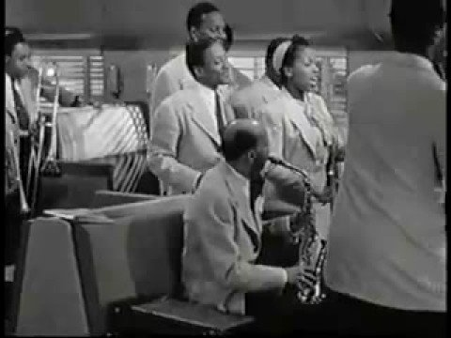
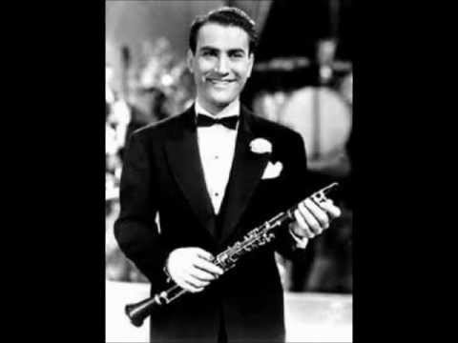
Notes:
If you find a video link that no longer works….search for a new link on YouTube and replace it here on this slide. Then let your teacher know so they can change their copy.:)

Slide 24
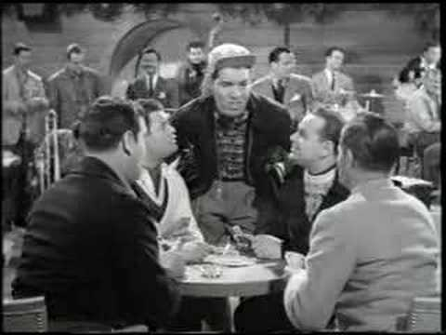
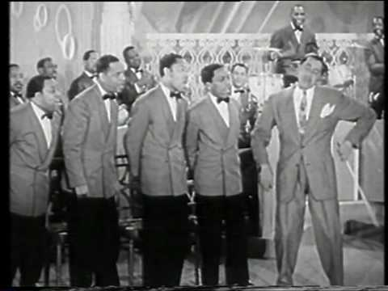
Notes:
If you find a video link that no longer works….search for a new link on YouTube and replace it here on this slide. Then let your teacher know so they can change their copy.:)

Slide 25
Type here
Type here
Type here
Insert > Media > Video > Online Video
Notes:
You may need to change the size of the font to make your answer fit.

Slide 29
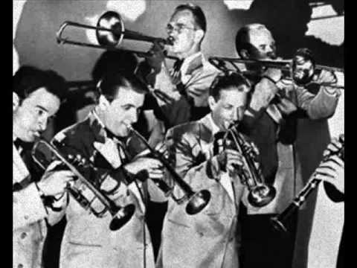
Notes:
If you find a video link that no longer works….search for a new link on YouTube and replace it here on this slide. Then let your teacher know so they can change their copy.:)

Slide 31
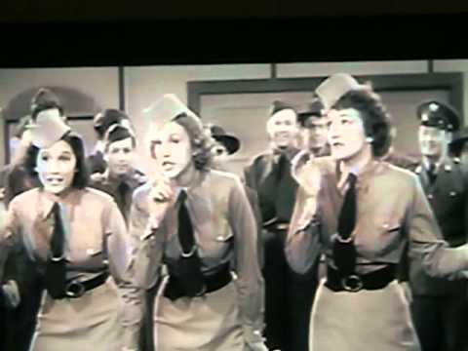
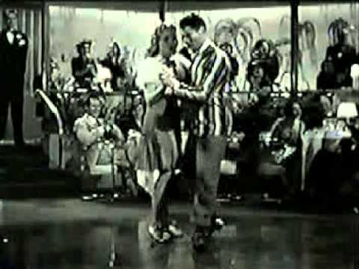
Notes:
If you find a video link that no longer works….search for a new link on YouTube and replace it here on this slide. Then let your teacher know so they can change their copy.:)

Slide 32
Type here
Type here
Type here
Insert > Media > Video > Online Video
Notes:
You may need to change the size of the font to make your answer fit.

Slide 36
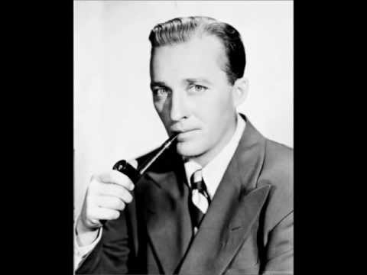
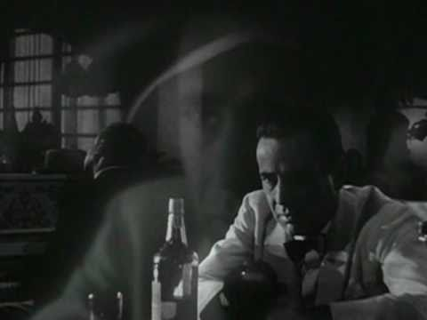
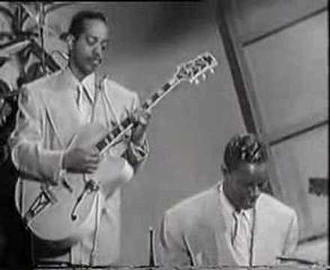
Notes:
If you find a video link that no longer works….search for a new link on YouTube and replace it here on this slide. Then let your teacher know so they can change their copy.:)

Slide 37
Type here
Type here
Type here
Insert > Media > Video > Online Video
Notes:
You may need to change the size of the font to make your answer fit.

Slide 41
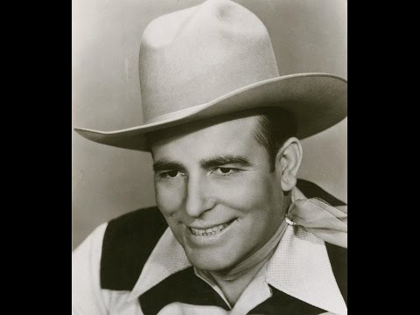
Notes:
If you find a video link that no longer works….search for a new link on YouTube and replace it here on this slide. Then let your teacher know so they can change their copy.:)

Slide 43
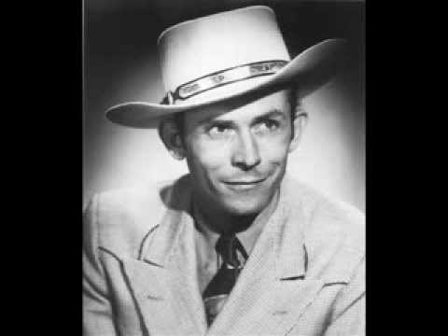
Notes:
If you find a video link that no longer works….search for a new link on YouTube and replace it here on this slide. Then let your teacher know so they can change their copy.:)

Slide 45
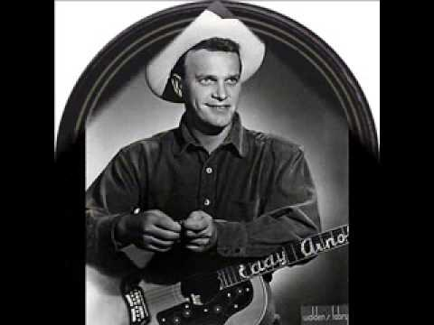
Notes:
If you find a video link that no longer works….search for a new link on YouTube and replace it here on this slide. Then let your teacher know so they can change their copy.:)

Slide 47
Notes:
If you find a video link that no longer works….search for a new link on YouTube and replace it here on this slide. Then let your teacher know so they can change their copy.:)

Slide 48
Type here
Type here
Type here
Insert > Media > Video > Online Video
Notes:
You may need to change the size of the font to make your answer fit.

Slide 51
Notes:
If you find a video link that no longer works….search for a new link on YouTube and replace it here on this slide. Then let your teacher know so they can change their copy.:)

Slide 52
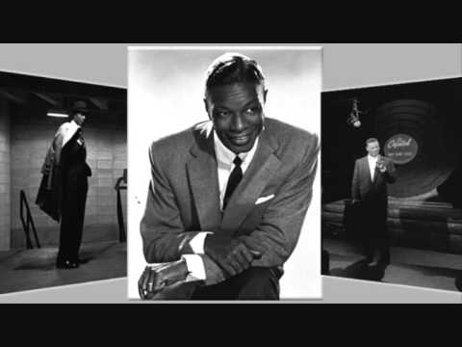
Notes:
If you find a video link that no longer works….search for a new link on YouTube and replace it here on this slide. Then let your teacher know so they can change their copy.:)

Slide 53
Type here
Type here
Type here
Insert > Media > Video > Online Video
Notes:
You may need to change the size of the font to make your answer fit.

Slide 57
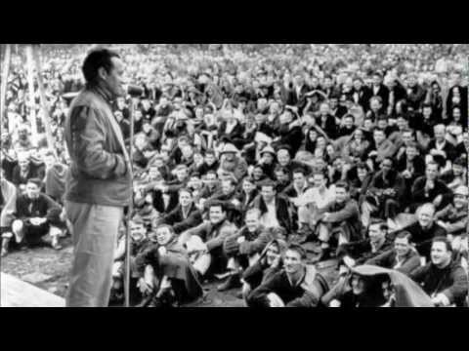
Notes:
If you find a video link that no longer works….search for a new link on YouTube and replace it here on this slide. Then let your teacher know so they can change their copy.:)

