Slide 1

Type your name here
Enter song title here
Notes:
Enter your name beside “Created By” text. Then type the title of the song you chose to represent this decade on the computer screen.

Slide 2
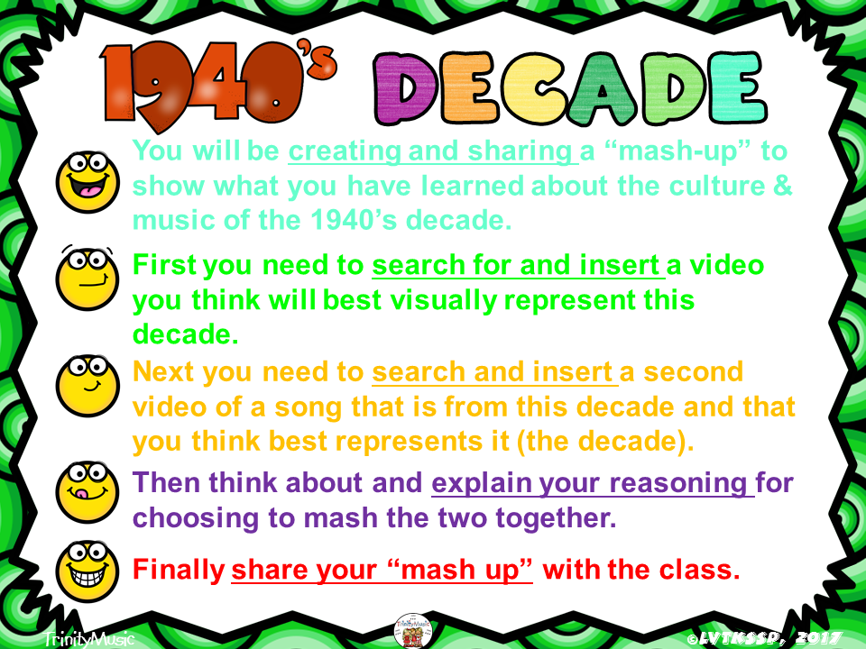

Slide 3


Slide 4
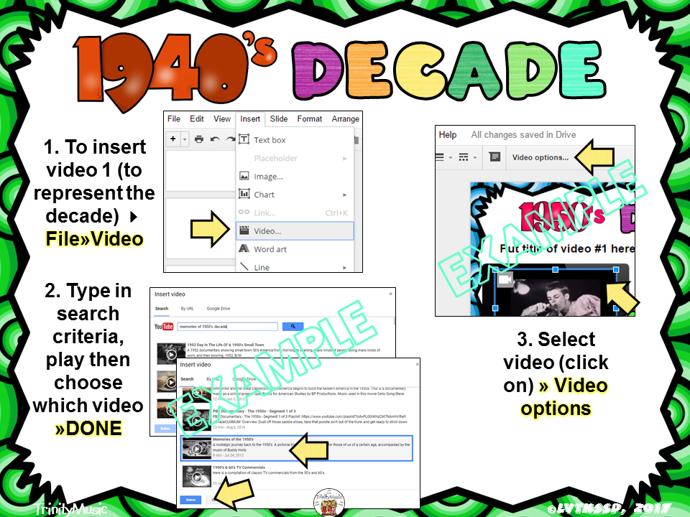

Slide 5
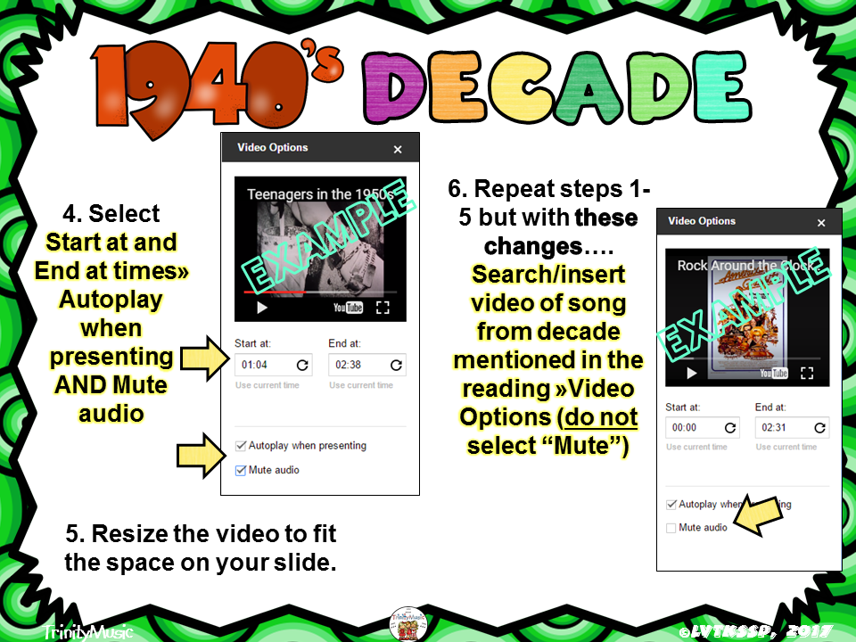

Slide 6

Video #1 is the video you choose to represent the decade. Video #2 is the song from the decade you chose.
Enter song title here
Notes:
Video #1 is the video you choose to represent the decade. Video #2 is the song from the decade you chose.

Slide 7

Video #1 is the video you choose to represent the decade. Video #2 is the song from the decade you chose.
Enter song title here
Notes:
Video #1 is the video you choose to represent the decade. Video #2 is the song from the decade you chose.

Slide 8

Enter song title here
Notes:
Video #1 is the video you choose to represent the decade. Video #2 is the song from the decade you chose.

Slide 9


Slide 10

Type here
Notes:
You may need to change the font size, move the text box and/or create more text boxes to make your answer truly fit and look good.

Slide 11

Type here
Notes:
You may need to change the font size, move the text box and/or create more text boxes to make your answer truly fit and look good.

Slide 12


Slide 13


Slide 14


