Slide 1

Name:

Slide 2

Type here
Type here
Type here
Type here
Notes:
You may want or need to change the size of the font or reposition the text boxes.

Slide 3

Type here
Type here
Type here
Type here
Type here
Notes:
You may want or need to change the size of the font or reposition the text boxes.

Slide 4

Type here
Type here
Type here
Type here
Type here
Type here
Type here
Type here
Notes:
You may want or need to change the size of the font or reposition the text boxes.

Slide 5
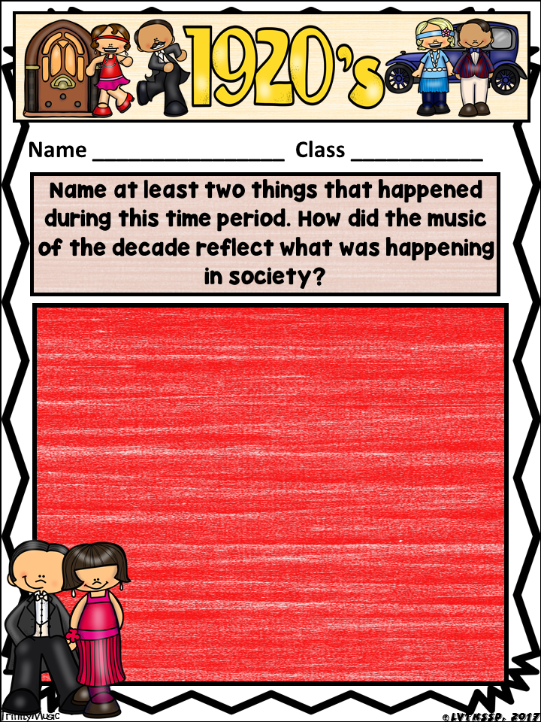
Type here
Type here
Type here
Notes:
You may need to change the font size, move the text box or create additional text boxes to make your answer fit.

Slide 6
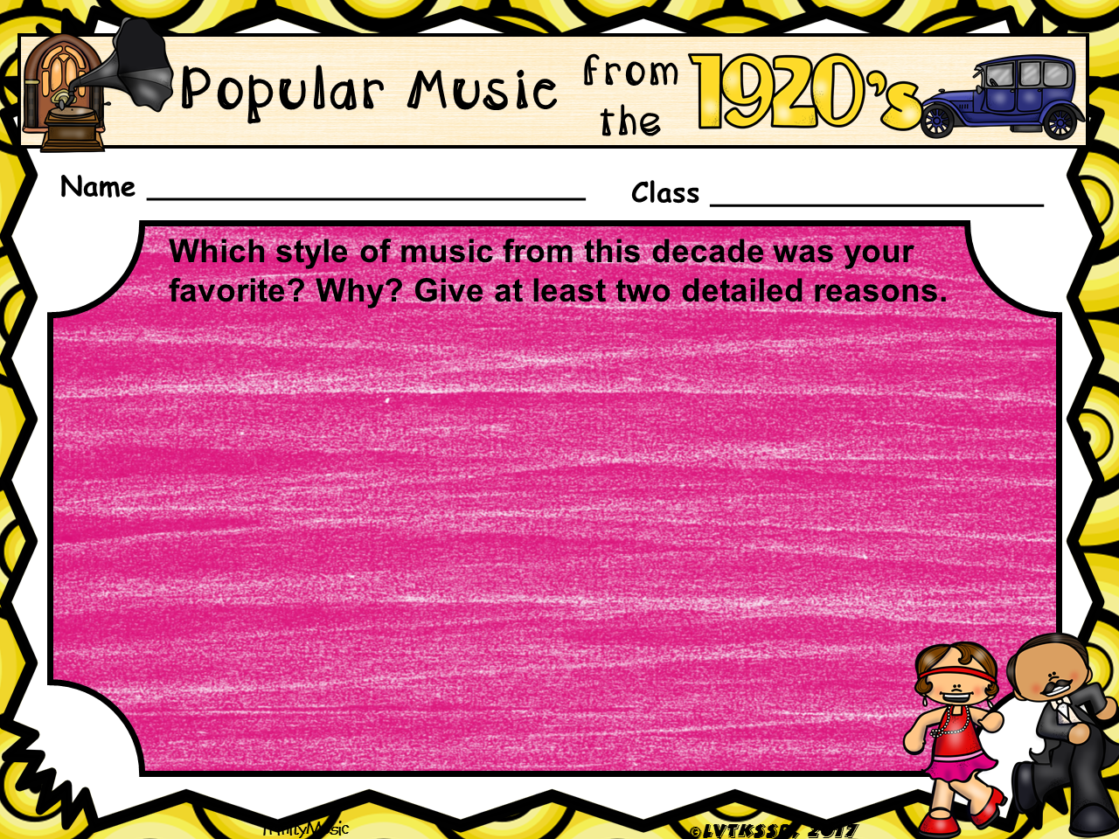
Type here
Type here
Type here
Notes:
You may need to change the font size and/or reposition the text boxes.

Slide 7
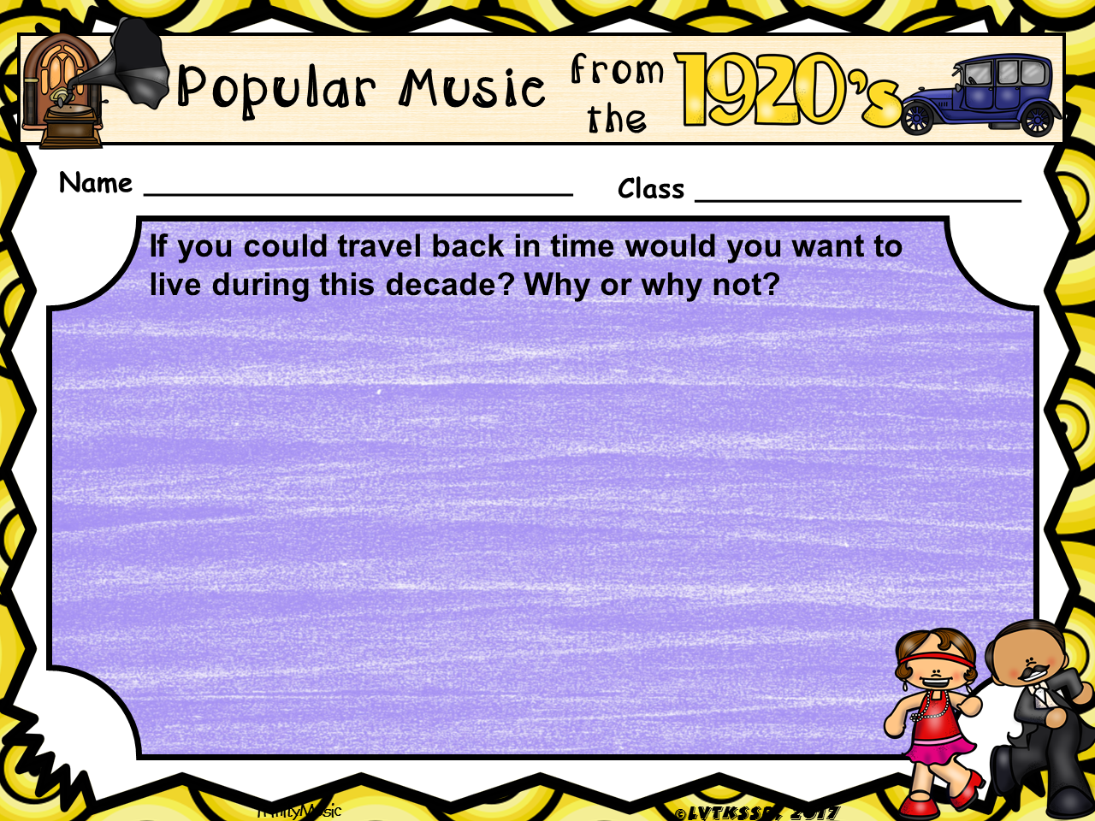
Type here
Type here
Type here
Notes:
You may need to change the font size and/or reposition the text boxes.

