Slide 1
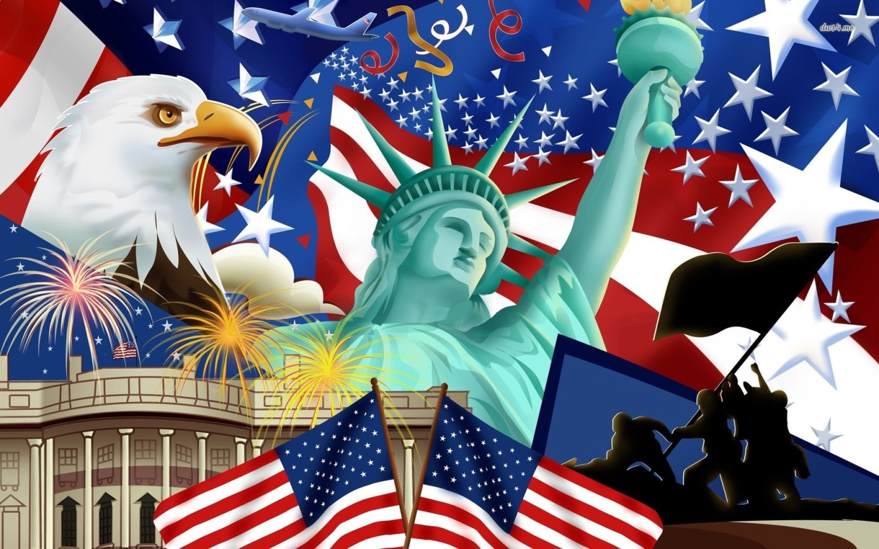

American Symbols and Icons
What Makes America Different?

Slide 2
What Are Symbols and Icons?
Both symbols and icons represent other things, but an icon is a pictorial representation of the product it stands for whereas a symbol does not resemble what it stands for.
A symbol represents products or ideas, whereas icon represents only items that are visible.
Icons are restricted to graphical representation of objects and one can easily understand what they stand for. On the other hand, one has to learn what a symbol stands for, as it is not similar to what it stands for.

Slide 3
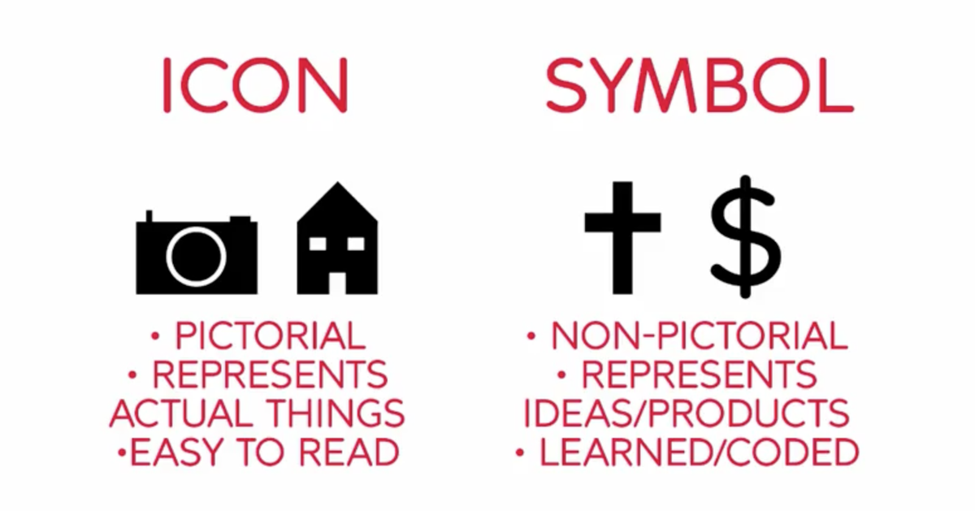
What Are Symbols and Icons?

Slide 4
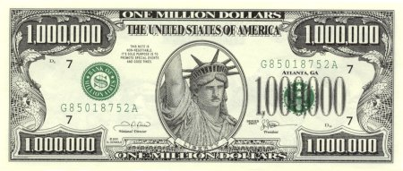
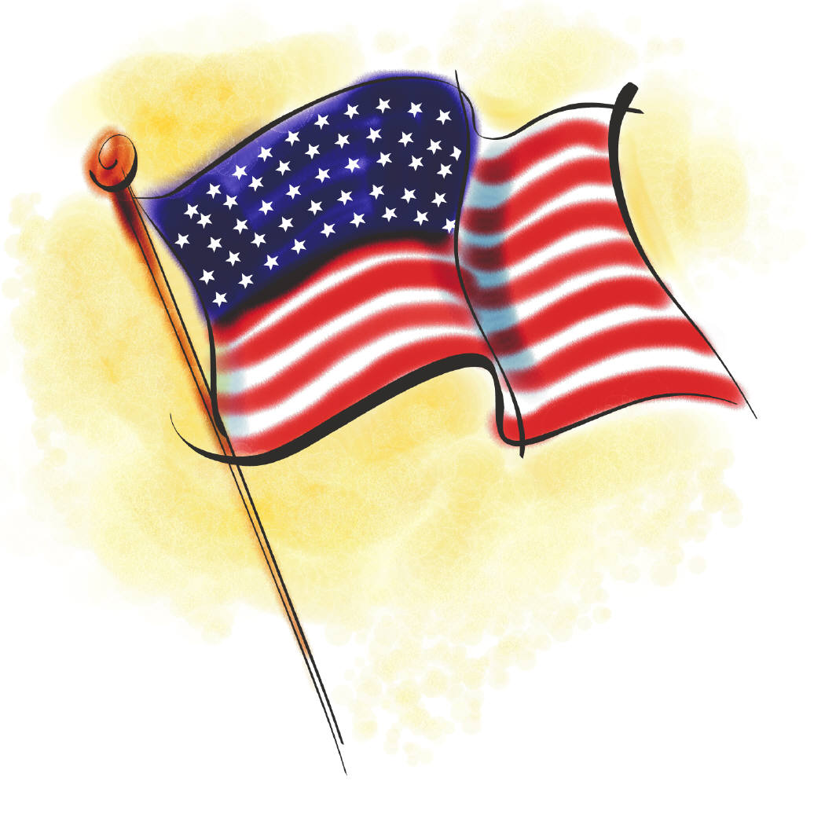
American Symbols
Notes:
BALD EAGLE, US National Emblem. The bald eagle was chosen June 20, 1782 as the emblem of the United States of America, because of its long life, great strength and majestic looks, and also because it was then believed to exist only on this continent.
FLAG: Thirteen stripes represent the original thirteen colonies that declared independence from England; fifty stars symbolize the current 50 United States. White signifies purity and innocence, red signifies valor and bravery; and blue signifies vigilance, perseverance, and justice.
Liberty Bell is an iconic symbol of American independence, located in Philadelphia, Pennsylvania.
White House is no ordinary house! It stands for freedom and democracy. It is also a symbol of our president, our country's history, and the American people.
Statue of Liberty stands in Upper New York Bay, a universal symbol of freedom.

Slide 5
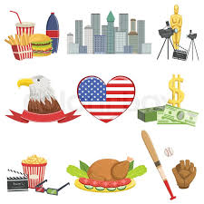
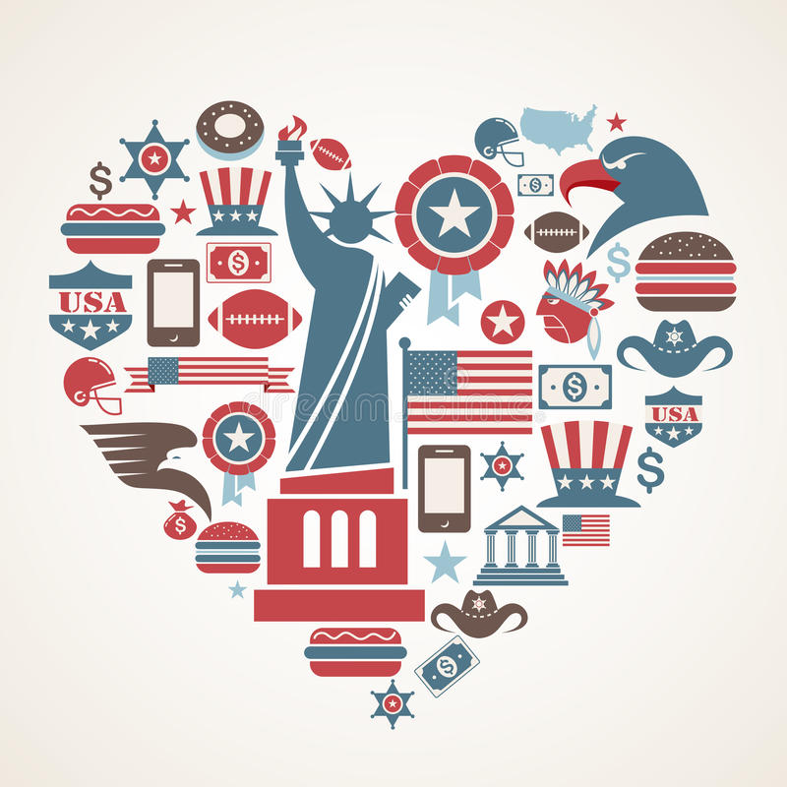
American Icons

Slide 6
Activity 1: What is an American? Reading
What is an American?
By: Akbar Ahmed July 20, 2009
Chair of Islamic Studies at American University and former Pakistani Ambassador to the UK
Watch the How To movie
Annotate the text
Upload to Google Classroom
Due by the START of next class.
Why Annotate Text?
Highlight important information | Make connections | Identify and define words
Help you remember information | Organize information | Ask questions

Slide 7

Marking the Text
Number the paragraphs (keep the numbers small)
Circle Key Terms, Names of People, Names of Places, and or Dates.
Color code areas.
Underline or highlight an Author’s Claims . Data, facts, or other backing should support an assertion.
Underline or highlight Relevant Information
Evidence
Definitions
Explanations
Descriptions
Data/Statistics

Slide 8

The Great Seal: Obverse
The eagle (freedom) grasps an olive branch (peace) in its right talon and a bundle of thirteen arrows in its left.
The olive branch and arrows are symbols for the power of peace and war.
The original national motto: "E Pluribus Unum," which is Latin for "one from many" or "one from many parts" (one nation created from 13 colonies).
Shield: A shield with thirteen red and white stripes (13 original colonies) covers the eagle's breast.
Cloud: Above the eagle's head is a cloud surrounding a blue field containing thirteen stars which form a constellation (a new State is taking its place among other nations)

Slide 9
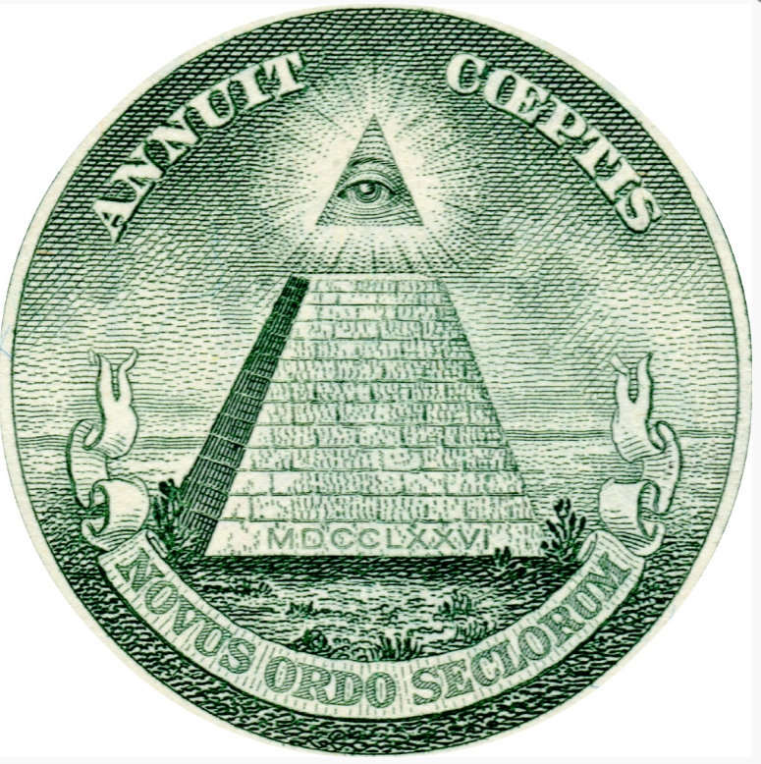
The Great Seal: Reverse
Pyramid: The seal's reverse side contains a 13-step pyramid with the year 1776 in Roman numerals at the base (the year independence was declared).
Eye: At the top of the pyramid is the Eye of Providence with the Latin motto "Annuit Coeptis" in the sky above - meaning "It [the Eye of Providence] is favorable to our undertakings" or "He favors our undertakings."
Scroll: Below the pyramid, a scroll reads "Novus Ordo Seclorum" - Latin for "New Order of the Ages." which refers to 1776 as the beginning of the American new era.

Slide 10

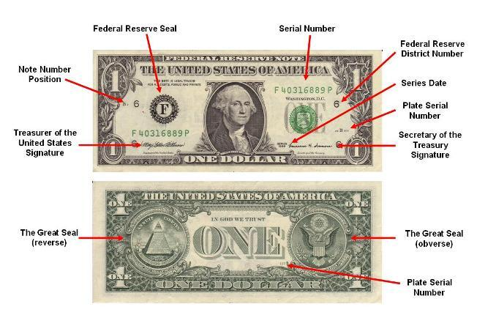
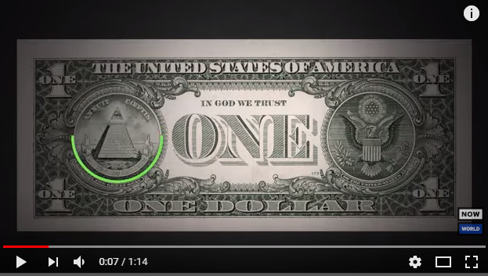
Decoding the Dollar Bill (YouTube 1:14)

Slide 11

Activity 2: The Great Seal
Read the Great Seal Information Sheet on the website
Imagine that congress has asked you to design a new national seal to represent America. Use the Great Seal Information Sheet to inspire you.
Draw a sketch of your new seal on the worksheet.
Use lots of color.
Then write a few complete sentences to describe your new seal and the meaning of its symbols.

Slide 12
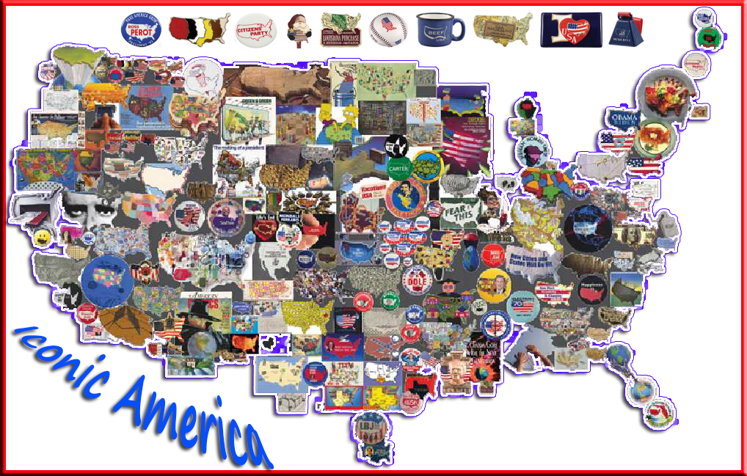
Activity 3 : Iconic America
Remember: an icon is a pictorial representation of the product it stands for
Map of the USA: one icon for each State (no words!!).
Lots of color.
One more thing:
This is the end of the Orientation unit
All work must be handed in by the start of next class.
Late work = half credit.

Slide 13
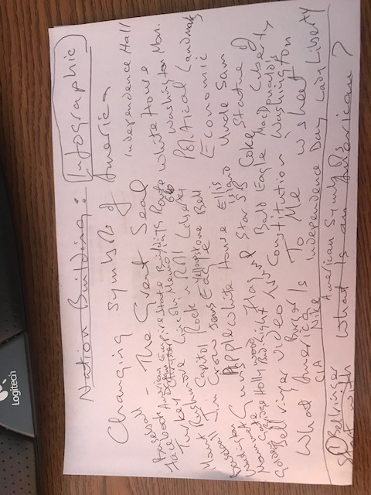
List of US Icons

