Slide 1
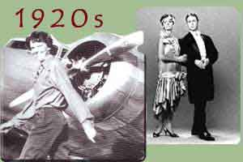
The Roaring Twenties
“It was the Best of times and the Worst of times”
1919-1929

Slide 2
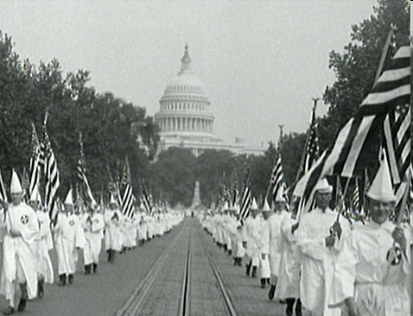
Pro-America, Anti-Everything Else
The new Ku Klux Klan: anti-foreign, Catholic, black, Jewish, pacifist, Communist, internationalist, revolutionist, gambling, adultery, and birth control.
Quotas on Immigration: limits on the number of immigrants from each country
Emergency Quota Act of 1921: Only 3% of a nations American population in 1910 may be admitted
Immigration Act of 1924:Amends EQA to 2% of 1890 populations
Mitchell Palmer: leader of the movement against the ‘Red Scare’ and arrested about 6000 suspected Communists

Slide 3
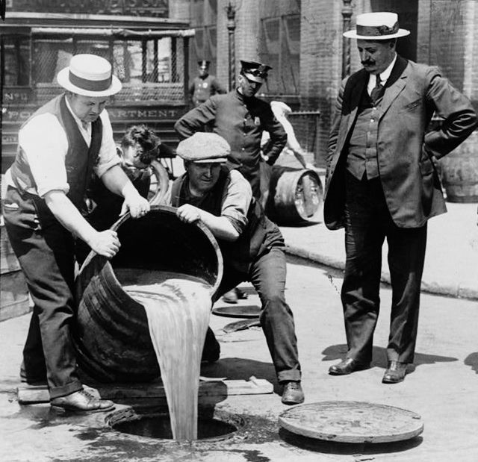
Conservation & Crime
Prohibition: Enacted in 1919 by the 18th Amendment. Prohibition was popular in the Midwest and the South but was opposed by large eastern cities and many ethnic communities.
Organized Crime: Bootlegging becomes a big business. Chicago the home of numerous gang wars. 1925 Al “Scarface” Capone controlled the illegal liquor trade in Chicago. By 1930, underground crime had a $12-$18 billion dollar per year economy.
Saloons were replaced by speakeasies and encouraged consumption of harder alcohol because it is easier to transport

Slide 4
Trials during the 1920s
Sacco and Vanzetti
Two Italian anarchists immigrants Nicola Sacco and Bartolommeo Vanzetti convicted of murder and robbery
Many people questioned the evidence. They were convicted on origin and beliefs more than the crime
Despite mass demonstrations the men were executed in 1927
Eventually cleared by MA governor in 1977 (50 years later)
Scopes “Monkey” Trial
John Scopes a biology teacher taught about evolution, which violated the state’s rules forbidding the teaching of evolution
The school district wanted fundamentalist Christianity beliefs taught.
Scopes was convicted and fined $100

Slide 5
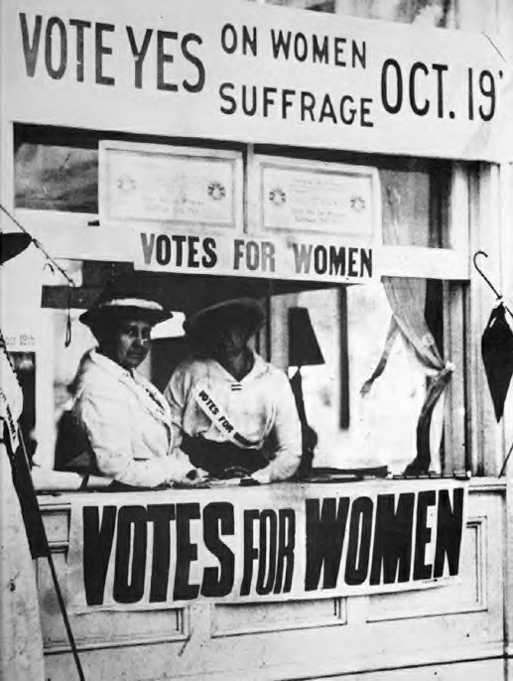
Sex & Jazz
Women’s Rights: Birth control movement, Women find work in the cities during WWI in war-industries. Achieved vote in 1920
Flappers: A symbol of independence and freedom from traditional values. They broke the sexual values and advertising capitalizes on sexual allure to sell products
Jazz: a energetic and improvised music that captured the spirit of the 1920s. It was mainly embraced by youth.

Slide 6
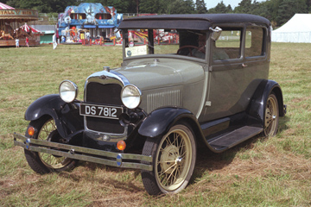
Technology
The Automobile: It emerged in the 1890s when Henry Ford began production of American autos. By 1929 there was 1 car for every 4.9 Americans
Airplanes: Orville and Wilbur Wright – Kitty Hawk, N.C. 1903 and by WWI countries were using them.
Radio: Guglielmo Marconi – invented the “wireless” in the 1890s and they were also used in WWII for long range communication.
Film: An invention of Thomas Edison and by the 1890’s film was being used as a novelty in penny-arcades and peep shows. The first real “movie” -- 10 minutes long.

Slide 7
Shifting Cultural Values
Harlem Renaissance: group of African American writers in Harlem NYC
Worked against hatred and bigotry
Famous figures: W.E.B. Du Bois, Langston Hughes,
Renewed during the Civil Rights Movement
Jazz Age
Edward E. “Duke” Ellington: towering figures of Jazz
Bessie Smith: “empress of the blues” one of the most popular Jazz singers
Danced to Charleston
Movies: The Jazz singer was the first movie with sound, started to idolize famous people such as Charlie Chaplin
Games: crossword, puzzles, and board games and sports such as baseball with Babe Ruth
Literature: The writers in the 1920s protested the efforts of technology and mass consumption

Slide 8
Boom-and-Bust
Buying-on-margin: purchasing stocks with a small down-payment; expecting that profits will cover the loan
Buying on credit or Installment Payments: Paying a certain amount of money each month
National Debt: Increased from $1,188,235,400 (1914) to $23,976,250,608 (1921) as a result of WWI

Slide 9
The Roaring Twenties
Pro-America, Anti …
.
.
.
Crime
.
.
.
Trials
.
.
Sex & Jazz
.
.
.
Technology
.
.
.
Shifting Culture
.
.
.
.
.
Boom and Bust
.
.
.

