Slide 1

Name:

Slide 2
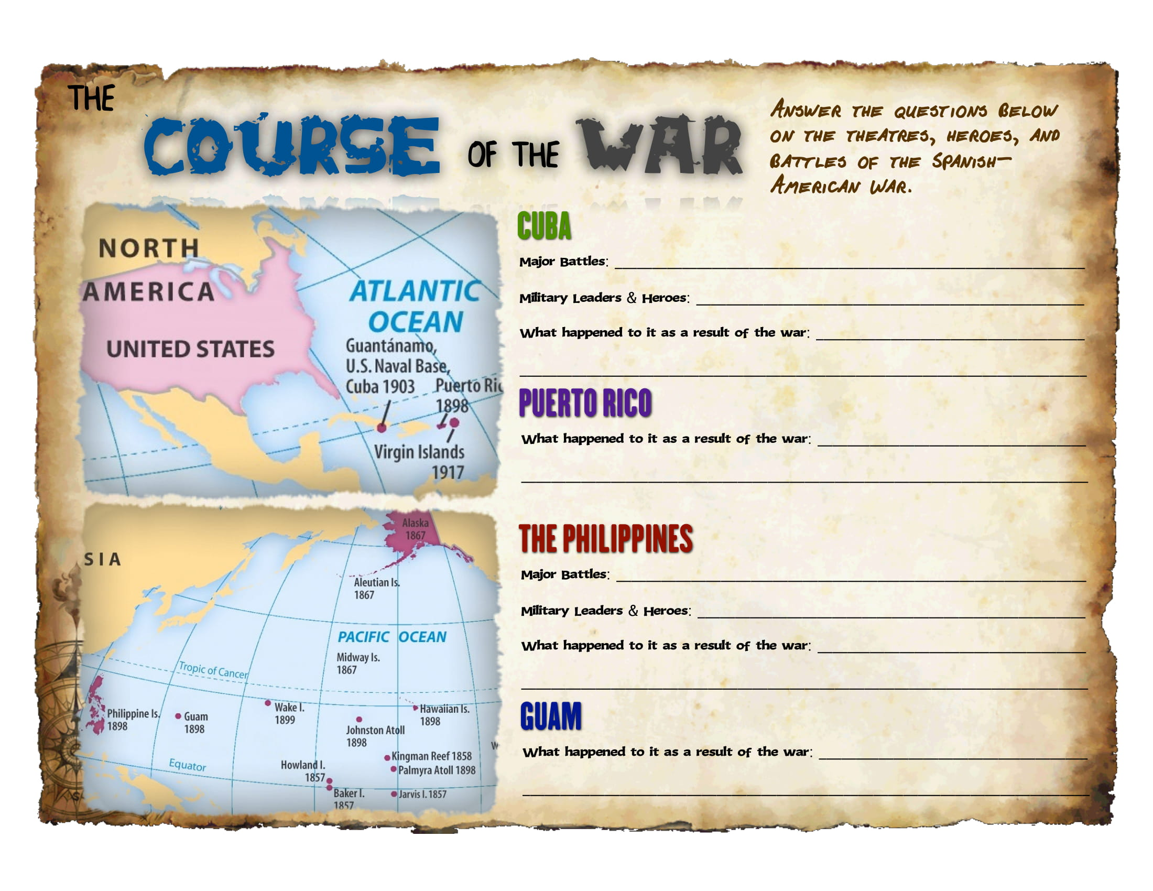

Slide 3


Slide 4
