Slide 1
The West
Essential Question: What factors encouraged American economic growth in the decades after the Civil War?

Slide 2
TEKS and Objectives
We will…
I will…
(3A) analyze Indian policies.
(3B) analyze growth of railroads, farm issues, and cattle industry boom.
(12A) analyze impact of physical and human geographic factors on the settlement of the Great Plains and the Klondike Gold Rush.
(13A) analyze the causes/effects of western expansion.
(15A) describe how the Transcontinental RR and the Homestead Act contributed to the close of the frontier.
(23B) evaluate American Indian Citizenship Act of 1924.
(26B) discuss the Americanization movement to assimilate American Indians into American culture.
Analyze the language from the Homestead Act

Slide 3
Causes of Settlement in the West

Slide 4
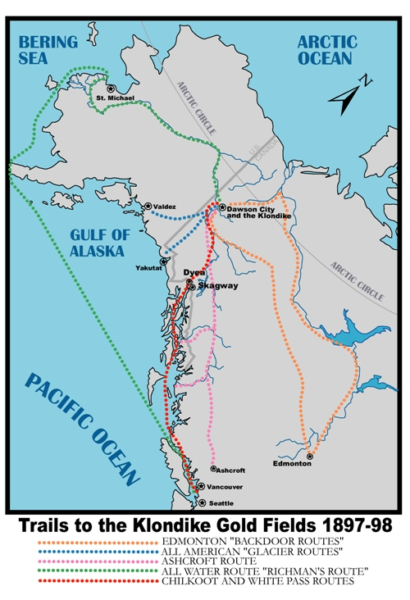
Lure of Precious Metals
California Gold Rush (1848-1849)
Klondike Gold Rush (1896)
Alaska
Many died on the way

Slide 5
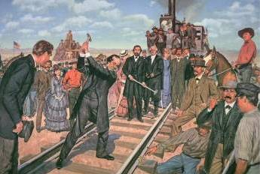
Transcontinental Railroad
Encouraged settlement in West
Completed in 1869
Crops could be shipped East

Slide 7
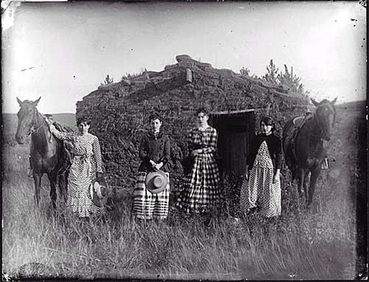
Cheap Land
Homestead Act (1862)
Any citizen could occupy 160 acres of government land
Must “improve” land (build home; grow crops)
Homesteaders own land after 5 years
European Immigrants
Attracted by free land

Slide 8
Homestead Act Requirements
Under the Homestead Act, the government offered public lands to settlers. This section lays out what was required for a settler to buy land:
“Be it enacted, that the person applying for the benefit of this act shall register that he or she is the head of a family, or is 21 years or more, or performed military service in the army, and the he has never borne arms against the U.S. government or given aid to its enemies, and that such application is made for the purpose of actual settlement and cultivation, and not either directly or indirectly for the use or benefit of another person or persons; and upon filing the said affidavit with the register, and on payment of ten dollars, he or she shall be permitted to enter the quantity of land specified.”
List the requirements that a settler had to meet to settle on federal land.

Slide 9
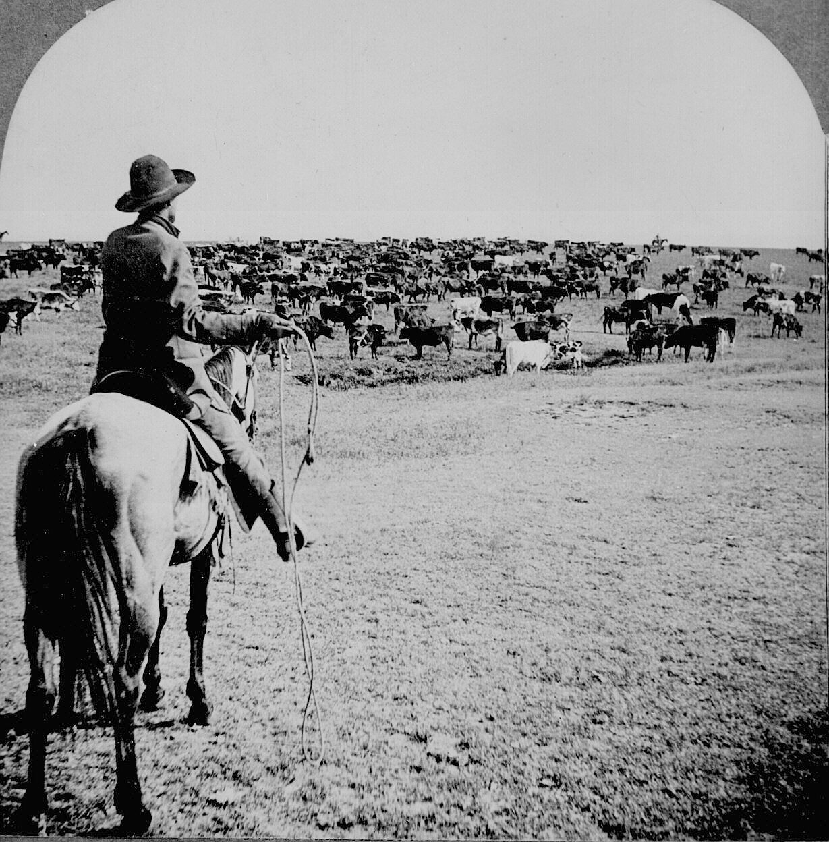
The Cattle Industry
Cattle Drives
Cattle driven to RR lines in Kansas (open land; no fences)
Shipped to Chicago for slaughter
Cowboys
Learned to ride, rope, and brand from Mexican vaqueros
One in five were African American

Slide 10
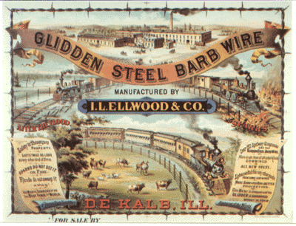
Cattle Industry (Continued)
End of Cattle Drives
Owners enclosed land with barbed wire
Severe winters/summers killed millions of cattle

Slide 11
Fate of Native Americans

Slide 12
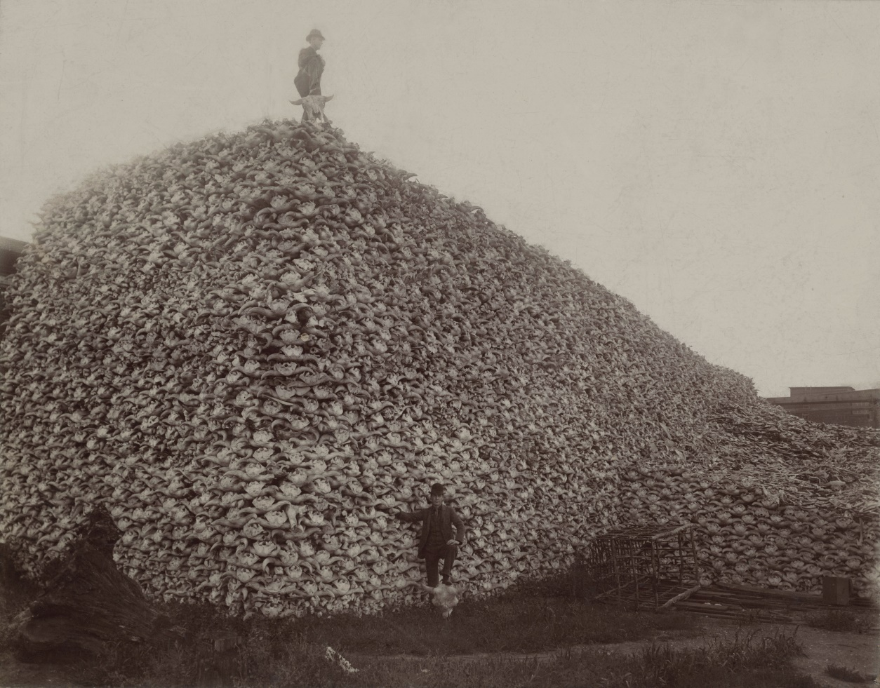
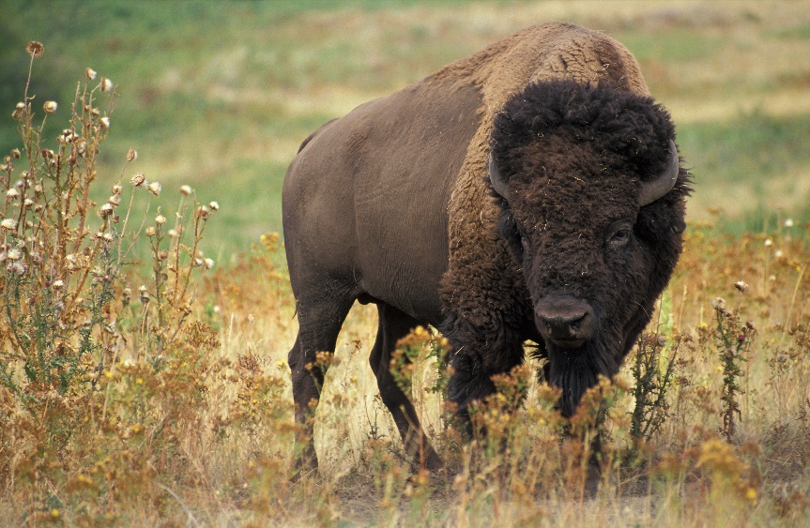
Destruction of Natural Environment
Over-farming and overgrazing destroyed their land
Bison hunted nearly to extinction

Slide 13
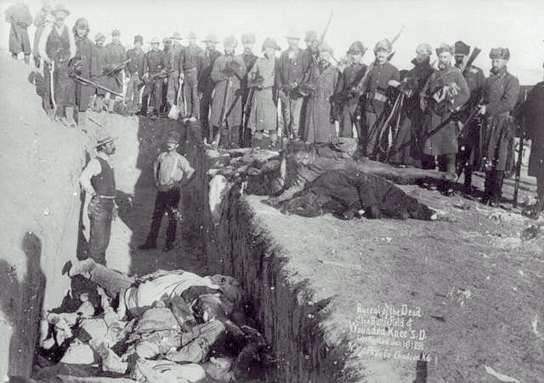
Indian Wars
Battle of the Little Big Horn (1876)
Black Hills of North Dakota
Sioux asked to move
Sitting Bull and Crazy Horse defeated General Custer
Crazy Horse captured and killed
Wounded Knee Massacre (1890)
300 unarmed Sioux men, women, and children killed by machine guns

Slide 14
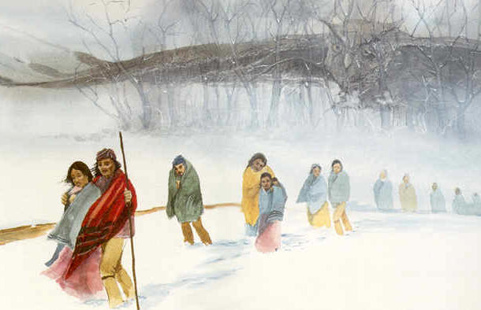
Forced Removal and Assimilation
Trail of Tears
Congress ordered removal of Indians to west of Mississippi
25% of Cherokees perished on the journey
Dawes Act (1887)
Americanization (adopting American culture)
Promised citizenship and right to vote
Destroyed Native American Culture

Slide 15
Reservations
Hunters not Farmers
Native Americans were hunters by lifestyle and tradition
Infertile Lands
Land was not good for farming
Government did not provide equipment or education for farmers
Life of poverty on Reservations
Malnutrition, poverty, and untreated health problems
Schools provided inferior education

Slide 16
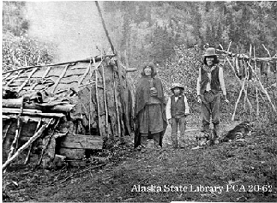

Slide 17
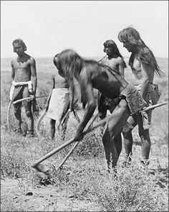
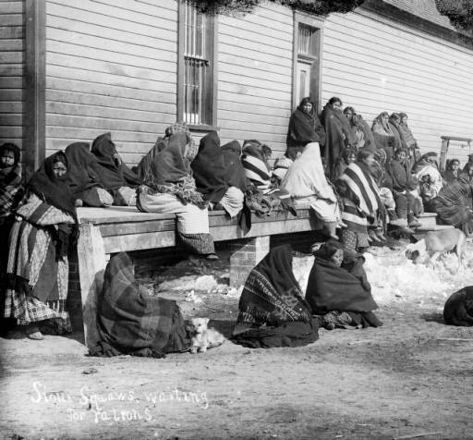

Slide 18
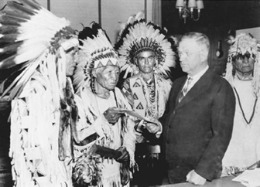
Native American Citizenship
Status before 1924
Most Native Americans not citizens
Some became citizens through marriage, military service, or treaties
American Indian Citizenship Act (1924)
Law granting immediate citizenship to all Native Americans born in U.S.
Did not need to give up tribal lands/customs

