Slide 1
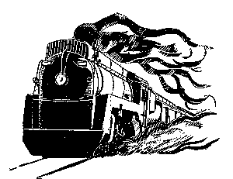
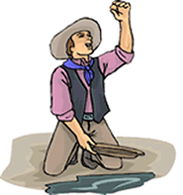
NAME:
The West
Causes of Settlement in the West
Lure of Precious Metals
Transcontinental Railroad
Cheap Land
Homestead Act (1862)
European Immigrants
Under the Homestead Act, the government offered public lands to settlers. This section lays out what was required for a settler to buy land:
“Be it enacted, that the person applying for the benefit of this act shall register that he or she is the head of a family, or is 21 years or more, or performed military service in the army, and the he has never borne arms against the U.S. government or given aid to its enemies, and that such application is made for the purpose of actual settlement and cultivation, and not either directly or indirectly for the use or benefit of another person or persons; and upon filing the said affidavit with the register, and on payment of ten dollars, he or she shall be permitted to enter the quantity of land specified.”
List the requirements that a settler had to meet to settle on federal land.
Cattle Drives:
Cowboys:
The Cattle Industry
End of Cattle Drives:

Slide 2
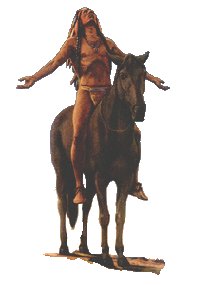
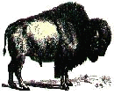
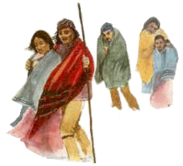
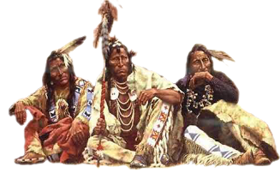
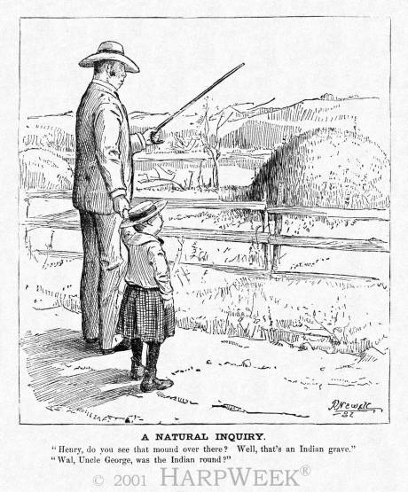
The West
Fate of Native Americans
Environment
Indian Wars
Battle of Little Big Horn
Wounded Knee Massacre
Forced Removal
Reservations
Trail of Tears
Dawes Act 1887
Native American Citizenship
Status before 1924
American Indian Citizenship Act (1924)
Summarize the political cartoon of the right:

