Slide 1
The West Transformed

Slide 2
Bell Ringer
Which of the following statements do you most agree with?
Westward expansion was an inevitable and positive process.
Westward expansion was immoral and unfair because of the way it affected Native Americans.
Westward expansion was a process of its time and cannot be judged by modern standards.
Explain why you agree.

Slide 3
Essential Questions
What were the contributing factors to westward settlement?
Describe innovations in agricultural technology and business practices and assess their impact on the South and West.
Compare and contrast the different groups of people who migrated to the west and describe the problems they experienced.

Slide 4
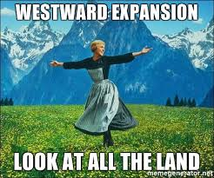
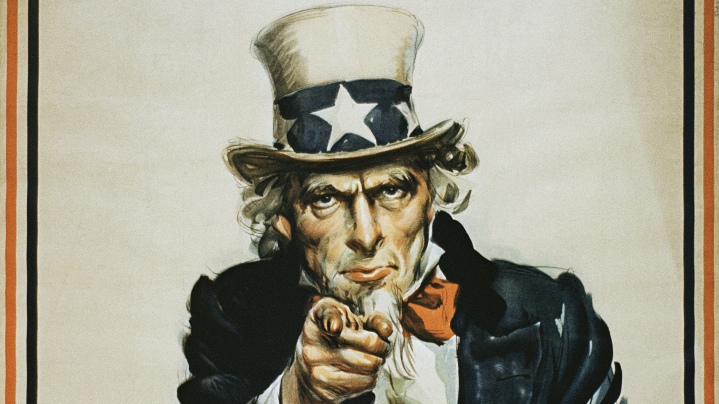
1862
Homestead Act (1862): Government sold 160 acre plots—you could have it if you made improvement (lived there for five years, dug a well and built a road)
Morrill Land Grant Act (1862): Gave states grants to found agricultural colleges
NC State is a land grant college
I WANT YOU TO GO WEST YOUNG MAN!!!

Slide 5
Box #1
Diversity in the West:
The West had 20% of the population - 80% of that population were minorities.
This caused fear, distrust and competition over land
Farmers v. Ranchers
Native Americans v. White Americans

Slide 6
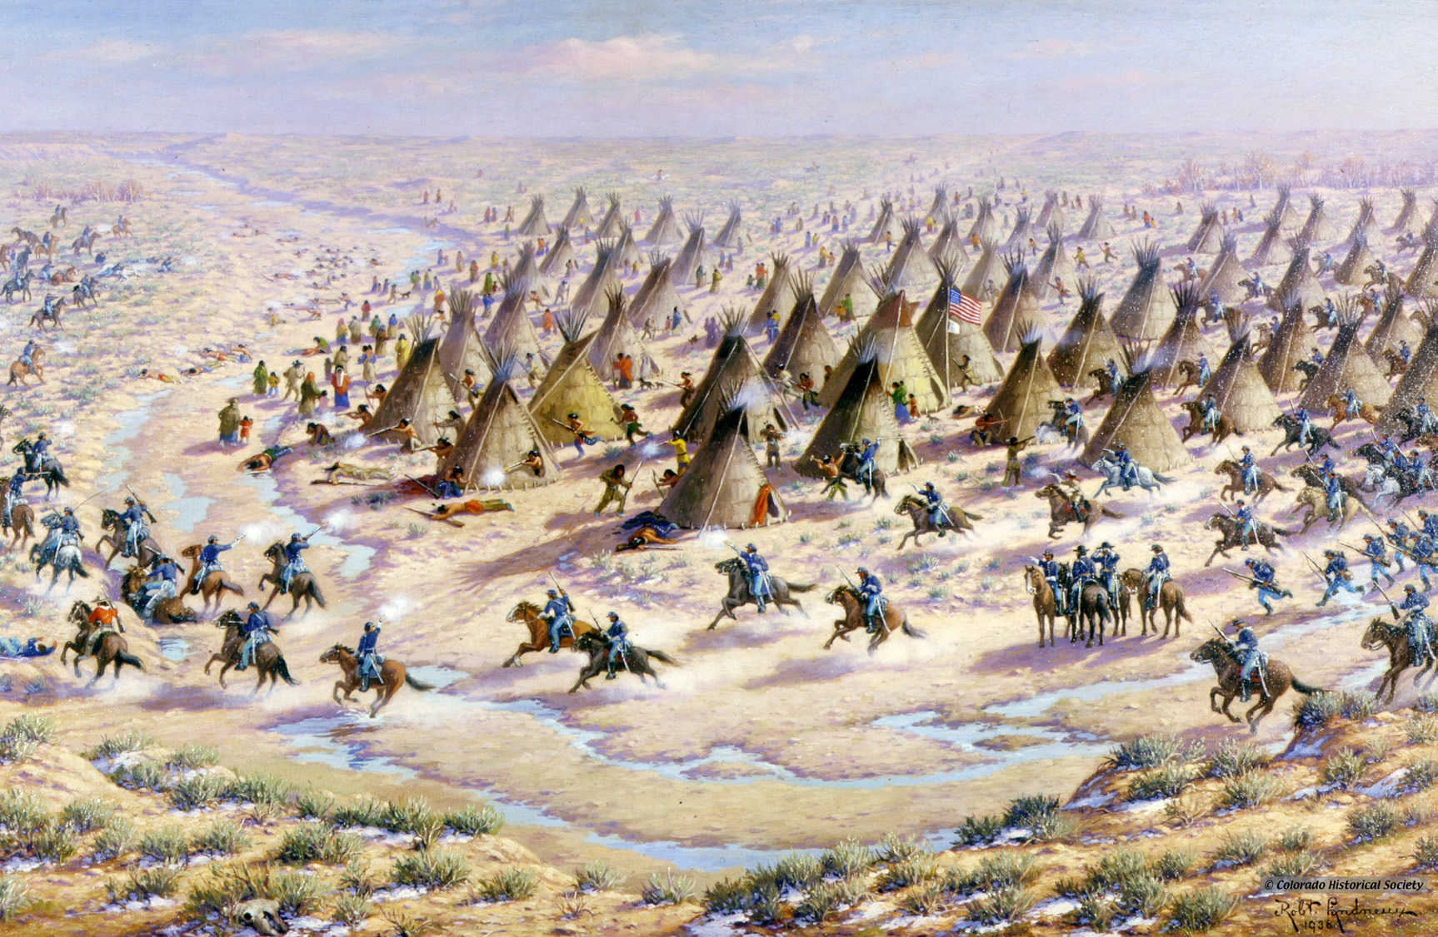
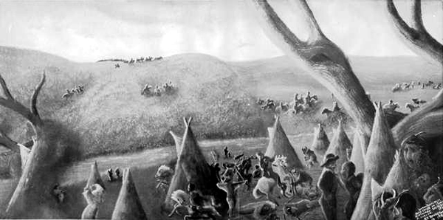
1864 - Sand Creek Massacre
Cause: increasing hostility between Natives and new settlers (treaties were signed and immediately broken)
US led an attack on a camp of unarmed Cheyenne and Arapaho Indians
500 Native Americans are killed
Impact: Native Americans respond with force

Slide 7
Thought Bubbles
If you were Col. Chivington what would you think about the Sand Creek Massacre?
If you were Black Kettle what would you think about the Sand Creek Massacre?

Slide 8
1866 - The Open Range and the Cowboy
Cattle Kingdom - built by Ranchers in the west
Causes:
Increase demand for meat in the east after the Civil War
Railroad was used to move meat (invention of the refrigerated box car) - Cow Towns like Dodge City, Kansas

Slide 9
Box #2
Characteristics of the Open Range:
Open-range system (no fences the cattle graze freely)
Stereotypical cowboy emerges with cattle drives
Legendary figures: Wild Bill Hickock, Wyatt Earp, Doc Holiday, Jesse James

Slide 10
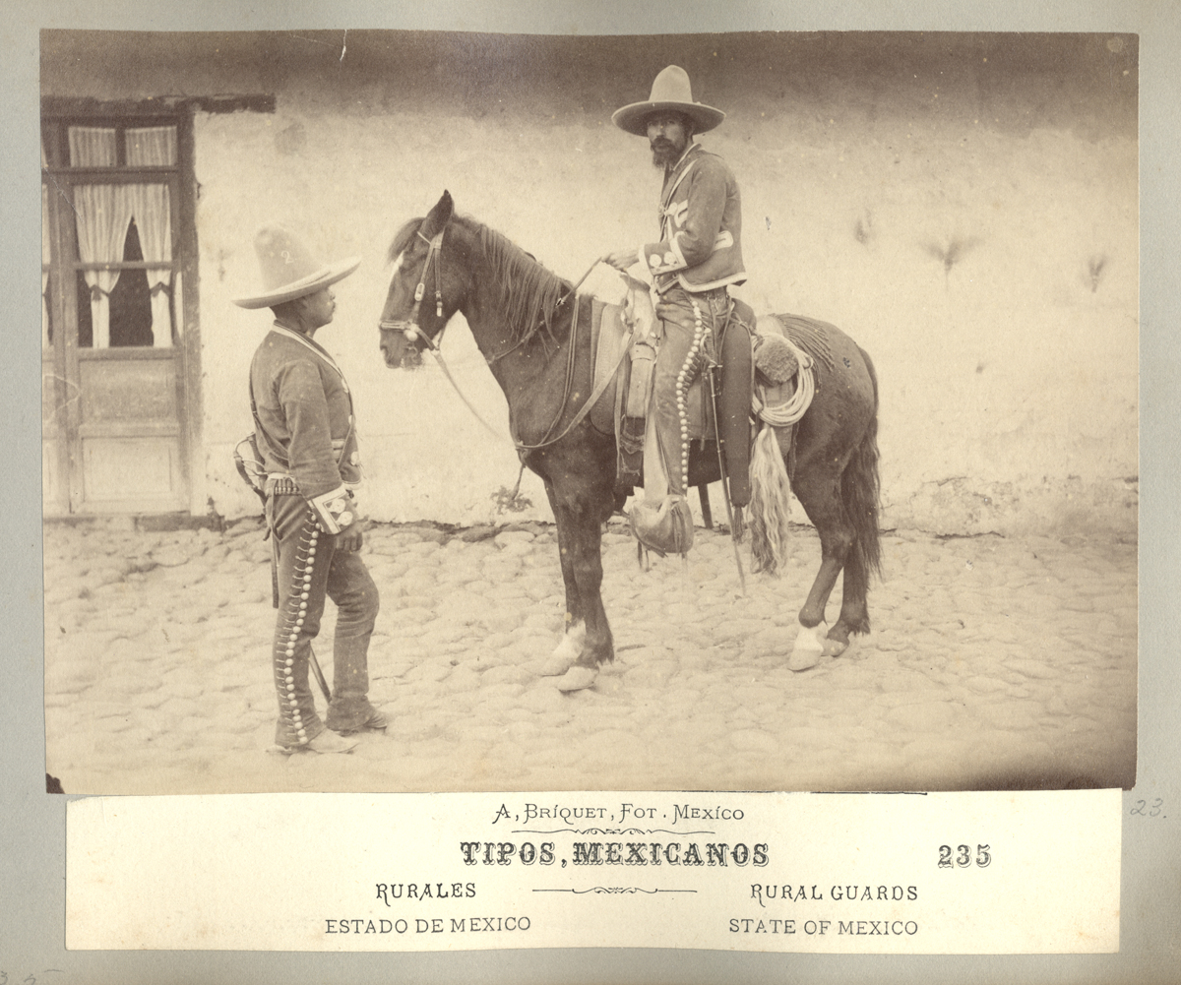
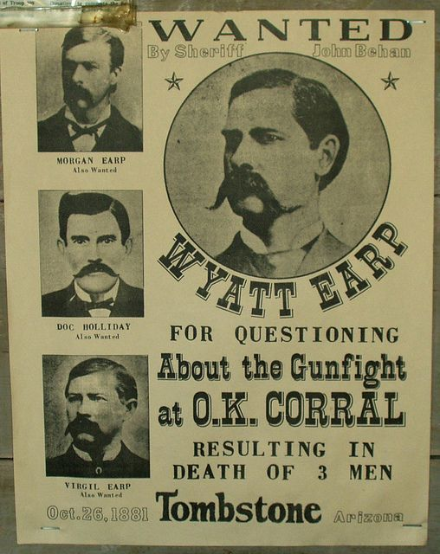
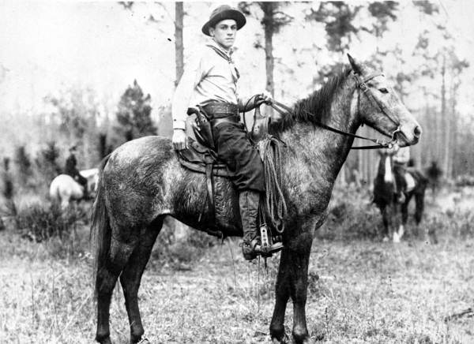
The American cowboy was modeled after the Mexican Vaquero - ranching had been introduced in the west by the Spanish..
Bandana to protect from dust on the trail.
Wide brimmed floppy hat to protect from the sun and weather.
Saddle with horn to ensure stability.
Lasso to capture cows
Colt Revolver for protection.

Slide 11
1869 - Promontory Point Utah
Tied the nation together with transportation and encouraged interdependence.
Transcontinental Railroad
Moved products and people encouraging settlement.
Encouraged industrial development by consuming steel, wood and other resources.
Promontory Point, Utah (1869): the physical place at which the Union Pacific and the Central Pacific Railways were joined with a golden spike. This signalled the completion of the transcontinental railroad.

Slide 12
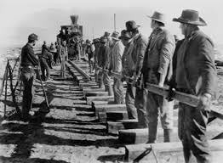
Box #3
The Irish
Build the railroad from the East to the West (Union Pacific)
Pushed to America by the Irish Potato Famine and worked west for better opportunities.

Slide 13
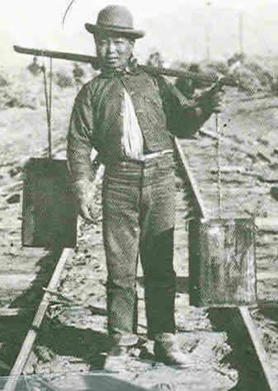
Box #4
The Chinese
Built the railroad from the West to East (Central Pacific)
Pulled to the American west by promises of riches (Gold) and a better life.

Slide 14
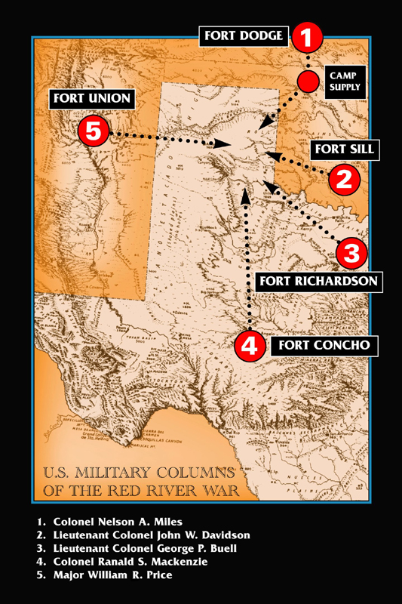
1874 - Red River War
Causes: decimation of the buffalo in Texas and the relocation of Native Americans to reservations to open the area for white American settlement
Effects: Destroyed the way of life for the plains Indians in the southwest

Slide 15
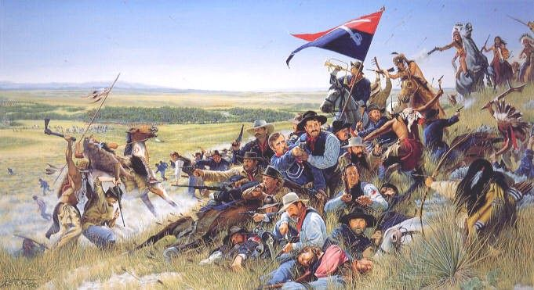
1876 - Battle of Little Big Horn
Causes: Gold is found in the Black Hills resulting in White invasion of Native American reservation lands
George Custer and his 600 men face off against 3000 Native Americans and are massacred
Effect: This is the only decisive Native American victory and strengthened American military efforts to force Native Americans onto reservations.

Slide 16
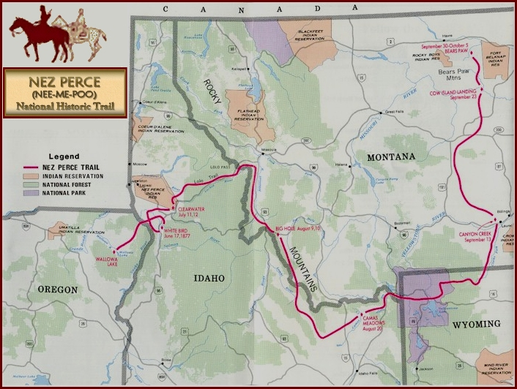
1877 - Nez Perce War
Causes: American forced removal of the Nez Perce, under the leadership of Chief Joseph, from Oregon to a reservation in Idaho
Chief Joseph and his people performed a tactical retreat over 1400 miles before they were caught and forced to surrender
Effect: the Nez Perce were
forced onto a reservation in
Idaho and then, later, Oklahoma

Slide 17
1887 - Dawes Severalty Act
Replaced the reservation system by giving Native Americans individual land
Native American families were given 160 Acre lots for 25 years
This is not enough land to adequately supply a family in the west
Assimilation (take on the traits of other immediately)
Native Americans would become farmers and adapt white culture
Schools were formed to learn White American Culture - The Carlisle Indian School in Pennsylvania was one of the most famous

Slide 18
Box #5
Assimilation has several negative effects:
Psychological changes that involve cutting emotional ties with traditional background and family
Causes a person to no longer belong to their old culture or their new culture
Can cause violent reactions

Slide 20
1888 - End of the Open Range
Several new technological developments changed the settlement of the west. These factors along with extreme weather and overproduction (decline of beef demand) ended the open range system

Slide 21
Box #6
Barbed Wire is invented by Joseph Glidden and causes the fencing in of the west = cattle drives are no longer necessary
Windmills are perfected and used to pull water up from underground on the prairie making settlement easier and farming more feasable.

Slide 22
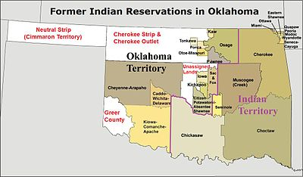
1889 - Oklahoma Land Rush
Oklahoma is the last territory not opened for white settlement (it is known as Indian Territory)

Slide 23
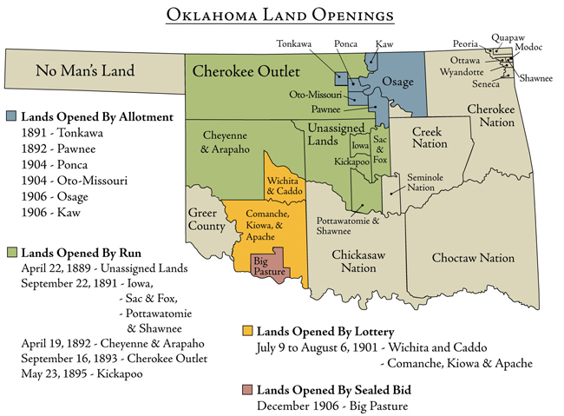
Oklahoma is opened for white settlement on April 22, 1889
Sooners - white settlers that snuck into the territory before it was officially opened
With the settlement of Oklahoma the American frontier is closed

Slide 24
Box #7
Frederick Jackson Turner’s Frontier Thesis
stated the American identity was created by the frontier
birthed and cultivated democracy
personal characteristics: self reliance, individualism, practicality, inventiveness
questioned the impact the closing of the frontier would have on Americans
stated the closing of the frontier was the end of a period in American history

Slide 25
Box #8
The Ghost Dance was a spiritual movement that taught Native Americans had been put on reservations and their way of life destroyed because they had adopted the ways of white Americans - the belief was that if Native Americans abandoned the ways of the white man and practiced the Ghost Dance their lives and land would be restored.

Slide 26
1890 - Wounded Knee
7th Cavalry try to round up a group of Native Americans encamped at Wounded Knee Creek to move them to another reservation
Tensions and fears over the Ghost Dance and the loss of land result in violence
150 Native Americans were killed (mostly women and children)
This was the last armed conflict between Native Americans and the US Army

Slide 28
Box #9
Philip Henry Sheridan
Civil War Officer who was put in charge of military operations in the west
Enforced a policy of Indian removal and total war
Attacked Native American encampments in the winter time
Encouraged the massacre of Buffaloe
"If a village is attacked and women and children killed, the responsibility is not with the soldiers but with the people whose crimes necessitated the attack."

Slide 29
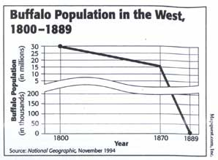
Box #10
Steep Decline in the Bison
Population
Causes: new weapons
white Americans find uses for the hides and bones - make $$ back east
Effect: destruction of Plains Indian’s way of life

