Slide 1
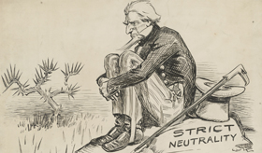
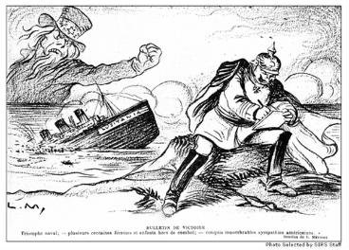
U.S in World War I
We will explain the significance of 19414-1918, identify the reasons for U.S. entry into WWI, understand the contributions of the AEF led by General Pershing, analyze isolationism and neutrality, analyze the Battle of Argonne Forest, and discuss importance of Alvin York.
I will summarize the main ideas of WWI by completing a graphic organizer.
Central Powers
Allied Powers
Explain U.S. foreign policy at the beginning of World War I.
Reasons for U.S. Involvement in WWI
Closer Ties to Allies
German Aggression
Allied Propaganda
Zimmerman Telegram
Freedom of the Seas

Slide 2
The War at Sea
British Blockade
Sinking of the Lusitania
The Sussex Pledge
Unrestricted Submarine Warfare
The U.S. Intervenes
Battle of Argonne Forest
American Expeditionary Force
General John J. Pershing
African Americans
Argonne Forest
AEF at Argonne
Alvin York
The Home Front (1917-1918)
Selective Service Act (1917)
American Economy
War Bonds
Espionage Act (1917)
End of WWI
Armistice
Treaty of Versailles

