Slide 1
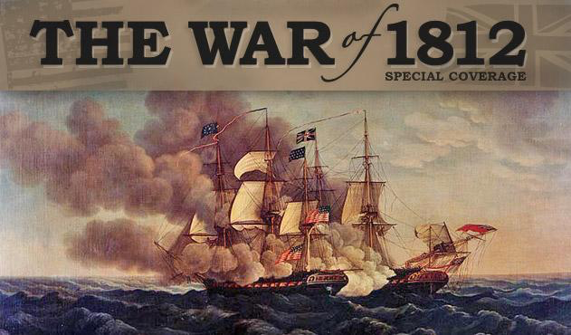
War of 1812 to Cotton Gin

Slide 2
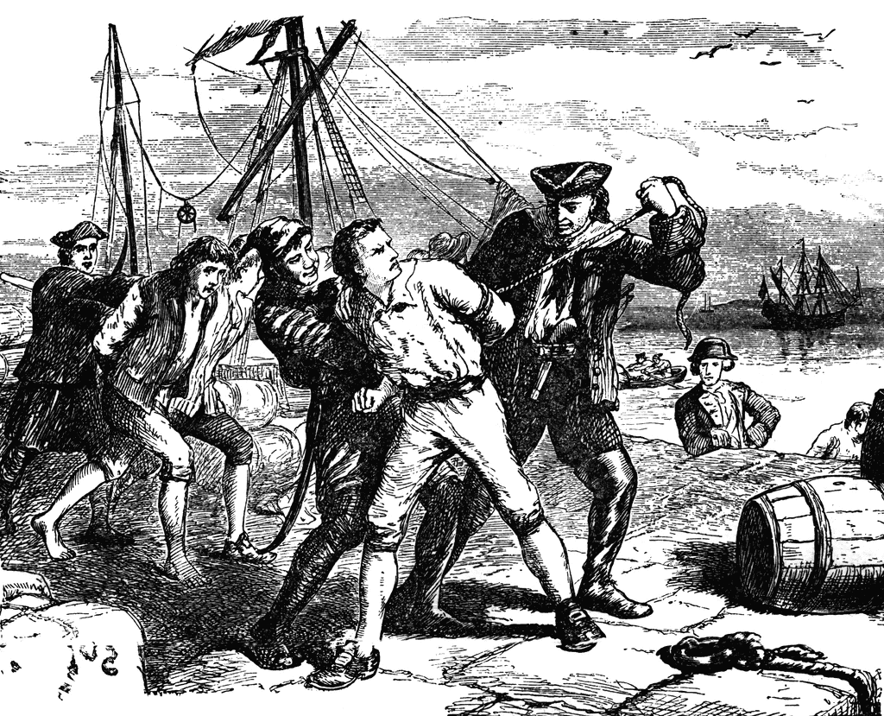
Jefferson’s Foreign Policy
Advised the United States to seek friendship with all nations
Doomed…
American merchants were engaged in trade all over the world
The Louisiana Purchase was about to open the country to westward expansion
United States had little control over foreign nations
Problems with France and England
British began to clamp down on US shipping
Didn’t want America to provide their enemy with food and supplies
Britain established a partial blockade
Angered France
Put US in predicament
If they obeyed British, they would anger the French
Vice Versa...

Slide 3
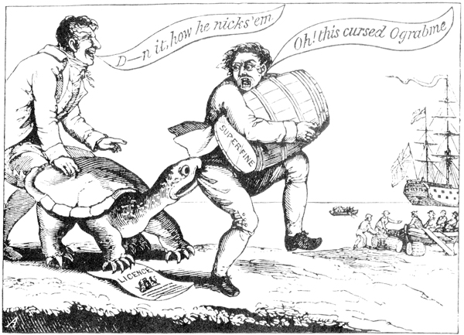
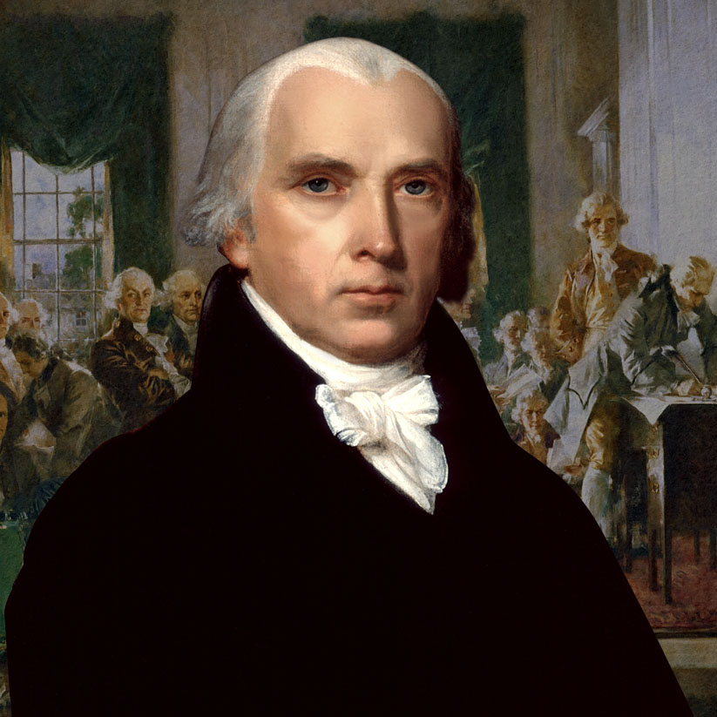
Trade as a Weapon
Jefferson asked Congress to pass bill that would stop all foreign trade
Peaceable coercion
Embargo Act of 1807
US ships no longer allowed to sail to foreign ports
More harmful to US than British or French
Quick Write: How is it more harmful to the US than it is to the French and British?
One New Englander wrote, “the embargo is like cutting one’s throat to cure the nosebleed”
Cost Jefferson the election to Madison
Madison’s Solution
Allowed merchants to trade with any country except France and Britain
Trade could begin again when they respected US ships

Slide 4
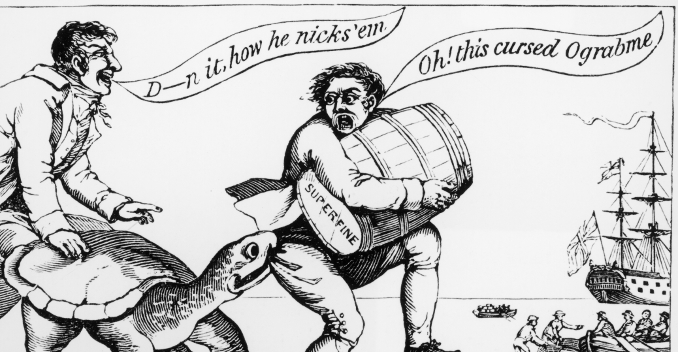
Quick Write
What is the purpose of this cartoon?
What are some of the clues you see?
What does “ograbme” spell backwards?

Slide 5
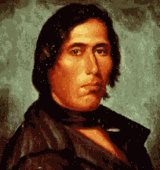
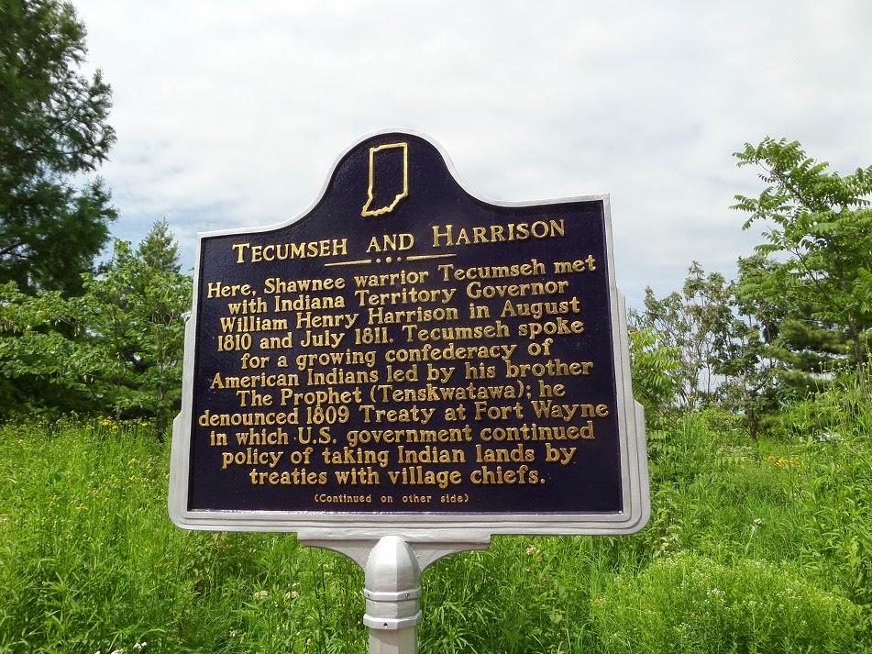
Tecumseh and Native American Unity
Many believed the British were stirring up Native American resistance
Afterall, thousands of white settlers had poured into the Ohio Valley pushing Natives further from their homes…
Tecumseh vowed to stop the loss of land
Believed that loss came from non-unity of Native American tribes
Called for the unification of tribes
Like Americans had called for the unification of the colonies
Treaty of Fort Wayne
Chiefs of the Miami, Delaware, and Potawatomi tribes signed over 3 million acres to William Henry Harrison
Angered tribe members
Land meant more to them than money
Rallied around Tecumseh and his want for unification
Tecumseh called the treaty meaningless

Slide 6
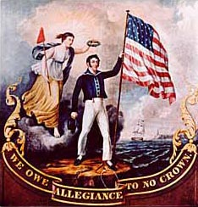
War Hawks
While Tecumseh was away recruiting tribes for his alliance…
Shawnee were defeated by Harrison’s forces at the Battle of Tippecanoe
Severe setback for Tecumseh
British and Native Americans become allies
Raised even higher anti-British feelings in the west
Leaders such as Congressman Henry Clay demanded war with Great Britain
Westerners who called for war became known as the War Hawks
Wanted British aid to Natives stopped
Wanted British out of Canada
Sought war due to British violations at sea
Future President Andrew Jackson said that war was necessary
Urged by War Hawks and Jackson, Congress declared war on Great Britain June 18, 1812

Slide 7
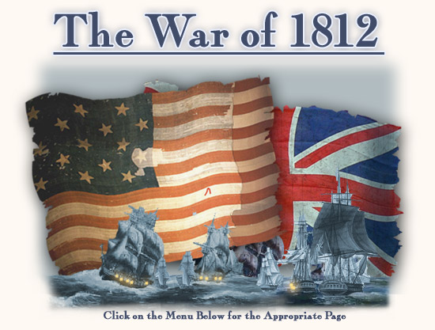
War Begins
Britain did not really want to start a war with US
British announce that they will no longer interfere with American shipping
Slow mail prevented the news from reaching Congress before they approved Madison’s request
Two Phases
1812-1814: Britain concentrates on war with France
Post April 1814: European war almost over and can focus on US
Problems
Democratic Republicans reduced the size of the army
Navy only had 16 ships
Army only had 7,000 poorly trained and equipped men

Slide 8
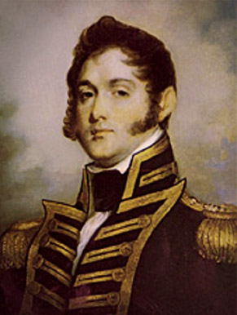
The First Phase
In spite of small size, Navy rose to the challenge
American naval officers gained valuable experience fighting pirates in Mediterranean Sea
British sent ships to blockade the American Coast
Constitution and United States won victories against the British blockade
Most important US naval battle took place on Lake Erie
Oliver Hazard Perry
Flew a banner declaring, “Don’t give up the ship”
British and US exchanged cannon shots for hours until Perry’s ship was destroyed
On another ship, Perry destroyed two British ships
Forced British ships to surrender

Slide 9
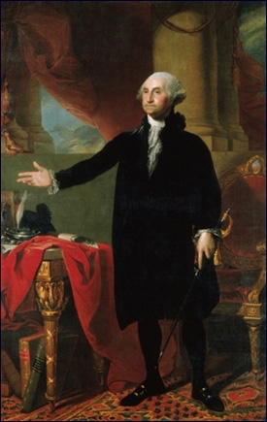
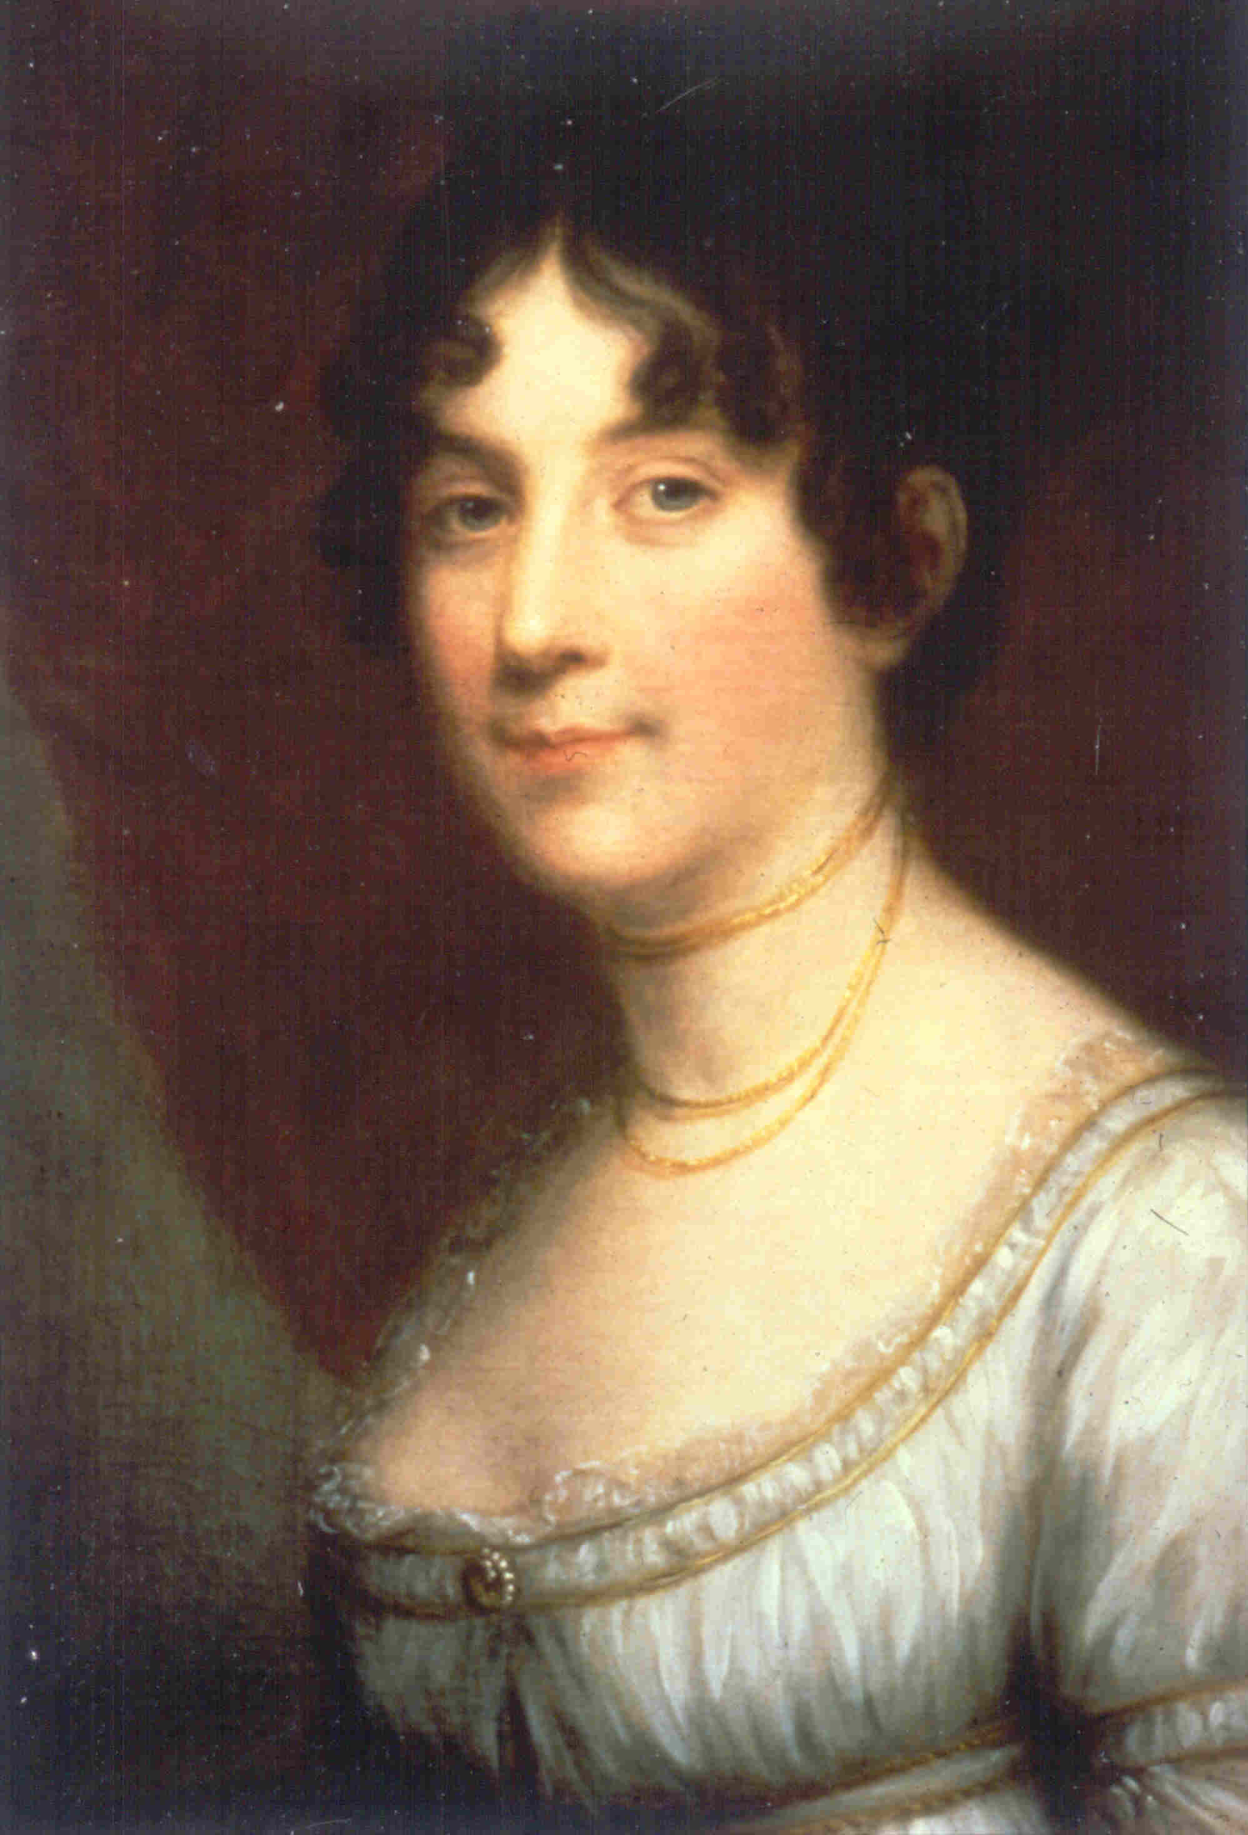
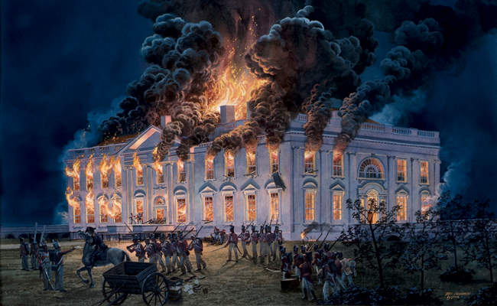
Perry sent message to General Harrison: “We have met the enemy and they are ours”
Harrison transported his army across Lake Erie to Detroit, where they discovered the British retreated to Canada
Harrison followed the British and defeated them at the Battle of the Thames
Put an end to British threat in Northwest
Tecumseh was killed
The Second Phase
After defeating Napoleon, Britain turned its full attention to US
British troops marched on Washington and burned the Capitol
Dolley Madison saves important objects from the White House including the portrait of George Washington

Slide 10
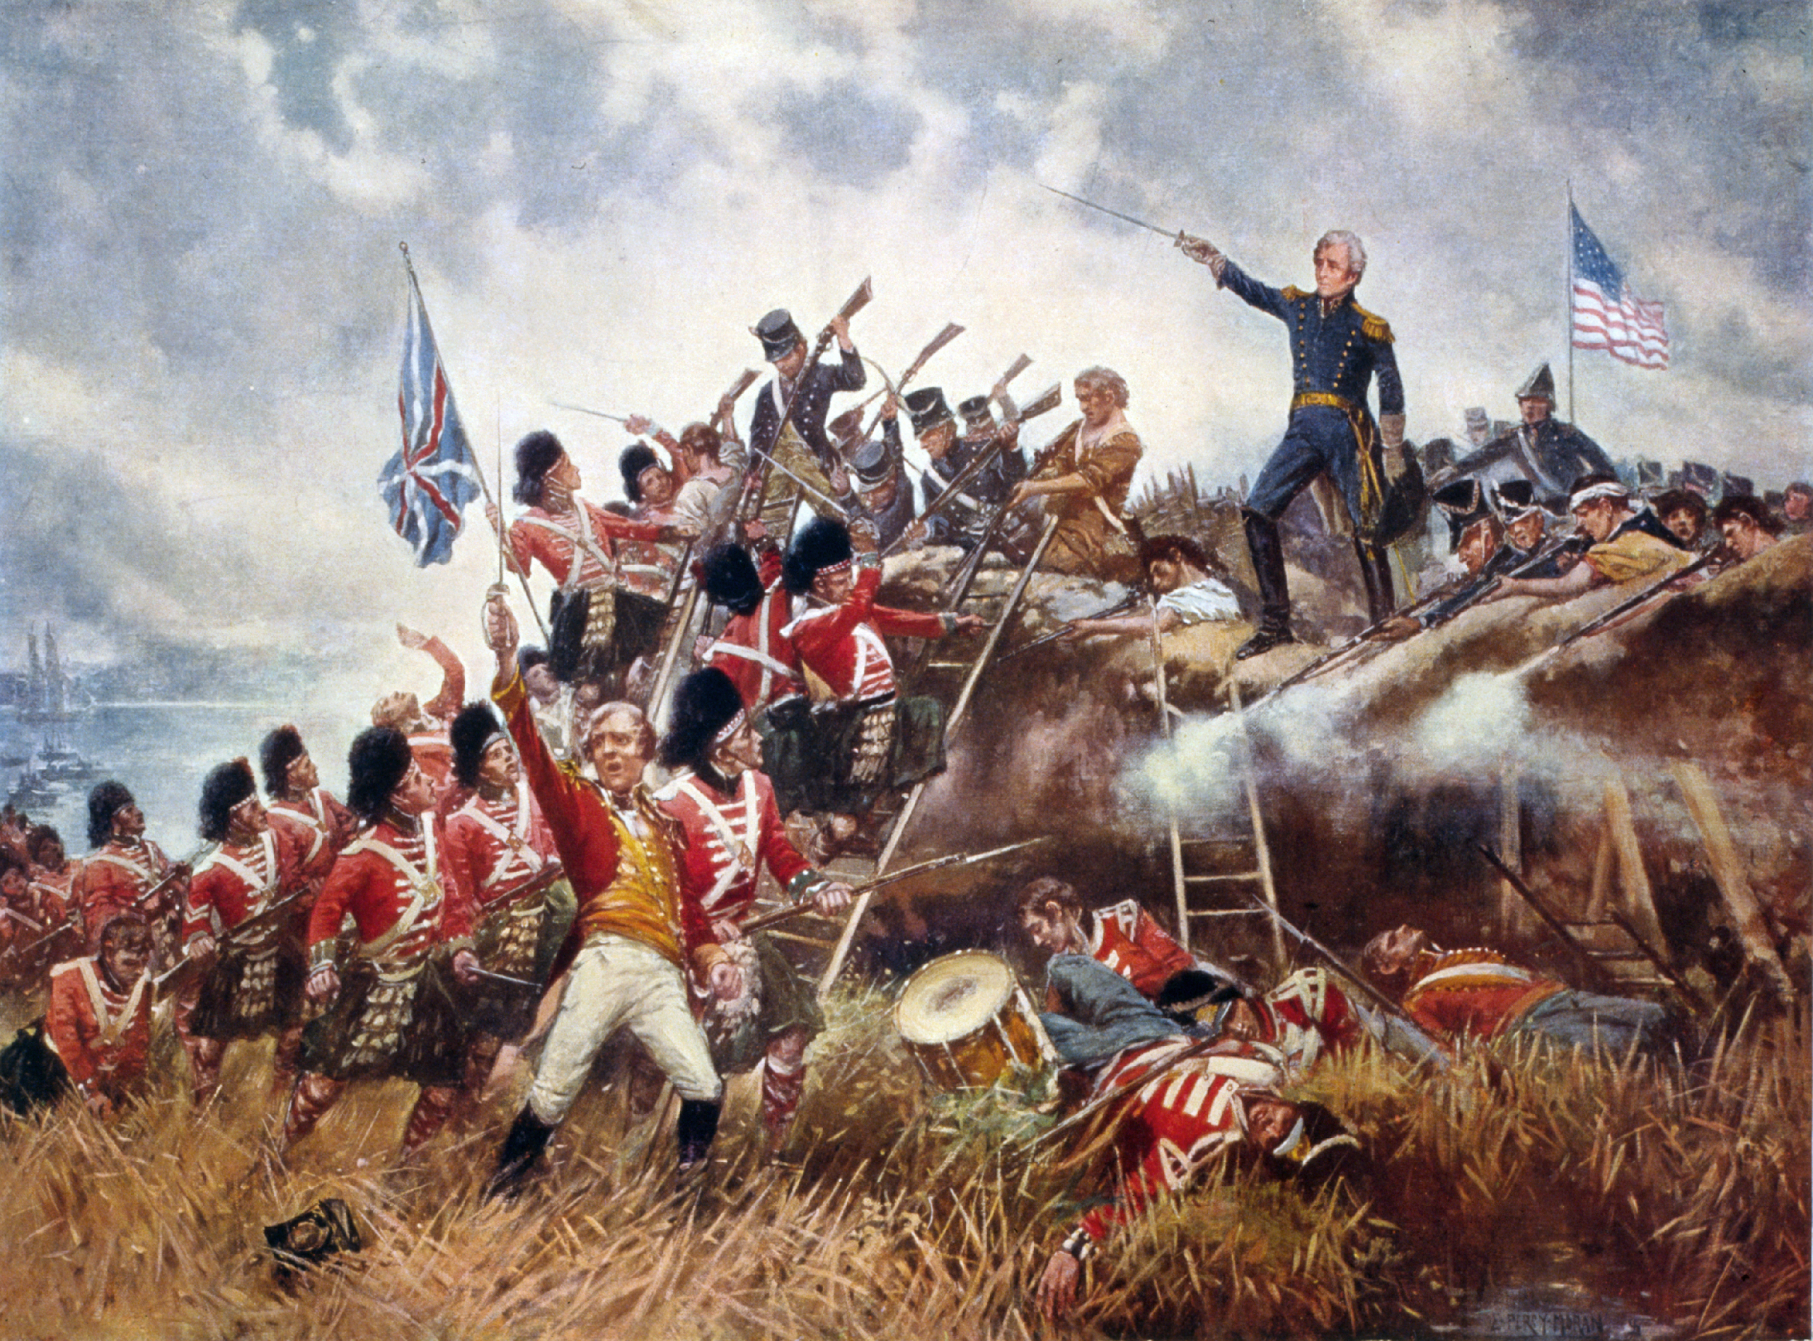
Fort McHenry
Had a flag so large that, “British would have no problem seeing it”
Francis Scott Key, Washington lawyer, detained on British ship
Watched the battle all night and at dawn, noticed the flag was still flying
Wrote the Star Spangled Banner
Lake Champlain
Britain wanted to cut off New England and push fighting South
American fleet defeated the British
New Orleans
Dozens of ships carrying 7,500 British soldiers approached Louisiana
Americans patched together under Andrew Jackson
American riflemen mowed down redcoats
Casualties:
Americans: 71
British: 2,000

Slide 11
Battle of New Orleans unnecessary
Treaty of Ghent
Ended the War of 1812 on December 24, 1814
Legacy of the War
No land traded hands, no clear winner, disputes over trade unresolved
Andrew Jackson deemed a hero
Increased Patriotism
Weakened Native Americans
US manufacturing grew
Proved US could defend itself against a military power

Slide 12
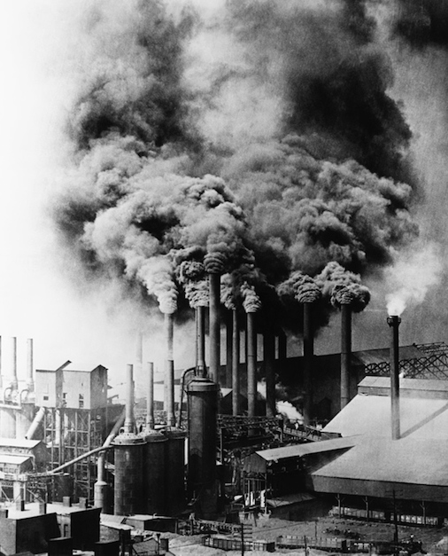
Industrial Revolution
Caused by the War of 1812
Factory machines replaced hand tools and large-scale manufacturing replaced farming as the main source of work
Spinning Jenny
Factory Systems
Brought workers and machines together under the same roof
Factories were built near a source of water to power the machines
People left their farms and crowded into cities
British Naval blockade kept imported goods from reaching US so Americans had to manufacture it for themselves

Slide 13
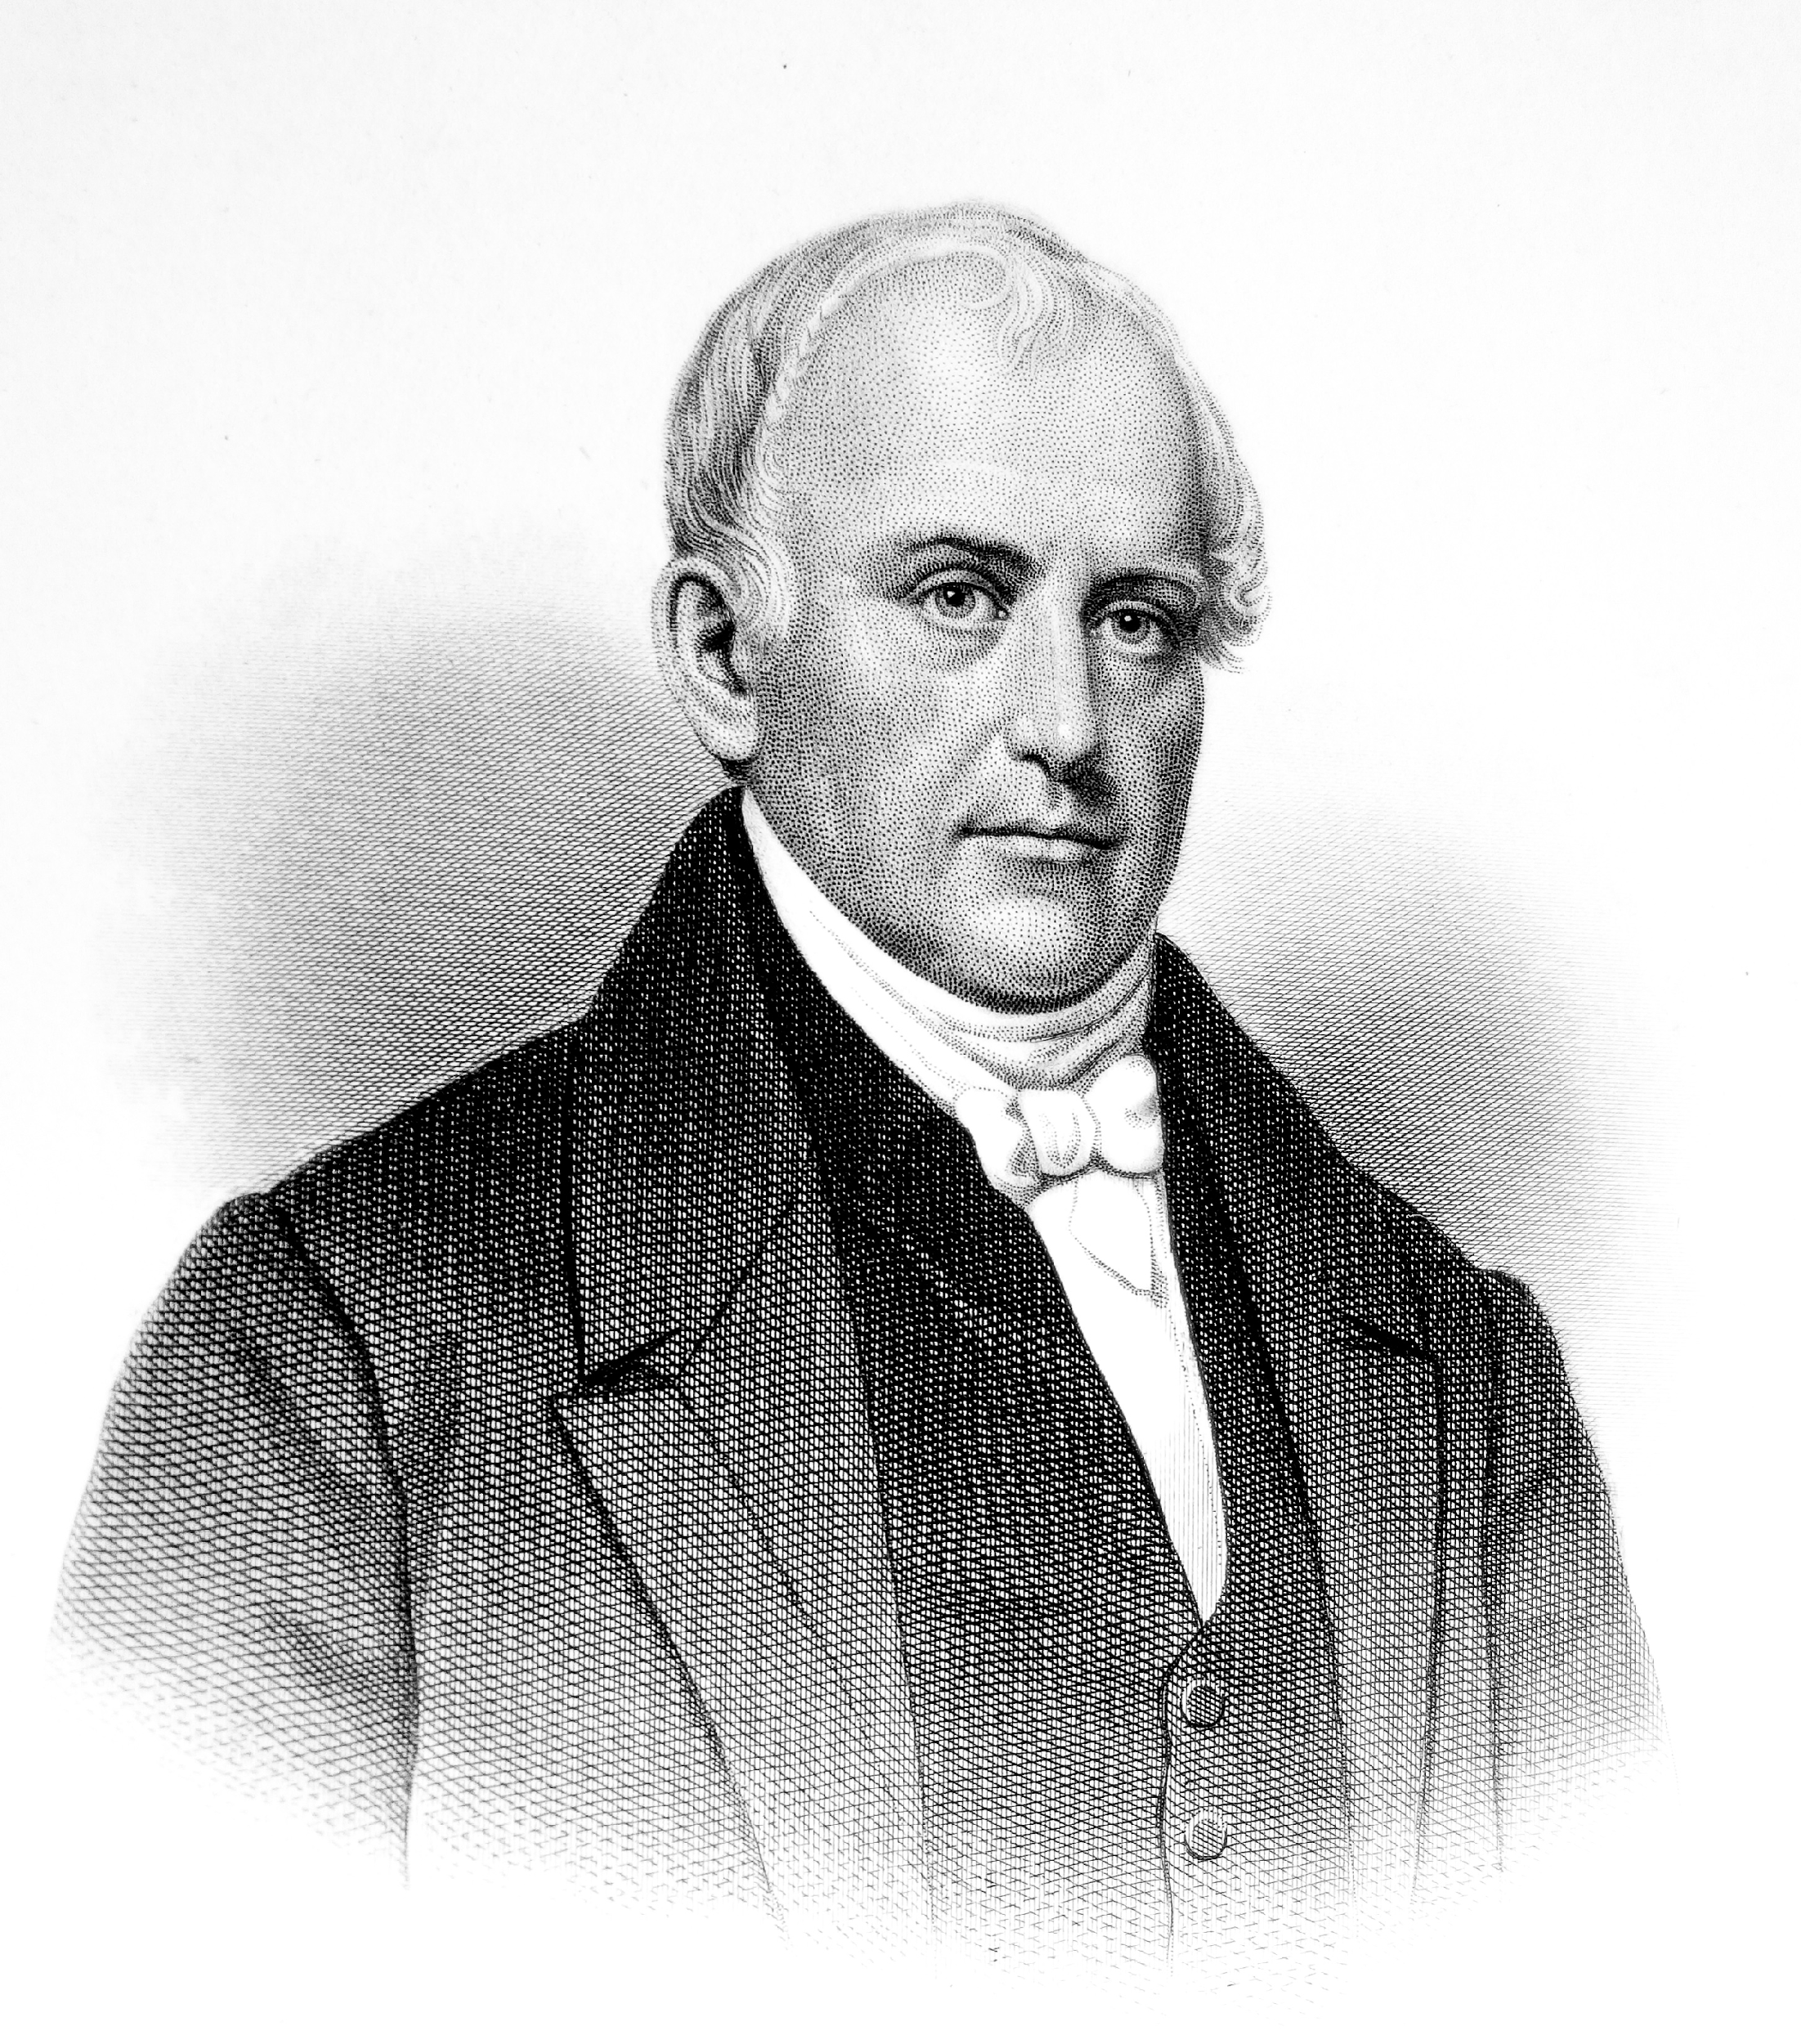
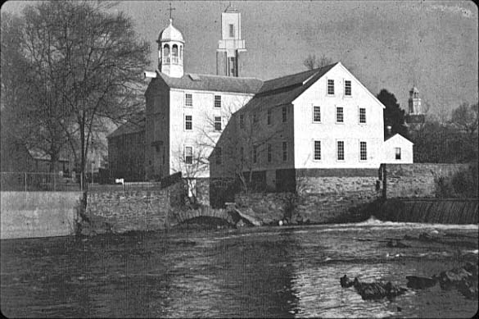
Factories in New England
Needed water supply
Ships and access to the ocean
Willing labor force
Samuel Slater
Illegal for textile workers to leave Britain
Sailed to US under false name
Built the first successful water-powered textile mill in America
Rhode Island
Hired eight children ages 7-12
Later built a larger mill and employed whole families

Slide 14
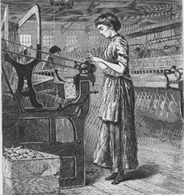
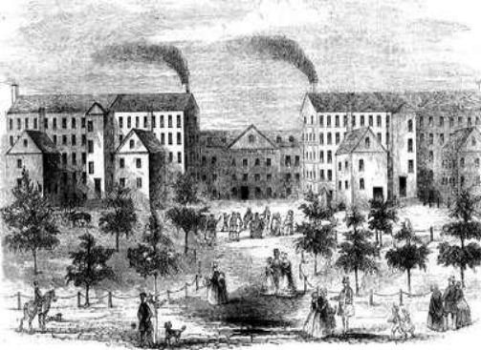
Francis Cabot Lowell
built Waltham
Spun raw cotton into yarn, but wove it into cloth on power looms
Brought the English secret to America
Built the town of Lowell Mills
Lowell Mills
Merrimack and Concord Rivers
Employed farm girls
Worked 12 ½ hour days
$2-$4 a week
Followed strict laws and attended church
Worked few years and then married

Slide 15
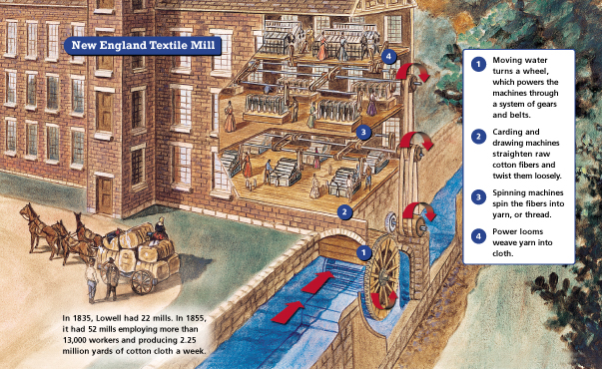

Slide 16
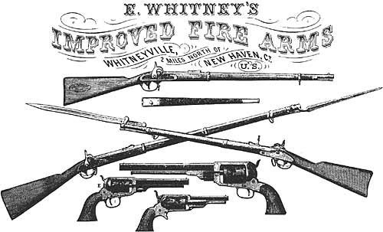
Ways to Manufacture
Eli Whitney manufactures 10,000 muskets for US army
Before now, guns were made one at a time by gunsmiths
Went to Washington with a box containing parts of muskets
Assembled a gun in seconds
Demonstrated the use of interchangeable parts, parts exactly alike
Machines were then created to manufacture these parts
Interchangeable parts sped up production, made repairs easy, and allowed low-wages

Slide 17
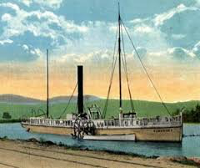
New Inventions increased factory productions, transportation, and communication
Robert Fulton
Invented steamboat that could move against the current
Growth cities: New Orleans and St. Louis
Henry Miller Shreve
Designed a powerful engine to get steamship back up the Mississippi River
Samuel F. B. Morse
Telegraph
Long pulses of electricity along a wire
Took seconds to communicate
First long-distance telegraph from Baltimore to Washington to inform the nomination of President for the election of 1844

Slide 18
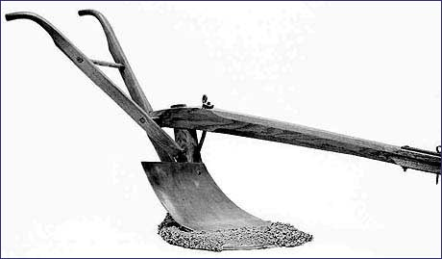
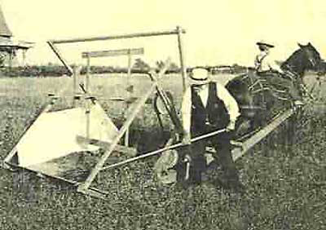
Improves Farming
John Deere invented the lightweight plow and steel cutting edge
Cyrus McCormick invented the reaper
United the nation
Midwestern Farmers grew food to feed Northeastern factory workers
Northeastern textile increased need for Southern cotton
Leads to expansion of slavery

Slide 19
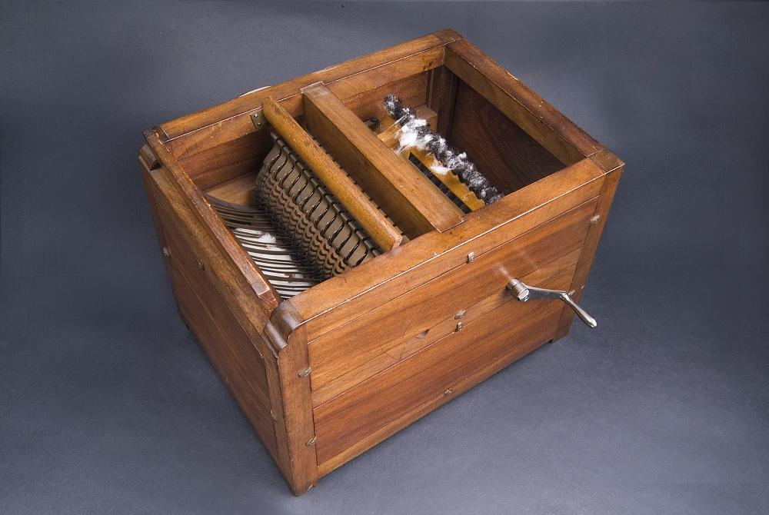
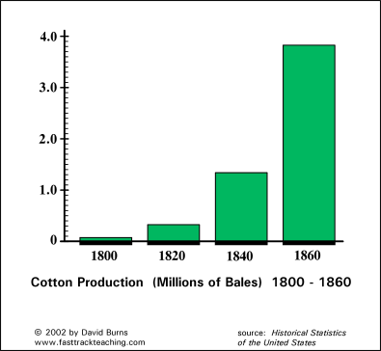
Eli Whitney...again
Invented a machine for cleaning cotton in 1793
Knew that there was a demand for cotton with the boom in textile
Knew that it took forever to clean
One worker could now clean 50 pounds a day
Helped set the South on a different course of development from the North
Cotton Gin Triggers…
Vast move westward
Farmers grew cotton more than other goods
More Native Americans to be moved off Southern lands for cotton
Higher demand in slave trade because of the new source of labor needed

Slide 20
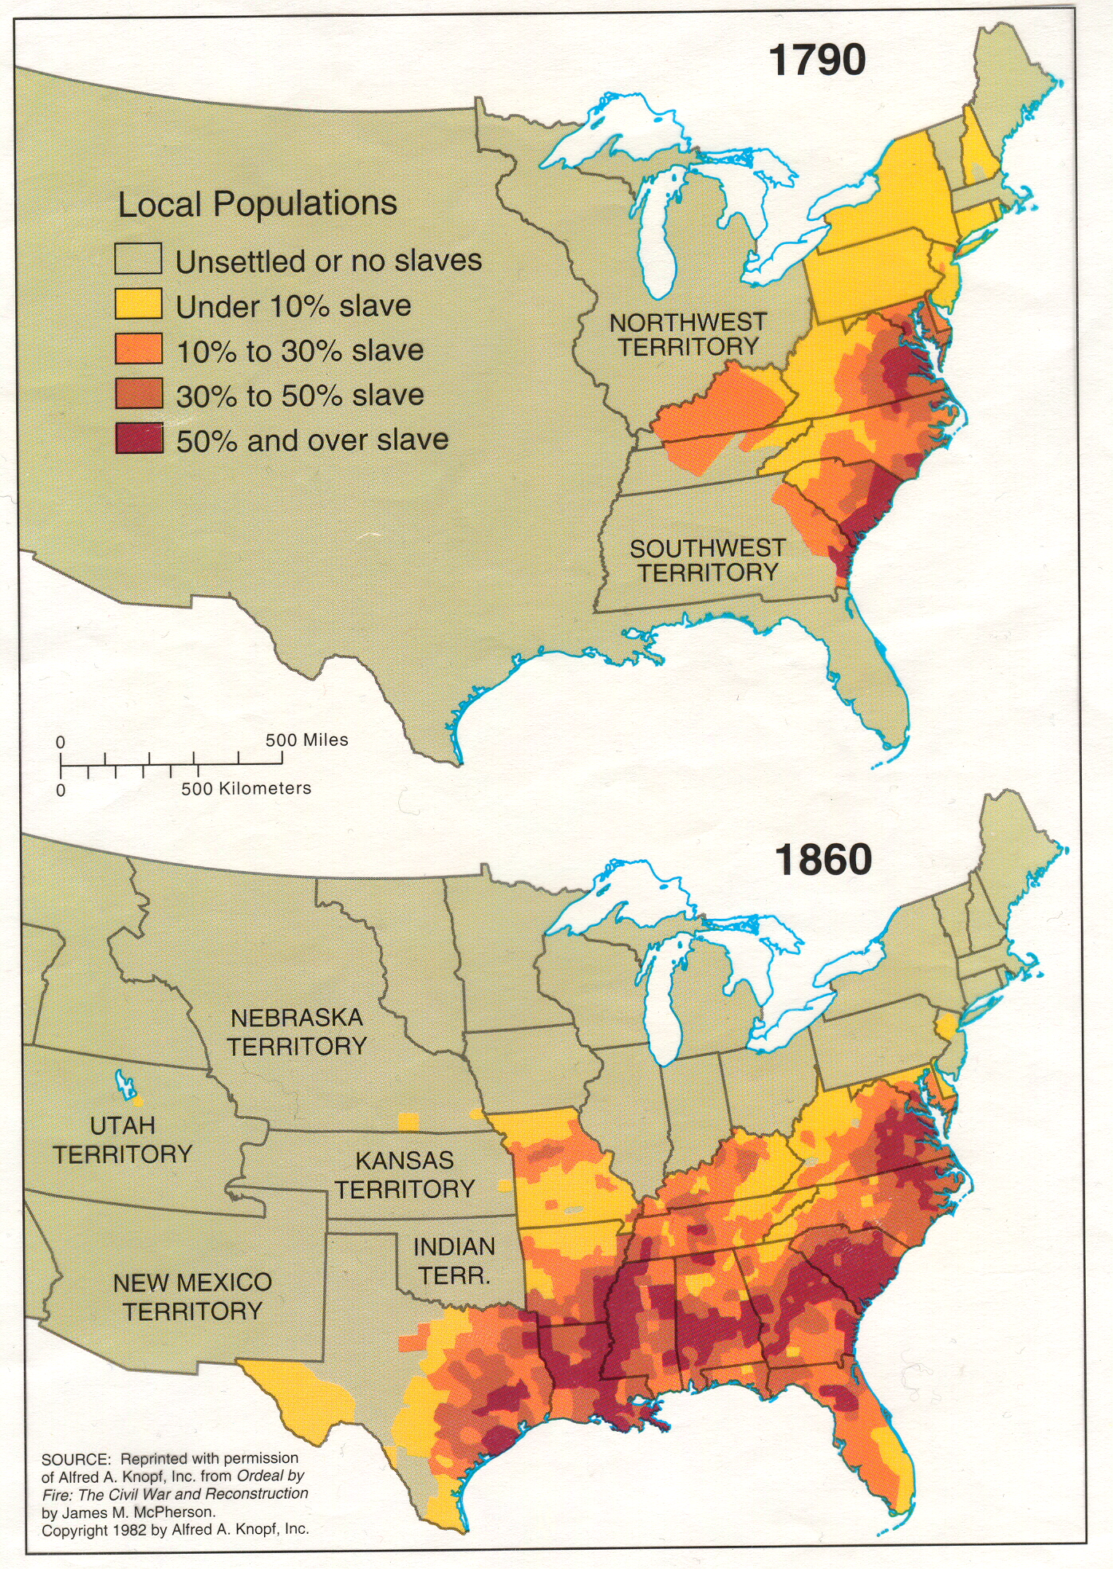
Slavery Expands
Using slave labor, the South raised millions of bales of cotton
In 1820, the South earned $22 million alone in cotton exports
By the 1830s, profits were $200 million
As cotton prices rose so did the cost and demand for slaves…
Male field hand in 1790…
$300
Male field hand in 1830…
$1000
It became illegal to import Africans for slave trade in 1808
Population in America was already great enough to keep trade going
...and monopolize it
It’s expansion had a major impact on the South
But its effect on the people living there was even greater

Slide 21
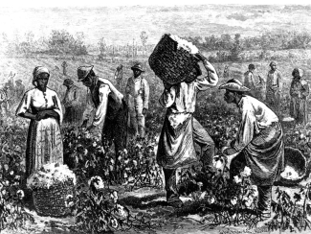
Slavery Divides the South
South is divided into whites who have slaves and whites who do not
Slaveholders with large plantations were the wealthiest and most powerful
But they were rare
Roughly ⅓ of white families owned slaves in 1840
Of this, roughly 1/10 had large plantations with 20+ slaves
Most Southern farmers owned <5 slaves
Still supported the institution
They hoped to be rich enough to buy more someday
Which would allow them to raise more cotton…
And become richer!
Becomes a ‘necessity’ to increase profit in the South

