Slide 1
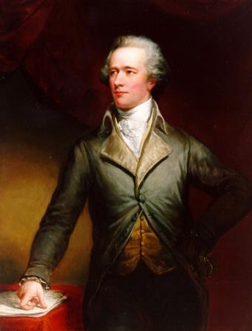
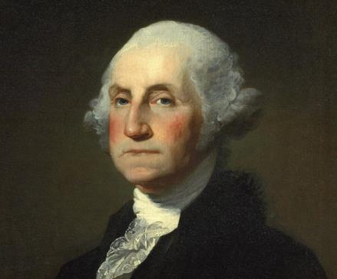
Washington and the New Republic
EQ – What was the impact of the major domestic issues faced by Washington?

Slide 2
The Preamble to the Constitution– What are the goals of the New Nation?
1.
More perfect Union
Establish justice
Ensure domestic tranquility
Provide common defense
Promote general welfare
Secure blessing of liberty
2.
3.
4.
5.
6.

Slide 3
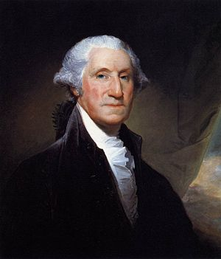
As the first President, Washington set many “precedents”
Key Vocab!
Examples that become traditions to be followed

Slide 4
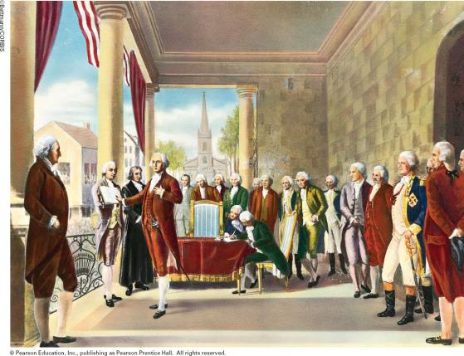
Concept
Problem
Solution
Executive
Offices
No executive offices to help run the government
Creates the
Cabinet…

Slide 5
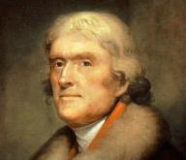
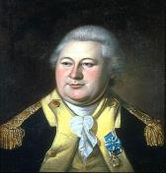
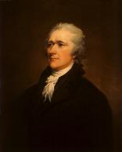
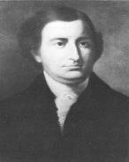
Washington’s Cabinet
State Dept
War Dept
Sect. of Treasury
Attorney General
Henry Knox
Thomas Jefferson
Alexander Hamilton
Edmund Randolph
Defend cases
Foreign policy
National Defense
Nation’s finances
http://www.visitingdc.com/images/thomas-jefferson-picture.jpg , http://www.nps.gov/history/museum/exhibits/revwar/image_gal/indeimg/web_exhibit/KNOX_exb.jpg , http://law.wustl.edu/Faculty/Wiedenbeck/BasicTax/Hamilton1806Trumbull.jpg, http://www.usdiplomacy.org/exhibit/images/secretaries/Randolph,%20Edmund.jpg

Slide 6
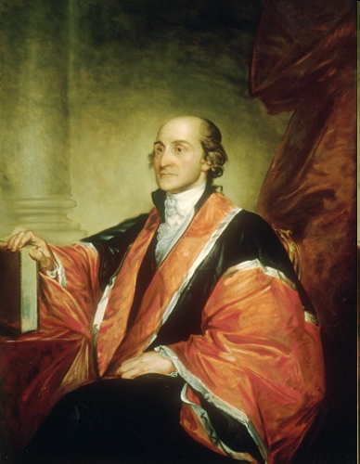
What about a court system?
Concept
Court
System
Problem
Solution
No Federal Court System
Judiciary Act of 1789 creates a federal court system & 6-person Supreme Court; John Jay = first chief justice

Slide 7
A Nation in Debt
Concept
Problem
Solution
National &
State Debt
$52 million war debt;
Lack of international
respect
Hamilton’s
Economic Plan
-Pay debts in full
-Fed. gov. assumes
state debts
-Create a national
bank

Slide 8
Concept
Taxes
Problem
Solution
No tax system, no money to run the government
Excise Tax
(Part of Hamilton’s Plan)
Tariff – 25% tax on
imported goods

Slide 9
Challenging the New Government
Concept
Problem
Solution
Enforcement
of Laws
Whiskey Rebellion
PA farmers refuse to pay the tax on whiskey
Washington sends troops; US will enforce its laws

Slide 10
Washington and Political Parties
Authors of the Constitution wanted to avoid political parties
Why do you think this was the case?
They felt these groups were “factions” that threatened the unity of a republic
However, two political parties form…
Federalists & Democratic-Republicans

Slide 11
Characteristics of our first political parties
Federalists
Democratic-Republicans
Hamilton
Strong central
Leader
Power of Gov.
Economy
British/French
Constitution
Jefferson
More power to states
Industry/Trade
Pro-British
Loose construction
Farming
Pro-French
Strict construction

Slide 12
Quick Assessment
Example or tradition to be followed _________________
Washington’s solution to the lack of a court system _____________________
Leader of the Federalist Party _______________
Who was the first Secretary of State?
PA farmers who rebelled against liquor tax; name the event ________________
Who was the first Secretary of the Treasury?
Name two problems Washington faced as he took office.

Slide 13
Washington’s Foreign Policy Issues
EQ – How did the U.S. confront foreign policy issues during this era?

Slide 14
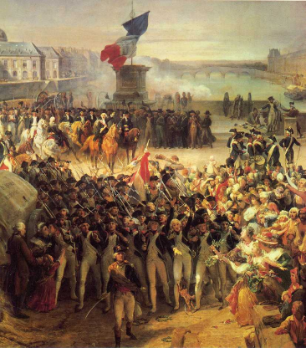
Foreign Issues with Europe
Conflicts between Great Britain & France
1
Proclamation of Neutrality (1793)
Why…?
a
Young nation, did not want to get involved
Weak military
Dependent on foreign trade
http://www.freewebs.com/ssjchokobo/06_french_revolution.jpghttp://www.freewebs.com/ssjchokobo/06_french_revolution.jpg

Slide 15
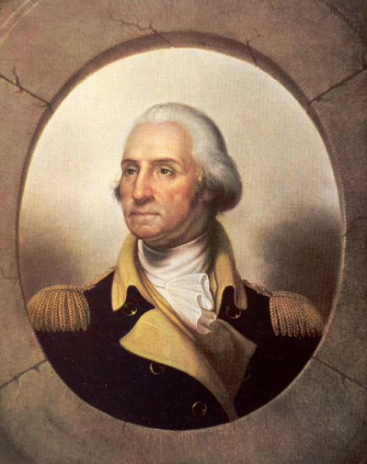
Proclaiming Neutrality
Proclamation of Neutrality (1793)
Britain begins stealing US ships & sailors…
aka “Impressment”
2
Why does G.B do this?
How does this affect the Neutrality Proclamation?
http://azfar08.files.wordpress.com/2007/11/george-washington-big.jpg

Slide 16
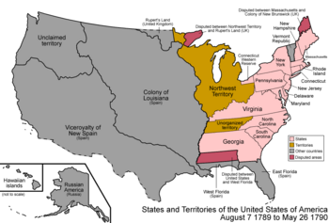
Foreign Policy Struggles
The British wanted to keep Americans from settling in the Northwest Territory
How…?
The British supplied Indians with arms to fight; Indians resisted American troops
http://content.answers.com/main/content/wp/en-commons/thumb/8/88/350px-United_States_1789-08-1790.png

Slide 17
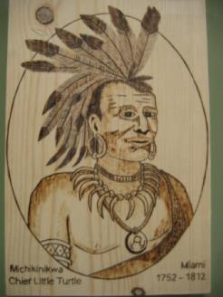
Proclamation of Neutrality (1793)
Conflicts with Indians
Native American war chief
Little Turtle
3
Battle of Fallen Timbers
Who won?
What resulted?
4
Treaty of Greenville
5
Opened Ohio to settlement
b

Slide 18
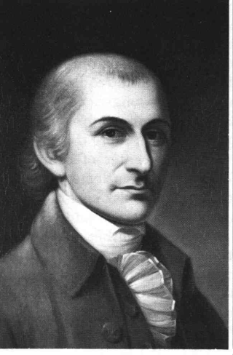
Issues with foreign powers
Impressment
Jay’s Treaty
6
Avoided war with Britain
Pickney’s Treaty
7
Opened Mississippi River & New Orleans to trade (Spain)

Slide 19
Jay’s Treaty of 1794
What did Britain & the U.S. agree to?
No British forts on American soil
Americans must pay prewar debts
c
Result?
Avoids war with Britain
Does this treaty stop impressment?
NO!

Slide 20
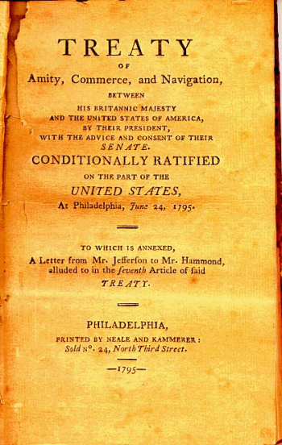
Reaction to the Jay Treaty
Split along party lines…
Washington & Federalists = “good job”
Democratic Republicans = “Jay is a sellout”
Treaty was passed
http://www.earlyamerica.com/earlyamerica/milestones/jaytreaty/1.html

Slide 21
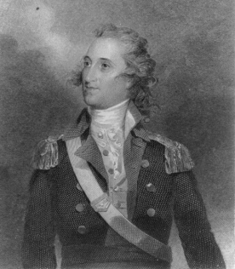
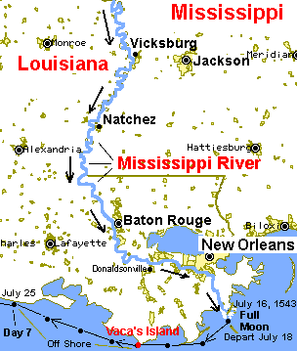
Pickney’s Treaty
What did Spain & U.S. agree to?
U.S. gains shipping rights on the Mississippi River & access to New Orleans
d
Result?
U.S. can send goods down the Mississippi to New Orleans, trade with other nations

Slide 22
Washington’s Farewell Address
Complete the Primary Source Analysis Activity
Discussion:
What three things did Washington warn against?
Why did Washington feel this way?
What is your opinion about his advice? Did “we” listen?

Slide 23
Washington Retires
After two terms, Washington retires from the Presidency
Could he have run for a third term?
Why did he chose not to?
What were some of the precedents set by Washington?
http://upload.wikimedia.org/wikipedia/commons/thumb/d/dd/George_Washington_1795.jpg/300px-George_Washington_1795.jpg

Slide 24
Quick Assessment
What was the most direct result of the Battle of Fallen Timbers?
Whose job was it to develop a plan to reduce the nation’s national debt?
Kidnapping American sailors was called _____.
What event greatly hurt the relationship between the U.S. and France?
What event allowed President Washington to show Americans that laws will be enforced?
What did Washington warn Americans to avoid during his Farewell Address?
What did the U.S. gain with the passage of Pickney’s Treaty?

