Slide 1
Mrs McLin’s U.S. History
Welcome to Class!

Slide 2
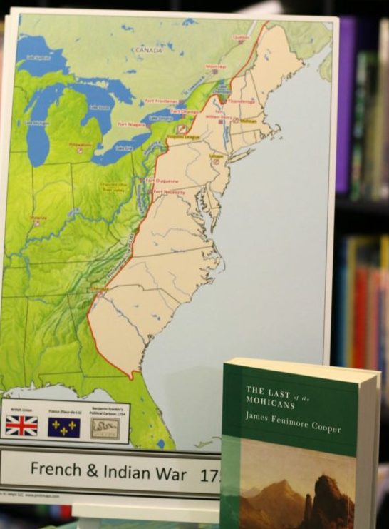
Different Types of Assignments
Tests
Quizzes
Binder Checks
Projects
Presentations

Slide 3
Binder Checks
ALL STUDENTS must have binders for JUST the class.
If the student does not have a binder for JUST this class it will be very hard to pass the binder check.
The binder should be organized with a completed table of contents that the teacher will provide.

Slide 4
Course Outline & Contract
Read through.
Return the signed contract to me next class.

Slide 5
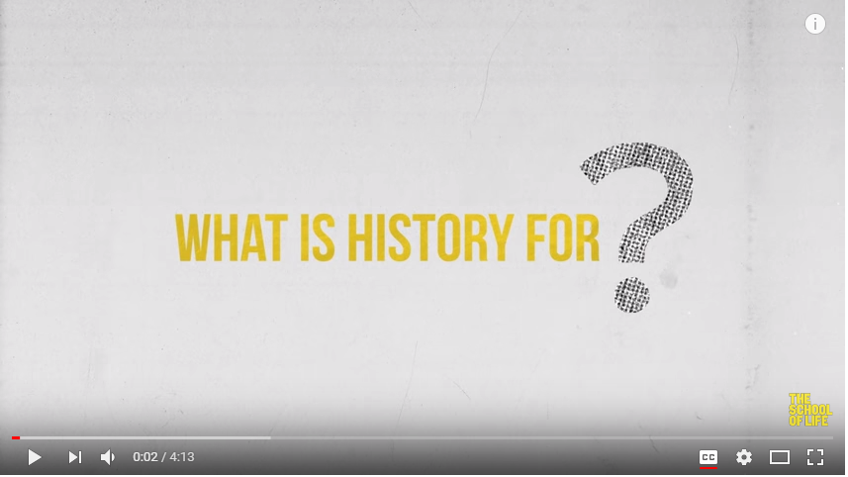
What is History for?
The fundamentals about History and why we need it.

Slide 6
Ice-Breaker: Who I Am
(PDF)
Complete page 1 (about yourself).
Complete page 2 by asking 20 people one question:
Name
Response to question
Keep this worksheet – you’ll be handing it in on Friday.

Slide 7
Log Onto Computers
Let me know if I need to reset your password.
I’ll need your student # and date of birth (year, month, day).
Then open the class website:
MclinUShistory.weebly.com
Password is westmont

Slide 8
Join Google Class
Go to classroom.google.com
Period 1 Google Class Join Code: d09cho
​Period 2 Google Class Join Code: ​e0w50gp
Open the “Test Upload” assignment and tell me about your plans for after you graduate and beyond.
When you finish, press “Submit”.

Slide 9
Why Study History?
(PPT)
(Doodle)
(Article)
(Spectrum)
Keep these worksheets – you’ll be handing them in on Friday.

Slide 10
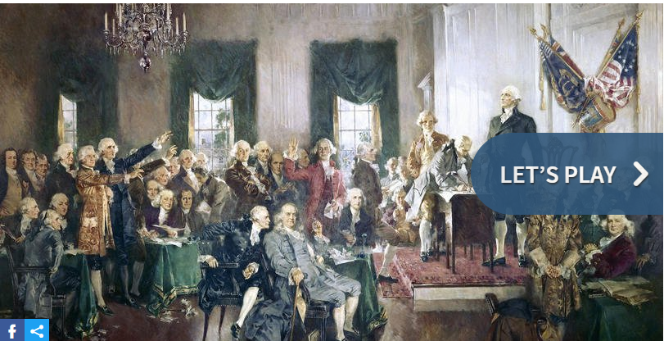
US History Quiz
Quick US History Quiz (link)

