Slide 5
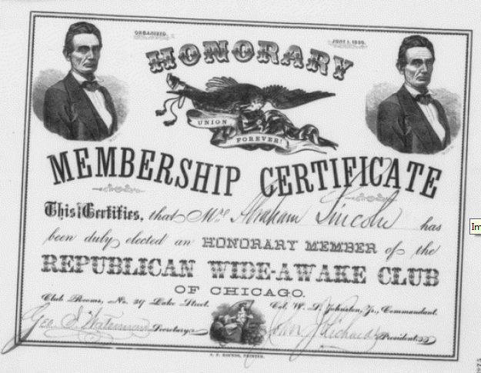

Slide 8
A primary source provides a firsthand account of events recorded during or shortly after the events described occurred. Primary sources can include newspaper articles, government documents, diaries, photographs, and maps.

Slide 9
Secondary sources might include textbooks, essays, scholarly articles, biographies, or encyclopaedias.
Secondary sources do not just present facts – they provide an interpretation of events

