Slide 1
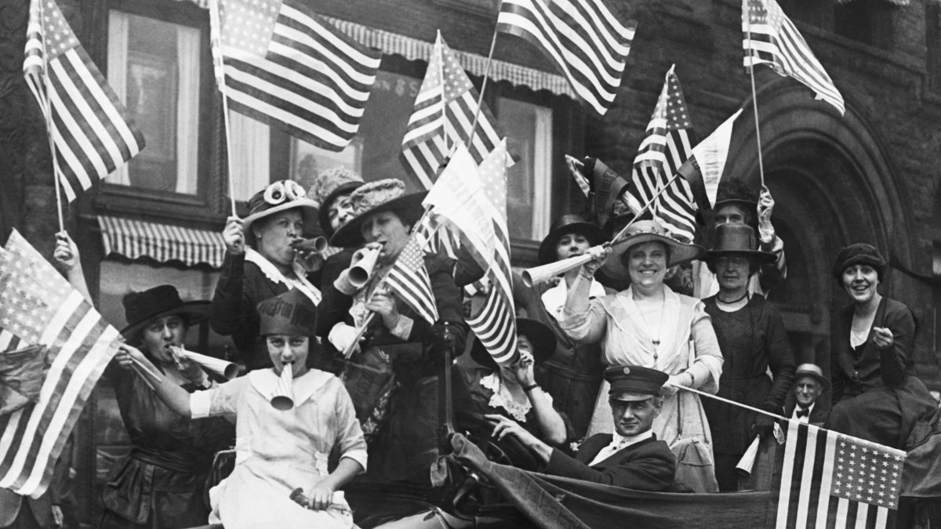
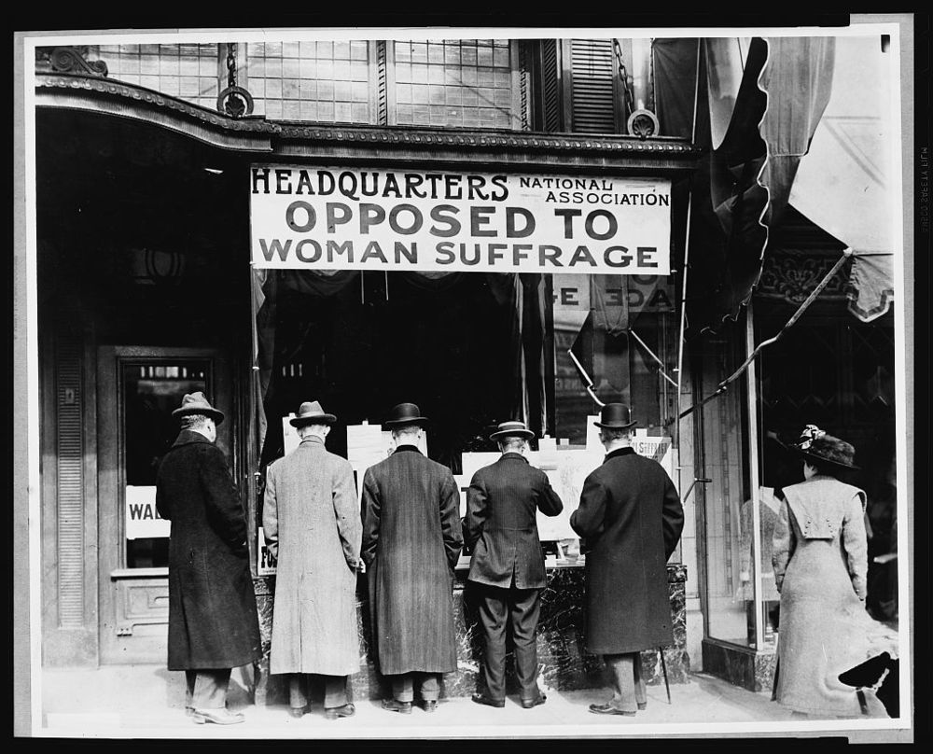
This activity …
… will have you explore the arduous road of how women came to have the right to vote in this country.
Objectives:
Understand the events & factors that led to suffrage.
Compare /contrast different portrayals of how women gained suffrage using secondary and primary sources of information.

Slide 2
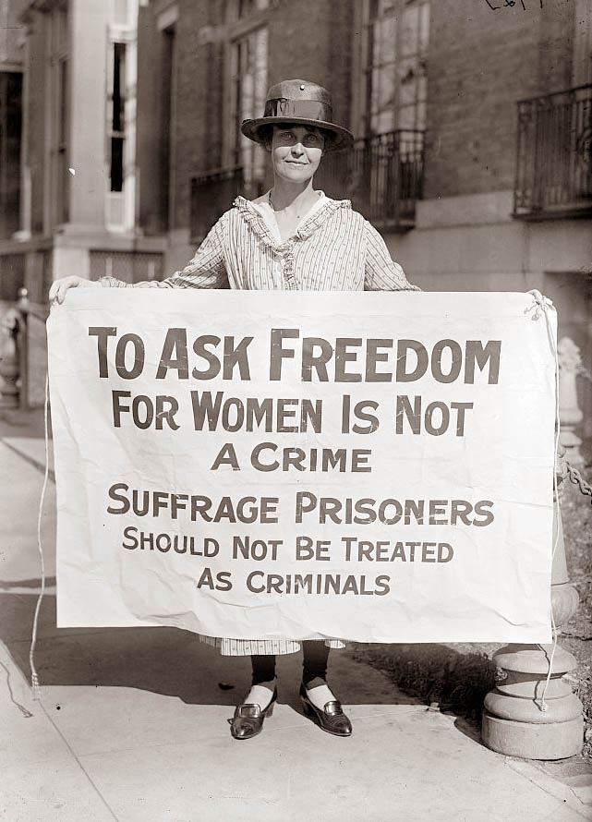
Predict:
Why do you think this woman is holding this sign?
Write down one question you have for this primary source.

Slide 3
Imagine if….
You were
not allowed
to vote.
You got married, then after 10 years was divorced.
Your spouse decides to take the house, the property & belongings, and takes full custody of the kids.
You wanted to become a doctor or lawyer and were told by an authority figure “No, you are not allowed”.
You are not allowed to
hold public office… you
were prohibited from
serving on juries.
Choose at least two “Imagine ifs” and predict how these
limitations could have impacted women’s lives?

Slide 4
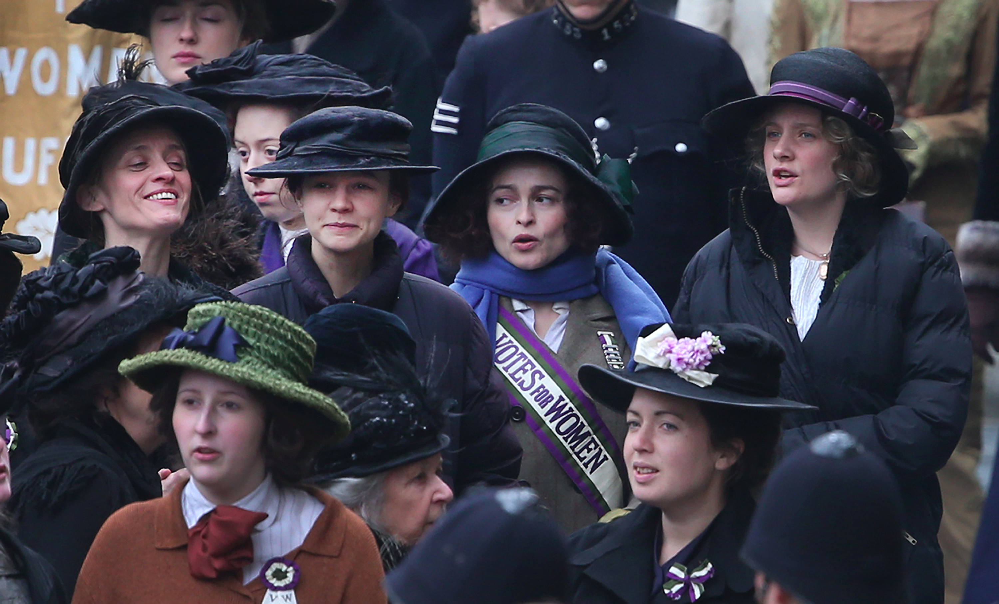
What does the term ‘Suffrage’ mean?
The right to vote.
A ‘suffragist’ is a man or woman who
supports the extension of the right to vote.
Notes:
Ask the students, first, what they think the term suffrage means, then unveil the answer.

Slide 5
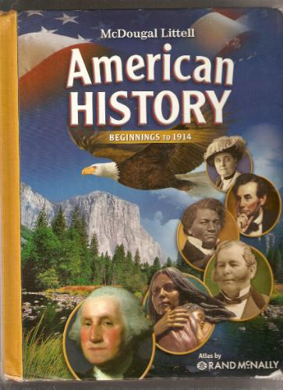
Critical Reading of
Secondary Source
Critically read the textbook version on the next slide that explains how women in the U.S. gained the right to vote.
Afterwards, answer the following question: Do you feel that this reading gives its’ readers a fairly complete and full understanding of this historical time period? Support your answer.

Slide 6
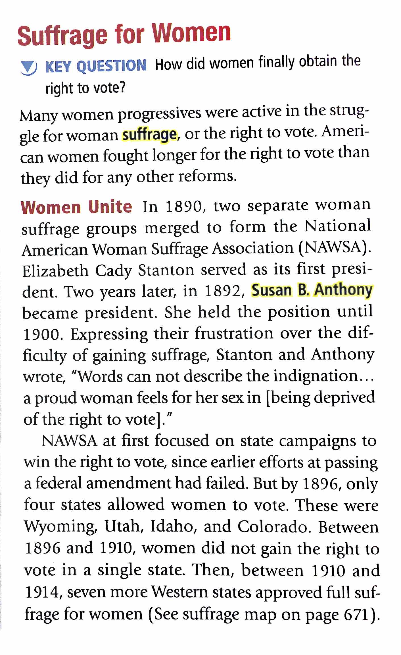
Notes:
The teacher (or student popcorn) will read the following textbook excerpt out loud.

Slide 8
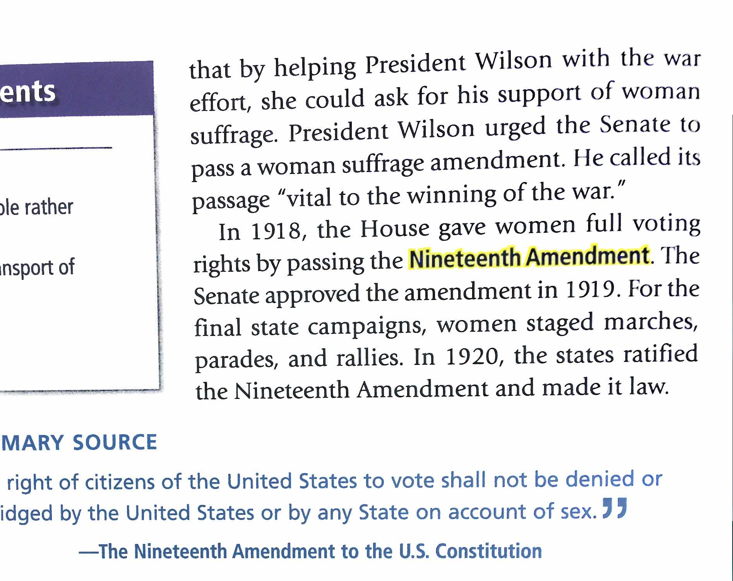
#4. Write & Discuss:
Do you feel that this reading gives its’ readers a fairly complete and full understanding of this historical time period? Support your answer.

Slide 9
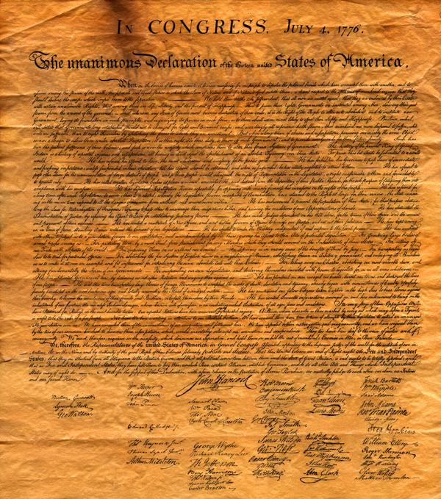
Declaration of Independence
#5. Predict, Write, & Discuss:
What groups of people in America do you think did not receive "equality" at the time the Constitution was written?
“We hold these truths to be self-evident, that all men are created equal, that they are endowed by their Creator with certain unalienable Rights, that among these are Life, Liberty and the pursuit of Happiness”.

Slide 10
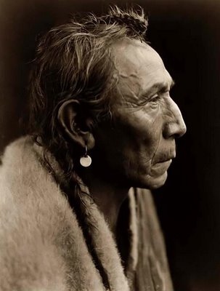
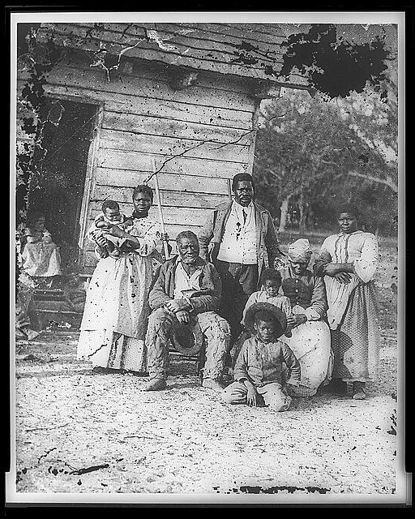
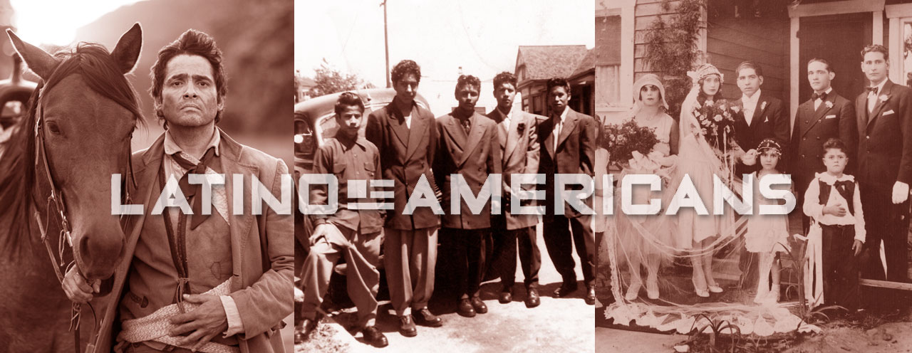
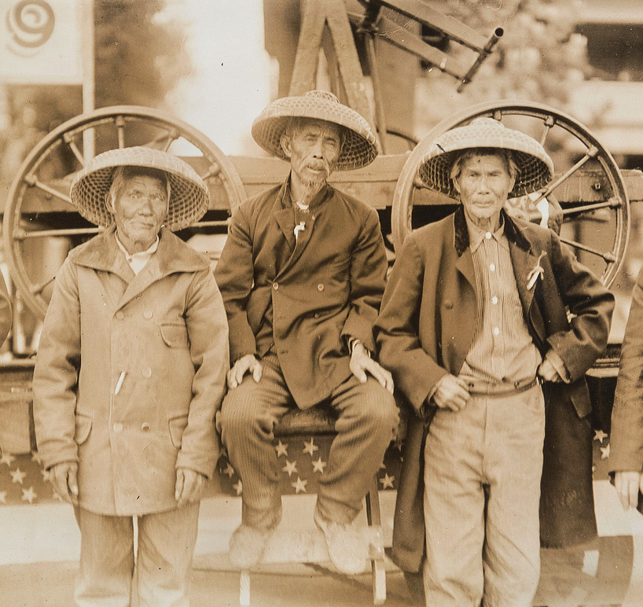
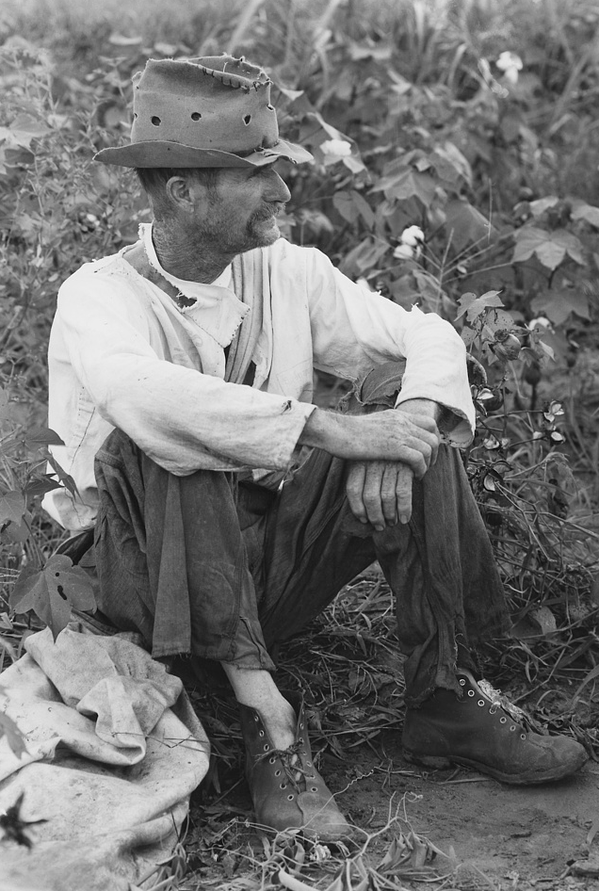
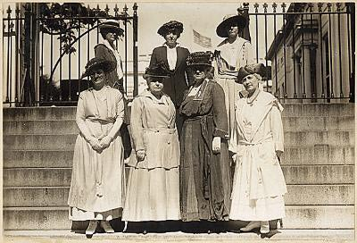
Whose Equality?
“Equality” did not include….
Native Americans
Enslaved Blacks
Latinos
Asians
Poor whites
Women
Video up next:
Take notes
When the Constitution was written, only white male property owners (about 10 to 16% of the nation's population) had the vote.

Slide 11
Voting: History Overview
4 min

Slide 12
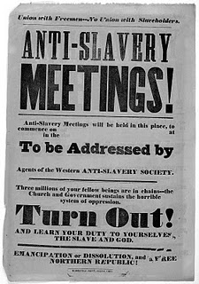
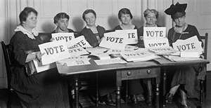
Early Women’s Movement…
Grew partly out of the anti-slavery movement of the 1800’s.
1866- 15th Amendment gave voting rights to all male citizens, regardless of race.
1st time: “Citizens” “voters” were defined as male
Women’s group primarily centered on suffrage- right to vote.

Slide 13
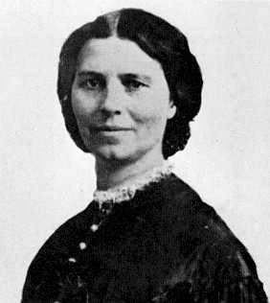
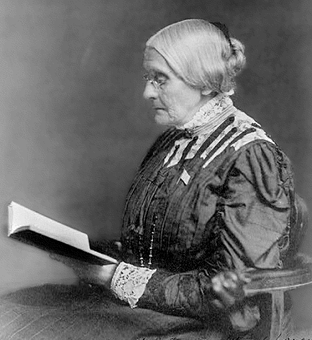
Suffrage for Women
In 1890, two separate woman suffrage groups merged to form the National American Woman Suffrage Association (NAWSA).
Elizabeth Cady Stanton served as its first president.
1892, Susan B. Anthony became president.

Slide 14
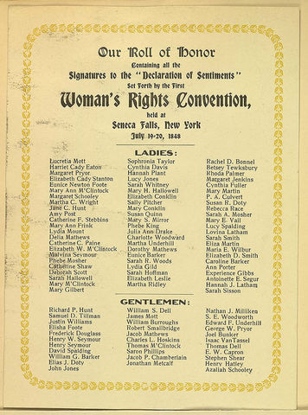
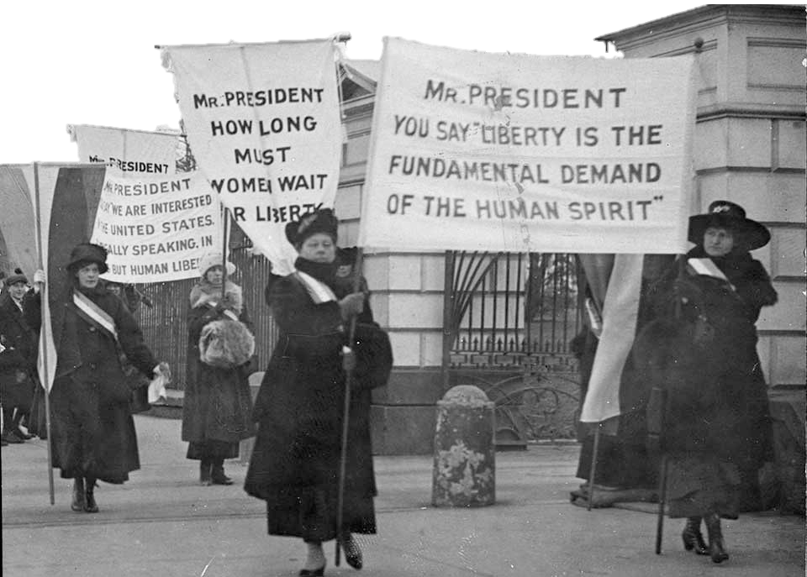
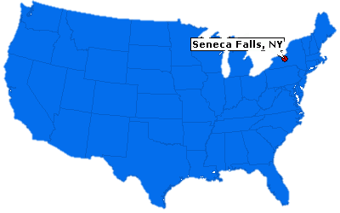
Declaration of Sentiments
1848 Women’s rights convention in Seneca Falls, New York.
Elizabeth Cady Stanton drafted the
A document signed in 1848 by 68 women and 32 men.
Outlined the ways U.S. women were being treated unjustly.
Declaration of
Sentiments
#8. Predict:
What do you think were some of the injustices outlined in this document?

Slide 15
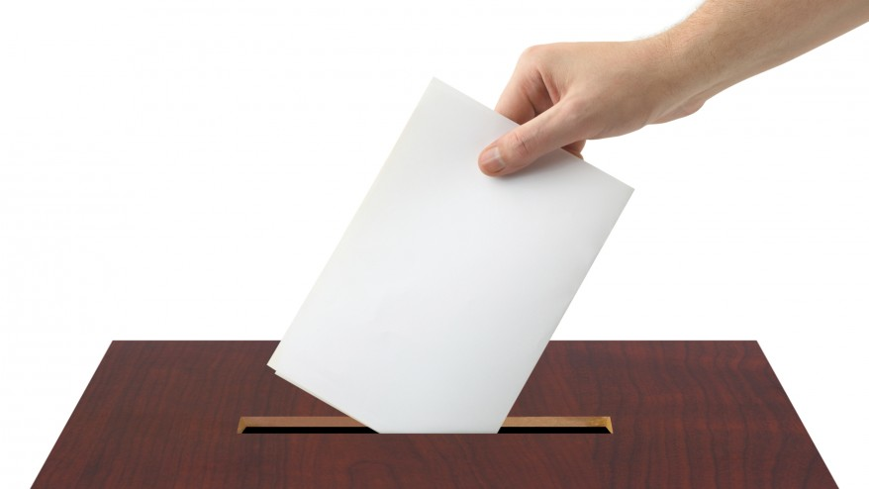
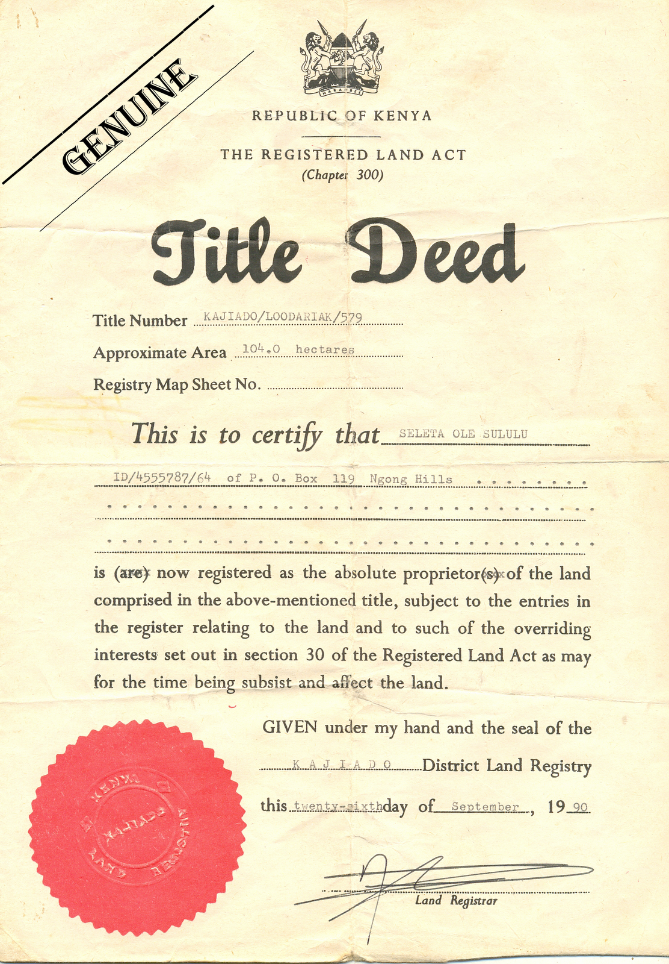
Declaration of Sentiments
Not allowed to vote.
Married women had no legal
or property rights.
Most occupations &
educational opportunities
were closed to women.
Working women earned a
fraction of what men earned.

Slide 16
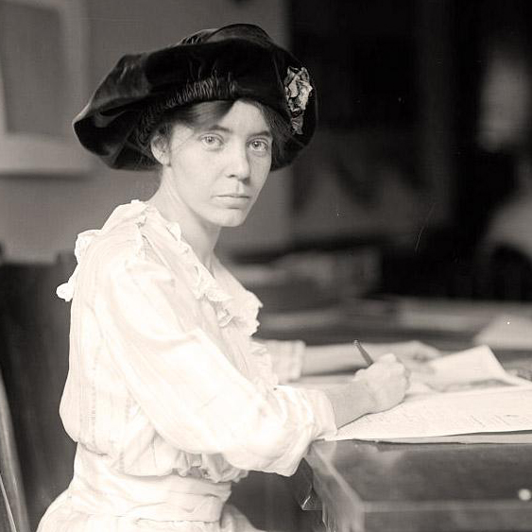
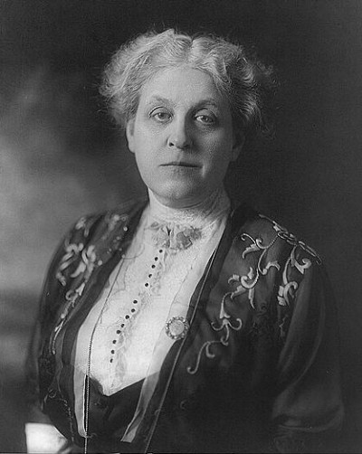
Alice Paul (1885-1977)
Early twentieth century leader of the woman suffrage movement, Alice Paul was born in 1885 in New Jersey, to a Quaker family that believed in gender equality, education for women, and working to improve society.
Alice Paul and the National Woman's Party emphasized working for a federal constitutional amendment for suffrage. Their position was at odds with the position of the NAWSA, headed by Carrie Chapman Catt, which was to work state-by-state as well as at the federal level.

Slide 17
#10. Comparing Political Strategies
Goal: Constitutional
Amendment
Women
Suffrage
NAWSA
NWP
Analyze the next several primary sources and infer the main differences of HOW each political group attempted to gain the right to vote….

Slide 18
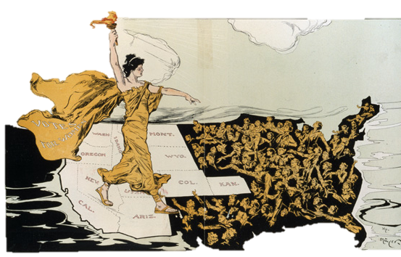
Comparing Political Strategies
NAWSA at first focused on state to state campaigns to win the right to vote, since earlier efforts at passing a federal amendment had failed.
NAWSA

Slide 19
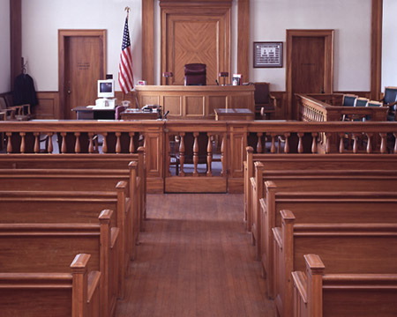
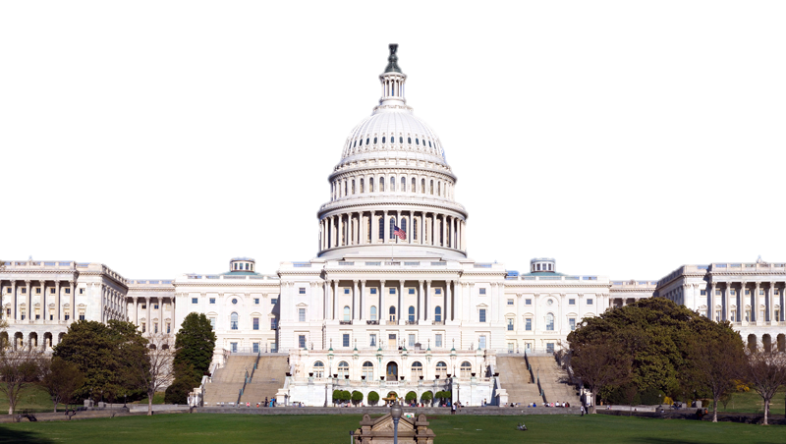
NAWSA: Political Strategies
Convince the
national
government
to support
suffrage
amendments
Convince
states to
support
suffrage
amendments
Continue to
use court
cases to
challenge
women’s lack
of voting rights

Slide 20
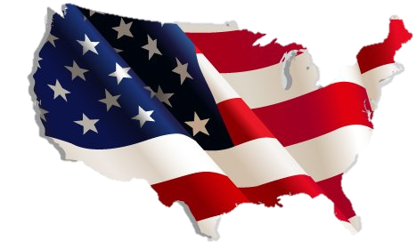
State By State Campaigns
By 1896, only four states allowed women to vote.
Between 1896 & 1910, women did not gain the right to vote in a single state.

Slide 21
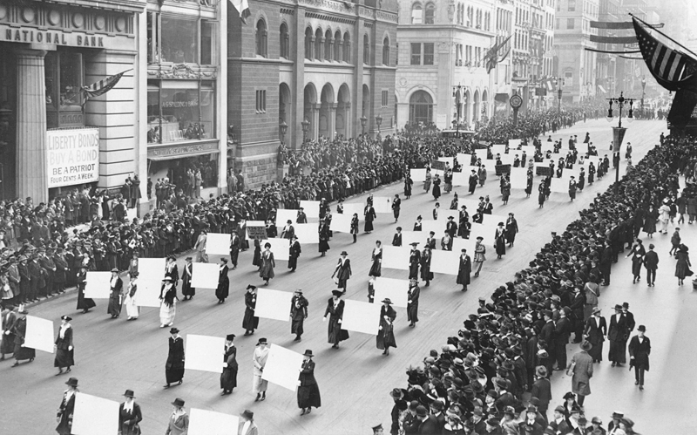
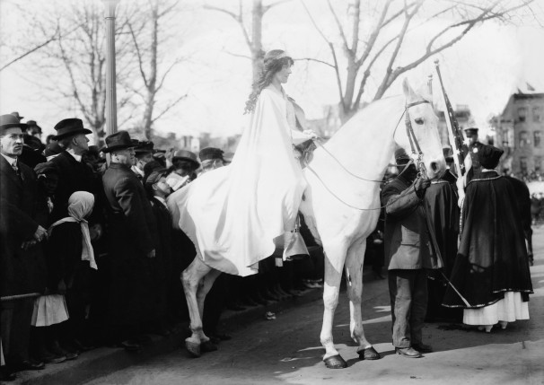
NWP

Slide 22
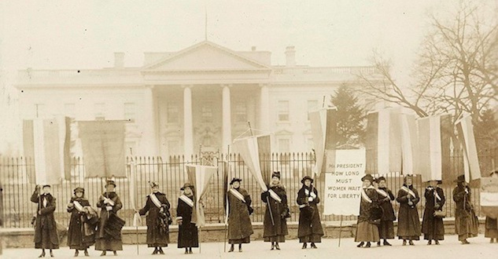
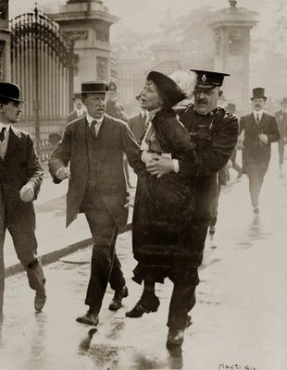
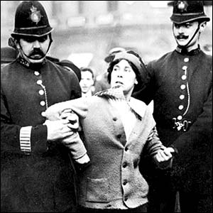
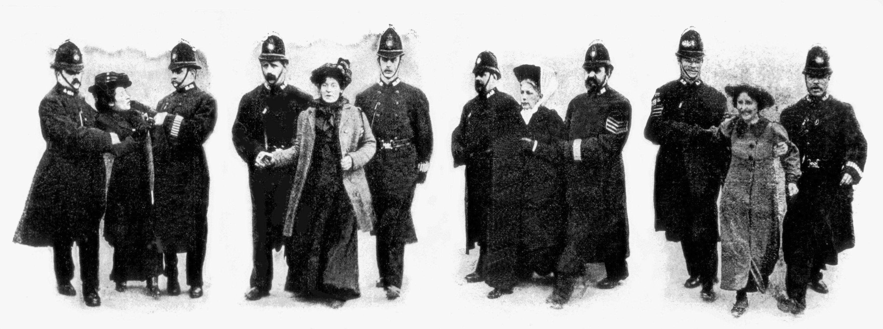
Notes:
Note: Do no click. Allow images to run automatically.
Women were the first group of people to picket the White House. Many of the suffragists, including Alice Paul and Lucy Burns, were also arrested on the bogus grounds of “obstructing traffic”.

Slide 23
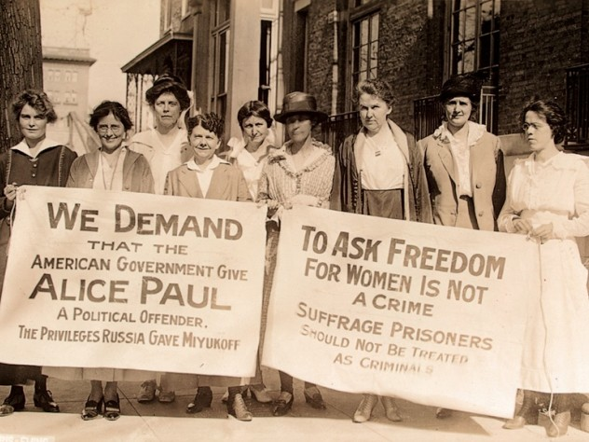
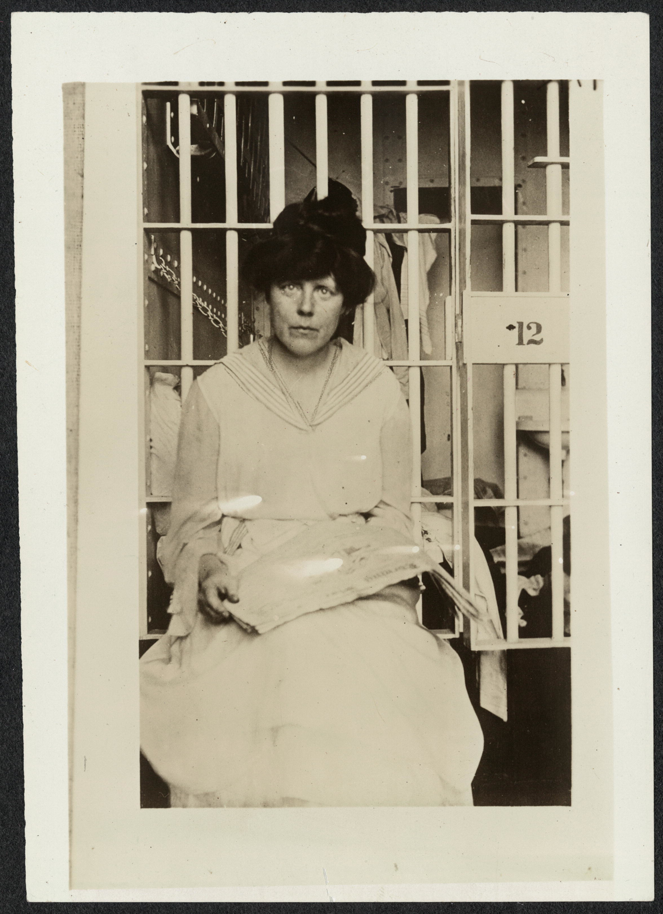
Alice Paul
Lucy Burns
Notes:
Note: Do no click. Allow images to run automatically.

Slide 24
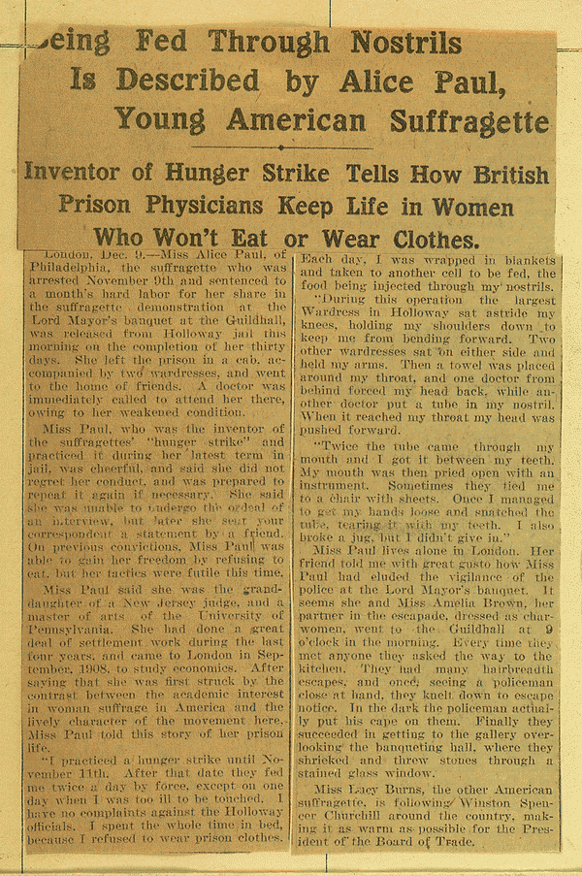
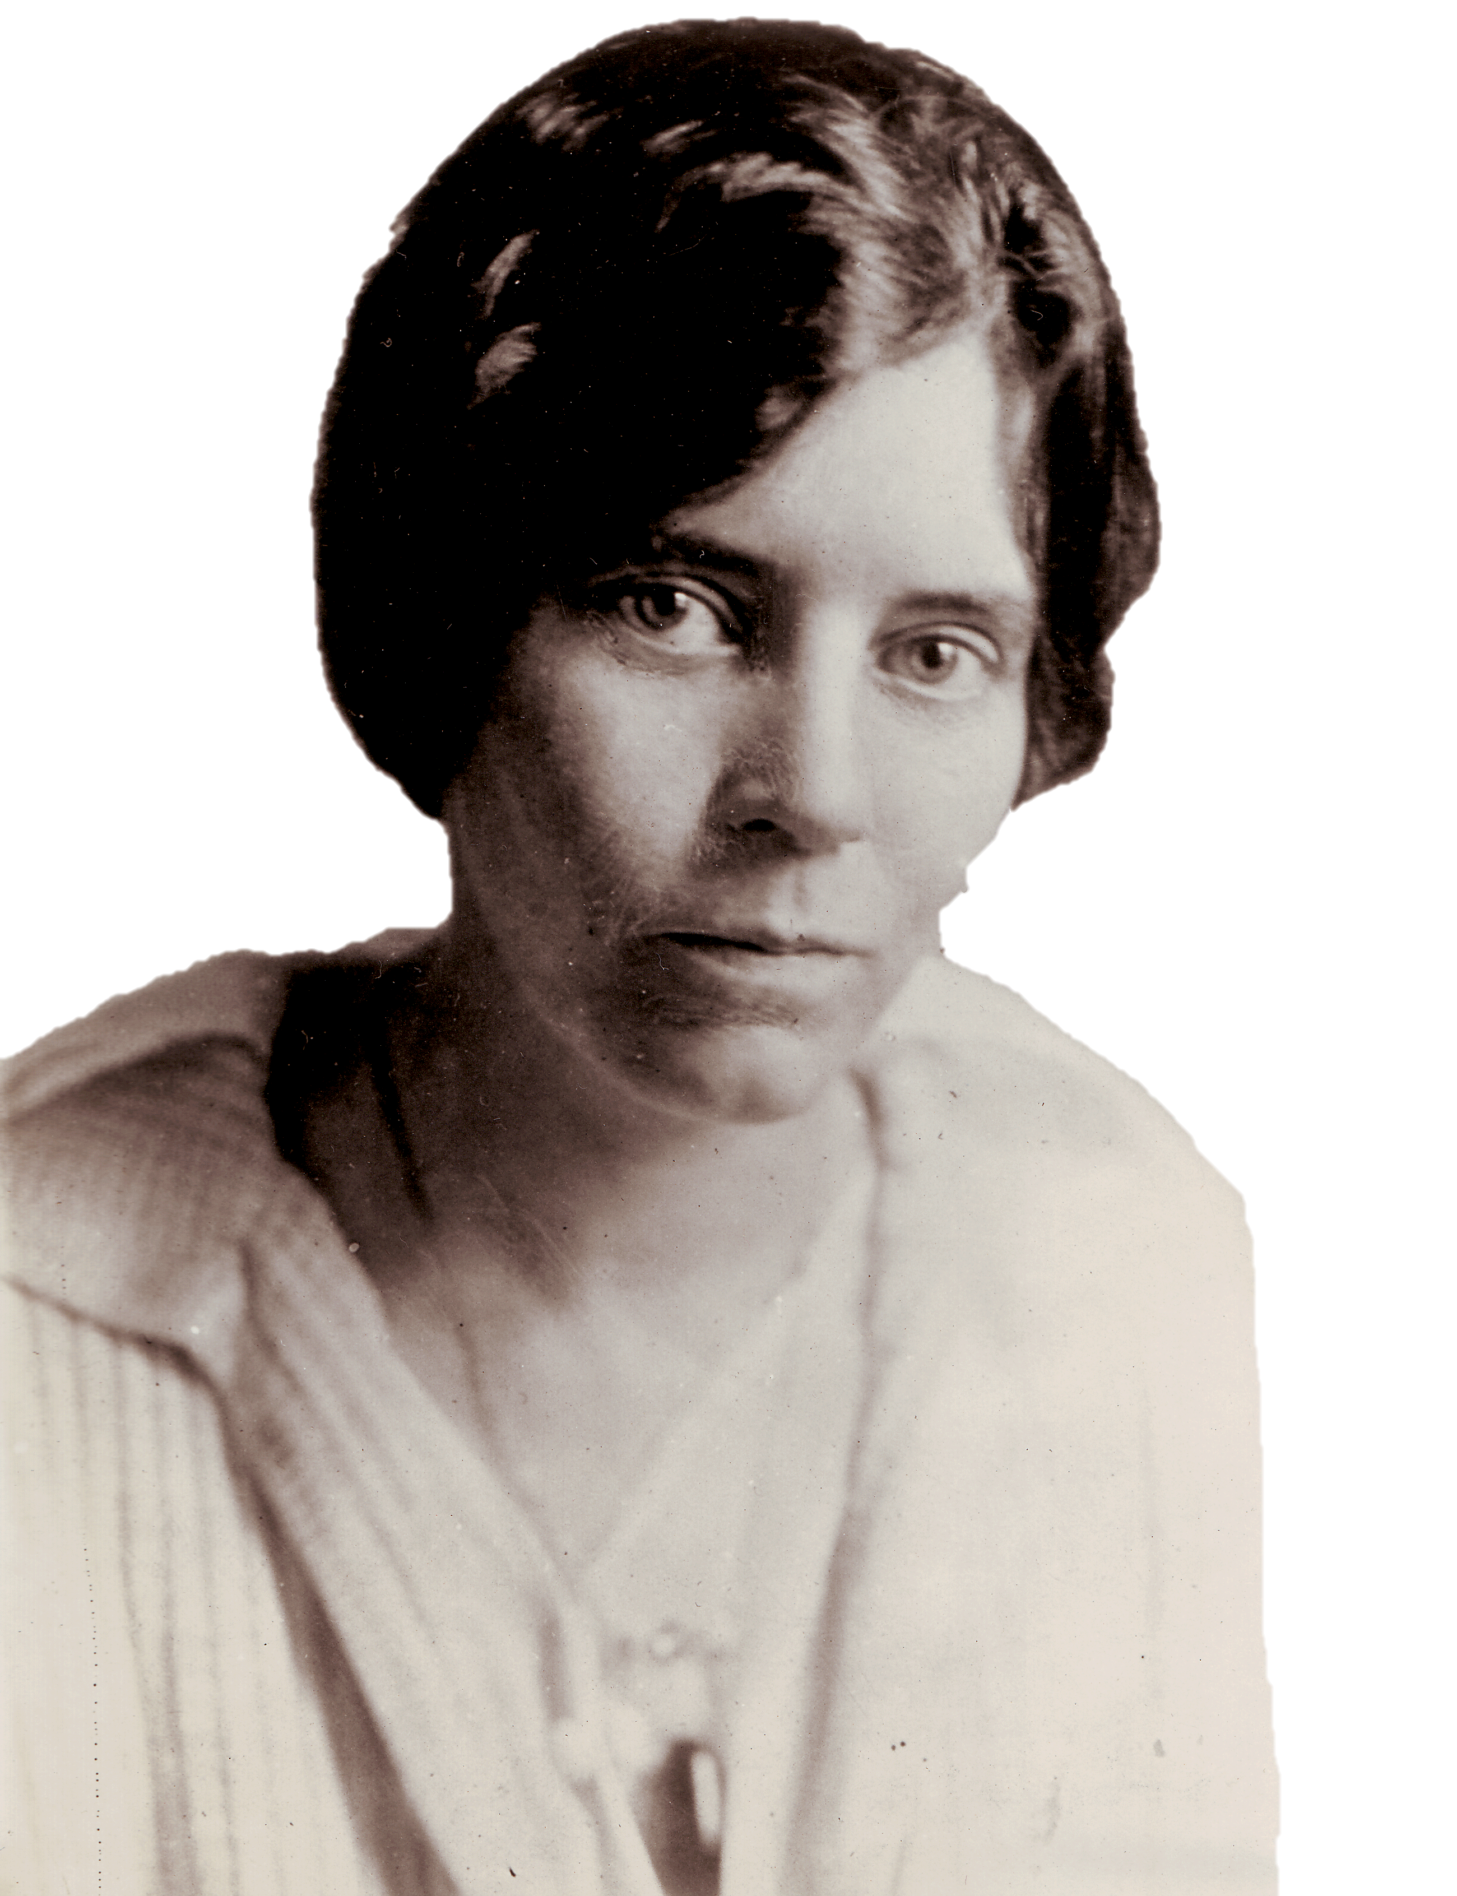
Alice Paul fought to get women the right to vote with passion and tenacity. Hunger strikes were a powerful tool for suffragettes, and Paul went on one while imprisoned in 1917 at Virginia’s Occoquan Workhouse to protest the poor conditions. Her hunger strike got her a ticket to the psych ward, where she was force-fed raw eggs, but her protest served a larger purpose by helping fan the flames of public. opinion.
Alice Paul
Notes:
Alice Paul led a hunger strike while in prison, generating other women to also participate in the this method of non-violent resistance.

Slide 25
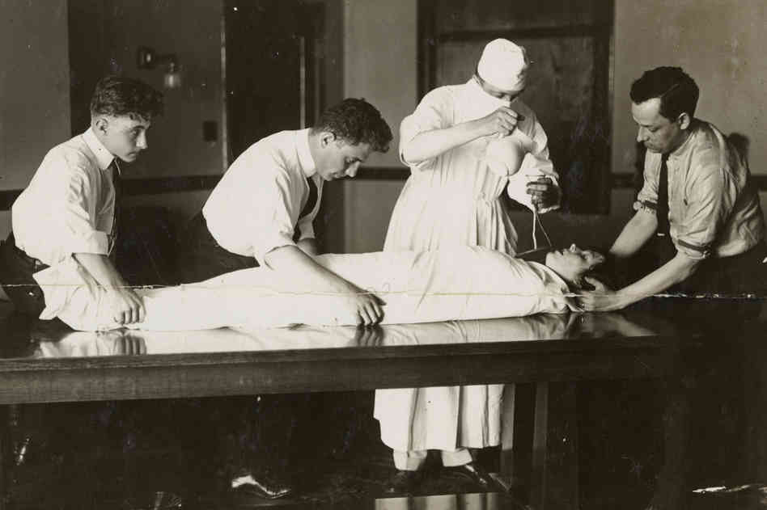
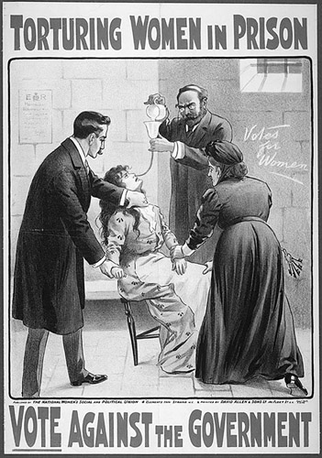
A hunger strike is a method of non-violent resistance or pressure in which participants fast as an act of political protest, or to provoke feelings of guilt in others, usually with the objective to achieve a specific goal, such as a policy change. Most hunger strikers will take liquids but not solid food.
In cases where an entity (usually the state) has or is able to obtain custody of the hunger striker (such as a prisoner), the hunger strike is often terminated by the custodial entity through the use of force-feeding.
#11. Write & Discuss:
What is a ‘hunger strike’? Do you think this approach
would be an effective strategy in promoting change?

Slide 26
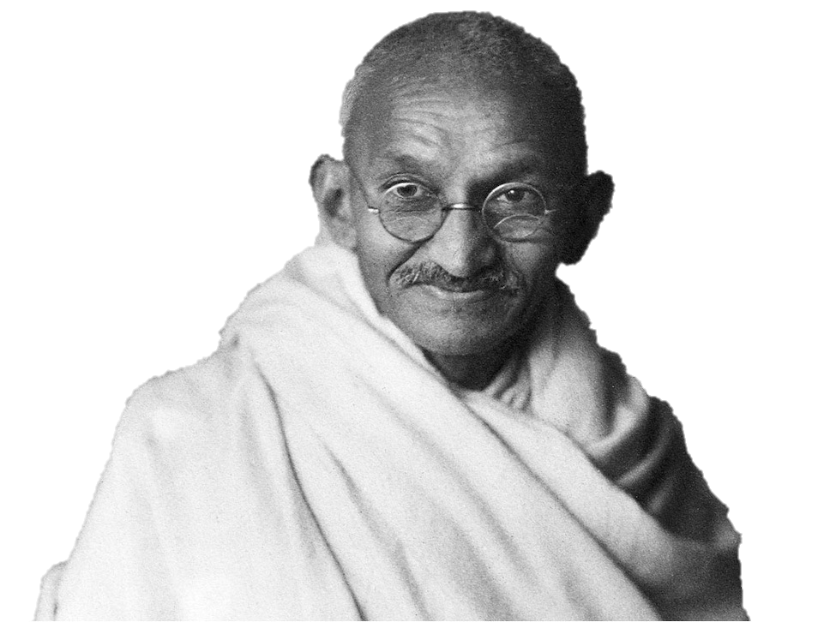
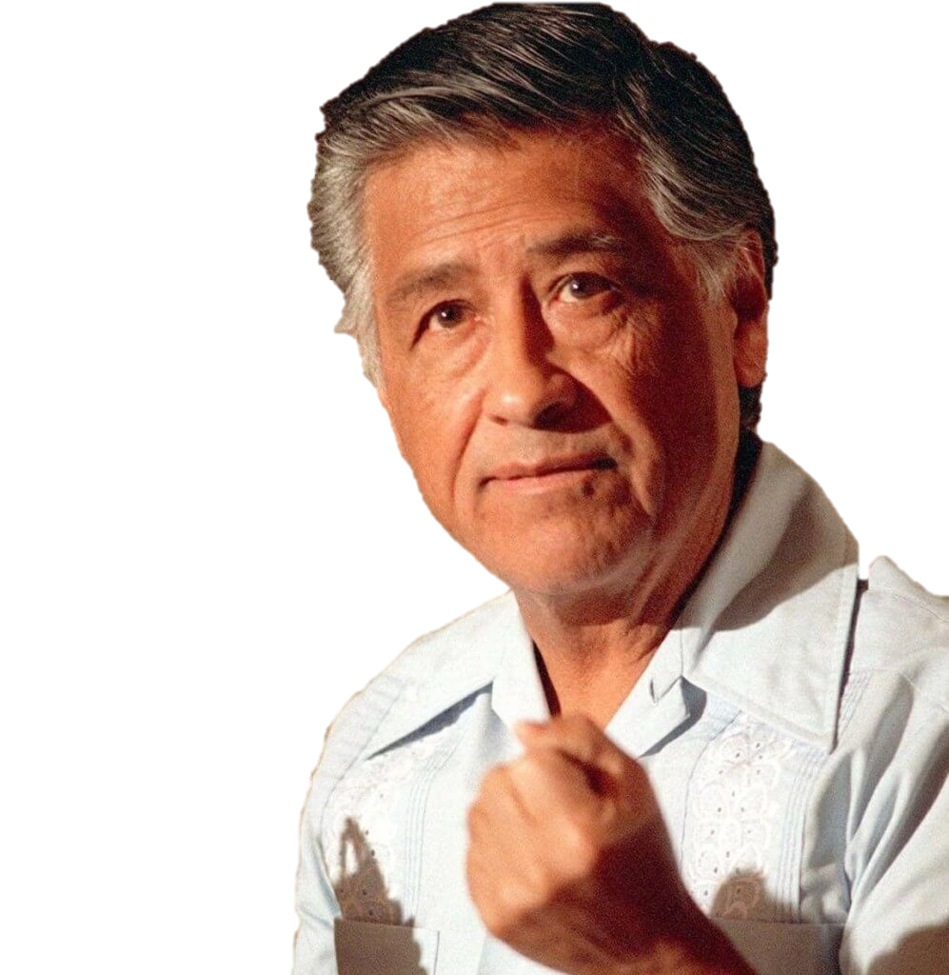
HUNGER STRIKES
Known as the "Iron Lady”, Irom Sharmila is a civil rights activist, political activist, and poet from the Indian state of Manipur. On 2 November 2000, she began a hunger strike which she ended on 9 August 2016, after 16 years of fasting. Having refused food and water for more than 500 weeks, she has been called "the world's longest hunger striker”. The 44-year old campaigner, detained under a law that makes attempting suicide illegal, has become a symbol of resistance against state violence in the conflict-torn north-eastern state of Manipur.
The Latino-American labor rights leader used hunger strikes multiple times while agitating for farm workers. In 1968, Chavez undertook a 25-day fast to gain recognition for the union he helped co-found, the United Farm Workers. He repeated the fast for 24 days in 1972, then carried on a 36-day fast in 1988 at the age of 61.
The man credited with helping found an independent Indian state and the inspiration for countless non-violent protests, Gandhi used hunger strikes as a tactic numerous times. Some proved unsuccessful, like a twenty-one day fast against British rule that Gandhi began in February 1943. Another fast in 1948 ended after five days, with Muslims, Sikhs, and Hindus saying they would work toward Gandhi’s vision of greater national unity.
Irom Chanu Sharmila
Cesar Chavez
Mohandas Gandhi

Slide 27
Back to #10.
Comparing Political Strategies
Goal: Constitutional
Amendment
Women Suffrage
NAWSA
NWP
The strategies of NAWSA were moderate.
The strategies of NWP were more radical in nature.
Main difference(s)?

Slide 28
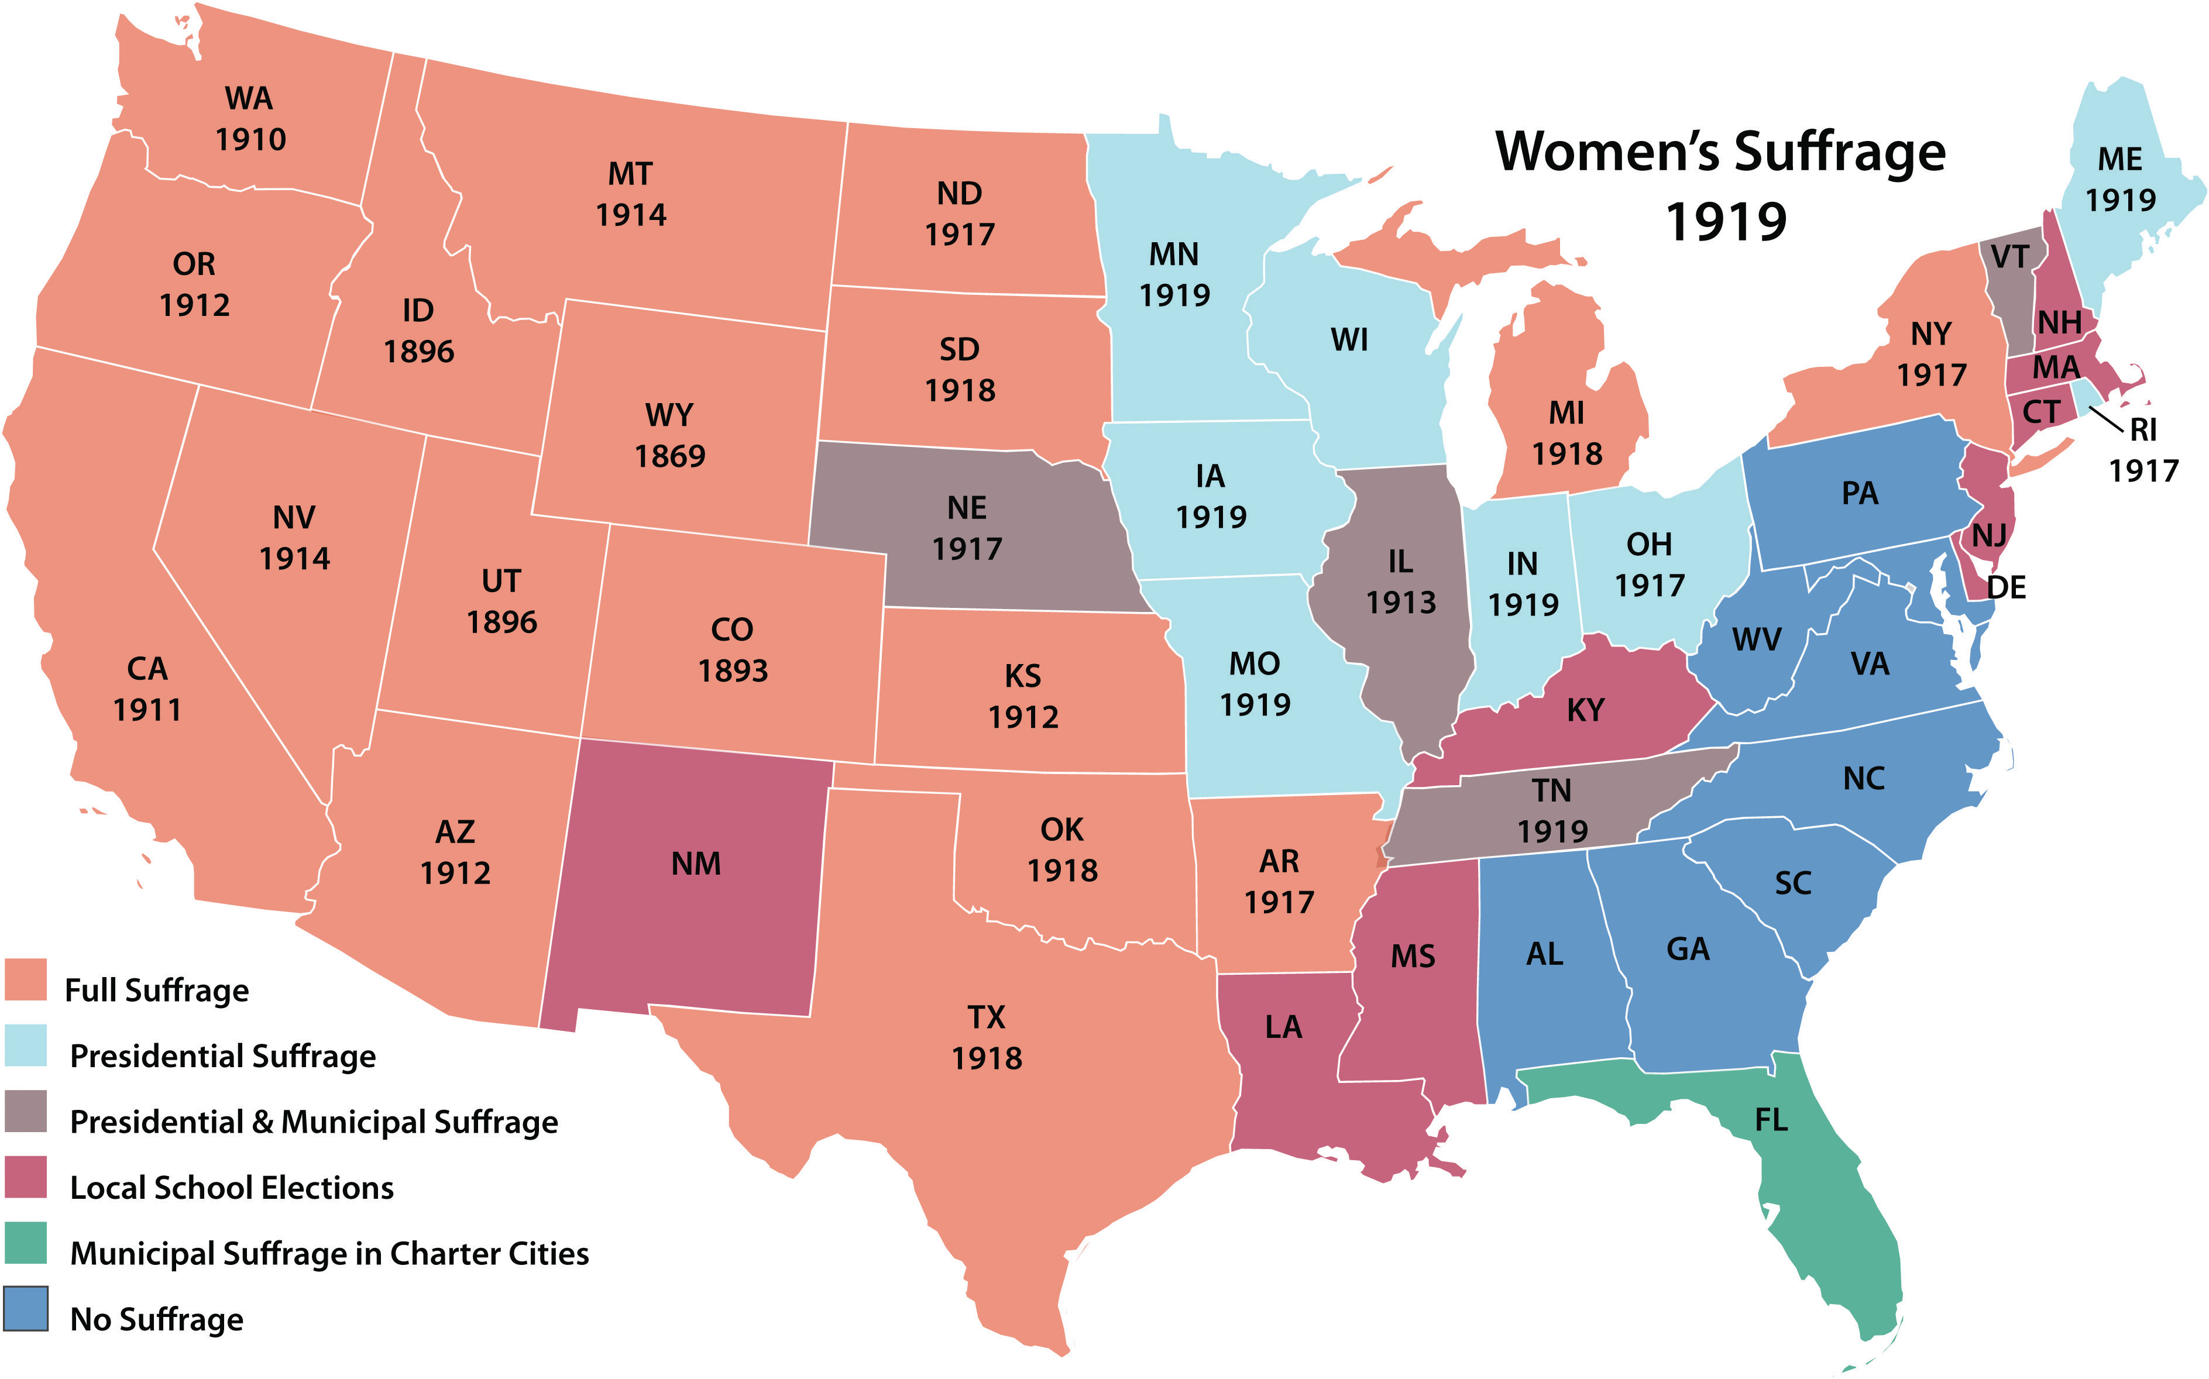
Each political party had the same goal: Make an amendment to the Constitution of America that grants women the right to vote.
#12. Write & Discuss:
What information does this map give you?
Identify any patterns you see.
Which state was the 1st to give women the right to vote?
Wyoming the 1st state to grant women this fundamental right of citizenship
Write & Discuss:
Write down two possible reasons as to why you think
Wyoming (or the west) was the 1st area of the U.S. to grant women the right to vote.

Slide 29
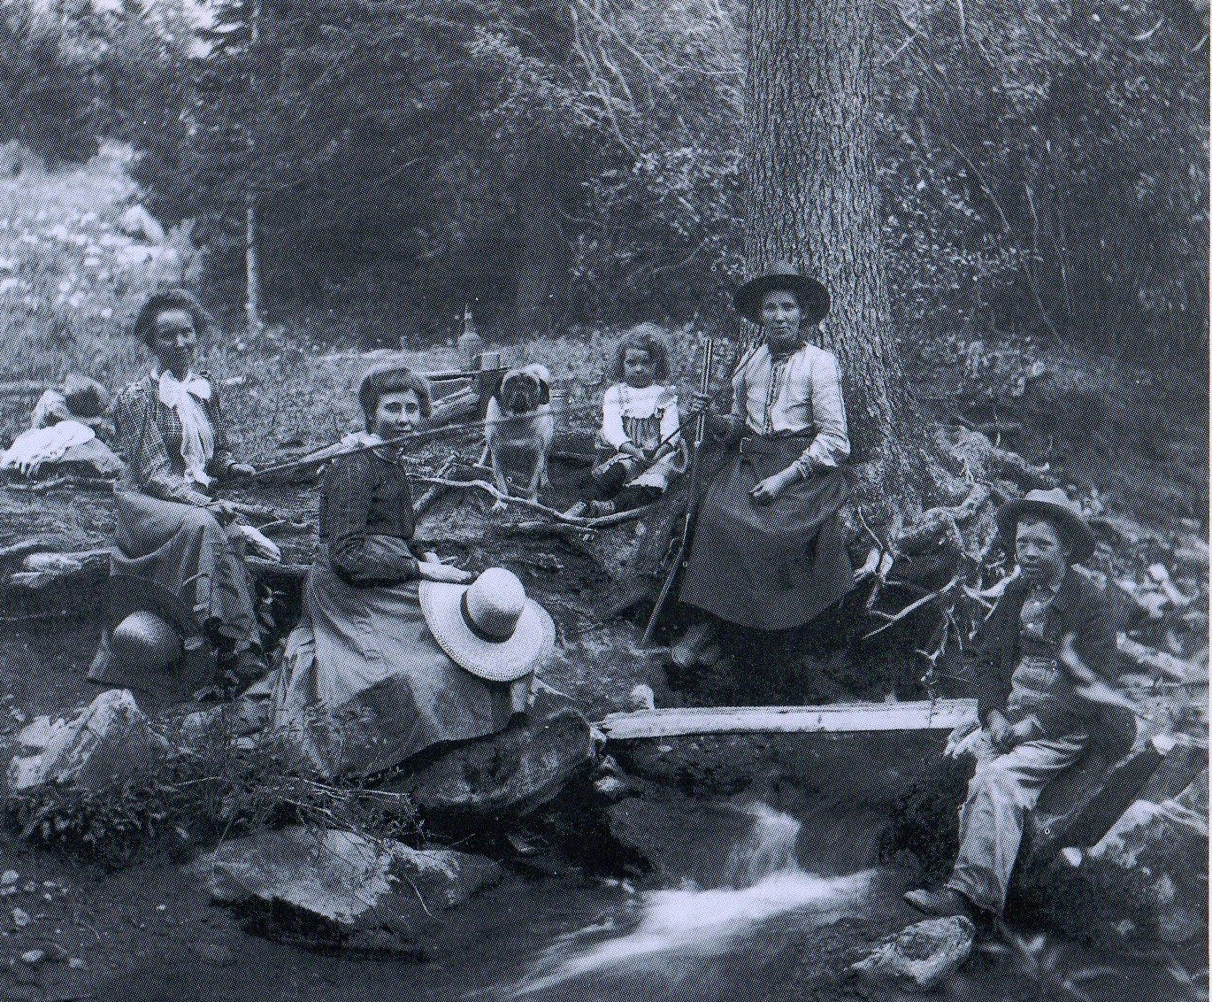
Some men recognized the important role women played in frontier settlement.
PowerPoint Answers
Notes:
Students are to write the answers that they did not predict from slides #29-31.

Slide 30
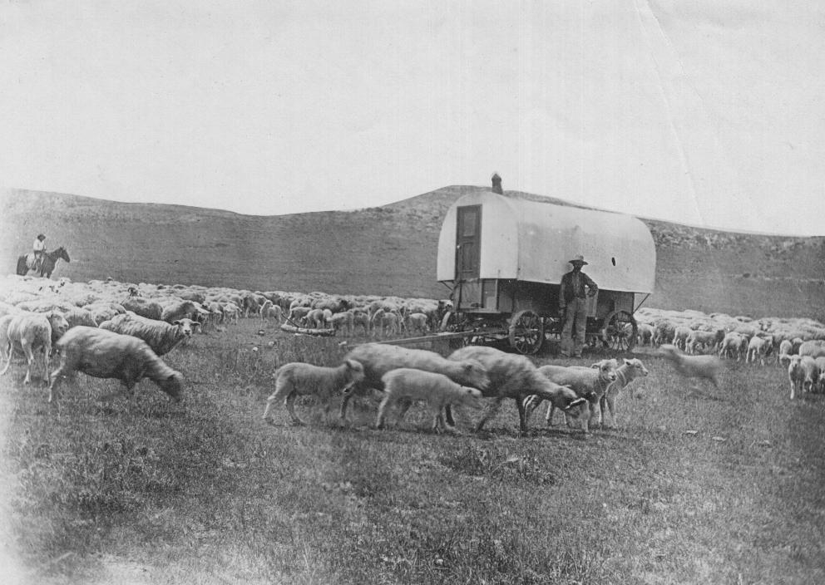
Some men were also motivated by sheer loneliness--in 1869, the territory had over 6,000 adult males and only 1,000 females, and area men hoped women would be more likely to settle in the rugged and isolated country if they were granted the right to vote.

Slide 31
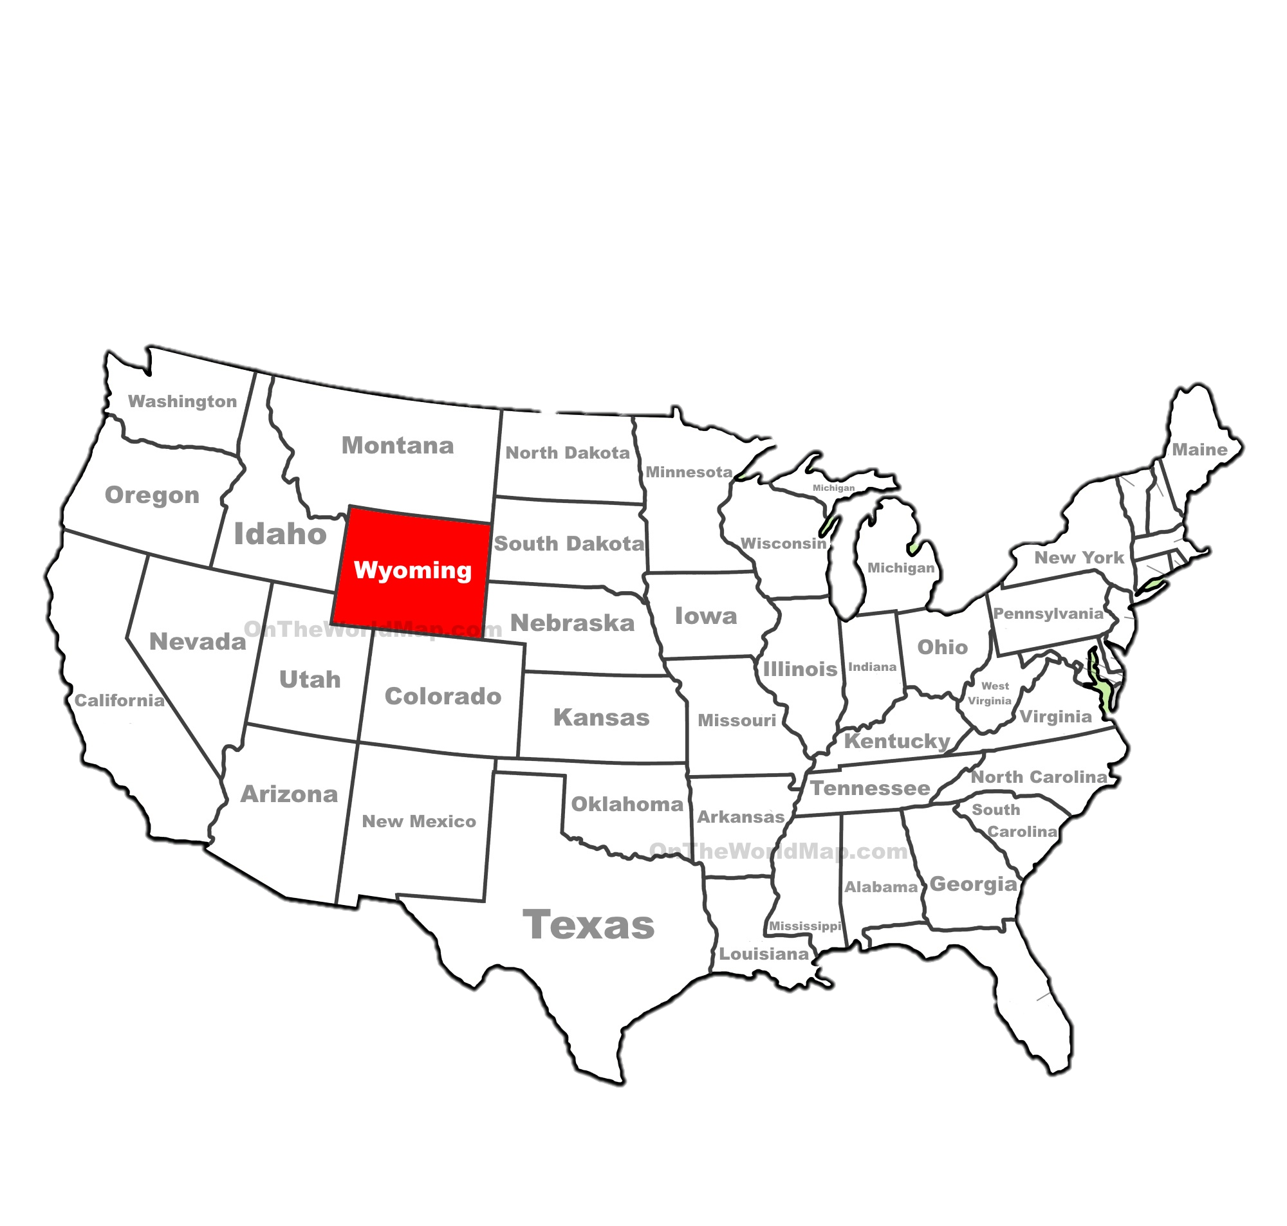
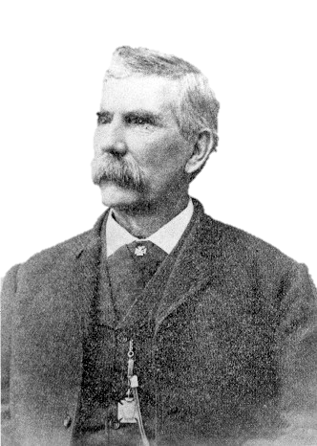
Ultimately, though, appeals to justice and equality did not pass the legislation--most Wyoming legislators supported Bright’s bill because they thought it would win the territory free national publicity and might attract more single marriageable women to the region.
Some of the suffrage movement's leaders did have more respectable reasons for supporting women's right to vote. William Bright, a territorial legislator had a persuasive young wife who convinced him that denying women the vote was a gross injustice.

Slide 32
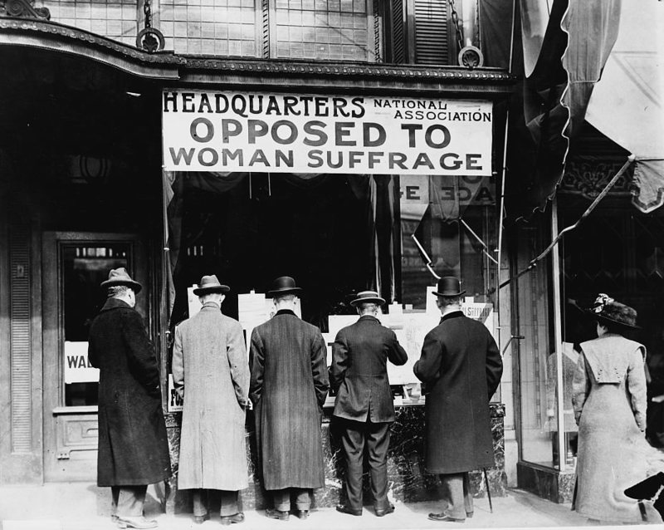
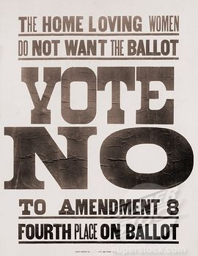
Think & Discuss:
What do you think were the arguments and reasoning as to why some people felt women should NOT have suffrage?

Slide 33
#13. Analyzing Political Cartoons
Identify whether the author was FOR or AGAINST suffrage by filling in ONE box of the T-chart for each cartoon.
Describe the details in the cartoon that you think offer support for the author’s position.
Response

Slide 34
#2.
Suffrage: the Right to Vote
#5.
#3.
#4.
#1.

Slide 35
#14. Main Reasons Why the Great Majority of Women DO NOT Get the Ballot
Issued by the Nebraska Association Opposed to Women Suffrage, Omaha, Nebraska
“Because they have not lost faith in their men, who can offer full protection in their community”.
“Because if they become voters, have to sit as jurors, compelled to hear all the repugnant details incident to murder trials– abhorrent to every normal woman”.
Be prepared to discuss…
What conceptions of women, men, and family are presented in these documents? How is a “normal woman” defined?

Slide 36
“Because in political activities there is constant strife, turmoil, contention & bitterness, producing conditions from every normal woman naturally shrinks”.

Slide 37
“Because women suffrage will not enhance peace in the home, but in the heat of the campaign, it will sure bring about dissension and discord”.
“Because the woman worker wants rest and quietude—not political excitement”.
What conceptions of women, men, and family are presented in these documents? How is a “normal woman” defined?

Slide 38
Key Arguments….
#14. Based upon the ‘Political Cartoons’, & ‘Why Majority
of Women Do Not Get the Ballot’, what were some
of the key arguments for…..
Why women should have the right to vote….. | And why they should not?
Which ones do you agree or disagree with the most?

Slide 39
How does the U.S. Compare?
Before the 19th Amendment was ratified in the U.S. in 1920, women already had the right to vote in these countries…
New Zealand 1893
Australia 1902
Mexico 1917
Russia 1917
England 1918
Germany 1918
Canada 1918

Slide 40
#15. PAST TO PRESENT What barriers to full equality between women and men still exist in American society…. Or is it equal? If not, what do you think accounts for these obstacles? For example, why do you think the United States has never had a female President?

