Slide 1
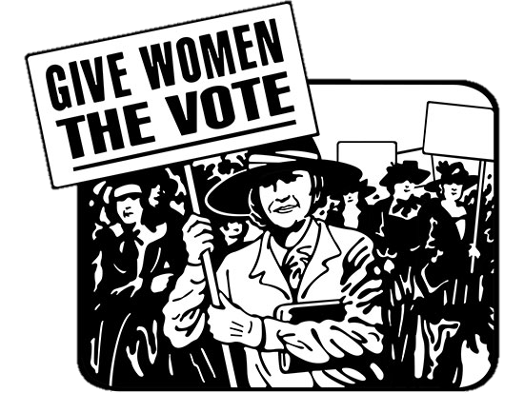
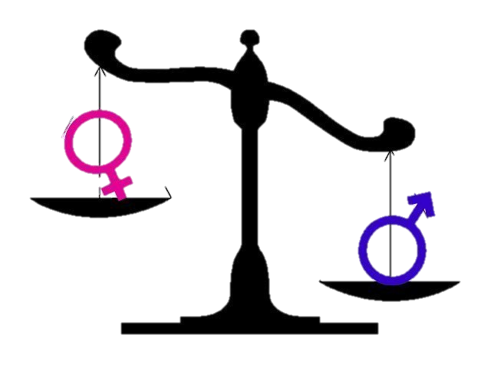
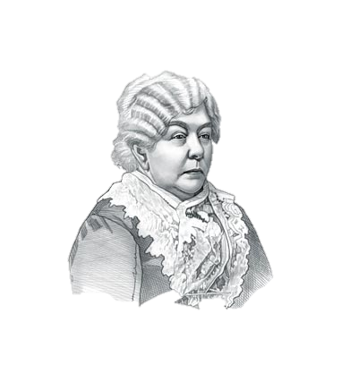
Name:
Women’s Suffrage
Patriarchal Society
The Role of Women
We will evaluate the impact of the 19th Amendment, trace the historical development of the 19th Amendment, and identify the political, social, and economic contributions of women to American society.
I will find three compatible matches during the Progressive Era Speed Dating Activity.
The Traditional Role of Women
Biography
Suffrage
Seneca Falls Convention (1848)
Elizabeth Cady Stanton
Susan B. Anthony
Illegal Voting
National Women’s Suffrage Association
World War I
The Nineteenth Amendment
Impact of the Nineteenth Amendment
The Enfranchisement of Women

