Slide 1


Slide 2
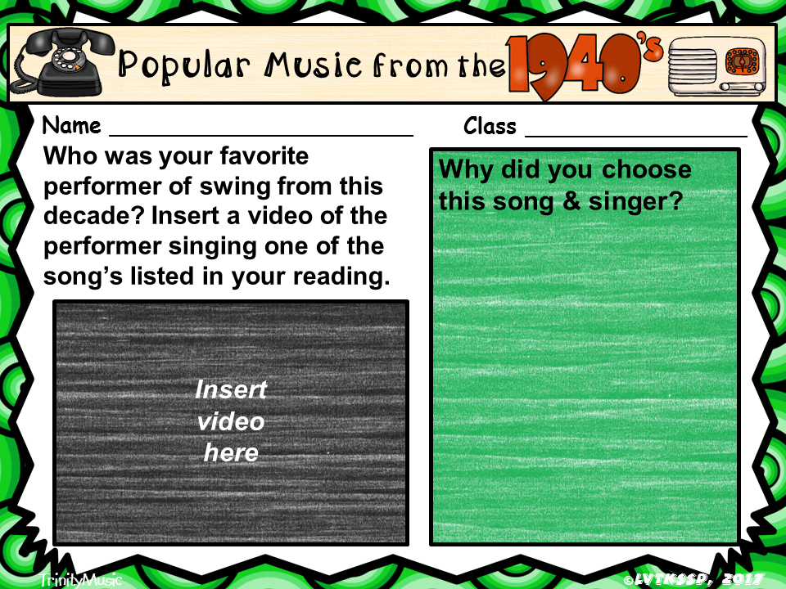
Type here
Type here
Type here
Insert > Media > Video > Online Video
Notes:
You may need to change the size of the font to make your answer fit.

Slide 3
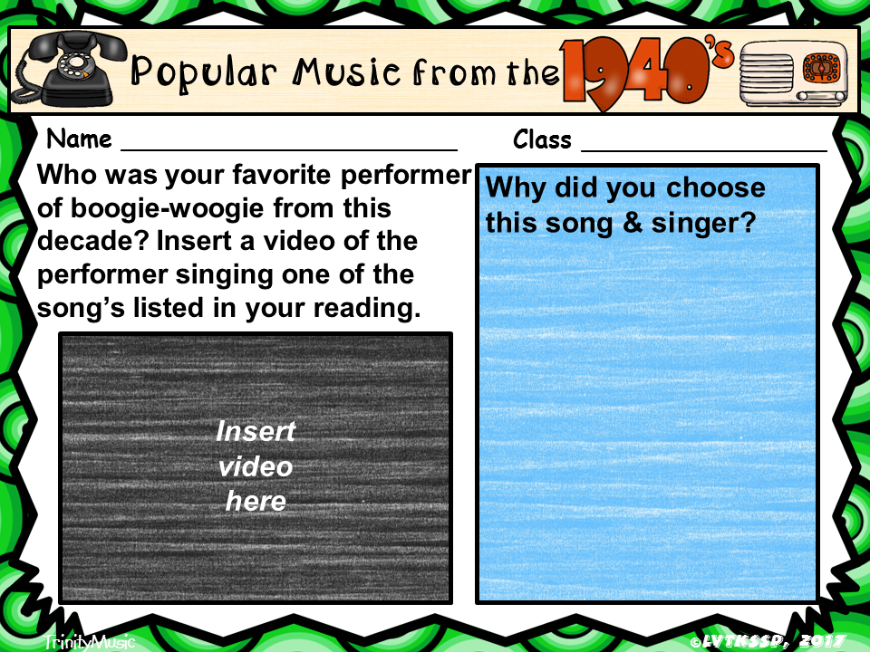
Type here
Type here
Type here
Insert > Media > Video > Online Video
Notes:
You may need to change the size of the font to make your answer fit.

Slide 4
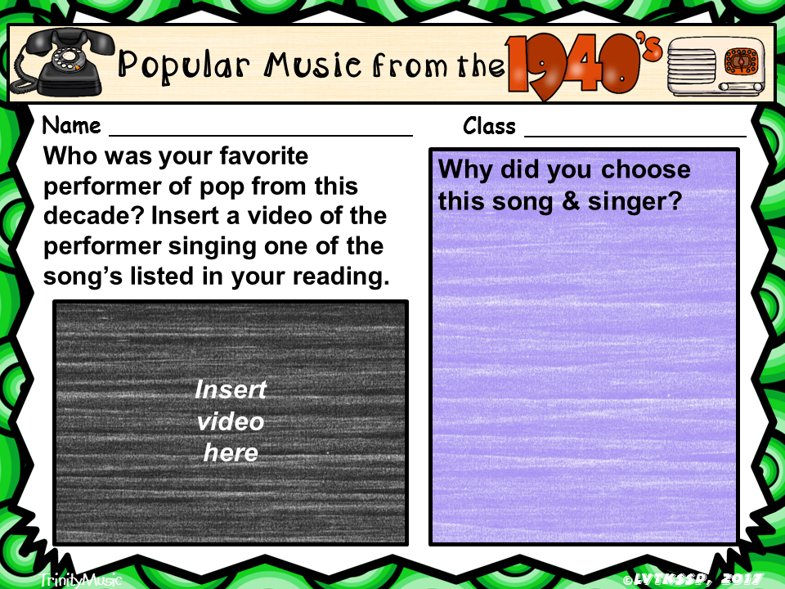
Type here
Type here
Type here
Insert > Media > Video > Online Video
Notes:
You may need to change the size of the font to make your answer fit.

Slide 5
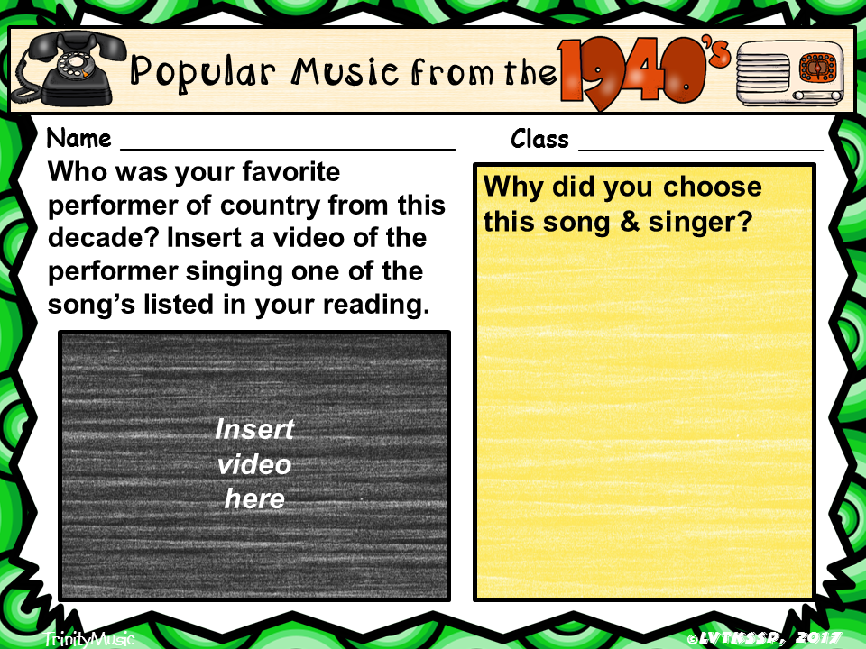
Type here
Type here
Type here
Insert > Media > Video > Online Video
Notes:
You may need to change the size of the font to make your answer fit.

Slide 6
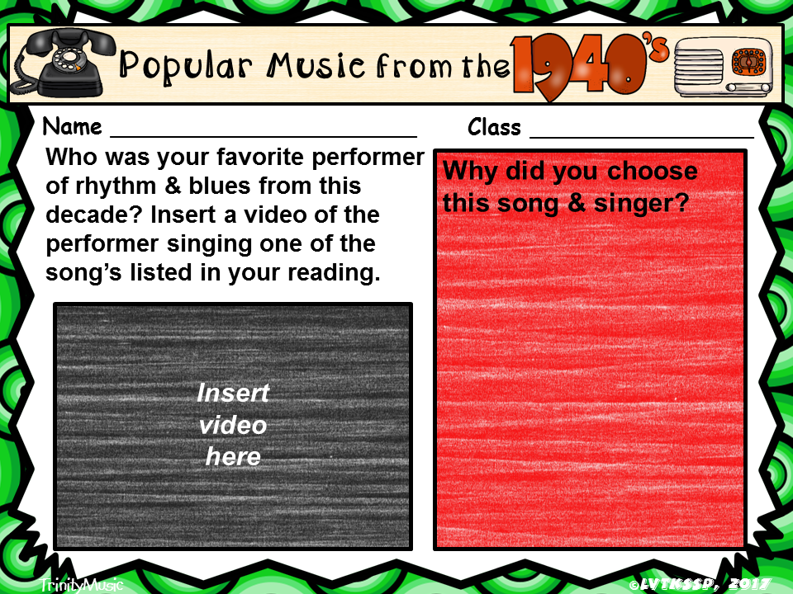
Type here
Type here
Type here
Insert > Media > Video > Online Video
Notes:
You may need to change the size of the font to make your answer fit.

Slide 7
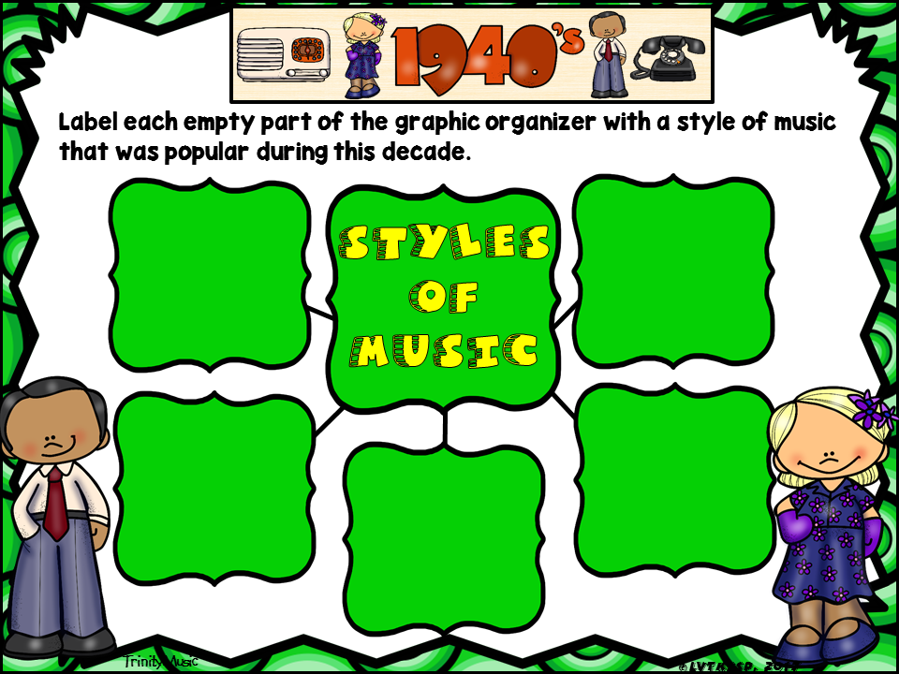
Type here
Type here
Type here
Type here
Type here
Notes:
You may want or need to change the size of the font or reposition the text boxes.

Slide 8

Type here
Type here
Type here
Type here
Type here
Notes:
You may want or need to change the size of the font or reposition the text boxes.

Slide 9
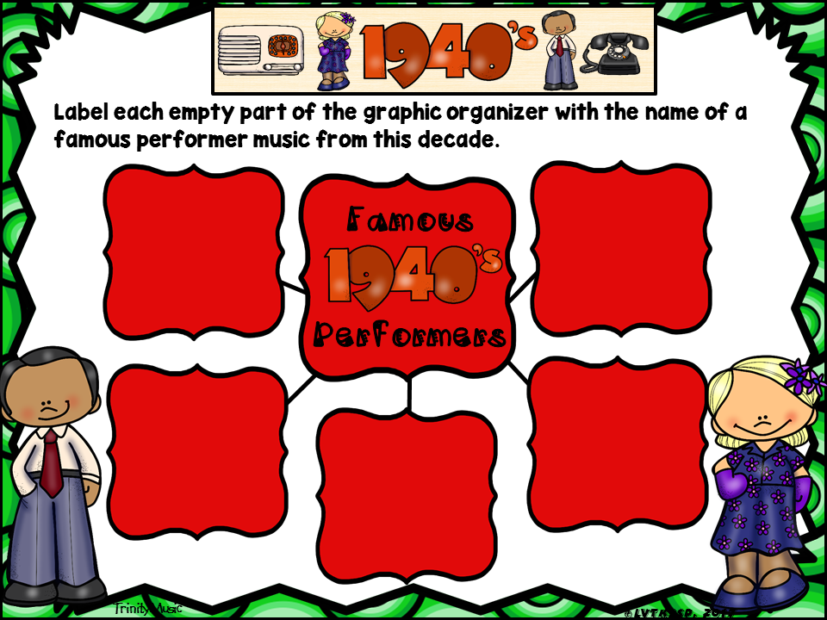
Type here
Type here
Type here
Type here
Type here
Notes:
You may want or need to change the size of the font or reposition the text boxes.

Slide 10
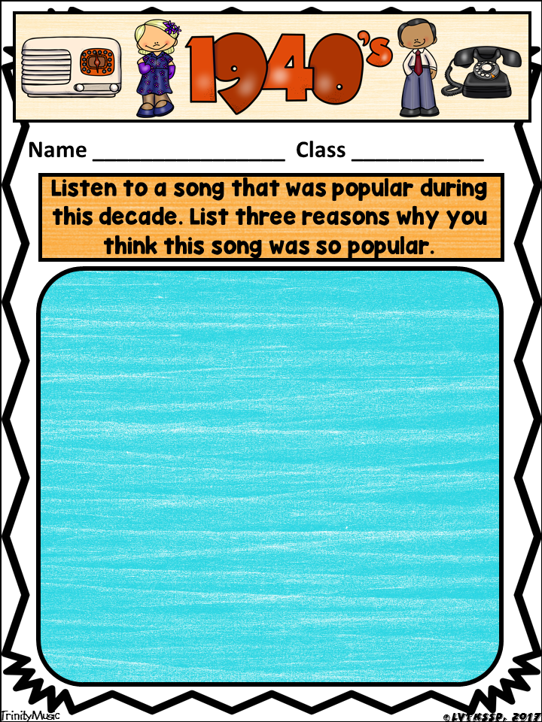
Type here
Type here
Song Title:
Performer’s name:
Reasons:
Notes:
You may need to change the font size, move the text box or create additional text boxes to make your answer fit.

Slide 11
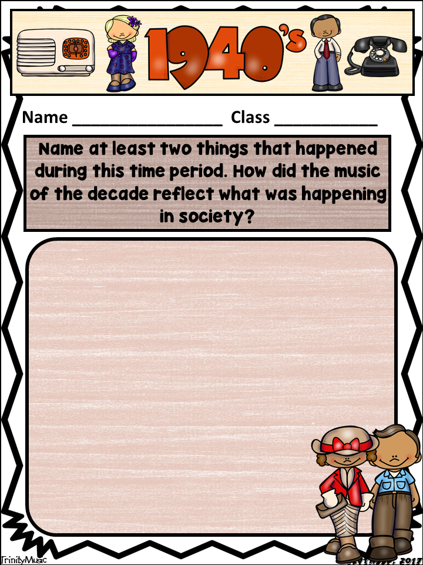
Type here
Type here
Type here
Notes:
You may need to change the font size, move the text box or create additional text boxes to make your answer fit.

Slide 12
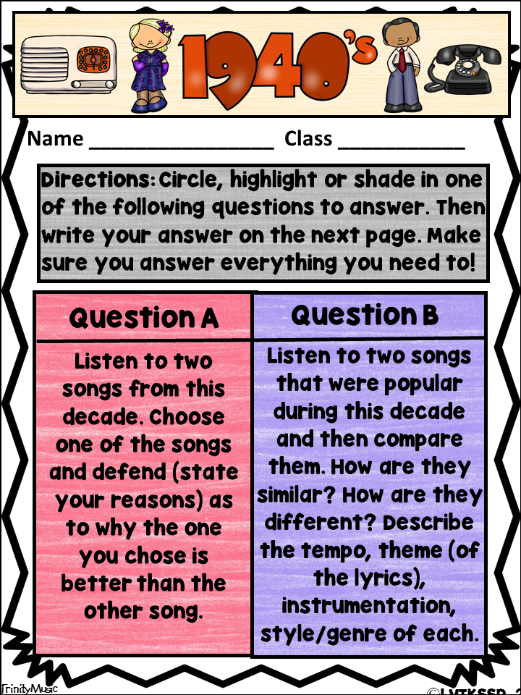
Type here
Type here

Slide 13
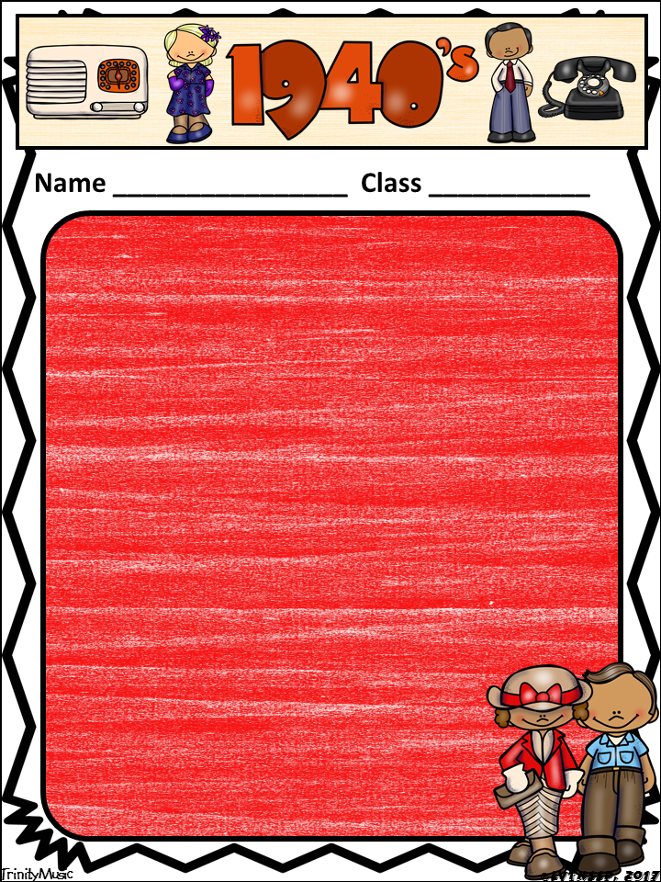
Type here
Type here
Type here
Notes:
You may need to change the font size or move the text box to make your answer fit.

Slide 14
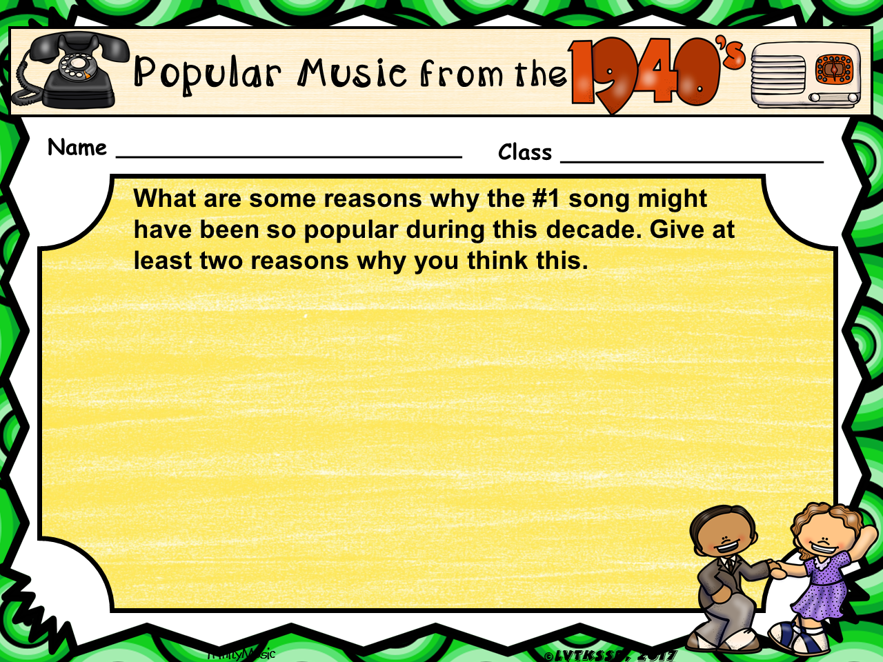
Type here
Notes:
You may need to change the font size and/or reposition the text boxes.

Slide 15
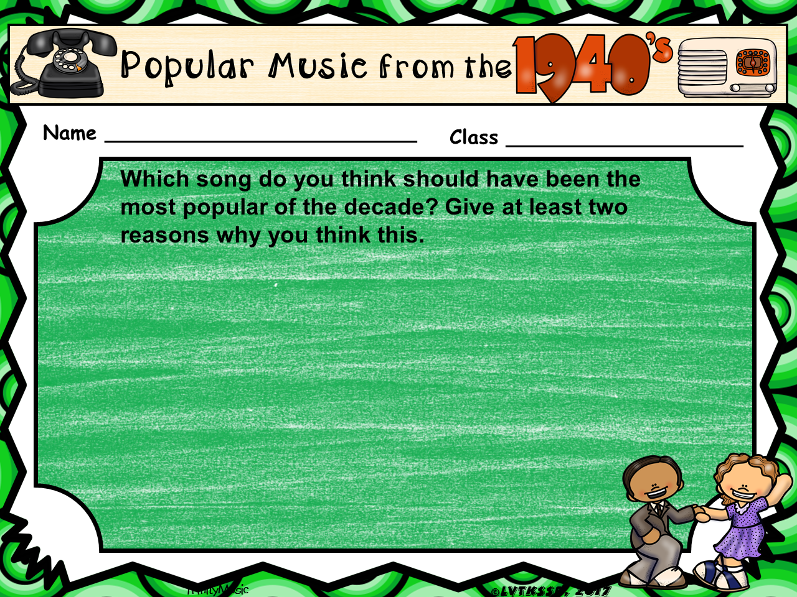
Type here
Notes:
You may need to change the font size and/or reposition the text boxes.

Slide 16
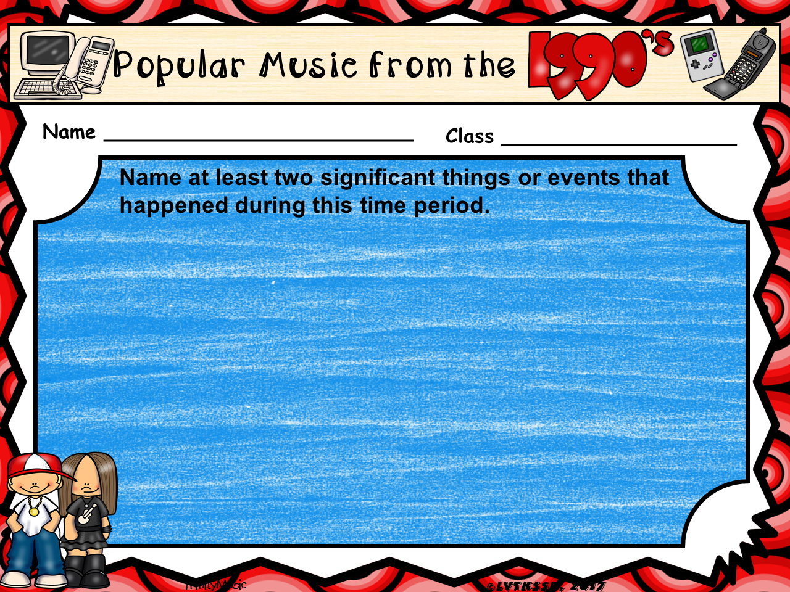
Type here
Notes:
You may need to change the font size and/or reposition the text boxes.

Slide 17
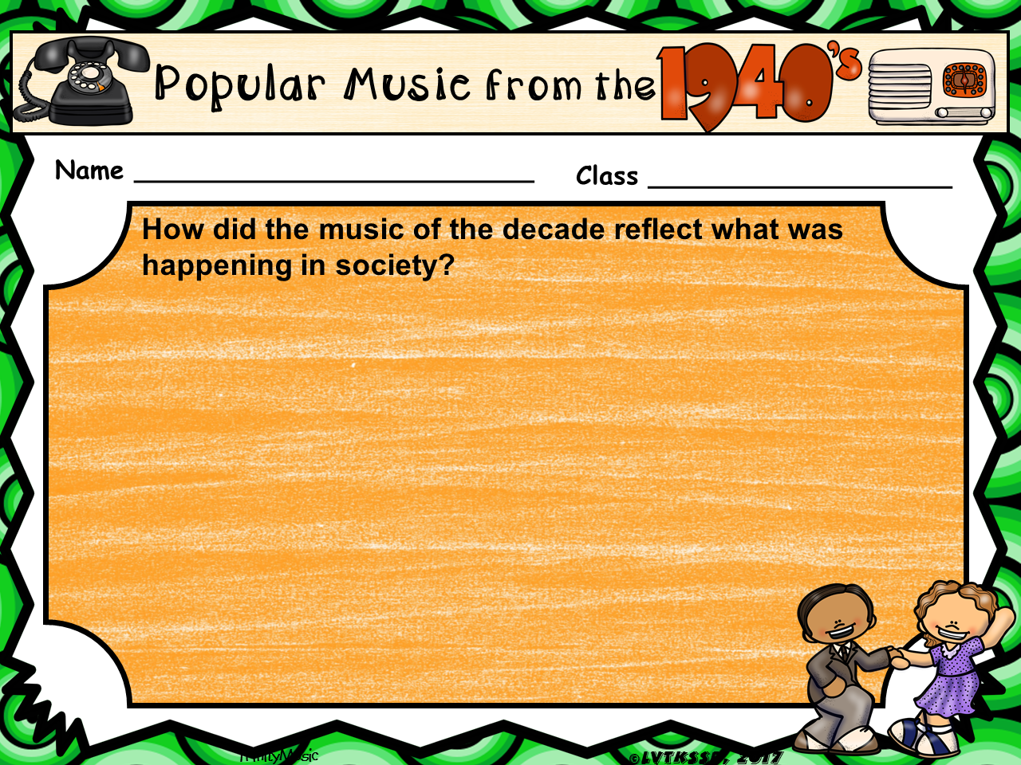
Type here
Notes:
You may need to change the font size and/or reposition the text boxes.

Slide 18
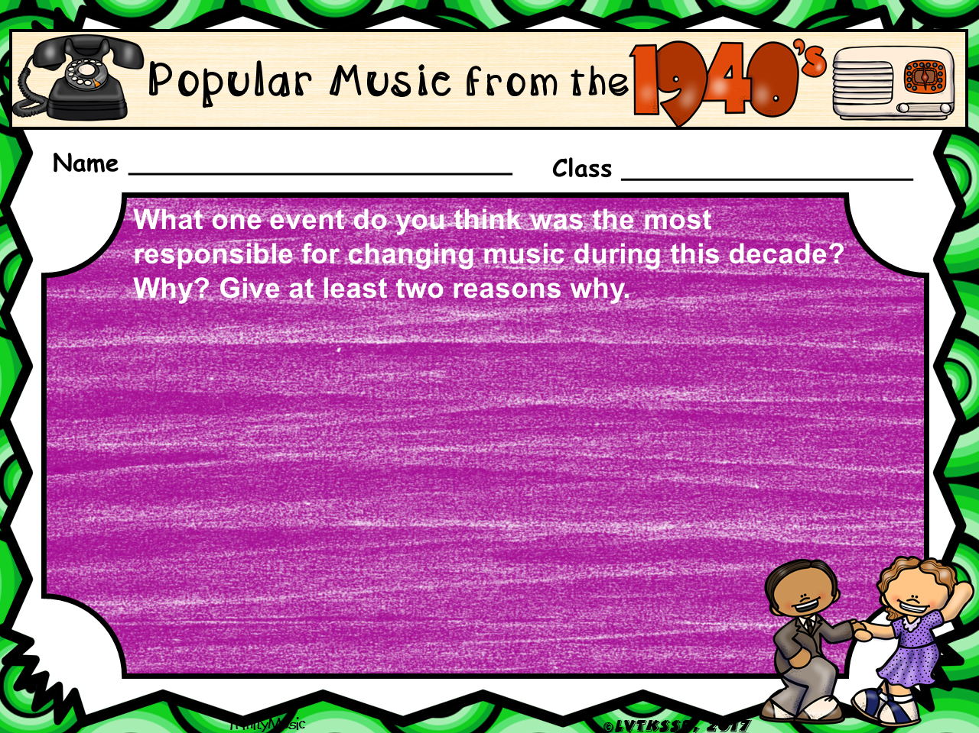
Type here
Notes:
You may need to change the font size and/or reposition the text boxes.

Slide 19
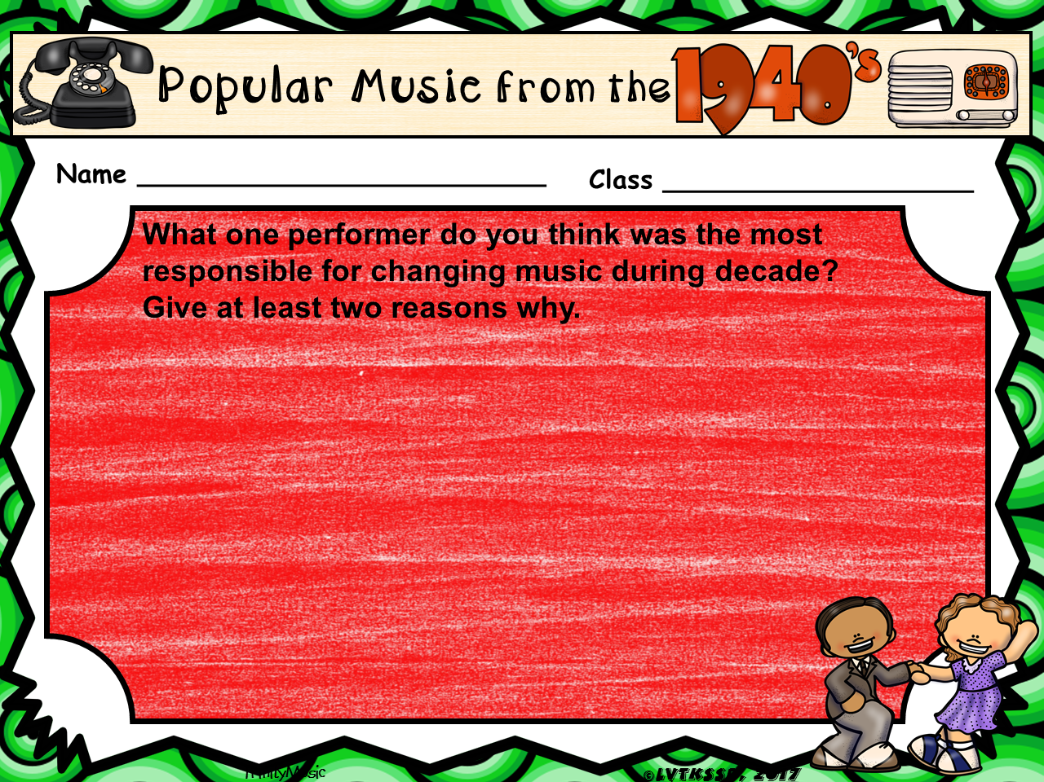
Type here
Notes:
You may need to change the font size and/or reposition the text boxes.

Slide 20
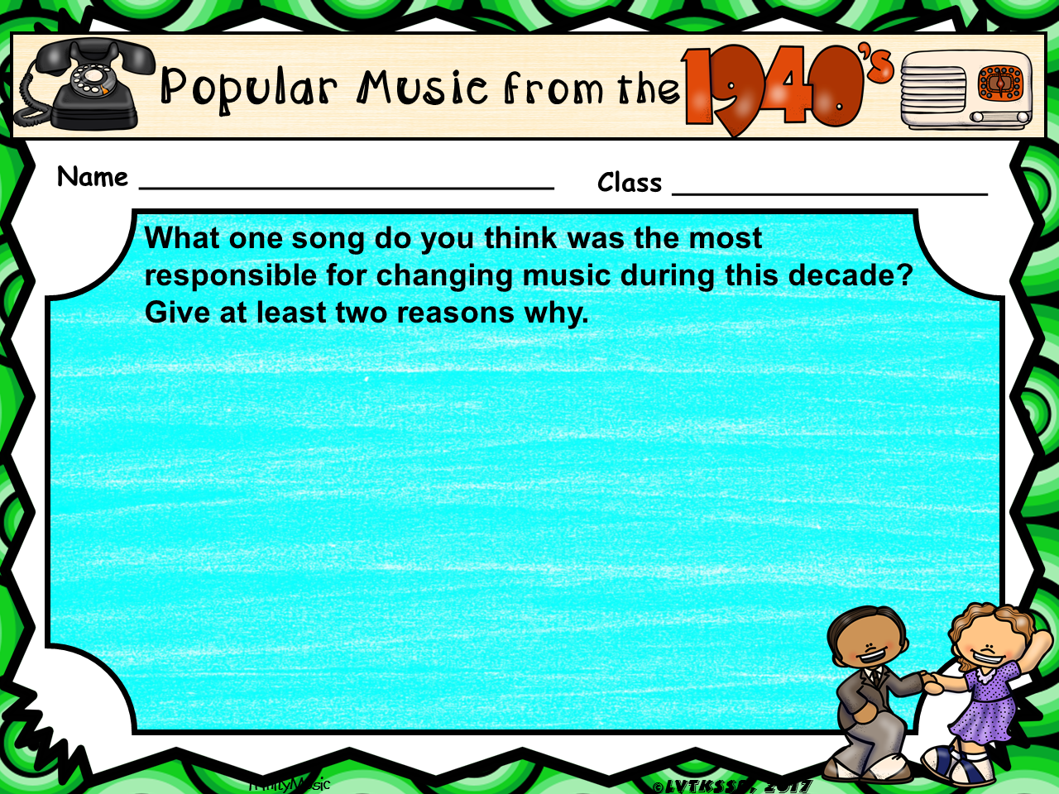
Type here
Notes:
You may need to change the font size and/or reposition the text boxes.

Slide 21
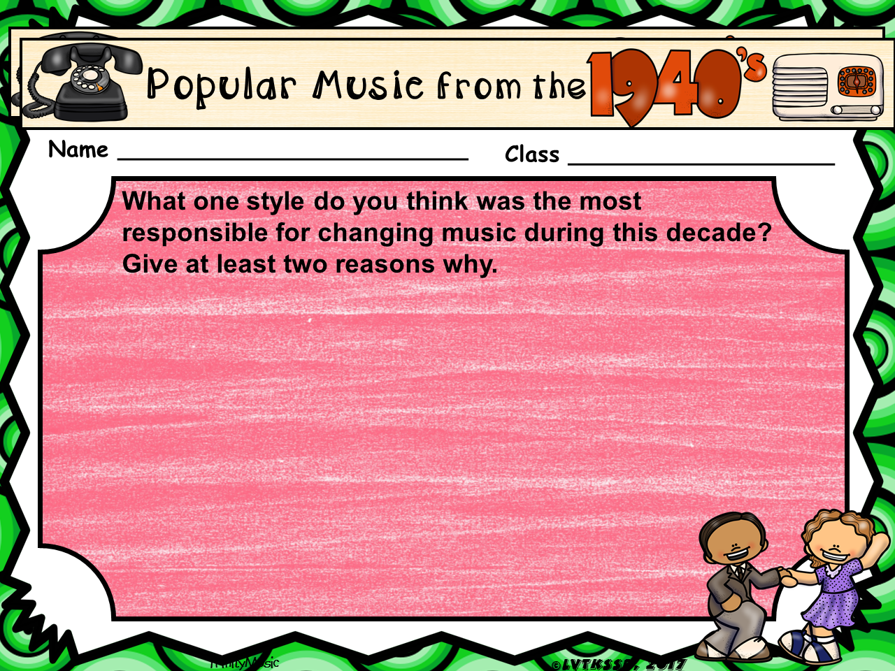
Type here
Notes:
You may need to change the font size and/or reposition the text boxes.

Slide 22
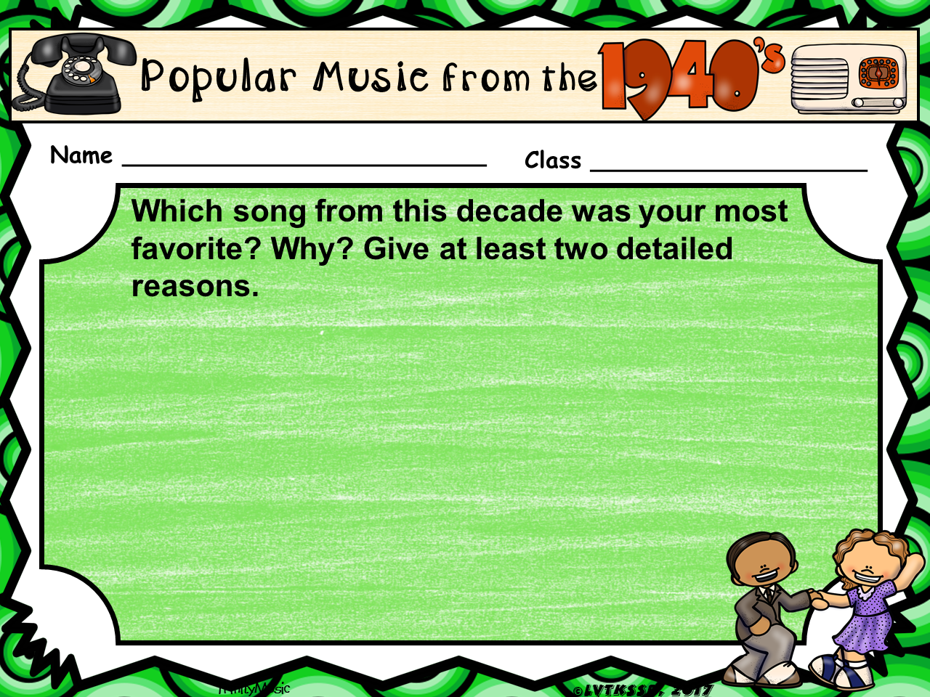
Type here
Notes:
You may need to change the font size and/or reposition the text boxes.

Slide 23
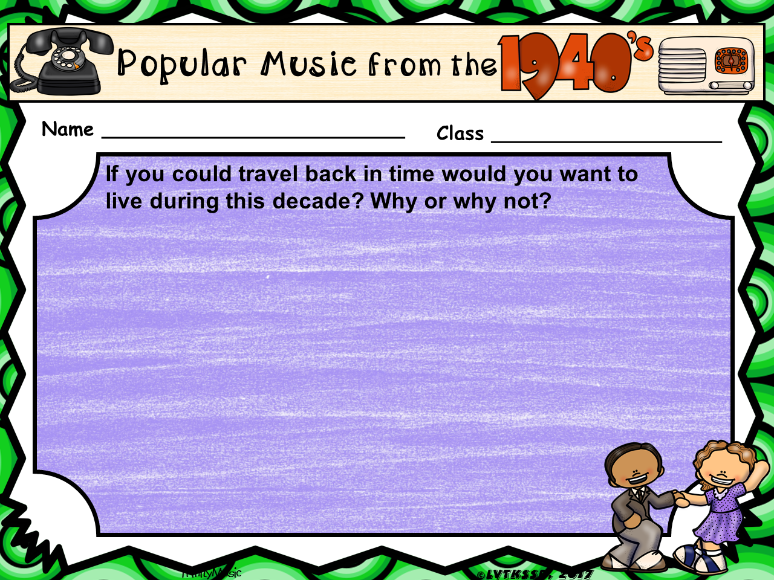
Type here
Notes:
You may need to change the font size and/or reposition the text boxes.

