Slide 1
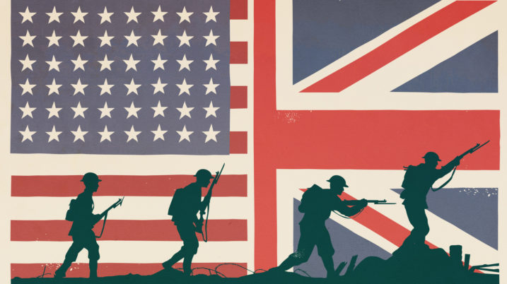
Explain MILITARISM
ALLIES
CENTRAL POWERS
SELECTIVE SERVICE ACT
ESPIONAGE ACT
Explain ALLIANCES
VS
U.S. Home Front
Explain IMPERIALISM
The United States
in World War I
American War Heroes
AMERICAN EXPEDITONARY FORCE
Explain NATIONALISM
GENERAL JOHN J. PERSHING
Causes (1914)
End of WWI
ZIMMERMAN TELEGRAM
UNRESTRICTED SUBMARINE WARFARE
BATTLE OF ARGON FOREST
ALVIN YORK
U.S. Joins (1917)
ARMISTICE
Journal Prompt
Explain how American attitudes to involvement in WWI changed between 1914-1917 and why they ultimately sided with the Allied Powers.
TREATY OF VERSAILLES

