Slide 1
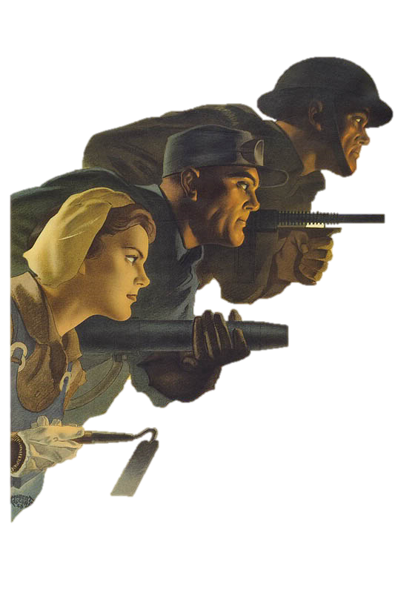
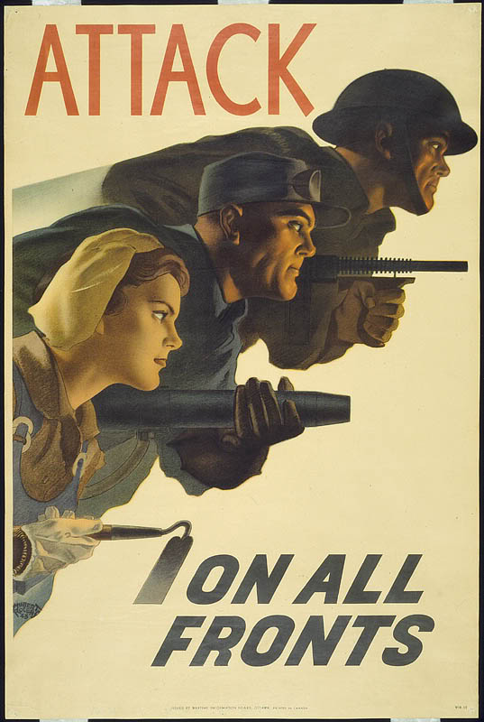





Slide 2
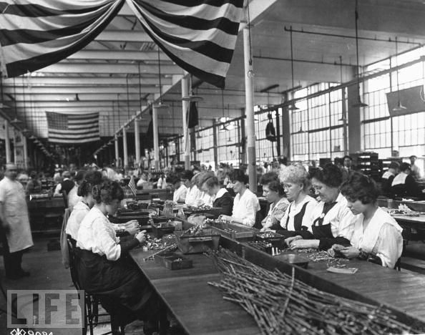
Home Front- What it means
Home front is the civilian population (and their activities) of a country at war. It usually applies to any aspect of wartime life

Slide 3
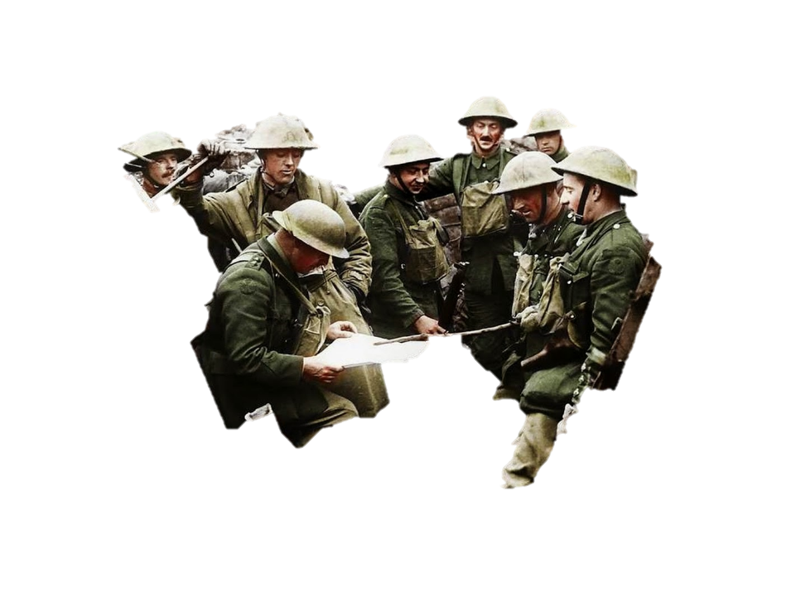
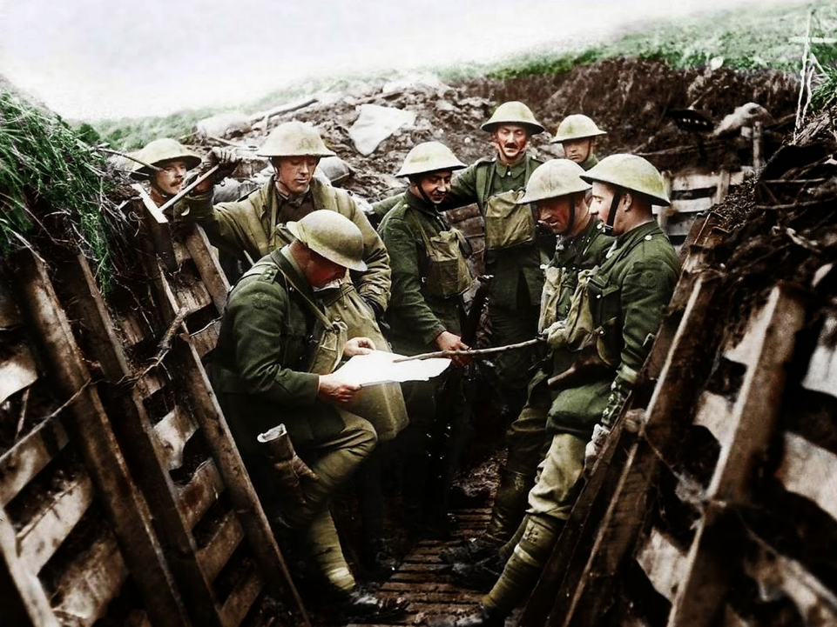
BUILDING UP OUR MILITARY

Slide 4
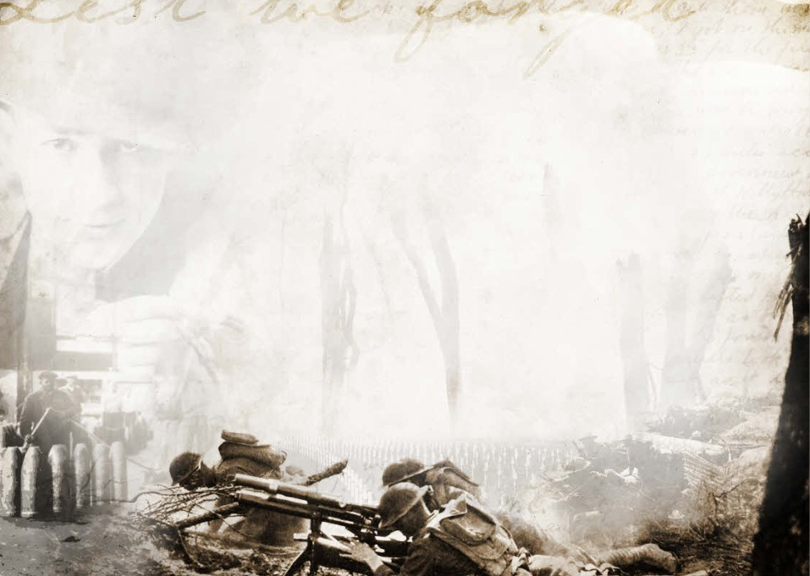
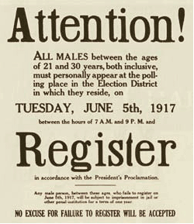
Selective Service Act
As the United States entered the war; it was necessary to recruit more soldiers.
conscription, or forced military service
A new system, called selective service, resulted in about 2.8 million Americans being drafted.

Slide 5
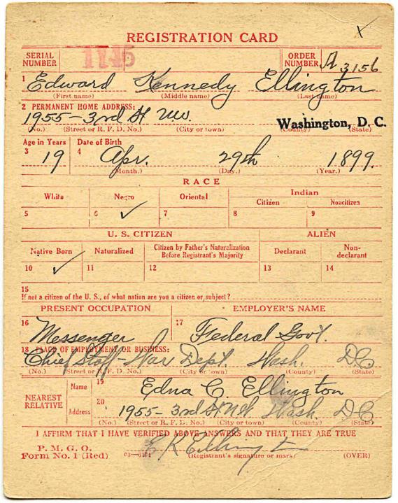
Selective
Service
Act
1917 Draft Card

Slide 6
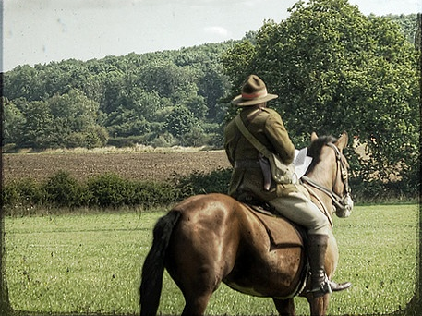
Volunteers for the War
Not all soldiers were drafted
2 million were excited to enlist
PROPAGANDA

Slide 7
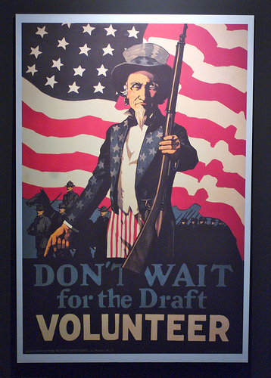
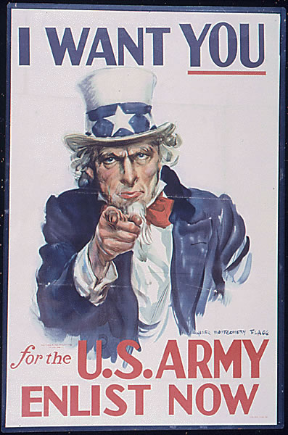
Volunteers for the War
Not all soldiers were drafted
2 million were excited to enlist

Slide 8
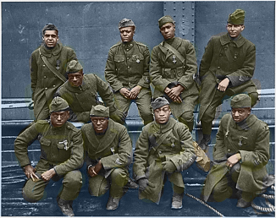
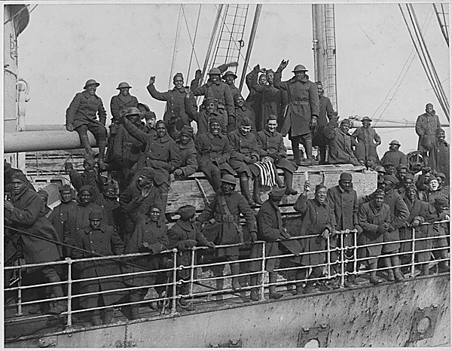

African Americans Join the War
400,000 African Americans were drafted, 42,000 served over seas
African American soldiers faced discrimination and prejudice
They served in racially segregated units
Many African Americans won praise from their commanders and received war medals.

Slide 9
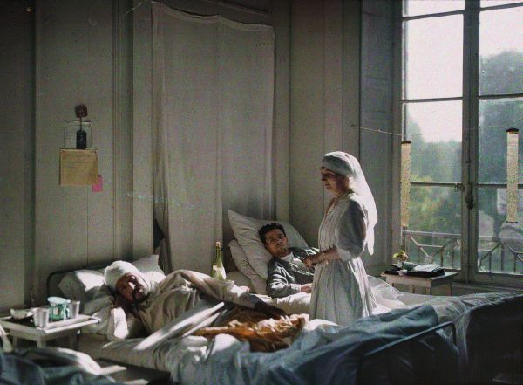
Women in the Military
WWI first war in which women officially served.
The navy enlisted 11,000 women, whose jobs included clerics, pharmacists, and photographers.
Army nurses were the only women in the military to go overseas during the war.

Slide 10
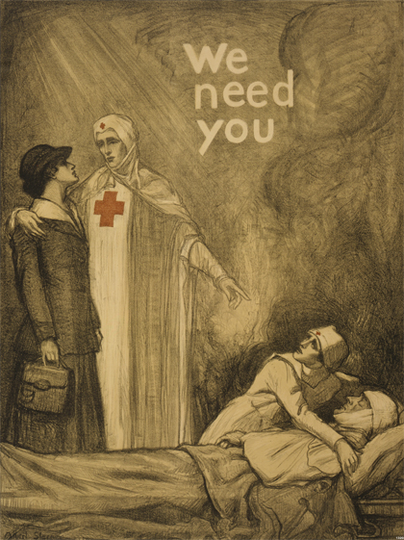
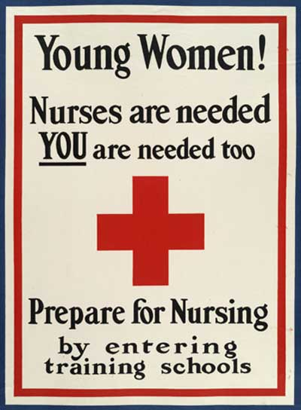
Women in the Military
WWI first war in which women officially served.
The navy enlisted 11,000 women, whose jobs included clerics, pharmacists, and photographers.
Army nurses were the only women in the military to go overseas during the war.
PROPAGANDA

Slide 11
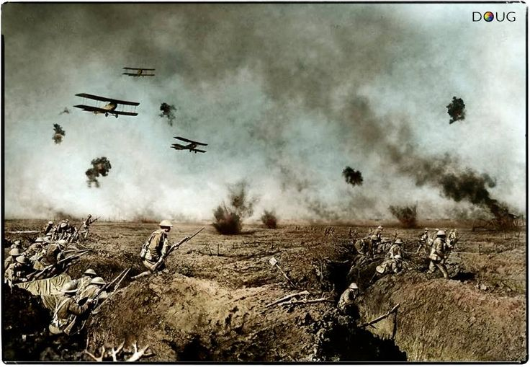
What is conscription ?
Checking for Understanding
forced military service

Slide 12
How were women involved in the military?
Checking for Understanding
clerics, pharmacists, photographers, and nurses

Slide 13
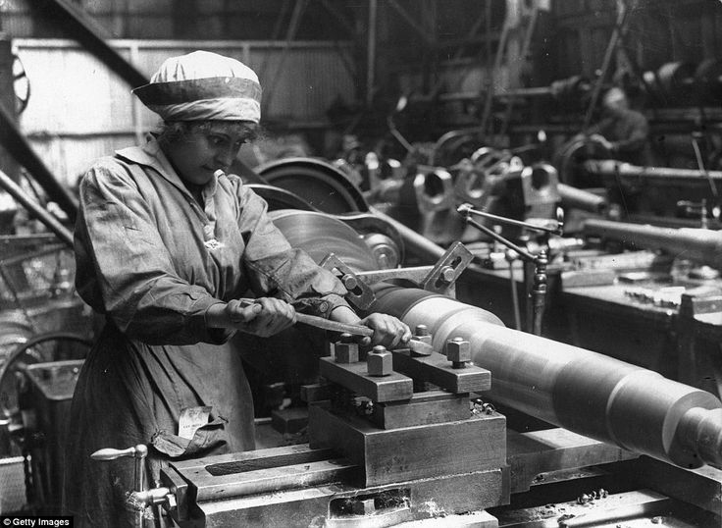
ORGANIZING INDUSTRY

Slide 14
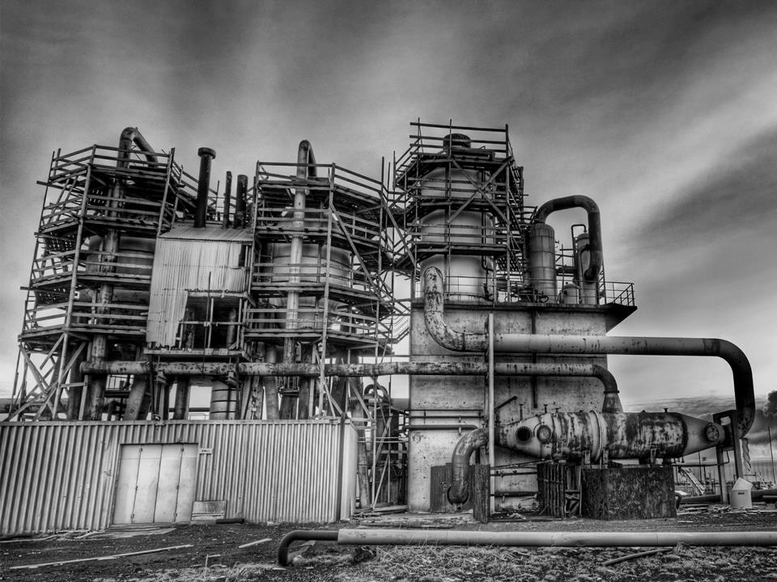
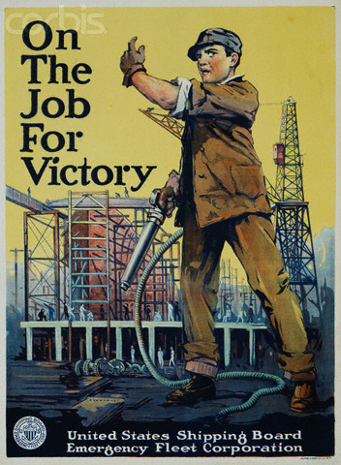
War Industries Board-1917
War Industry Board
Maintain and regulate the United States economy and war production schedules
Government encourage businesses to keep employees happy to continue producing war time goods
Relationship between big business and government to ensure efficient use of resources during the mobilization of the American economy for war.

Slide 15




Victory Garden
The Food Administration, under Herbert Hoover--> responsible for increasing food production while reducing consumption.
victory gardens people raise their own vegetables in order to leave more food for the troops.
The Fuel Administration encouraged people to conserve coal and oil. Daylight savings time was introduced to conserve energy.

Slide 16

Victory Garden
The Food Administration, under Herbert Hoover--> responsible for increasing food production while reducing consumption.
victory gardens people raise their own vegetables in order to leave more food for the troops.
The Fuel Administration encouraged people to conserve coal and oil. Daylight savings time was introduced to conserve energy.
PROPAGANDA

Slide 17
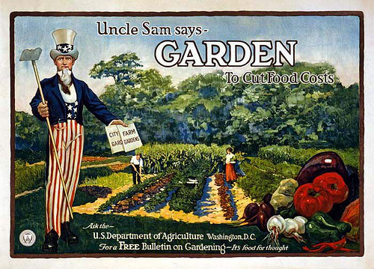
Victory Garden
The Food Administration, under Herbert Hoover--> responsible for increasing food production while reducing consumption.
victory gardens people raise their own vegetables in order to leave more food for the troops.
The Fuel Administration encouraged people to conserve coal and oil. Daylight savings time was introduced to conserve energy.
PROPAGANDA

Slide 18
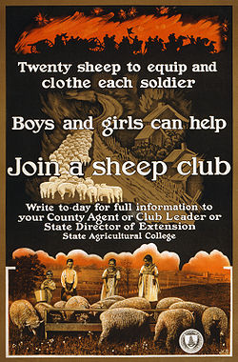
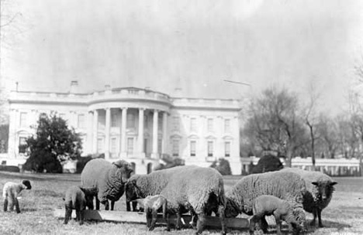

Sheep Clubs
Anyone from a small child to President Wilson can do their part for the war effort.

Slide 19
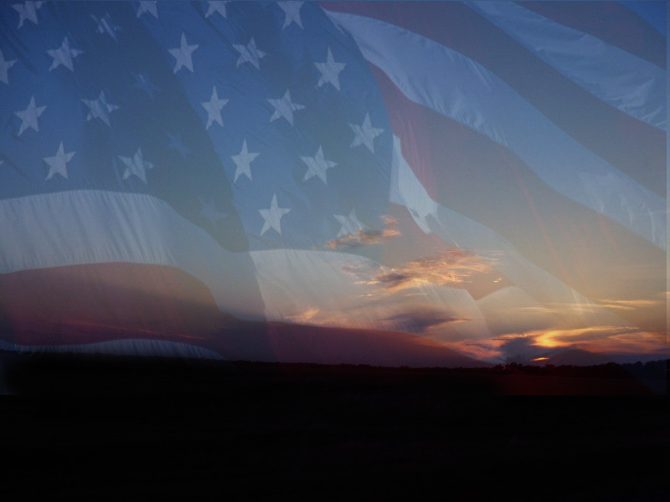

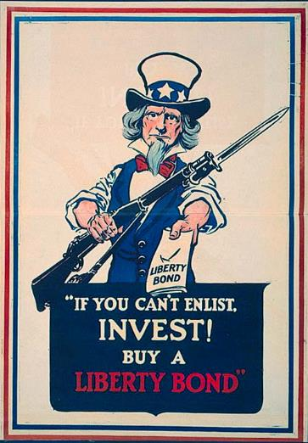

Liberty Bonds
To raise money to pay for the war, the government began selling Liberty Bonds and Victory Bonds.
By buying bonds, Americans were loaning the government money that would be repaid with interest in a specified number of years.
Raised $23 billion (national income was $70 billion)

Slide 20
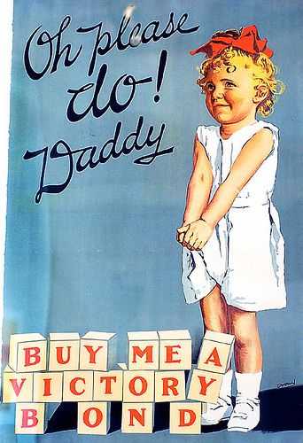


PROPAGANDA

Slide 21
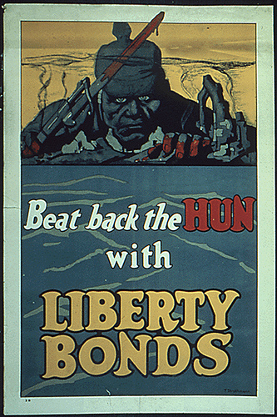
PROPAGANDA

Slide 22
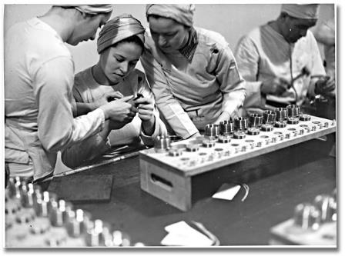
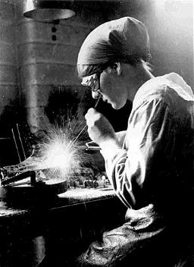
Women Working
WOMEN APPRECIATED!
After WWI women will get the right to vote with the 19th amendment due their contributions during WWI
FINALLY
The war increased the need for women in the workforce.
They took positions in the shipping, manufacturing, and railroad industries.
After the war, women returned to their previous jobs or left the workforce.

Slide 23
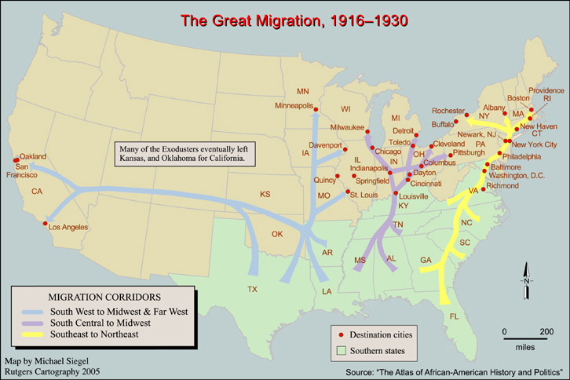

Slide 24

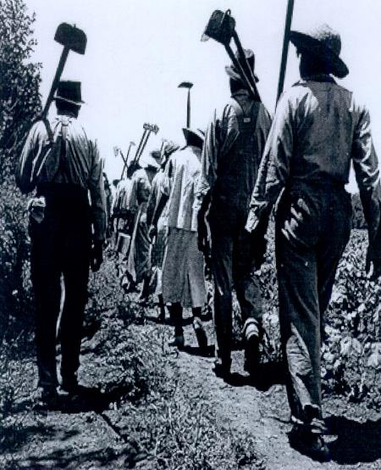
Great Migration
The war stopped the flow of immigrants to
the United States, which allowed African Americans wartime jobs.
Between 300,000 and 500,000 African Americans left the South to settle in the North to fill the job voids.
This “Great Migration” changed the racial makeup of many Northern cities.
Heading
North to
work!

Slide 25
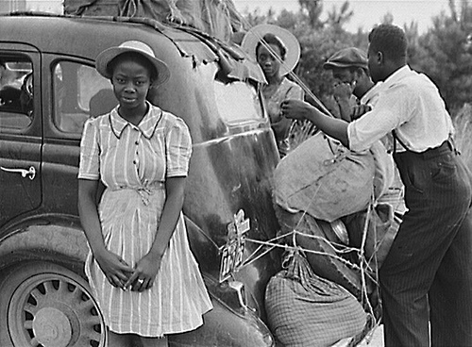

Slide 26
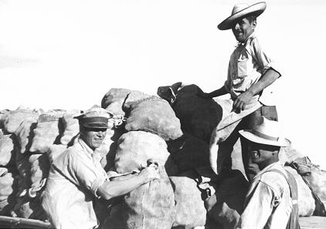
Mexicans Head North
Many Mexicans moved north, providing labor for farms and ranches in the American Southwest.
Mexicans also moved to cities to take wartime factory jobs.
They faced discrimination and hostility from Americans.

Slide 27
What was the function of the War Industries Board in the United States during World War I?
Checking for Understanding
  to maintain and regulate the United States economy and war production schedules

Slide 28
How did World War I affect the position of women in the United States?
Checking for Understanding
  Women were encouraged to work in factories
  And after the war won the right to vote

Slide 29
During World War I African Americans left the South to settle in the North and West looking for jobs, this was called?
Checking for Understanding
The Great Migration

Slide 30
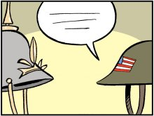
ENSURING PUBLIC SUPPORT

Slide 31

Selling the War
The Committee on Public Information (CPI) was a new government agency that attempted to “sell” the idea of war to the American people.
it was the nation's first formal government propaganda agency
  Pamphlets and speeches helped deliver patriotic messages.

Slide 32
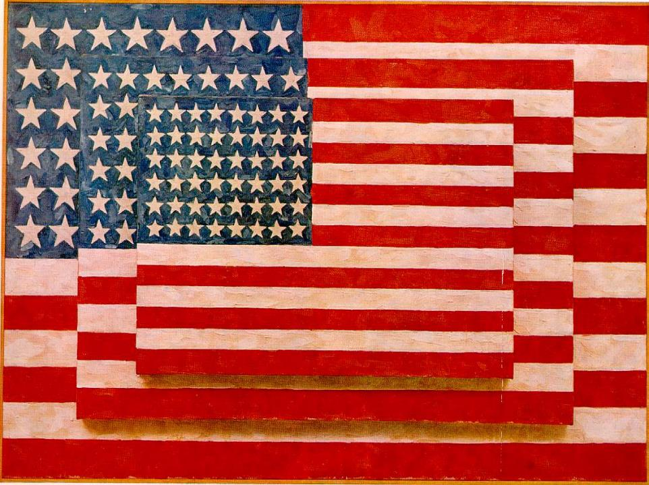
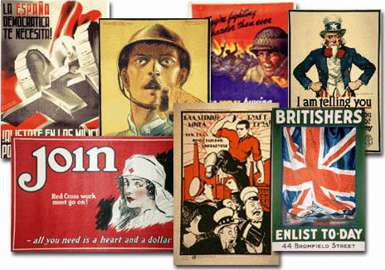
Propaganda
Information designed to influence opinion.
US used propaganda posters to influence citizens to ration, support the war, buy war bonds, and more.
The U.S.A. joined the war relatively late - April 1917 – yet she produced many more propaganda posters than any other single nation.

Slide 33
PROPAGANDA
FINANCING THE WAR
-WAR BONDS
SUPPORT THE WAR
RECRUITMENT
-SOLDIERS
-NURSES
-SAILORS
CONSERVE RESOURCES
-VICTORY GARDENS
-MEATLESS MONDAYS
DEMONIZE THE ENEMY

Slide 34
Why was the establishment of the Committee on Public Information significant to the general public of the United States during World War I?
Checking for Understanding
it was the nation's first formal government propaganda agency
attempted to “sell” the idea of war to the American people

Slide 35
What was the purpose of United States propaganda during World War I?
Checking for Understanding
To encourage Americans to support the war

Slide 36

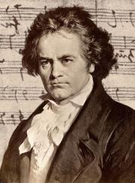


Anti-German Hysteria
Rumors of spying and sabotage as well as government propaganda whipped
the public into a frenzy of anti-German sentiment. Hatred of Germans and all things German swept the country.
Americans were tarred, feathered, and beaten and at least one German was lynched.
BEETHOVEN MUSIC
GERMAN LANGUAGE CLASSES
LIBERTY STEAK
HAMBURGER
Notes:
At the time of American entry into World War I, Americans with at least one German
born parent totaled over eight million and represented roughly eight percent of the
United States population. The vast majority of these people were loyal Americans.
However,

Slide 37

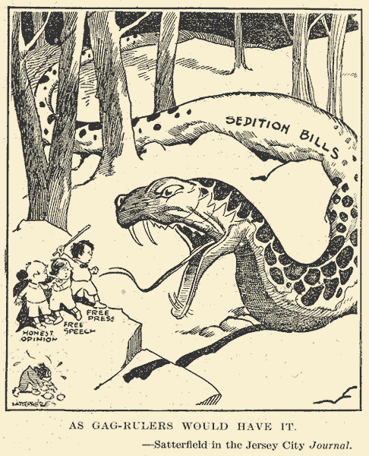
Espionage & Sedition Act
Espionage Act in June 1917
  Espionage, or spying to acquire secret government information
  It set up consequences for people who aided the enemy
Sedition Act in May 1918
  Sedition= Treason, or going against your country
  Made it illegal to criticize the president or the government
Possible Consequences include 20 years in jail and fined up to $10,000.
Under these acts some 2,000 people were prosecuted with roughly half resulting in convictions.

Slide 39


Government Limits
Freedom of Speech
In the case of Schenck v. the United States (1919), the Supreme Court ruling limited an individual’s freedom of speech if the words spoken constituted a “clear and present danger.”

Slide 40

Immigrants viewed
with suspicion
Suspicions of disloyalty led to the mistreatment of German Americans.
Many immigrants were suspected of being spies and potential traitors.
Anyone appearing disloyal also came under attack.
That immigrant looks suspicious!
Notes:
Anti-German feelings sometimes led to violence.

Slide 41
During World War I, how did American civilians contributed to the war effort?
Checking for Understanding
  rationing food
  buying bonds
  Victory gardens
  Working in factories to produce war goods
  Joining the military

Slide 42
During World War I, fears of nonconformity and disloyalty on the home front resulted in
Checking for Understanding
  Congressional passage of the Espionage Act and Sedition Acts.

Slide 43
The passage of the Espionage and Sedition
Acts reflected the Wilson Administration’s belief that
Checking for Understanding
  free speech by dissenters of the war would
  hamper the war effort

Slide 44

How did World War I affect legal immigrants to the United States?
Checking for Understanding
  Many immigrants were suspected of being spies and potential traitors.
http://www.youtube.com/watch?v=PqVD00bonxc

Slide 45
Discuss
Explain what life was like for people on the Home Front. Use the questions to guide your response:
POLITICAL: How did the war influence politics & policies at the time?
ECONOMIC: How was business impacted?
SOCIAL: What social norms changed as a result of the war?

