Slide 1
World War II Movies
Europe and Pacific Fronts
Notes:
Let’s start talking about WWII by looking at movie trailers about the war. We will talk about the European side of the war today and tomorrow talk about the Pacific side. The movies are in a timeline according to what they are about. There are many more WWII movies out there than just the ones we will look at today. Excuse the language

Slide 2
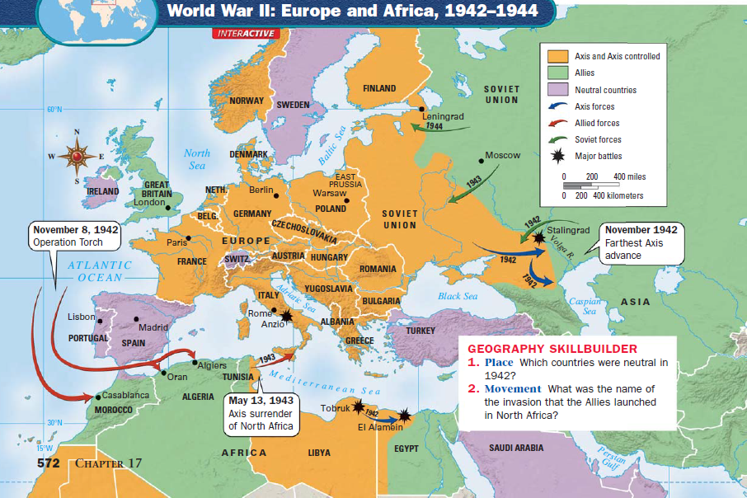

Slide 3
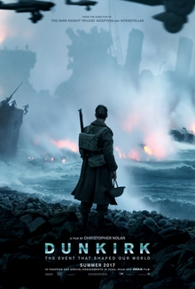
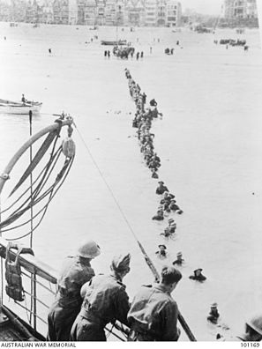
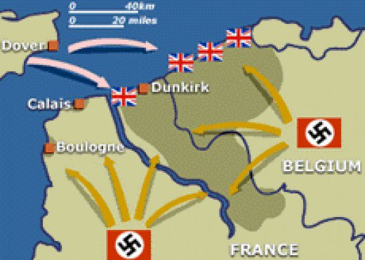
Dunkirk
Click movie picture to watch preview
The Dunkirk evacuation, code-named Operation Dynamo, also known as the Miracle of Dunkirk, was the evacuation of Allied soldiers from the beaches and harbour of Dunkirk, France, between 26 May and 4 June 1940, during World War II. The operation was decided upon when large numbers of Belgian, British, and French troops were cut off and surrounded by the German army during the Battle of France

Slide 4
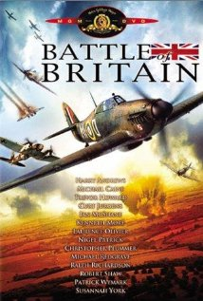
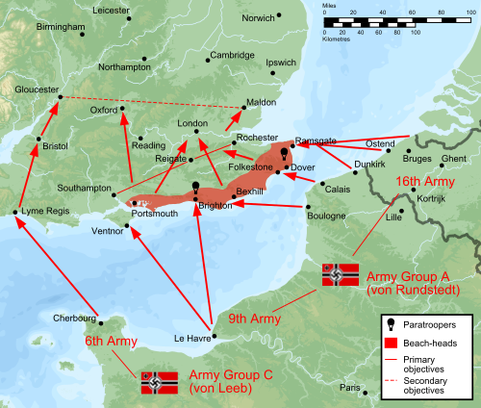
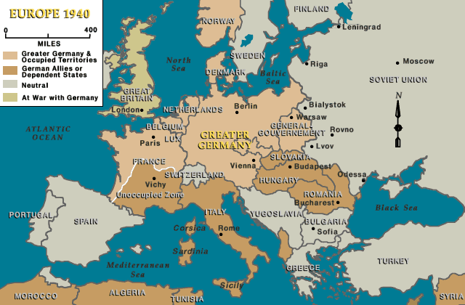
Battle of Britain
Click movie picture to watch preview
1940- British Royal Air Force fight against Nazi Germany
Fighting to prevent Nazi invasion of Britain
Click map for Pearl Harbor Battle of Britain scene
Notes:
War started in September 1939

Slide 5
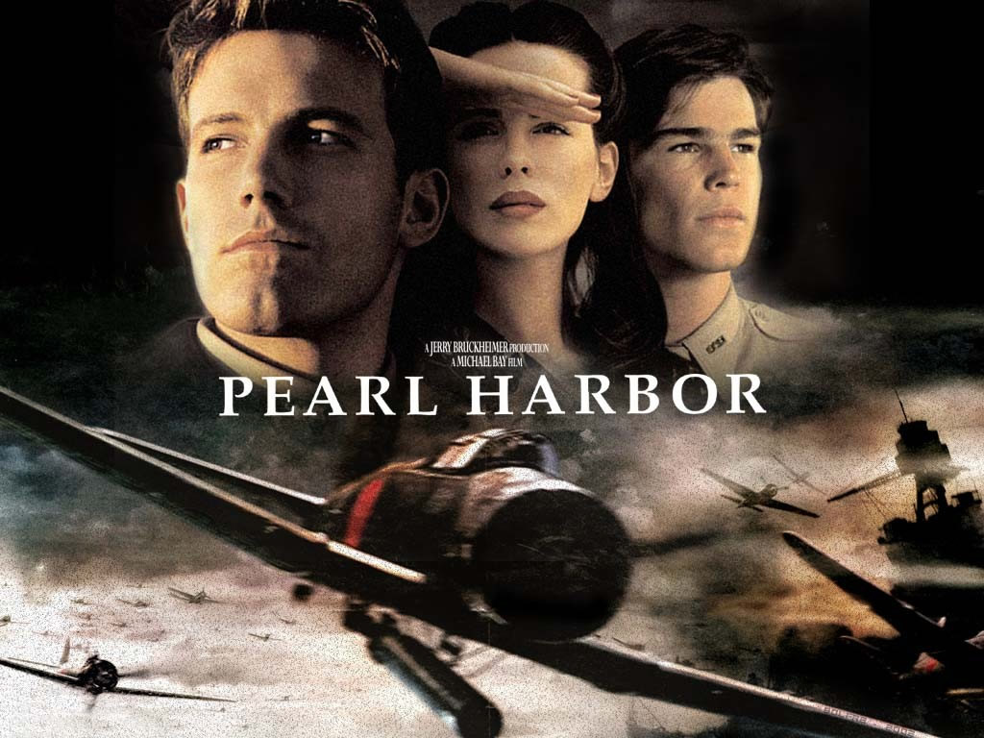
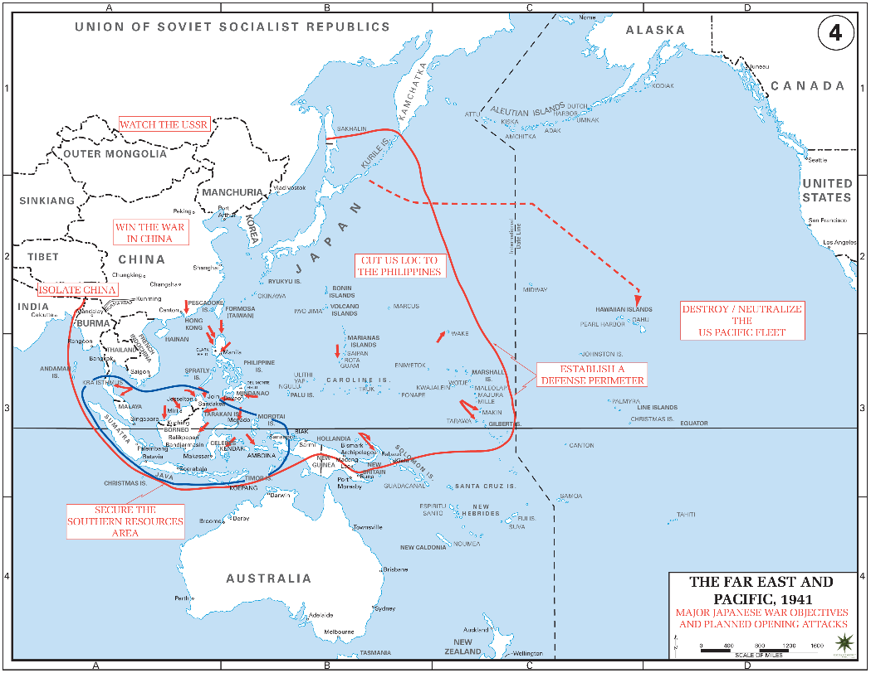
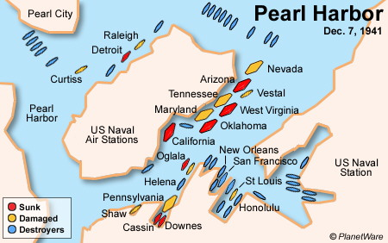
Pearl Harbor
Dec. 7, 1941
Japan attacks naval base in Hawaii
2,403 Americans were killed and 1,178 wounded
United States declares war on Japan on Dec. 8th
Germany declares war on the U.S. on Dec. 11th

Slide 6
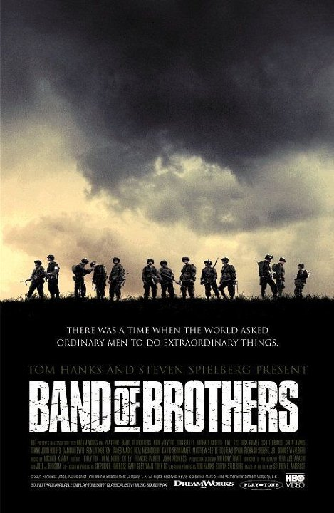
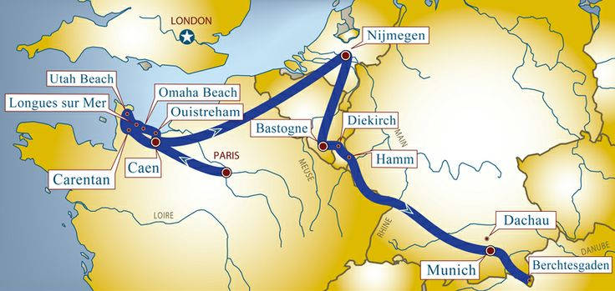
Band of Brothers
Miniseries - HBO
The series dramatizes the history of "Easy" Company from jump training in the U.S. through its participation in major actions in Europe, and up until the war's end.
D-Day, Operation Market Garden, Bastogne- 1944
Notes:
506th Parachute Infantry Regiment, 101st Airborne Division. Based from Stephen Ambrose’s book that details the members of the Easy Company. Normandy, Netherlands, and Belgium

Slide 7
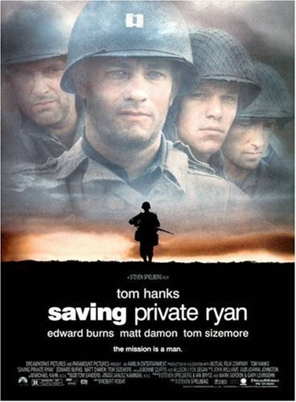
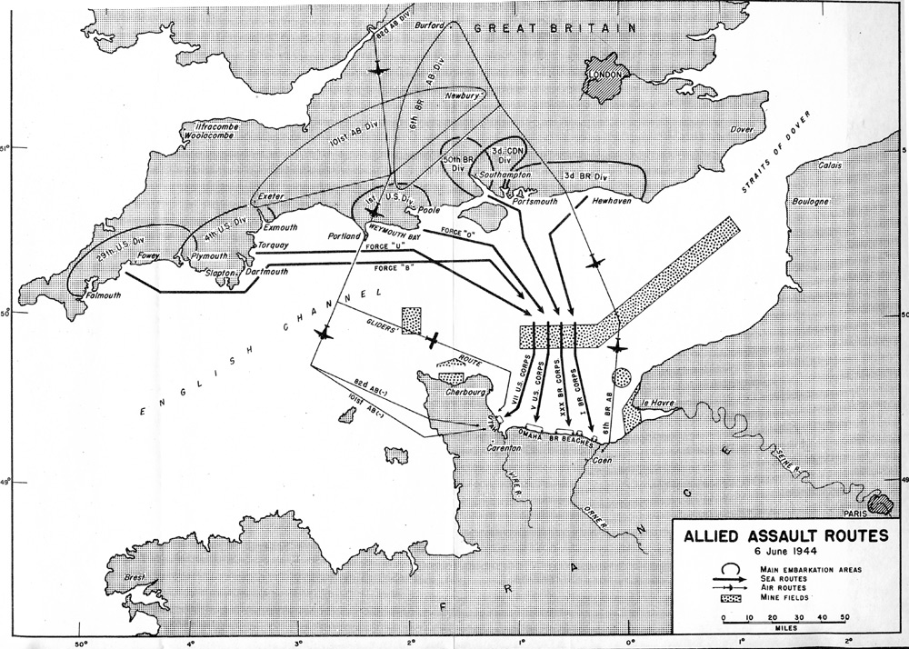
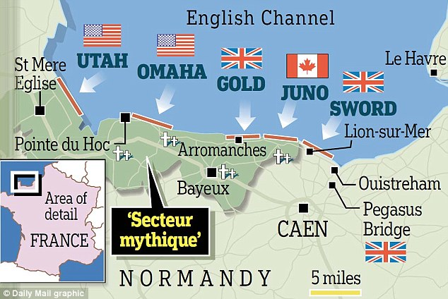
Saving Private Ryan
Following the Normandy Landings, a group of U.S. soldiers go behind enemy lines to retrieve a paratrooper whose brothers have been killed in action.
Notes:
June 6, 1944

Slide 10
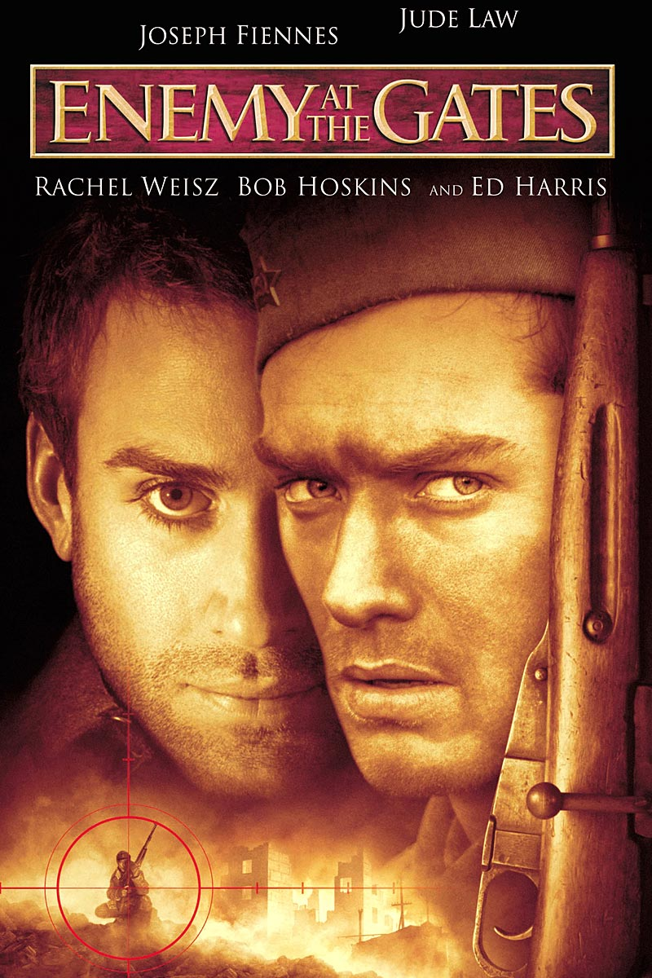
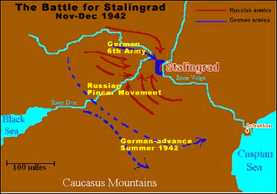
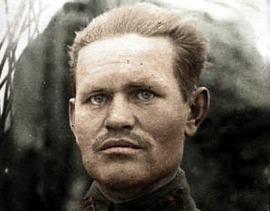
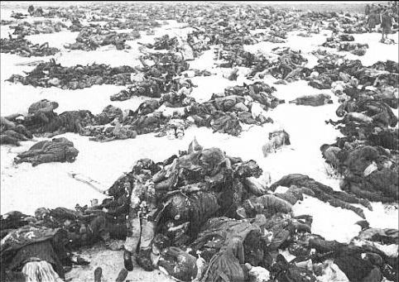
Enemy at the Gates
Battle of Stalingrad 1942- early 1943
German sniper and Russian sniper
Russian sniper’s efforts are published as propaganda to give Russians hope
German sniper comes to try and put an end to the Russian sniper
Vassili Zaitsev - Soviet sniper and hero of Stalingrad

Slide 11

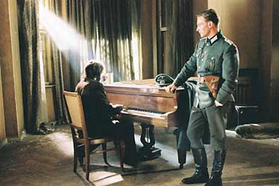
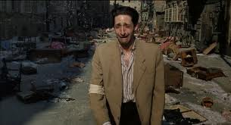
Pianist
Jewish pianist who was sent with his family to a concentration camp
A Jewish police officer saves him, but not his family
Nazi captain fed him because he was surprised by his talent
Notes:
Nazi captain was a fan and was amazed by his abilities. His family was not saved from the concentration camp. He went through many near-death experiences.

Slide 12
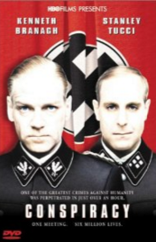
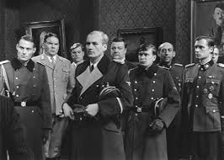
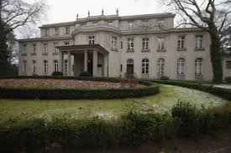
Conspiracy
Conspiracy is a BBC/HBO television film which dramatizes the 1942 Wannsee Conference. The film delves into the psychology of Nazi officials involved in the "Final Solution of the Jewish Question" during World War II.

Slide 13
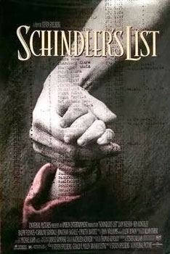
Schindler’s List
Oskar Schindler- German businessman who used his factory as a refuge for Jews.
He saved 1,100 Jews from being gassed at Auschwitz concentration camp.
He would employ Jews in his factory
Notes:
The film was shot in black and white and was made as a documentary. The scenes are not real life scenes. Spielberg wanted to give the film a sense of timelessness. (time is unaffected)

Slide 14
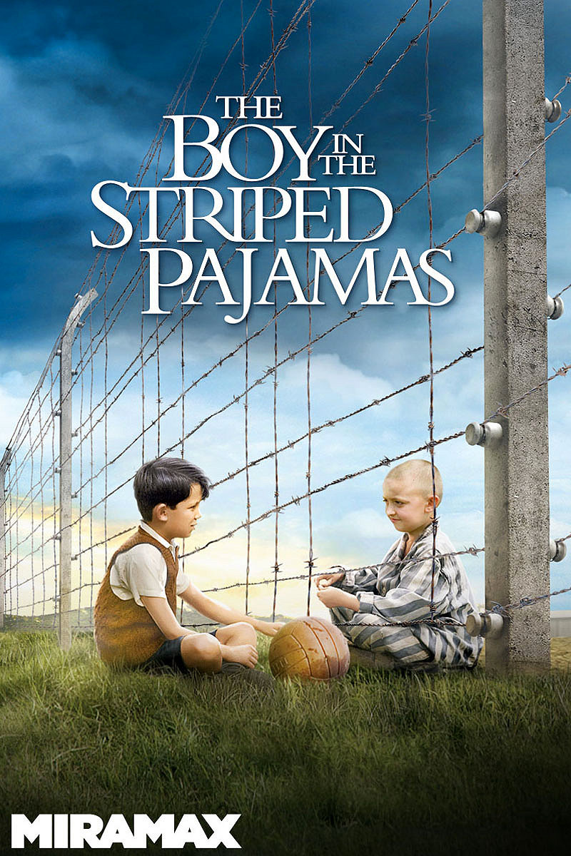
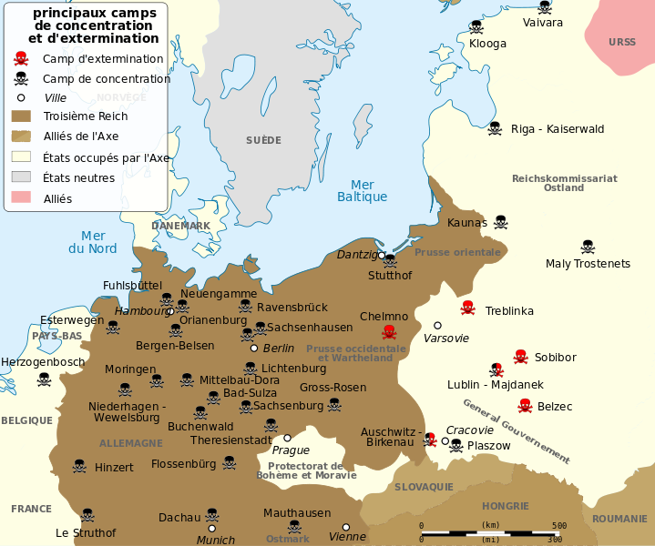
Boy in the Striped Pajamas
The boy’s father becomes commander of a prison camp in Germany.
The boy befriends another boy living on the other side of the fence in the concentration camp
Unexpected consequences
Notes:
The officer ultimately ends up killing his own son

Slide 15

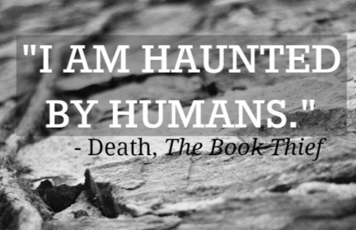
The Book Thief
While subjected to the horrors of World War II Germany, young Liesel finds solace by stealing books and sharing them with others. In the basement of her home, a Jewish refugee is being protected by her adoptive parents.
Movie is narrated by DEATH himself

Slide 16
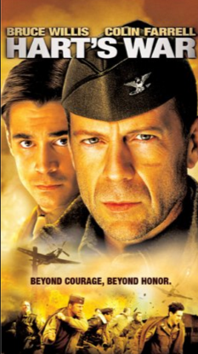
Hart’s War
Hart's War is a 2002 American thriller drama film about a World War II prisoner of war camp based on the novel by John Katzenbach. It stars Bruce Willis as Col. William McNamara and Colin Farrell as Lt. Thomas Hart
FULL MOVIE IS ON YOUTUBE! – CLICK HERE

Slide 17
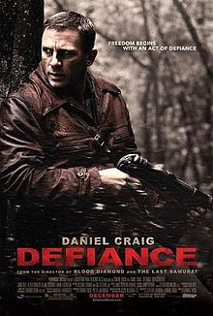
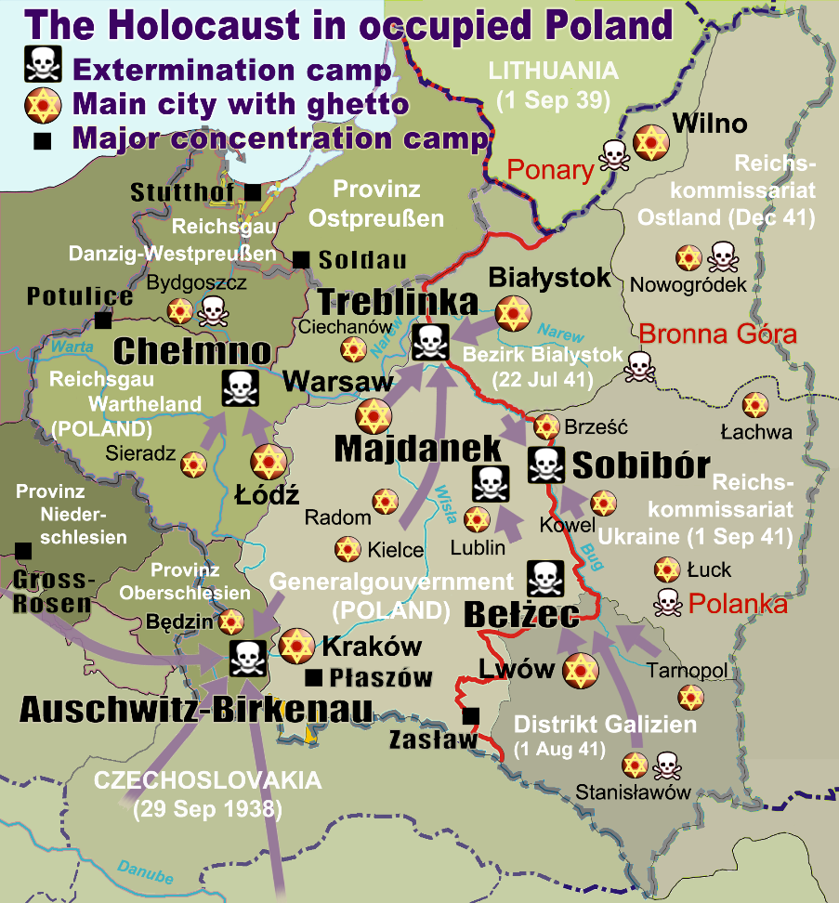
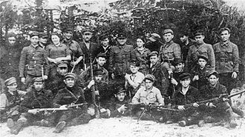
Defiance
Jewish brothers escape Nazi occupied land and go into the Belorussian forests
They join Russian resistance fighters and build a village in order to protect themselves and about 1,000 Jewish non-combatants.
Notes:
There were Jews and others who stepped up to fight against Germany.

Slide 18

Top 10 Holocaust Movies

Slide 20
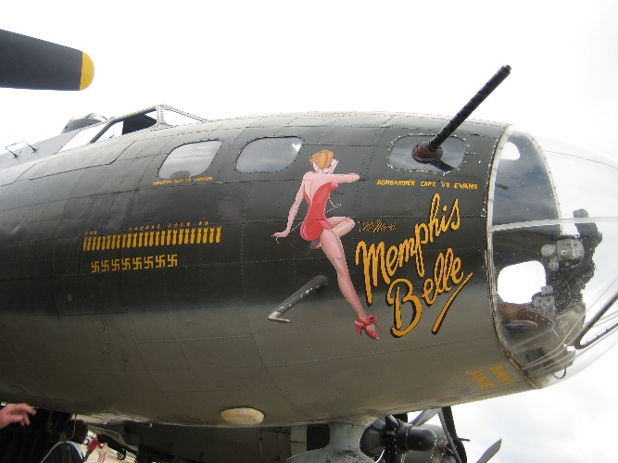
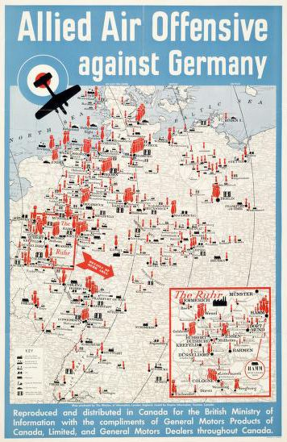
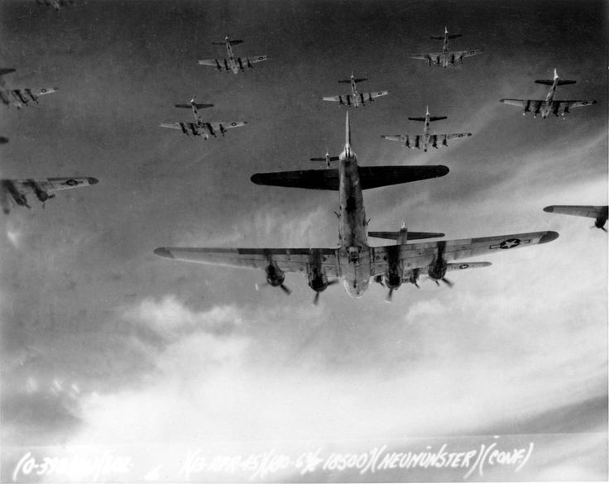
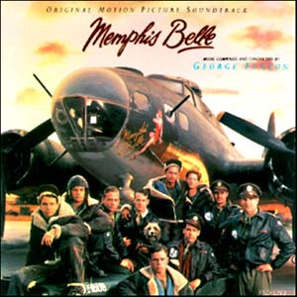
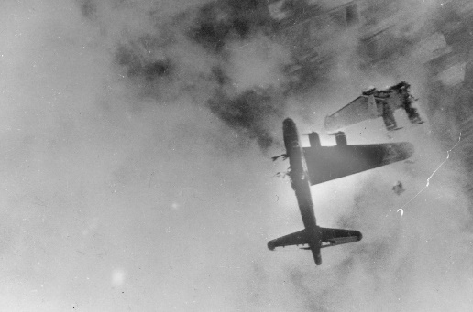
Memphis Belle
Very dangerous day time bombings over Germany
Bomber plane had successfully completed 24 missions and on the 25th mission it was damaged by Germans
After hitting their target (German aircraft factory) the plane barely makes it back to base
https://www.youtube.com/watch?v=lKkBdvS5kso
Notes:
Name of the plane

Slide 21
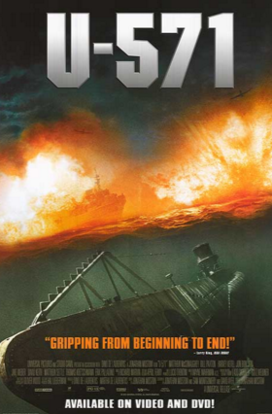
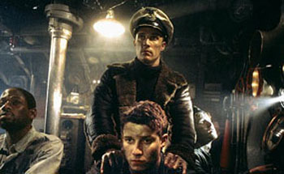
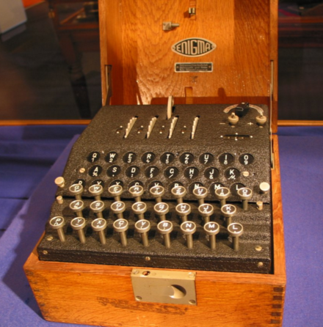
U-571
A German submarine is boarded by disguised American submariners trying to capture their Enigma cipher machine.

Slide 22
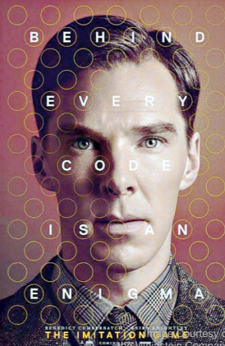
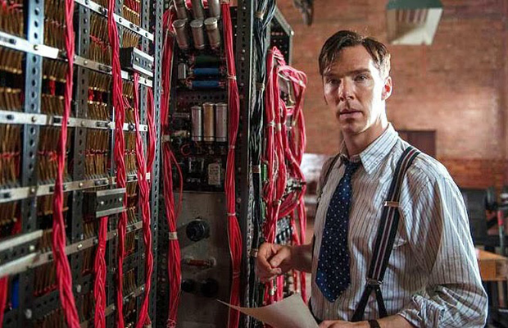
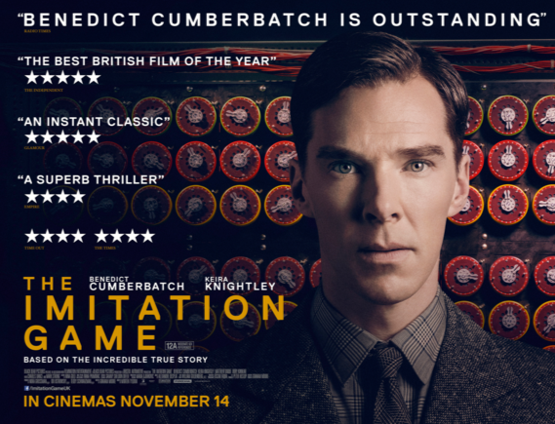
Imitation Game
During World War II, mathematician Alan Turing tries to crack the enigma code with help from fellow mathematicians.

Slide 23
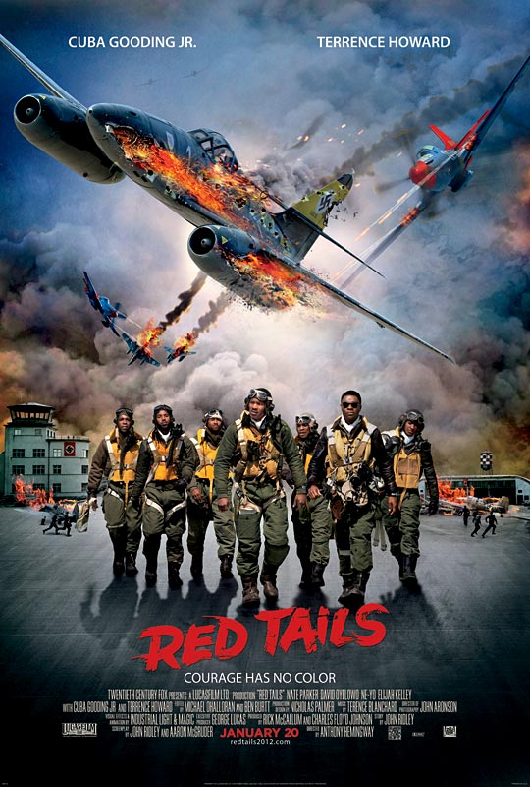
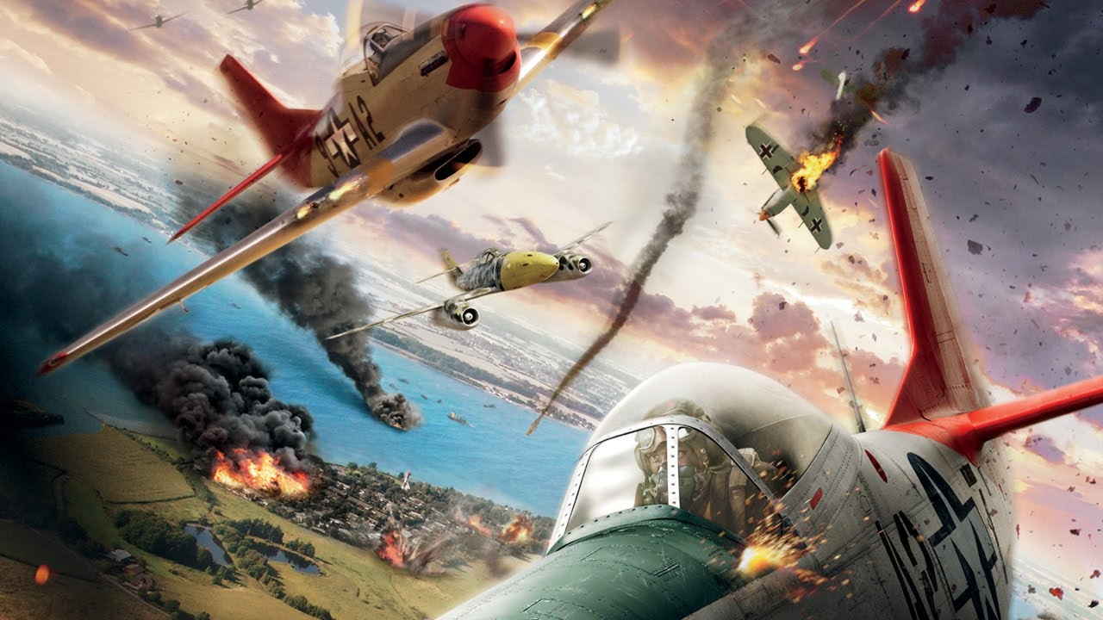
Red Tails
A crew of African American pilots in the Tuskegee training program, having faced segregation while kept mostly on the ground during World War II, are called into duty under the guidance of Col. A.J. Bullard.

Slide 24
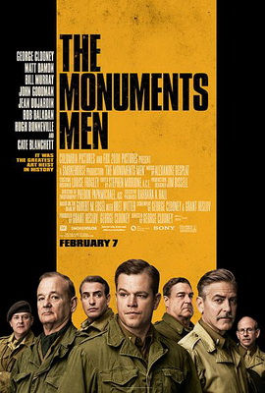
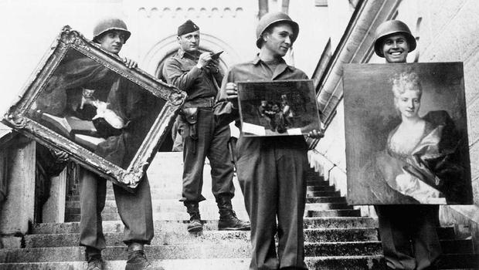
The Monuments Men
During World War II, the Nazis steal countless pieces of art and hide them away. Some over-the-hill art scholars, historians, architects and other experts form a unit to retrieve as many of the stolen masterpieces as possible. The mission becomes even more urgent when the team learns about Hitler's "Nero Decree," which orders destruction of the artworks if the Third Reich falls. Caught in a race against time, the men risk their lives to protect some of mankind's greatest achievements.

Slide 25
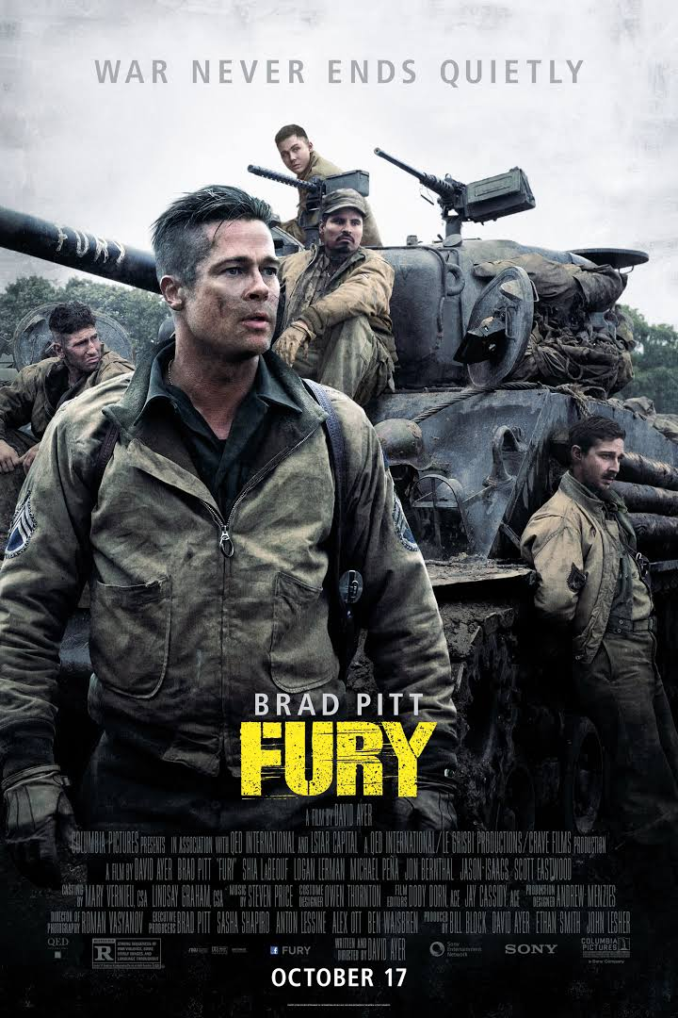
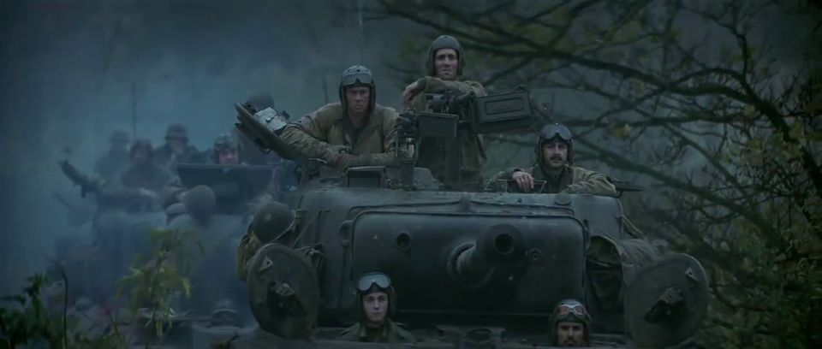
Fury
A grizzled tank commander makes tough decisions as he and his crew fight their way across Germany in April, 1945.

Slide 26
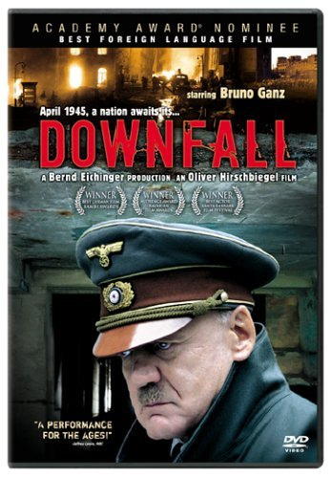



Downfall
Hitler’s secretary tells of his final days in his Berlin bunker at the end of World War II
https://www.youtube.com/watch?v=Bp1RXmM1-60
Notes:
Good movie about the chaos of the last days of his life and also all of the generals who were involved.

Slide 27


Documentaries
WWII in HD
Ken Burns The War

Slide 28

Pacific Front
TORA TORA TORA
Pearl Harbor movie
The title is the Japanese code word used to indicate that complete surprise had been achieved. Tora literally means "tiger", but in this case was an acronym for totsugeki raigeki ("lightning attack").[

Slide 29



The Pacific
Miniseries
Stories of three Marines during America’s battle with the Japanese
Guadalcanal, Okinawa, etc.
https://www.youtube.com/watch?v=smoNSbMs9Yo

Slide 30




Unbroken
Story of Louis Zamperini
Olympic runner
Survived a plane crash and floated 47 days on a raft in the Pacific
Landed on the Marshall Islands and was put in a Japanese concentration camp until the end of the war
https://www.youtube.com/watch?v=X8mBzKLhL0U
Notes:
He shook Hitler’s hand in the 1936 Olympics in Berlin. He was singled out and tortured in Japan prison camp because he was an Olympian.

Slide 31




Midway
Turning point in the Pacific War
U.S. intercepted Japanese codes and was able to surprise and destroy the Japanese Carrier force
https://www.youtube.com/watch?v=WjofsqGsDvY

Slide 32




Flags of Our Fathers
Story of Iwo Jima on the American side
Battle of Iwo Jima 1945
The government brings the three survivors to America to raise funds for war, bringing hope to desolate people, and making the three men heroes of the war.
The picture brought hope to Americans at home.
https://www.youtube.com/watch?v=1KiBildlym4
Notes:
Only three of the six soldiers in the picture survived the war. They did not look at themselves as heroes.

Slide 33


Slide 34




Letters from Iwo Jima
Japanese perspective
The Japanese hold off the Americans on Iwo Jima for as long as possible.
1945
https://www.youtube.com/watch?v=51lo2dpaZ_g
Notes:
Americans wanted Iwo Jima because it would provide a launching point for an invasion of Japan. Same people who made Flags of our Fathers (Clint Eastwood) Letters found in Mt. Suribachi detailing what they went through
Over 22,000 defending the island, only around 200 survived

Slide 35



Bridge on the River Kwai
After settling his differences with a Japanese PoW camp commander, a British colonel co-operates to oversee his men's construction of a railway bridge for their captors - while oblivious to a plan by the Allies to destroy it.
Notes:
Bridge is in Bangkok

Slide 36


Windtalkers
Two U.S. Marines in WWII are assigned to protect Navajo Marines who use their native language as an unbreakable radio cypher.
Protect the code at all cost!

Slide 37

The Thin Red Line
Guadalcanal August 1942- February 1943
Follows a group of Marines through the battle as they bond together and fight to save each other and themselves
https://www.youtube.com/watch?v=LCmlOhsIwBk
Notes:
Terrence Malick's adaptation of James Jones' autobiographical 1962 novel, focusing on the conflict at Guadalcanal during the second World War.

Slide 39


Hacksaw Ridge - Battle of Okinawa
On April 1, 1945, Allied forces invade the island of Okinawa and engage the Japanese in the bloodiest battle of the Pacific War.
http://www.history.com/topics/world-war-ii/world-war-ii-history/videos/battle-okinawa
Notes:
The extraordinary true story of conscientious objector Desmond T. Doss who saved 75 men in Okinawa, during the bloodiest battle of WWII, without firing a single shot. Believing that the war was just but killing was nevertheless wrong, he was the only American soldier in WWII to fight on the front lines without a weapon. As an army medic Doss single-handedly evacuated the wounded near enemy lines - braving enemy fire and putting his own life on the line. He was the first conscientious objector to ever win the Congressional Medal of Honor.

Slide 40




Atomic Bombs
American bomber drops atomic bomb on Hiroshima and Nagasaki to end WWII
Aug. 6 1945
http://www.history.com/topics/world-war-ii/bombing-of-hiroshima-and-nagasaki/videos

Slide 41


Little Boy
An eight-year-old boy is willing to do whatever it takes to end World War II so he can bring his father home.
The story reveals the indescribable love a father has for his little boy and the love a son has for his father.

